Slide 1
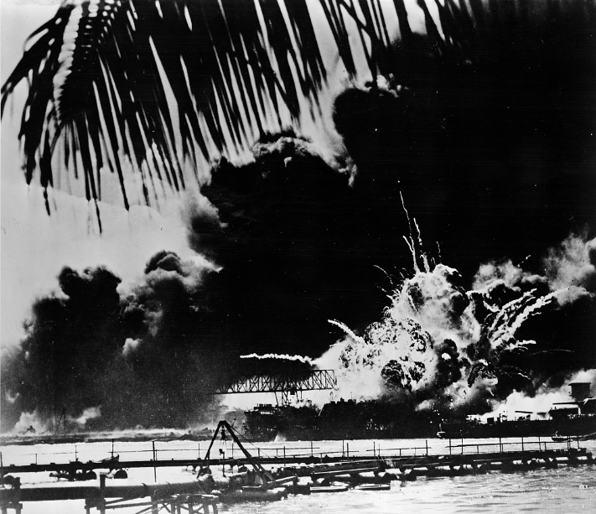

Unit 12:
The Great Depression
Lesson 12:
Looking Ahead
The Japanese attack on the U.S. naval base at Pearl Harbor, December 7, 1941. The Library of Congress
Notes:
Pearl Harbor naval base and U.S.S. Shaw ablaze after the Japanese attack. 1941. Photograph. Library of Congress Prints and Photographs Division. https://www.loc.gov/item/98506923/.

Slide 2

Warm-up
Use the image to complete your warm-up

Slide 3
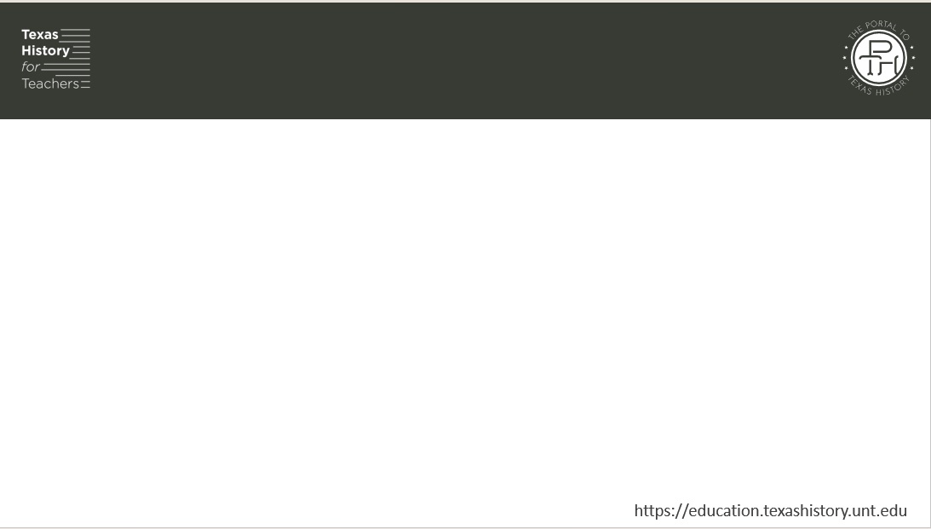
Share with the class
One thing I observe about the image is __________
One thing I can infer about the next unit based on my observation is ____________

Slide 4

Essential Question
What major world event will take place in the next unit, and what significant decision will the U.S. government have to make as a result?

Slide 5

In today’s lesson…
We will examine two primary source materials related to the beginning events of World War II and the bombing of Pearl Harbor.
I will evaluate the information provided in the primary source excerpts to make observations, inferences, and predictions about significant information and events of the next unit.

Slide 6
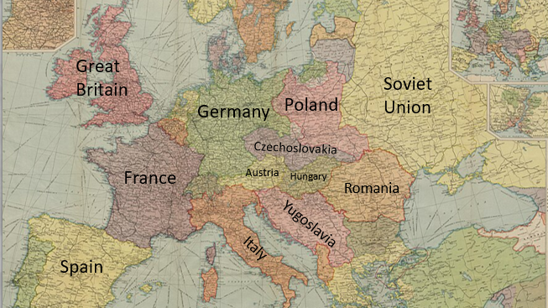
Part I: The World at War Again
Part I: The World at War Again
Map of Europe, 1939
Notes:
Bartholomew's political map of the new Europe 1920 according to treaties of Paris. Accessed 6/15/2026
https://commons.wikimedia.org/wiki/File:Bartholomew%27s_political_map_of_the_new_Europe_1920_according_to_treaties_of_Paris_(5007973).jpg

Slide 7

Part II:
The United States – From Isolationist to Involved
The Japanese attack on Pearl Harbor, December 7, 1941.
The Library of Congress
Notes:
Pearl Harbor naval base and U.S.S. Shaw ablaze after the Japanese attack. 1941. Photograph. Library of Congress Prints and Photographs Division. https://www.loc.gov/item/98506923/.

Slide 8

Exit Ticket
Follow the directions to complete your exit ticket
Read the primary source excerpt about Pearl Harbor.
Answer two questions about the excerpt.
Discuss with a partner

Slide 9
Share with the class 2
I think President Roosevelt and the U.S. Congress will decide to ________
I think this decision might influence Britain, the rest of Europe, and the war by _______

