Slide 1



Unit 12
Bingo Review Game
https://education.texashistory.unt.edu

Slide 2
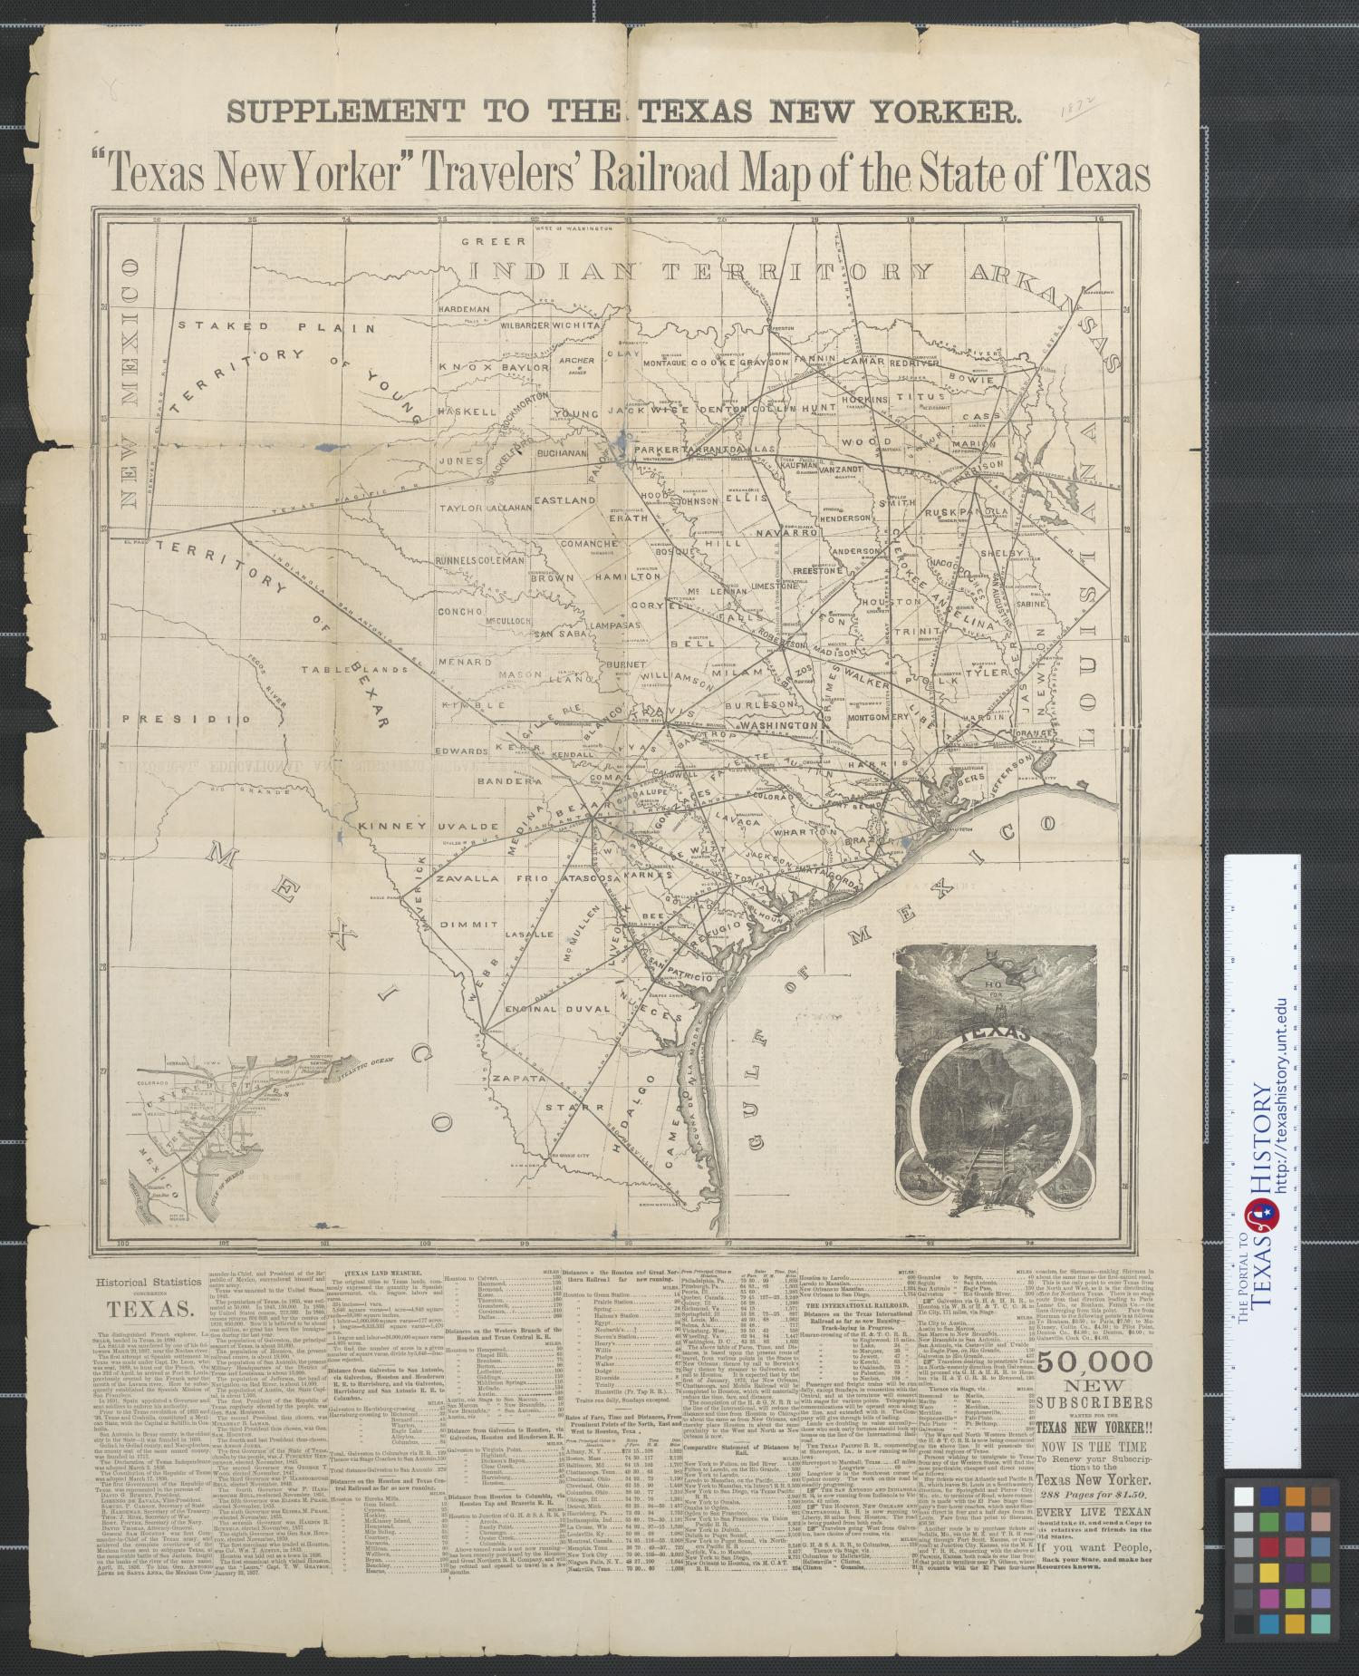
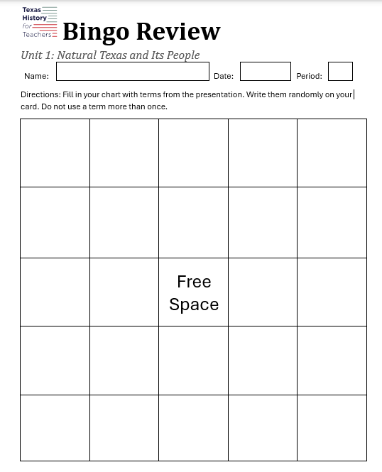
Fill In Your Card
Fill in every square on your Bingo card.
  Only write one term in each box.
  Do not use a term more than once.
  Advanced: Leave room in the box to make quick notes.
https://education.texashistory.unt.edu

Slide 3
How to Play:
Your teacher will call out clues related to each term.
If you think you know which term the clue is referring to, raise your hand.
If you are correct, everyone who has the term can cover it on their Bingo Card.
If you are incorrect, the class must keep trying to determine the correct term.
https://education.texashistory.unt.edu

Slide 4
How do you win?
You are trying to get 5 terms in a row horizontally, vertically, or diagonally.
https://education.texashistory.unt.edu

Slide 5


Unit 12 Bingo Review
Choose from the terms below to randomly fill in every square on your Bingo card. Do not use a term more than once. You will not use every term.
https://education.texashistory.unt.edu
1. “Black Tuesday” | 2. Drought | 3. Expansion | 4. Causes of Depression | 5. Effects of Depression
6. Stock market | 7. Dust Bowl | 8. Regulation | 9. Causes of Dust Bowl | 10. Effects of Dust Bowl
11. Unemployment | 12. Panhandle | 13. Hot Oil | 14. Erosion | 15. New Deal
16. Boom and Bust | 17. Franklin D. Roosevelt | 18. John Nance Garner | 19. Jesse Holman Jones | 20. Ecology
21. Oil wars | 22. Securities and Exchange Comm. | 23. Sam Rayburn | 24. Buying on margin | 25. Fed. Deposit Insurance Corp.
26. Overproduction | 27. Civilian Conservation Corps | 28. J. Frank Dobie | 29. Speculation | 30. Railroad Commission
31. Urbanization | 32. Rural Electrification Admin. | 33. Emma Tenayuca | 34. National Youth Admin. | 35. Agricultural Adjustment Act

Slide 6
Alternative Winning Pattern
#1
4 corners
https://education.texashistory.unt.edu

Slide 7
Alternative Winning Pattern #2
Postage Stamp
Any corner
https://education.texashistory.unt.edu

Slide 8
Alternative Winning Pattern
#3
Texas T
https://education.texashistory.unt.edu

Slide 9
Alternative Winning Pattern
#4
X Marks the Spot
https://education.texashistory.unt.edu

Slide 10
Closing Activity
One term from my card is ________. Something I know about this term is __________
One term from my card is ________. Three key words related to this term are _____ , _____ , and ______.
https://education.texashistory.unt.edu

