Slide 1
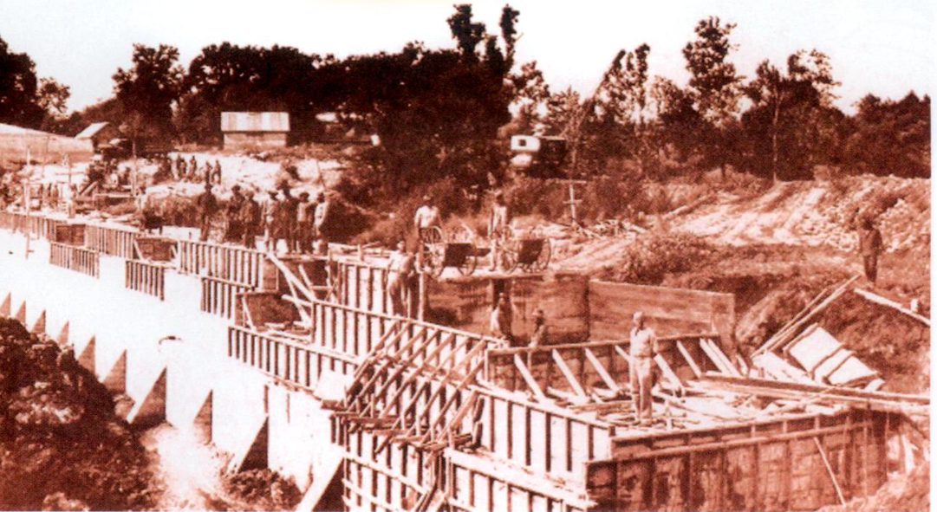
Unit 12:
The Great Depression
Review Lesson:
Study Guide & Flashcards
The Civilian Conservation Corps constructing a dam on the Navasota River at Fort State Parker, 1939. The Portal to Texas History
Notes:
Alvarez, Elizabeth Cruce. Texas Almanac, 2008-2009, book, 2008; Dallas, Texas. (https://texashistory.unt.edu/ark:/67531/metapth1760437/: accessed August 25, 2025), University of North Texas Libraries, The Portal to Texas History, https://texashistory.unt.edu; crediting Texas State Historical Association.

Slide 2

Warm-up:
Follow the directions to complete your warm-up
Read each statement in the graphic organizer.
Circle or highlight all topics you think we will see on our Unit 12 test
Discuss with a partner

Slide 3

Share with the class
One thing I expect to see on the Unit 12 test is ________ because __________

Slide 4

Essential Question
What is the key information we need to know to be successful on our Unit 12 test?

Slide 5
In today’s lesson…
We will review key terms, people, events, themes, and characteristics of the Great Depression to prepare for our Unit 12 test.
I will identify the definitions and significance of key terms, create a timeline of significant events, match statements of cause with their significant effects, and answer practice test questions.

Slide 6
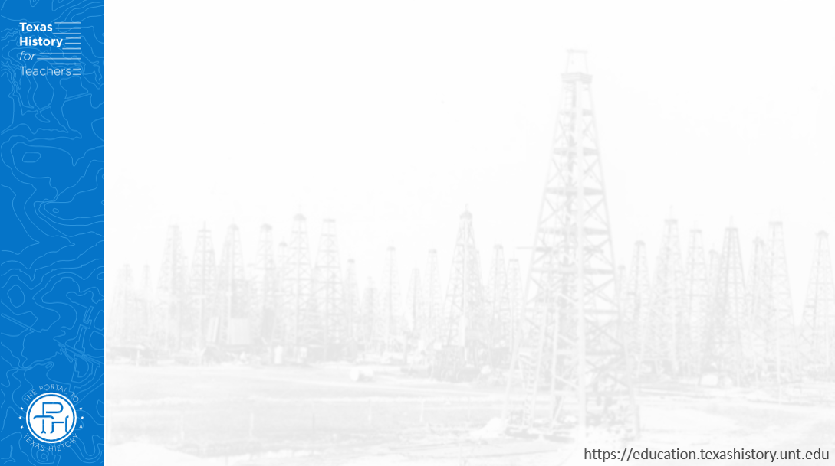
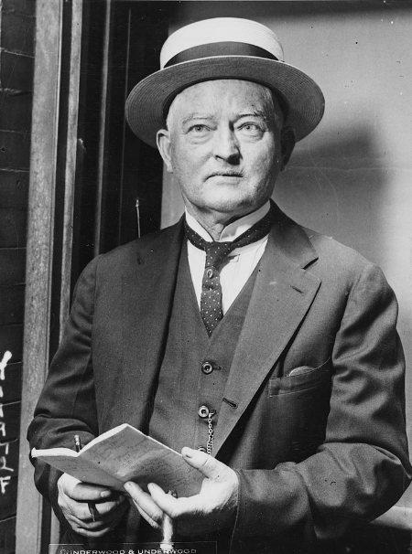
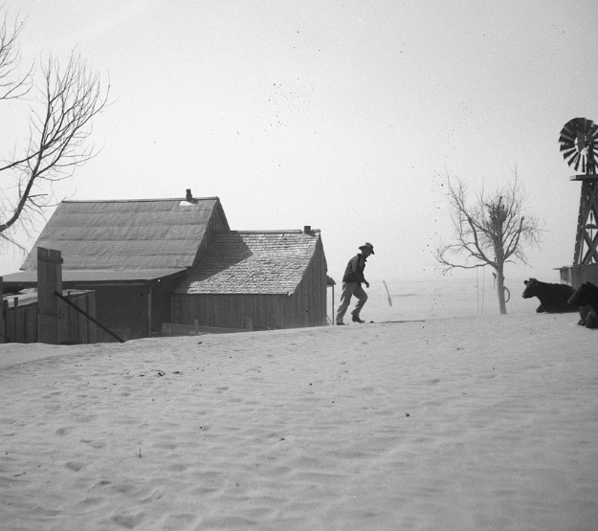
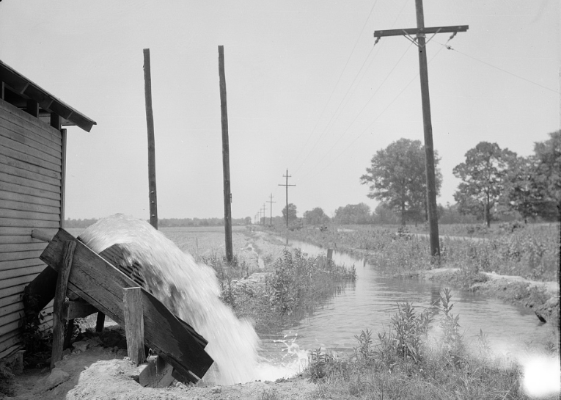
Part I: Key Terms and Definitions
A farm in the Dust Bowl
The Library of Congress
An electric water pump at a rural farm
The Library of Congress
John Nance Garner
The Library of Congress
Notes:
Underwood & Underwood. One of the delegates to the convention who comes from Texas Photo shows Congressman John N. Garner, member of Congress from Texas / / Underwood & Underwood. 1924. Photograph. https://www.loc.gov/item/2002722602/.
Rothstein, Arthur. Untitled photo, possibly related to: Cimarron County, Oklahoma. April, . Dust Bowl. April 1936. Photograph. https://www.loc.gov/item/2017766885/.
Mydans, Carl. An electric pump, one of the newest type water pumps in Arkansas. Rice farming business near Harrisburg. This farm figures expenses of sixty dollars a day, covering everything from electricity to labor, from the day of tilling the soil until the reaping of the rice. June 1936. Photograph. Library of Congress Prints and Photographs Division. https://www.loc.gov/item/2017761551/.

Slide 7
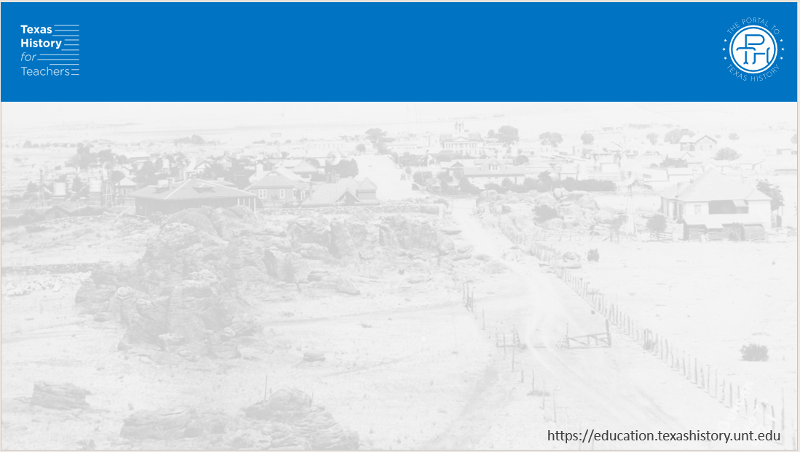
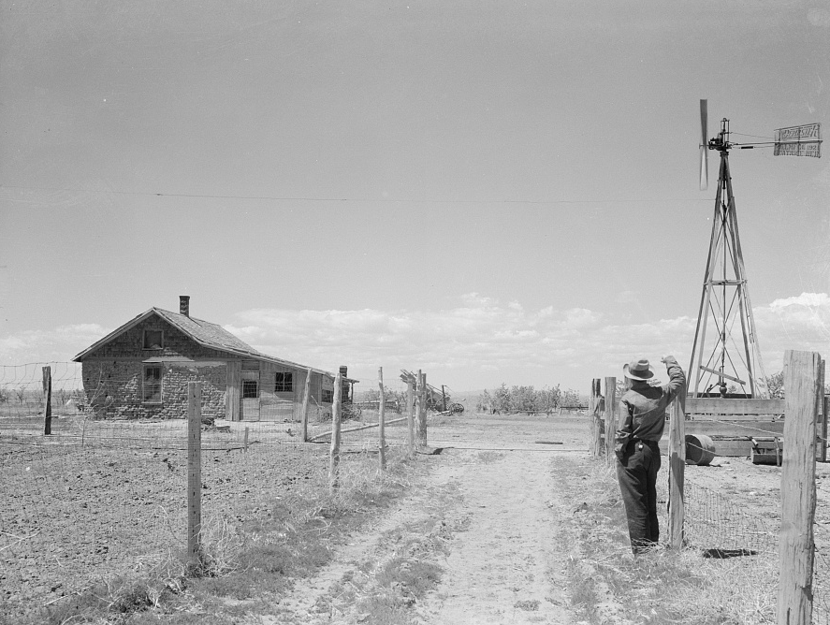
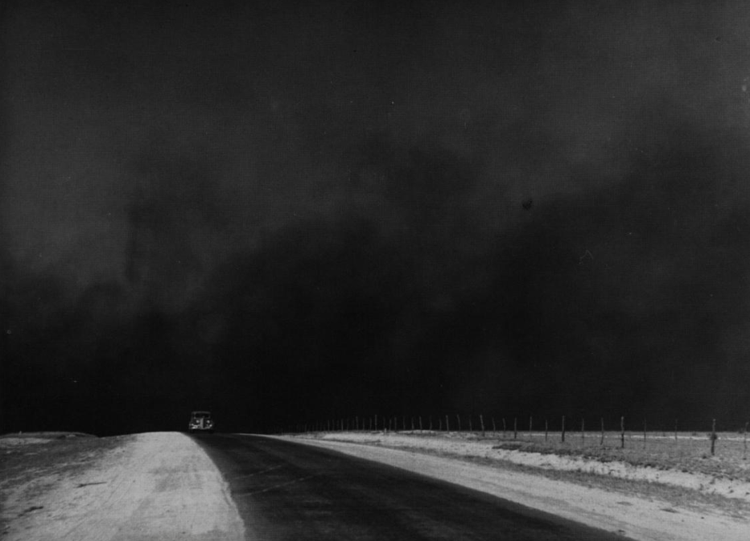
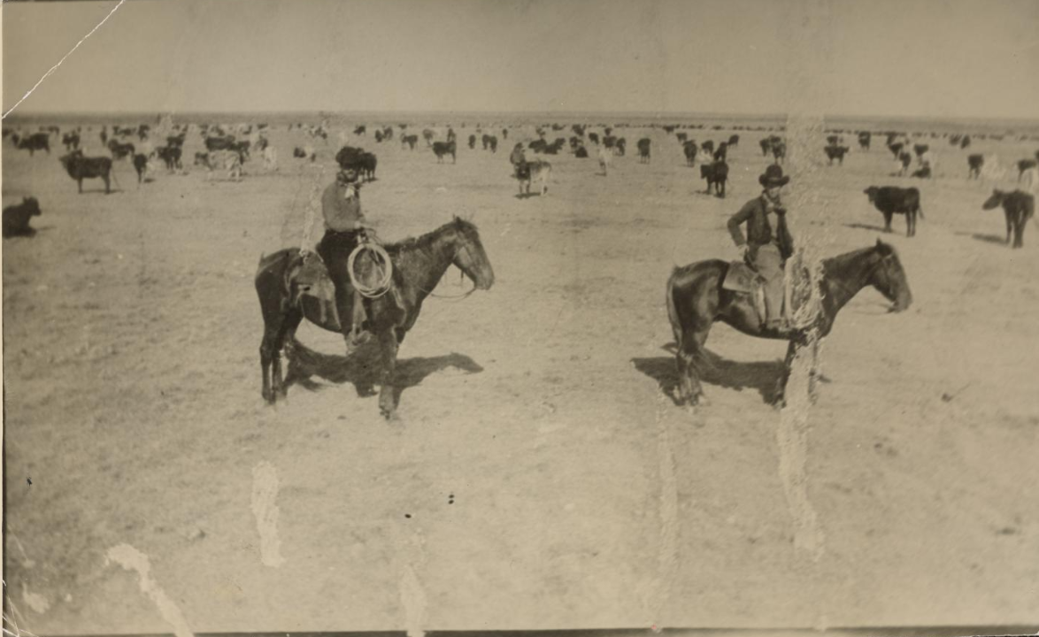
Part II: Cause and Effect Matching
Notes:
Rothstein, Arthur, photographer. A sod homestead built in . Pennington County, South Dakota. Sincethis sod house has been standing to mark a farmer's effort to reap wealth from the Great Plains. At the time of its construction there must have been skirmish after skirmish with the cattlemen as the fence of the homesteader narrowed down the range. Then wartime prosperity, with the price of wheat booming. Then the years of intermittent drought, up to the present, and instead of wealth, a bitter battle to achieve mere subsistence on the parched earth. Pennington County United States South Dakota, 1936. May-June. Photograph. https://www.loc.gov/item/2017760678/.
Reid, Robert L., 1938-. Picturing Texas: The Farm Security Administration-Office of War Information Photographers in the Lone Star State, 1935-1943, book, 1994; Austin, Texas. (https://texashistory.unt.edu/ark:/67531/metapth296835/: accessed April 13, 2026), University of North Texas Libraries, The Portal to Texas History, https://texashistory.unt.edu; crediting Texas State Historical Association.
[Cowhands and Cattle in Matador], photograph, 1900; (https://texashistory.unt.edu/ark:/67531/metapth1139311/: accessed November 4, 2025), University of North Texas Libraries, The Portal to Texas History, https://texashistory.unt.edu; crediting Cattle Raisers Museum.

Slide 8
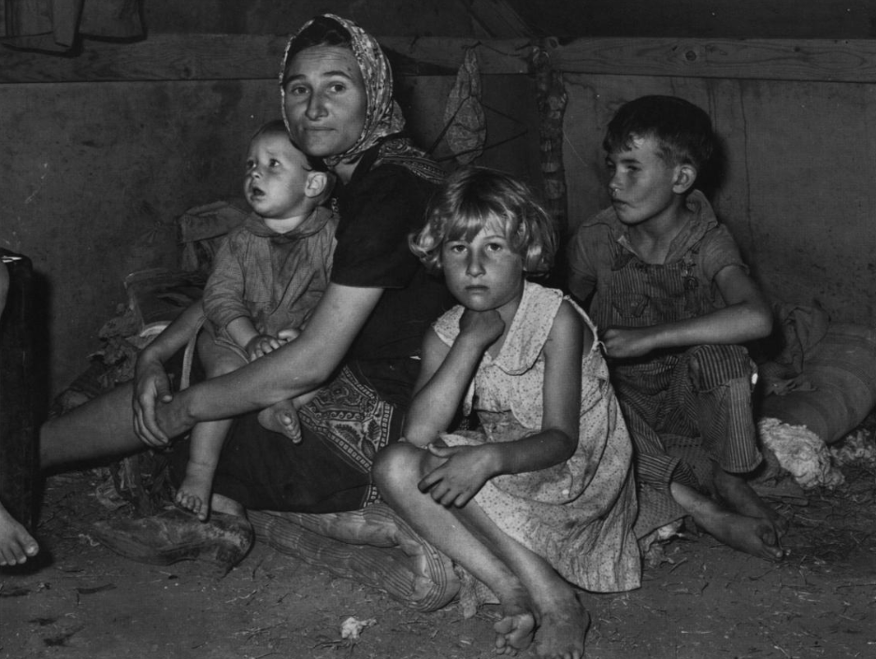
Part III: Practice Test Questions
A migrant mother with her children in Weslaco, Texas, on the Rio Grande.
The Portal to Texas History
Notes:
Reid, Robert L., 1938-. Picturing Texas: The Farm Security Administration-Office of War Information Photographers in the Lone Star State, 1935-1943, book, 1994; Austin, Texas. (https://texashistory.unt.edu/ark:/67531/metapth296835/: accessed April 13, 2026), University of North Texas Libraries, The Portal to Texas History, https://texashistory.unt.edu; crediting Texas State Historical Association.

Slide 9
Exit Ticket:
Follow the directions to complete your exit ticket
Use the graphic organizer to self-assess your preparedness for this test and reflect on the unit’s previous test
Discuss with a partner

Slide 10
Share with the class 2
(Share any response)

