Slide 1
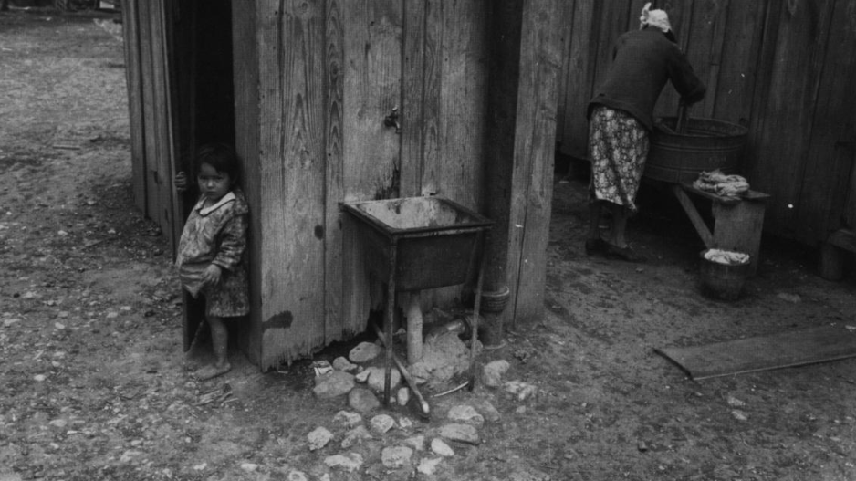
Unit 12:
The Great Depression
Lesson 1:
The Big Picture
A mother washing clothes in San Antonio, 1939
The Portal to Texas History
Notes:
Reid, Robert L., 1938-. Picturing Texas: The Farm Security Administration-Office of War Information Photographers in the Lone Star State, 1935-1943, book, 1994; Austin, Texas. (https://texashistory.unt.edu/ark:/67531/metapth296835/: accessed April 13, 2026), University of North Texas Libraries, The Portal to Texas History, https://texashistory.unt.edu; crediting Texas State Historical Association.

Slide 2
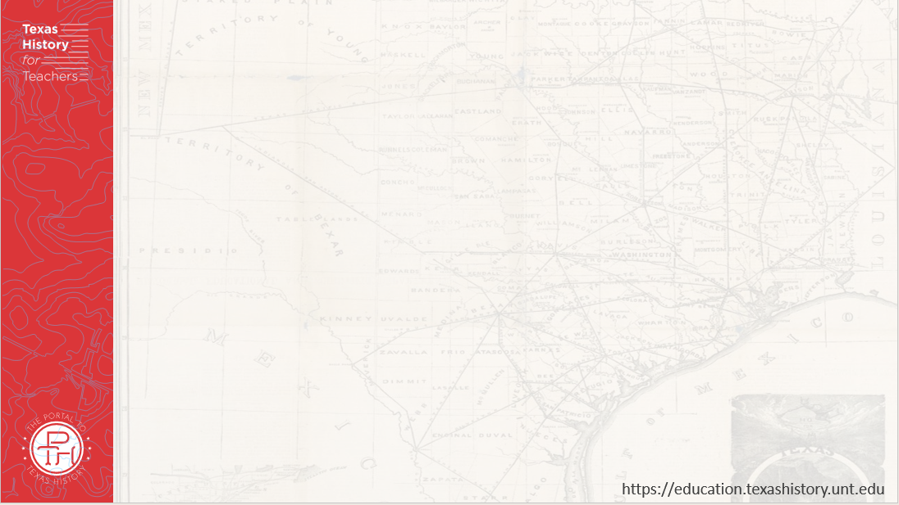
Warm-up
Follow the directions below to complete your warm-up
Read each statement in the chart.
Choose up to FIVE statements that you think are true for this unit: the Great Depression.
Share with a partner.

Slide 3
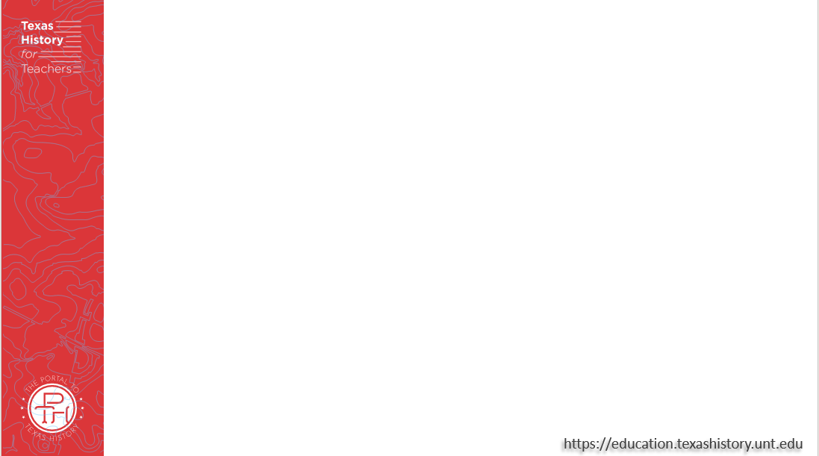
Share with the class:
One statement that I think is true for Unit 12: The Great Depression is ___________

Slide 4

Essential Question
What are the major themes, events, and defining characteristics of Unit 12: The Great Depression?

Slide 5
In Today’s Lesson
We will examine the major events, themes, and defining characteristics of the Great Depression era.
I will analyze a primary source photograph, read an essential ideas passage, and explain the significance of key events and topics in Unit 12: The Great Depression.

Slide 6
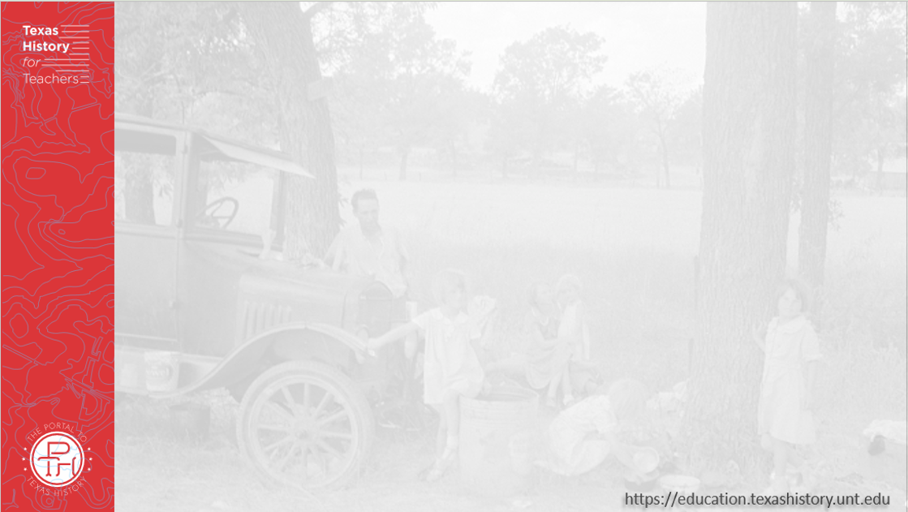
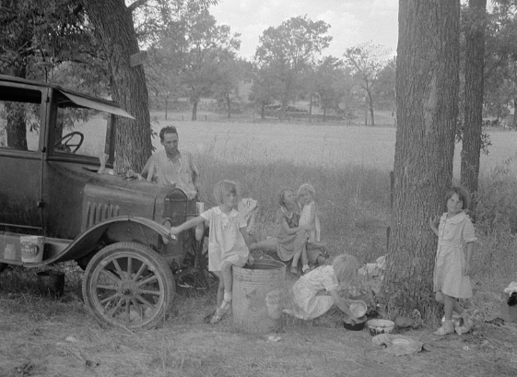
Part I: Analyze an Image
The Library of Congress
Notes:
Lange, Dorothea. Migrant family from Oklahoma in Texas. A family of six alongside the road. An example of how they fall between the relief agencies. The father, aged thirty-five, is an intelligent fellow, a painter by trade. Advanced tuberculosis, victim of an occupational disease. Ineligible for WPAWorks Progress Administration, rated as totally disabled. As a state charge under Oklahoma relief standards, the family were told the maximum relief would be seven dollars every two weeks. They lost their home, their furniture, took to the road a year ago and when the photographs were made they were found to be without money, shelter, and without food for the four children. August 1936. Photograph. Library of Congress Prints and Photographs Division https://www.loc.gov/item/2017763141/.

Slide 7

Part II:
Essential Ideas &
Reading Passage

Slide 8
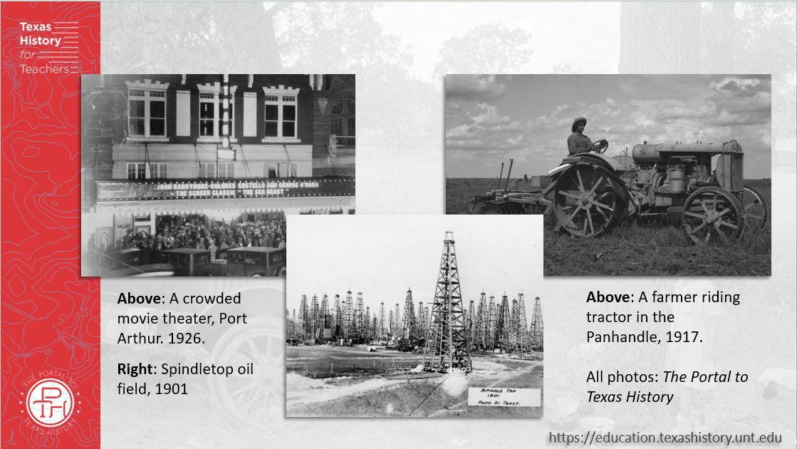
Paragraph 1: The Age of Oil
Notes:
[Oil Wells at Spindletop], photograph, Date Unknown; (https://texashistory.unt.edu/ark:/67531/metapth202771/: accessed January 30, 2026), University of North Texas Libraries, The Portal to Texas History, https://texashistory.unt.edu; crediting Museum of the Gulf Coast.
[Farmer on a Tractor]. 1917. Photograph. University of North Texas Libraries, The Portal to Texas History; crediting Panhandle-Plains Historical Museum. https://texashistory.unt.edu/ark:/67531/metapth1150256/.
[Crowd in front of the Strand Theater]. 1926. Photograph. University of North Texas Libraries, The Portal to Texas History; crediting Port Arthur Public Library. https://texashistory.unt.edu/ark:/67531/metapth79190/.

Slide 9
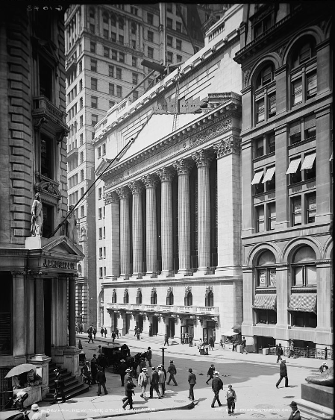
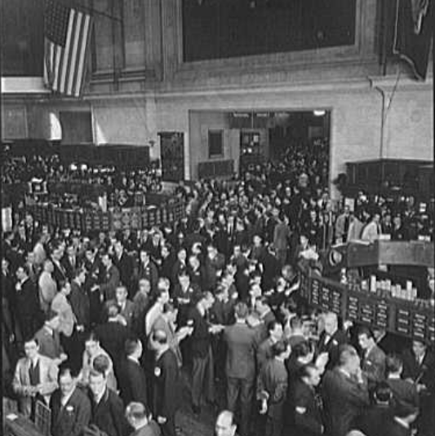
Paragraph 2: The Stock Market
The New York Stock Exchange, 1939.
The Library of Congress
The New York Stock Exchange, 1905.
The Library of Congress
Notes:
Detroit Publishing Co., Publisher. New York Stock Exchange. New York New York State United States, None. [Between 1900 and 1905] Photograph. https://www.loc.gov/item/2016813021/.
Gottscho-Schleisner, Inc, photographer. New York Stock Exchange. View III. United States New York New York State, 1939. Photograph. https://www.loc.gov/item/2018722305/.

Slide 10
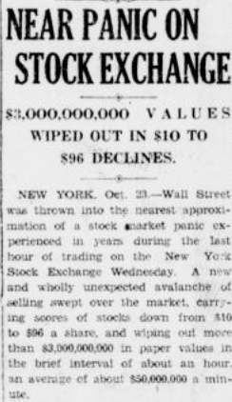
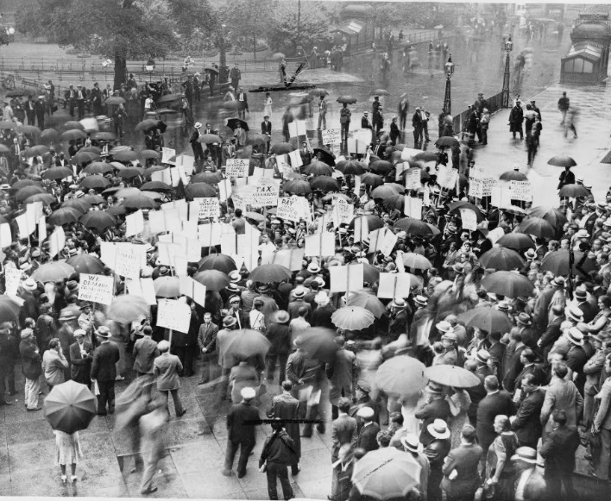
Paragraph 3: The Stock Market Crash of 1929
Protestors outside of a failed bank, 1931
The Library of Congress
The Portal to Texas History
Notes:
“Near Panic on Stock Exchange: $3,000,000,000 Values wiped Out in $10 to $96 Declines”. Cooper Review, October 25, 1929. University of North Texas Libraries, The Portal to Texas History; crediting Delta County Public Library. https://texashistory.unt.edu/ark:/67531/metapth1541229/.
Crowd of depositors gather in the rain outside Bank of United States after its failure / World-Telegram staff photo. 1931. Photograph. https://www.loc.gov/item/96521489/.

Slide 11
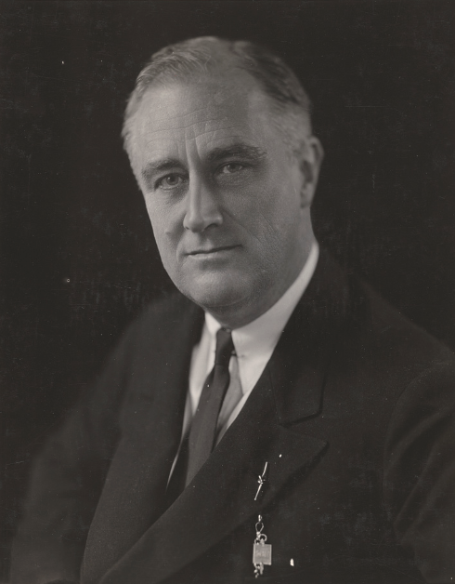
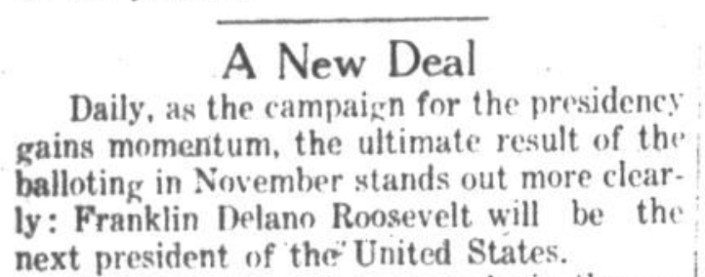
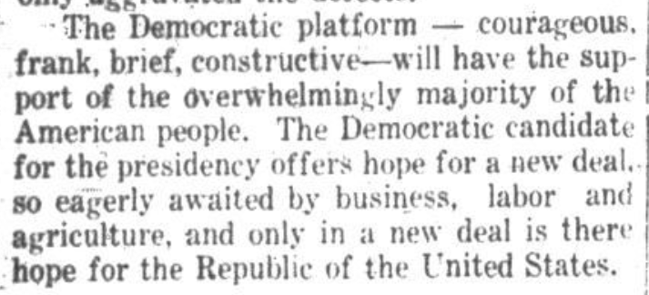
Paragraph 4: President Roosevelt’s New Deal
The Tri-Cities Sun, Goose Creek, TX, 1932
The Portal to Texas History
Franklin Delano Roosevelt
The Library of Congress
Notes:
Goldensky, Elias. Franklin Delano Roosevelt, head-and-shoulders portrait, facing slightly left. December 27, 1933. Photograph. Library of Congress Prints and Photographs Division. https://www.loc.gov/item/96523441/.
Pendergraft, W. L. The Tri-Cities Sun (Goose Creek, Tex.), Vol. 14, No. 34, Ed. 1 Tuesday, July 12, 1932, newspaper, July 12, 1932; Goose Creek, Texas. (https://texashistory.unt.edu/ark:/67531/metapth1021028/: accessed May 5, 2026), University of North Texas Libraries, The Portal to Texas History, https://texashistory.unt.edu; crediting Sterling Municipal Library.

Slide 12

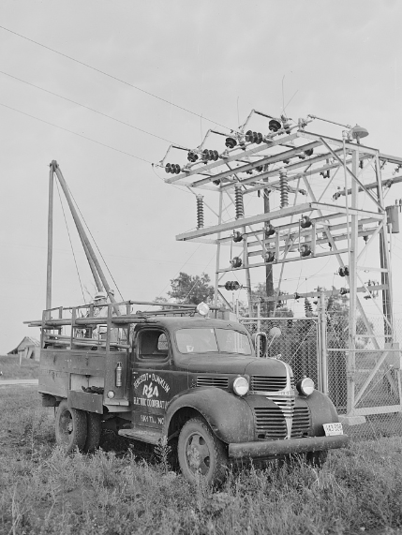
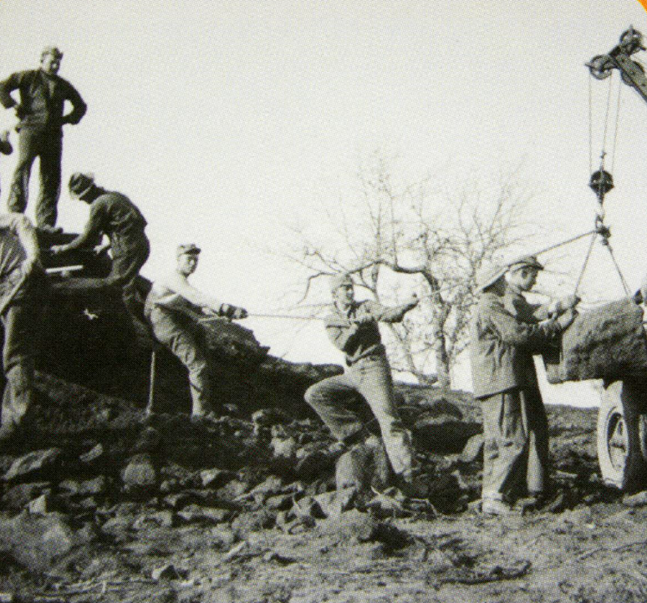
Paragraph 5: The New Deal in Action
Men with the Civilian Conservation Corps build Buescher State Park near Austin
The Portal to Texas History
A Works Progress Administration poster
The Library of Congress
The Rural Electrification Administration
The Library of Congress
Notes:
Bock, Vera. Work pays America! Prosperity. 1936-41. Photograph. https://www.loc.gov/item/98518682/.
Rothstein, Arthur. Hayti, Missouri. U.S. Rural Electrification Administration REA cooperative maintenance truck at the substation. Pemiscot County Missouri Hayti United States, 1942. July. Photograph. https://www.loc.gov/item/2017835124/.
Texas. Parks and Wildlife Department. [Trading Card: Civilian Conservation Corps], text, 2011; Texas. (https://texashistory.unt.edu/ark:/67531/metapth661917/: accessed April 9, 2026), University of North Texas Libraries, The Portal to Texas History, https://texashistory.unt.edu; crediting UNT Libraries Government Documents Department.

Slide 13
Part III: Comprehension Questions

Slide 14
Exit Ticket
Follow the directions below to complete your exit ticket
Read the sentence stem in the question.
Choose three answers that best complete the sentence stem.
Share with a partner.

Slide 15
Share with the class: 2
One defining characteristic of the Great Depression was ______________

