Slide 1
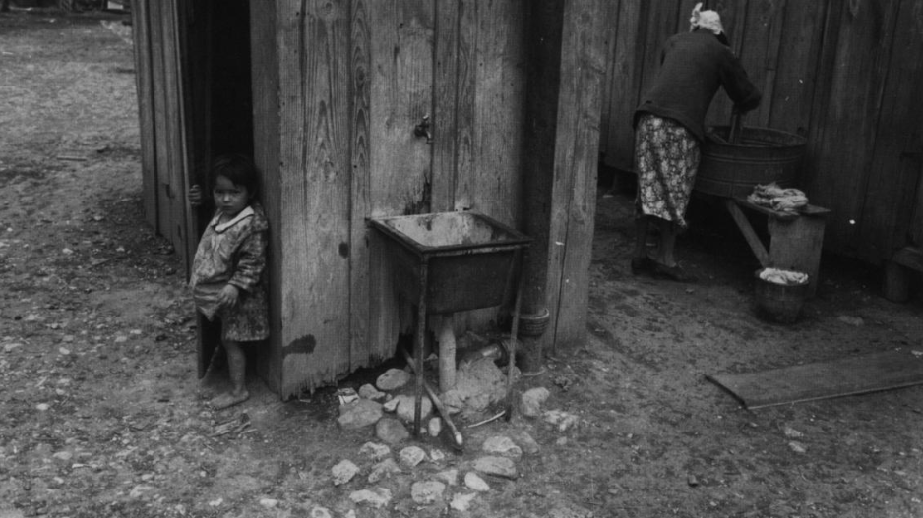
Unidad 12:
La Gran Depresión
Lección 1:
La visión general
Una madre lavando ropa in San Antonio, 1939
El portal a la historia de Texas
Notes:
Reid, Robert L., 1938-. Picturing Texas: The Farm Security Administration-Office of War Information Photographers in the Lone Star State, 1935-1943, book, 1994; Austin, Texas. (https://texashistory.unt.edu/ark:/67531/metapth296835/: accessed April 13, 2026), University of North Texas Libraries, The Portal to Texas History, https://texashistory.unt.edu; crediting Texas State Historical Association.

Slide 2

Calentamiento
Sigue las instrucciones de abajo para completar tu calentamiento
Lee cada afirmación del gráfico.
Elige hasta CINCO afirmaciones que consideres ciertas para esta unidad: la Gran Depresión.
Comparte con una pareja.

Slide 3

Comparte con la clase:
Una afirmación que creo que es cierta para la Unidad 12: La Gran Depresión es ___________

Slide 4

Pregunta esencial
Cuáles son los principales temas, eventos y características definitorias de la Unidad 12: La Gran Depresión?

Slide 5
En la lección de hoy
Examinaremos los principales acontecimientos, temas y características definitorias de la era de la Gran Depresión.
Analizaré una fotografía de fuente primaria, leeré un pasaje de ideas esenciales y explicaré la importancia de los eventos y temas clave en la Unidad 12: La Gran Depresión.

Slide 6
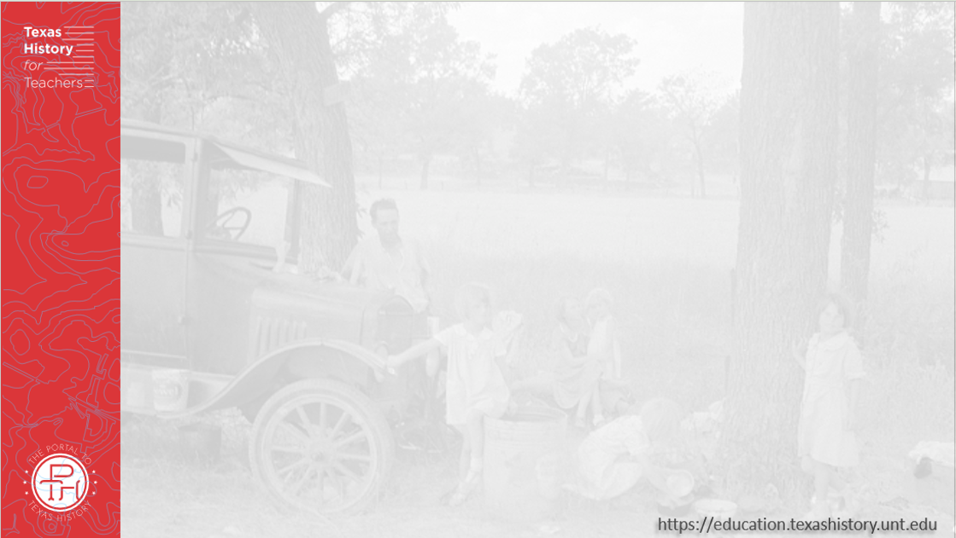
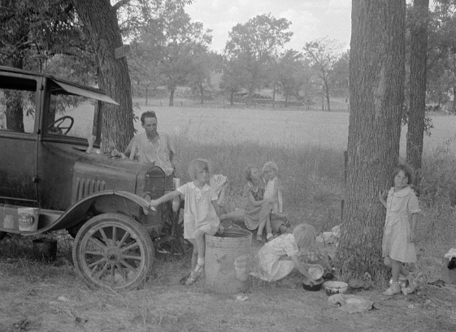
Parte I: Analizar una imagen
La Biblioteca del Congreso
Notes:
Lange, Dorothea. Migrant family from Oklahoma in Texas. A family of six alongside the road. An example of how they fall between the relief agencies. The father, aged thirty-five, is an intelligent fellow, a painter by trade. Advanced tuberculosis, victim of an occupational disease. Ineligible for WPAWorks Progress Administration, rated as totally disabled. As a state charge under Oklahoma relief standards, the family were told the maximum relief would be seven dollars every two weeks. They lost their home, their furniture, took to the road a year ago and when the photographs were made they were found to be without money, shelter, and without food for the four children. August 1936. Photograph. Library of Congress Prints and Photographs Division https://www.loc.gov/item/2017763141/.

Slide 7

Parte II:
Ideas esenciales y
Pasaje de lectura

Slide 8
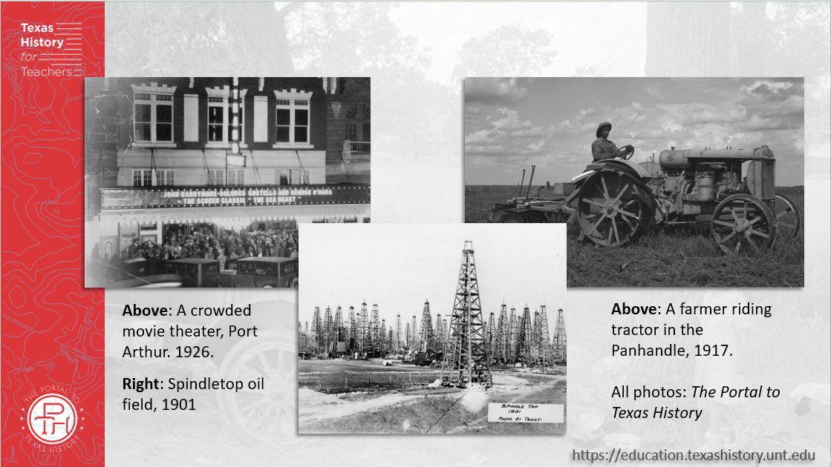
Párrafo 1: La Era del Petróleo
Notes:
[Oil Wells at Spindletop], photograph, Date Unknown; (https://texashistory.unt.edu/ark:/67531/metapth202771/: accessed January 30, 2026), University of North Texas Libraries, The Portal to Texas History, https://texashistory.unt.edu; crediting Museum of the Gulf Coast.
[Farmer on a Tractor]. 1917. Photograph. University of North Texas Libraries, The Portal to Texas History; crediting Panhandle-Plains Historical Museum. https://texashistory.unt.edu/ark:/67531/metapth1150256/.
[Crowd in front of the Strand Theater]. 1926. Photograph. University of North Texas Libraries, The Portal to Texas History; crediting Port Arthur Public Library. https://texashistory.unt.edu/ark:/67531/metapth79190/.

Slide 9
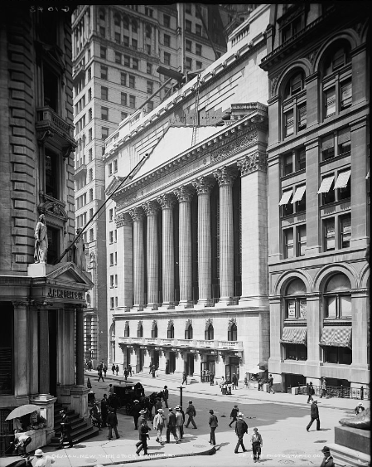
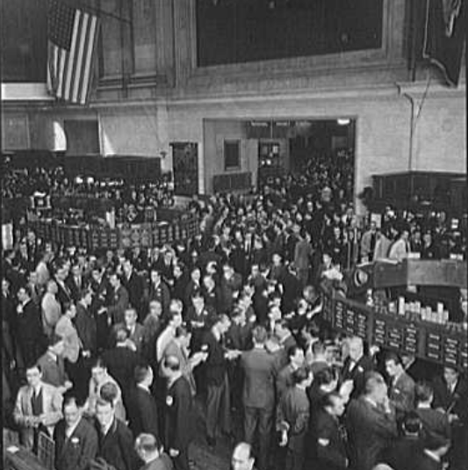
Párrafo 2: El mercado bursátil
La Bolsa de Nueva York, 1939.
La Biblioteca del Congreso
La Bolsa de Nueva York, 1905.
La Biblioteca del Congreso
Notes:
Detroit Publishing Co., Publisher. New York Stock Exchange. New York New York State United States, None. [Between 1900 and 1905] Photograph. https://www.loc.gov/item/2016813021/.
Gottscho-Schleisner, Inc, photographer. New York Stock Exchange. View III. United States New York New York State, 1939. Photograph. https://www.loc.gov/item/2018722305/.

Slide 10
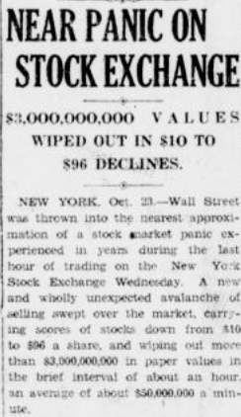
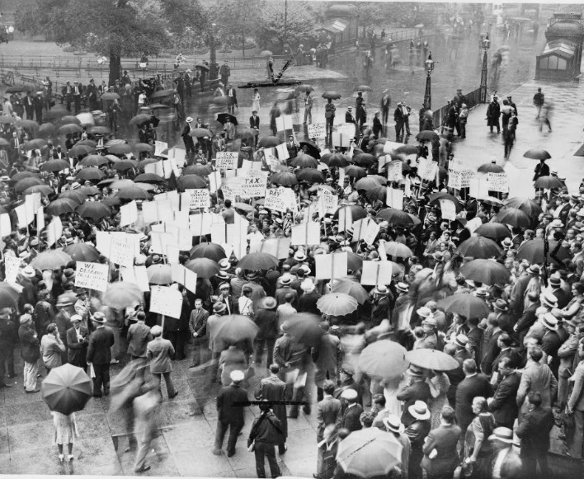
Párrafo 3: El desplome bursátil de 1929
Manifestantes frente a un banco quebrado, 1931
La Biblioteca del Congreso
El portal a la historia de Texas
Notes:
“Near Panic on Stock Exchange: $3,000,000,000 Values wiped Out in $10 to $96 Declines”. Cooper Review, October 25, 1929. University of North Texas Libraries, The Portal to Texas History; crediting Delta County Public Library. https://texashistory.unt.edu/ark:/67531/metapth1541229/.
Crowd of depositors gather in the rain outside Bank of United States after its failure / World-Telegram staff photo. 1931. Photograph. https://www.loc.gov/item/96521489/.

Slide 11
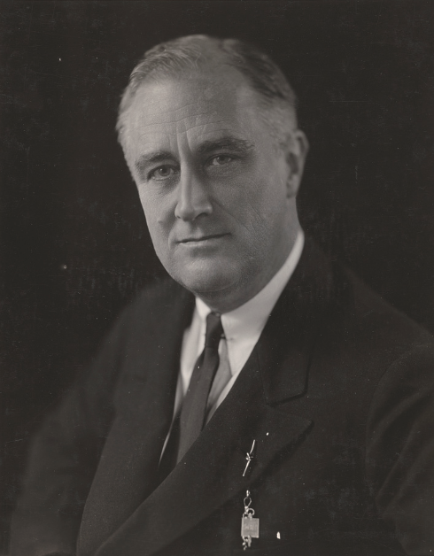
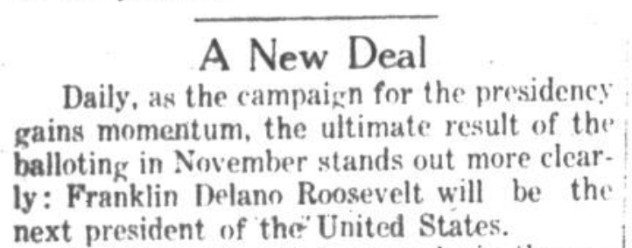
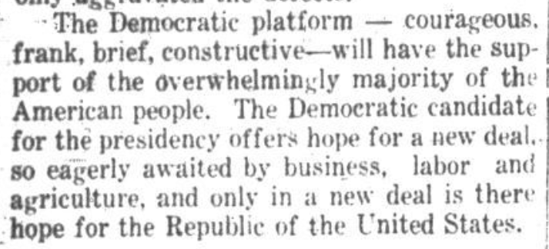
Párrafo 4: El New Deal del presidente Roosevelt
El sol de las Tri-Ciudades, Goose Creek, TX, 1932
El portal a la historia de Texas
Franklin Delano Roosevelt
La Biblioteca del Congreso
Notes:
Goldensky, Elias. Franklin Delano Roosevelt, head-and-shoulders portrait, facing slightly left. December 27, 1933. Photograph. Library of Congress Prints and Photographs Division. https://www.loc.gov/item/96523441/.
Pendergraft, W. L. The Tri-Cities Sun (Goose Creek, Tex.), Vol. 14, No. 34, Ed. 1 Tuesday, July 12, 1932, newspaper, July 12, 1932; Goose Creek, Texas. (https://texashistory.unt.edu/ark:/67531/metapth1021028/: accessed May 5, 2026), University of North Texas Libraries, The Portal to Texas History, https://texashistory.unt.edu; crediting Sterling Municipal Library.

Slide 12

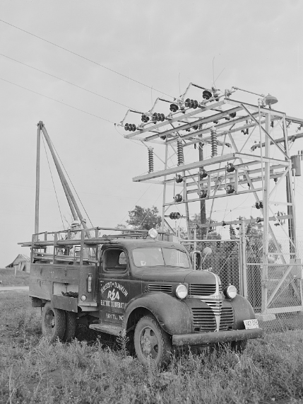
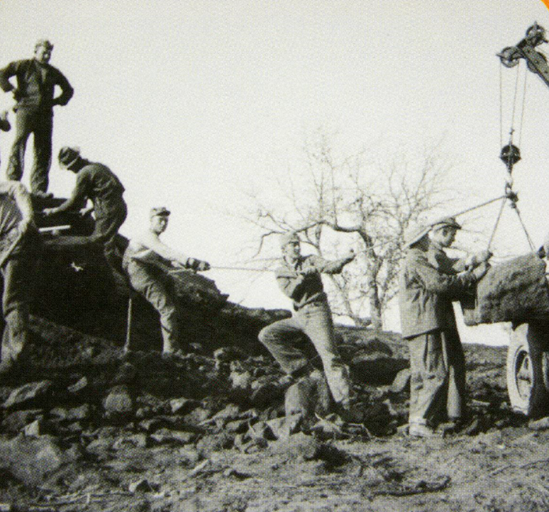
Párrafo 5: El New Deal en acción
Hombres del Cuerpo Civil de Conservación construyen el Parque Estatal Buescher cerca de Austin
El portal a la historia de Texas
Un cartel de la Works Progress Administration
La Biblioteca del Congreso
La Administración de Electrificación Rural
La Biblioteca del Congreso
Notes:
Bock, Vera. Work pays America! Prosperity. 1936-41. Photograph. https://www.loc.gov/item/98518682/.
Rothstein, Arthur. Hayti, Missouri. U.S. Rural Electrification Administration REA cooperative maintenance truck at the substation. Pemiscot County Missouri Hayti United States, 1942. July. Photograph. https://www.loc.gov/item/2017835124/.
Texas. Parks and Wildlife Department. [Trading Card: Civilian Conservation Corps], text, 2011; Texas. (https://texashistory.unt.edu/ark:/67531/metapth661917/: accessed April 9, 2026), University of North Texas Libraries, The Portal to Texas History, https://texashistory.unt.edu; crediting UNT Libraries Government Documents Department.

Slide 13
Parte III: Preguntas de comprensión

Slide 14
Billete de salida
Sigue las instrucciones a continuación para completar tu ticket de salida
Lee el frase en la pregunta.
Elige tres respuestas que completen mejor el tronco de la oración.
Comparte con una pareja.

Slide 15
Comparte con la clase: 2
Una característica definitoria de la Gran Depresión fue ______________

