Slide 1
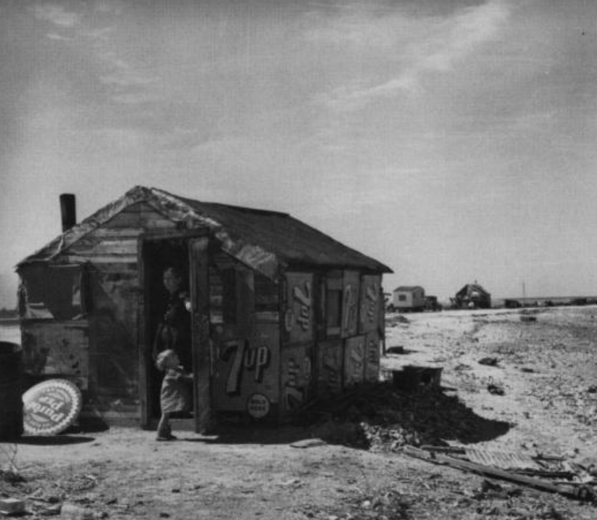
Unit 12:
The Great Depression
Lesson 3:
Vocabulary
A Texas farmhouse, 1938.
The Portal to Texas History
Notes:
Reid, Robert L., 1938-. Picturing Texas: The Farm Security Administration-Office of War Information Photographers in the Lone Star State, 1935-1943, book, 1994; Austin, Texas. (https://texashistory.unt.edu/ark:/67531/metapth296835/: accessed May 5, 2026), University of North Texas Libraries, The Portal to Texas History, https://texashistory.unt.edu; crediting Texas State Historical Association.

Slide 2

Warm-up:
Follow the directions to complete your warm-up
Assess your prior knowledge of the four vocabulary terms on your warm-up.
Write your level of understanding for each term.
Share with a partner.

Slide 3

Share with the class
One vocabulary term we will learn in this unit is ______.
(Read your chosen response for this term)

Slide 4

Essential Question
What are the key terms we need to know to understand this unit on the Great Depression, and what is the meaning of these terms in the context of our unit?

Slide 5
In today’s lesson…
We will identify, define, and exemplify the key terms of the Great Depression era.
I will use the information and context of several short passages to identify and record the definition of each term and provide examples of the term in the context of our unit.

Slide 6
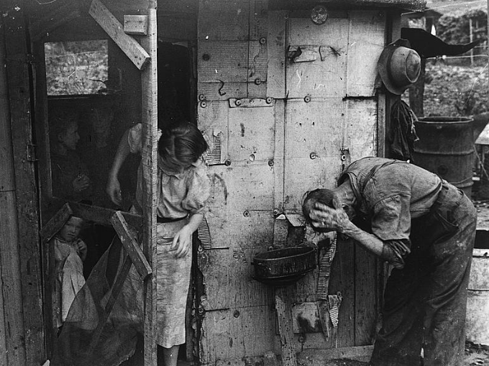
Economic Depression (n)
An economic depression is a long-term period of severe decline in the economy. Economic depressions typically lead to a decline in sales, bank and business failures, and high rates of people losing their jobs.
During the 1930s, the U.S. experienced the worst economic depression in the nation’s history, known as the Great Depression. Banks failed and businesses closed causing many to lose their savings, homes, and jobs. At the height of the depression in 1933, 25% of Americans were out of work – that is 1 in 4 people!
This unit explores how the depression affected Texans, and how the government worked to address the challenges millions faced.
A family during the Great Depression
The Library of Congress
Notes:
Shahn, Ben. Ex-farmer now on W.P.A. Work Projects Administration, central Ohio. August 1938. Photograph. Library of Congress Prints and Photographs Division. https://www.loc.gov/item/2017732198/.

Slide 7
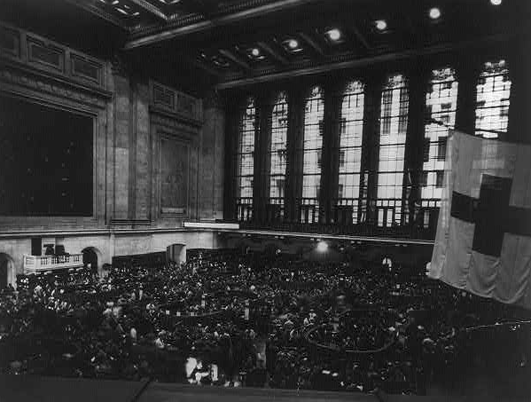
Stock Market (n)
The stock market is a financial system that allows people to buy stocks, or shares in different companies. For example, people can buy stock in a video game company. If the company does well, the value of the stock increases. People can sell their stocks for more than they bought them, earning a profit.
Today, about 62% of Americans take part in the stock market. In the 1930s, barely 10% of the population held stocks, while many, including Texans, did not know what the stock market was! Even so, the stock market would play a critical role in the challenges of this era.
The floor of the stock exchange during market session, 1934.
The Library of Congress
Notes:
Floor of Stock Exchange during market session, New York City. , ca. 1934. Photograph. https://www.loc.gov/item/2006682545/.

Slide 8
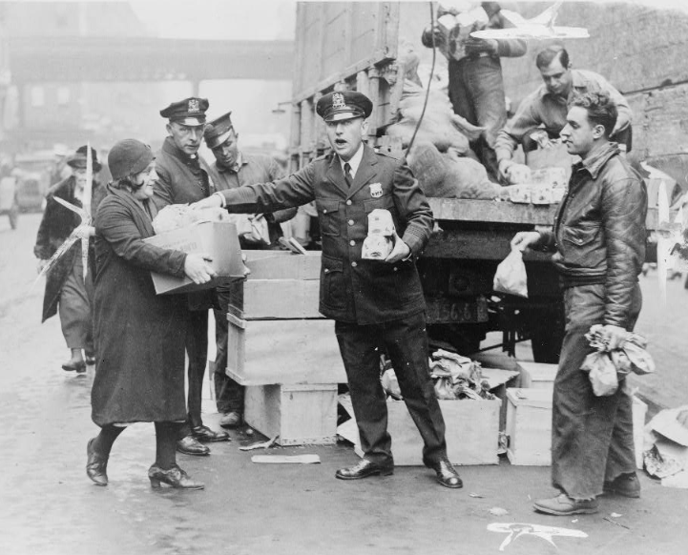
Relief (n)
The stock market crashed in October 1929, leading to the worst economic depression in U.S. history. Businesses failed, banks closed, millions lost their jobs, savings, and even homes.
People across the U.S. needed relief, or help with necessities like food, shelter, clothing, and work. Churches and other organizations that typically provided relief for the needy could not meet the needs of so many people. Under President Franklin D. Roosevelt, the government initiated relief programs to provide assistance to Americans in need.
Police distribute supplies to the needy, 1930
The Library of Congress
Notes:
Police give first city doles to unemployed. Police distributing eggs and bread to city's needy at E. 104th St. station house today / by Telegram staff photographer. 1930. Photograph. Library of Congress Prints and Photographs Division. https://www.loc.gov/item/95514429/.

Slide 9
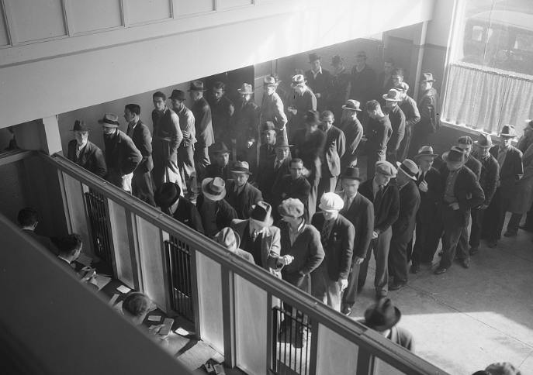
Unemployment (n)
At any given time in any country, there are some adults who are out of work for any number of reasons. The number or percentage people who do not have a job is referred to as unemployment. On average, the rate of unemployment in the U.S. is around 5%, meaning 5 out of 100 people are out of work.
During the Great Depression, the number of unemployed Americans rose to over 25%, meaning 25 out of 100 people (or 1 out of 4) people were unemployed. Government relief programs addressed the high rate of unemployment by instituting programs to provide jobs to unemployed Americans.
Men waiting in line to receive unemployment benefits, 1938
The Library of Congress
Notes:
Lange, Dorothea. Unemployment benefits aid begins. Line of men inside a division office of the State Employment Service office at San Francisco, California, waiting to register for benefits on one of the first days the office was open. They will receive from six to fifteen dollars per week for up to sixteen weeks. Coincidental with the announcement that the federal unemployment census showed close to ten million persons out of work, twenty-two states begin paying unemployment compensation. January 1938. Photograph. Library of Congress Prints and Photographs Division. https://www.loc.gov/item/2017770698/.

Slide 10
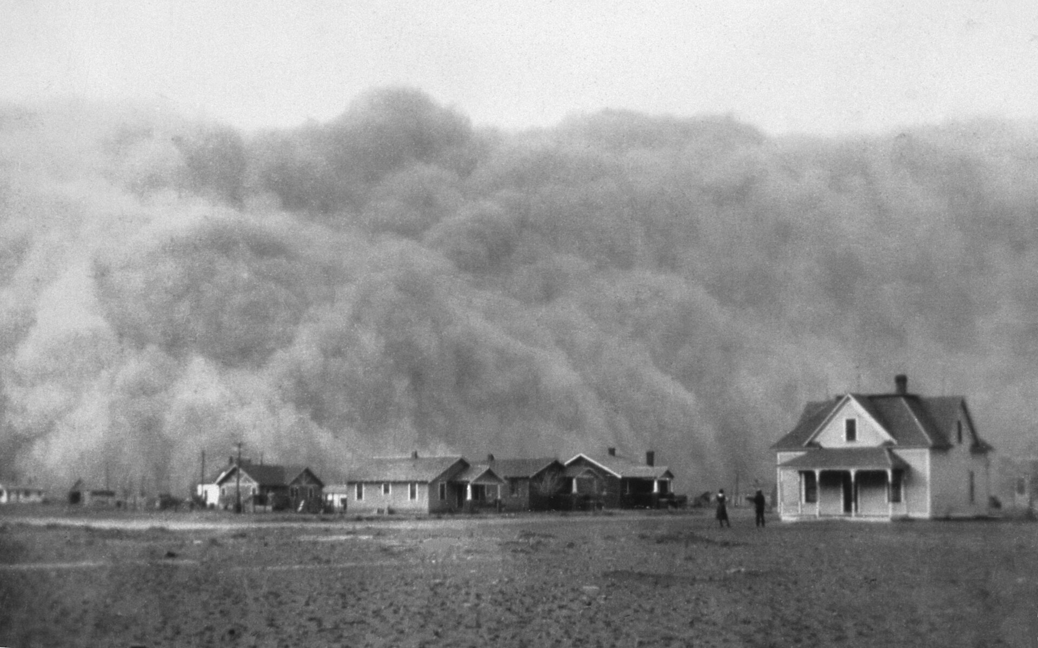
Ecology (n)
Ecology is the study of how living things interact with their environment, from plants to insects to animals to humans. Every living being plays a role to maintain balance.
During the Great Depression, the U.S. experienced the worst ecological disaster in the nation’s history. For decades, the native grasses of the Great Plains had been depleted due to harmful farming and ranching practices like over-farming and over-grazing cattle.
As a result of these harmful ecological practices combined with a severe drought, when high winds swept through the plains, without the grasses to hold down the soil, dirt and dust was thrown into the sky. Towns were covered in dust for hours or days at a time during the 1930s. This was known as the “Dust Bowl.”
A dust storm approaches Stratford, TX. 1935
The National Oceanographic and Atmospheric Administration
Notes:
What is a dust storm? National Environmental Satellite, Data, and Information Service.
Accessed 4/13/2026 https://www.nesdis.noaa.gov/about/k-12-education/dust-ash-fire-smoke/what-dust-storm

Slide 11
Exit Ticket:
Follow the directions to complete your exit ticket
Choose three to five terms in the graphic organizer the best relate to the unit.
Of your 3 to 5 choices, pick one and write a sentence explaining how it connects to the unit using the sentence stem provided.
Share with a partner.

Slide 12
Share with the class 2
One term I chose was ________. I think this term best relates to our unit because _________

