Slide 1
Unit 4: The Mexican National Era
Extension Lesson:
Empresario Activity
Notes:
“Connected Map of Austin’s Colony, 1833 – 1837” [1892]. #1944, Map Collection, Archives and Records Program, Texas General Land Office, Austin

Slide 2





Warm-up Follow the directions to complete your warm-up
Read the list of characteristics for applicants to Austin’s colony.
Place a checkmark next to characteristics you think Austin would want his colonists to have
Discuss with a partner
https://education.texashistory.unt.edu

Slide 3
Share with the class
One positive characteristic Austin would want is ________, while one negative characteristic Austin wouldn’t want is __________
I think the characteristic that would be most important to Austin is _________ because __________
https://education.texashistory.unt.edu

Slide 4
Essential Question
What types of people did Stephen F. Austin want to accept into his colony based on state and federal colonization requirements?
https://education.texashistory.unt.edu

Slide 5
In today’s lesson…
We will review six fictional applications of Anglo’s hoping to settle in Austin’s colony.
I will accept, deny, or conditionally accept each application based on state and federal colonization requirements. I will justify my decision based on the evidence provided.
https://education.texashistory.unt.edu

Slide 6
Colonization Applications Student Worksheet
https://education.texashistory.unt.edu

Slide 7
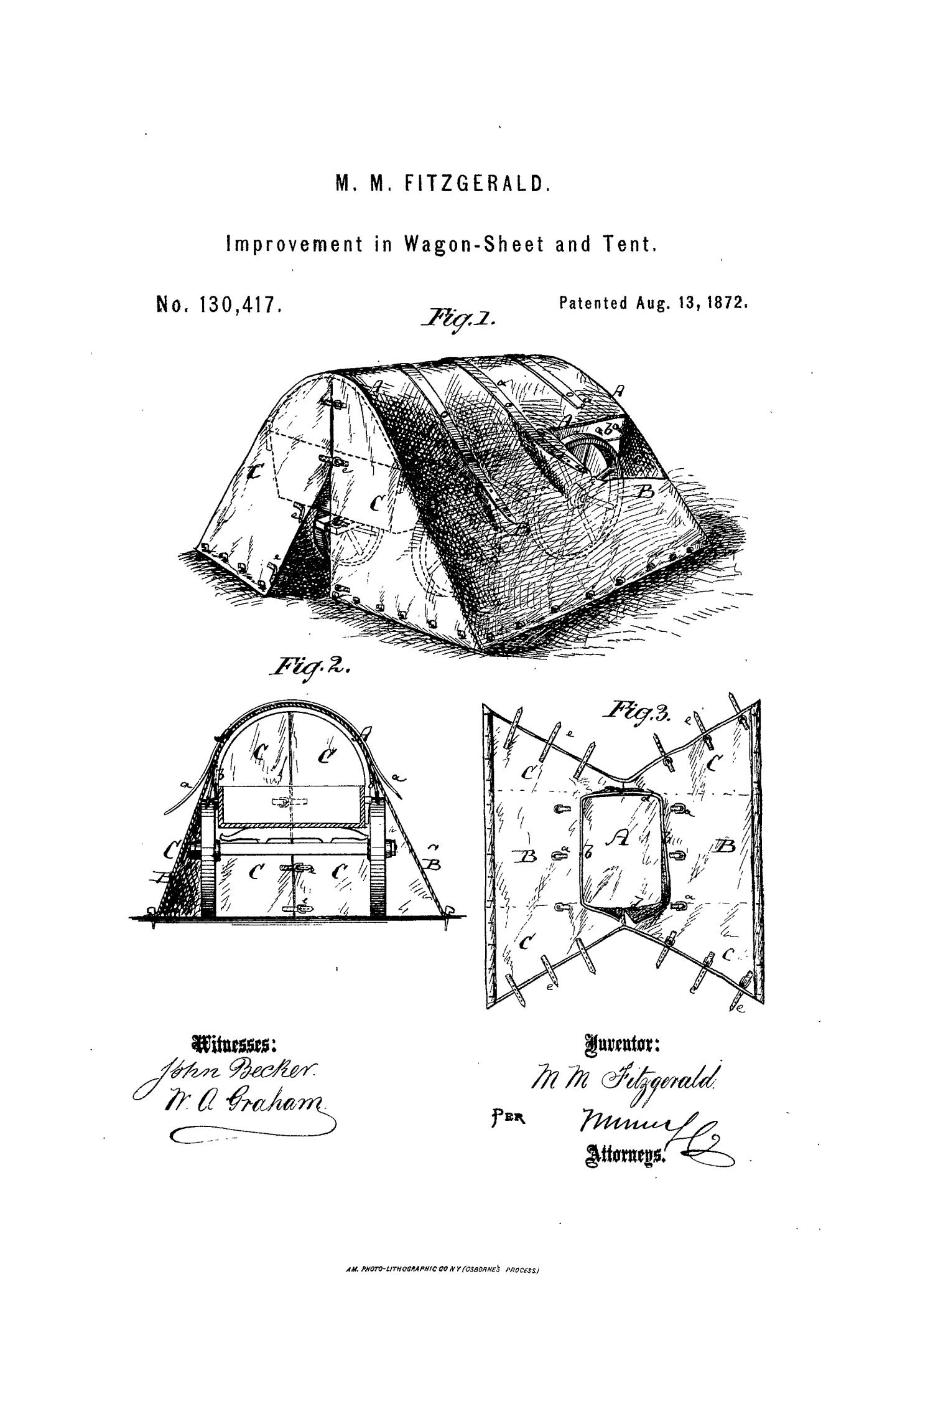
Picture it:
It’s 1829 in Texas. Stephen F. Austin has hired you to help him review some new applications from people hoping to settle in his colony. He has made a list to help you understand all the criteria set by him, by the state of Coahuila y Tejas, and by the Mexican government.
Review the list of requirements on your worksheet.
https://education.texashistory.unt.edu

Slide 8
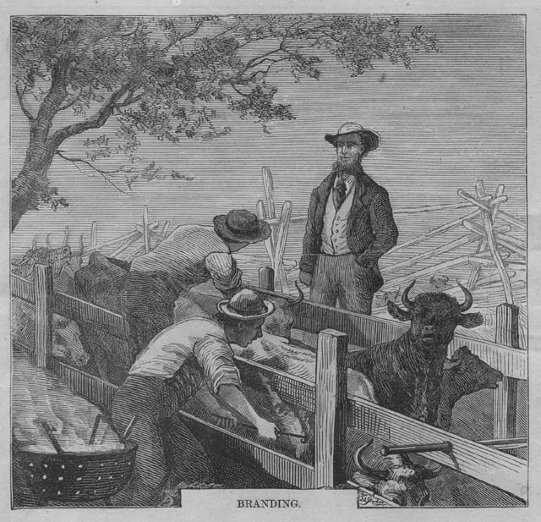
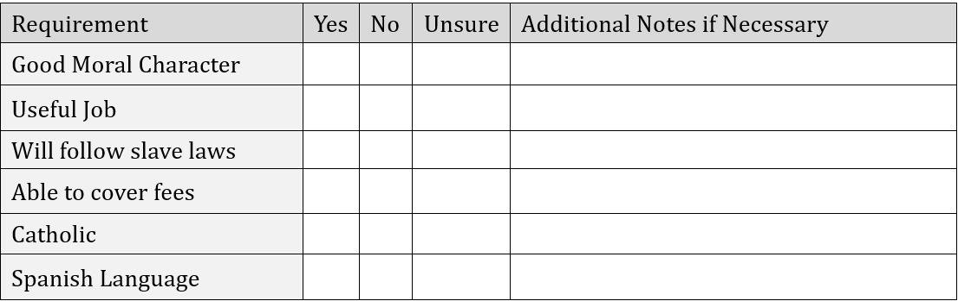
Review the required number of applications listed in your directions. Record Your Observations About Each Applicant
The “Additional Notes” section is not included on all work.
https://education.texashistory.unt.edu

Slide 9


Make your decision about each applicant
Circle your recommendation for each applicant.
Choose “Accept with Conditions” if the applicant is mostly a good candidate, but they have one or two minor things they need to do to be completely acceptable.
https://education.texashistory.unt.edu

Slide 10
Make your decision about each applicant 2
In the blank box provided for each application, explain your decision. For example:
I accepted this person because ______
I denied this person because _____
I accepted this person with conditions. This person needs to ______________ to be fully accepted.
https://education.texashistory.unt.edu

Slide 11
Share your results with the class: Note: There is not just one correct decision for each application. Your results may vary from others. Be sure to provide the justification for your decision based on evidence from the application.
https://education.texashistory.unt.edu

Slide 12
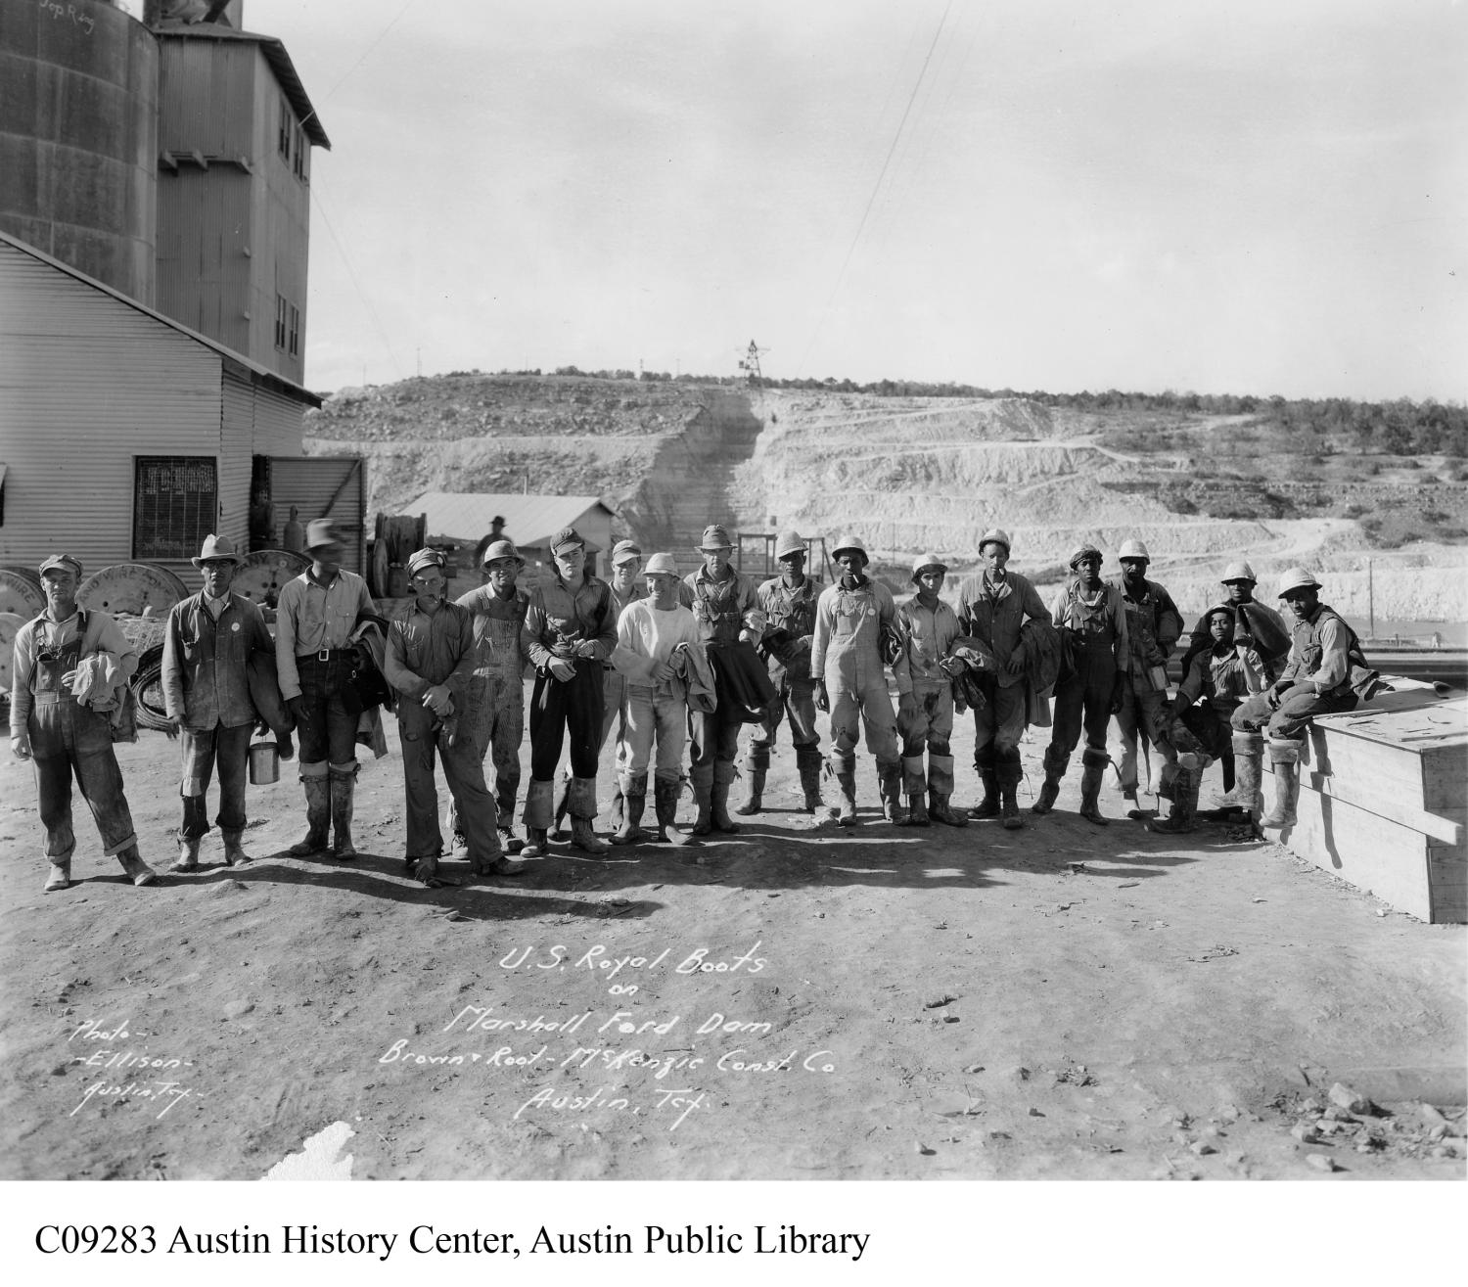
First: Who did you accept?
I accepted ________________
Because __________________
Class Check-in:
I also accepted this applicant.
Actually, I denied this applicant.
I accepted this applicant with conditions.
https://education.texashistory.unt.edu

Slide 13
Second: Who did you deny?
I denied ________________
Because __________________
Class Check-in:
I also denied this applicant.
Actually, I accepted this applicant.
I accepted this applicant with conditions.
https://education.texashistory.unt.edu

Slide 14
Third: Who did you accept with conditions?
I accepted __________ with conditions. They need to ________ in order to be fully accepted.
Class Check-in:
I also accepted this applicant with conditions.
Actually, I denied this applicant.
I accepted this applicant.
https://education.texashistory.unt.edu

Slide 15
Exit Ticket Follow the directions to complete your exit ticket
Read the excerpt of a primary source passage written by Stephen F. Austin
Answer the question that follows.
Discuss with a partner
https://education.texashistory.unt.edu

Slide 16
Share with the class 2
According to the excerpt, __(Read the answer you chose)___.
Evidence from the passage that supports this answer choice is ______________
https://education.texashistory.unt.edu

