Slide 1
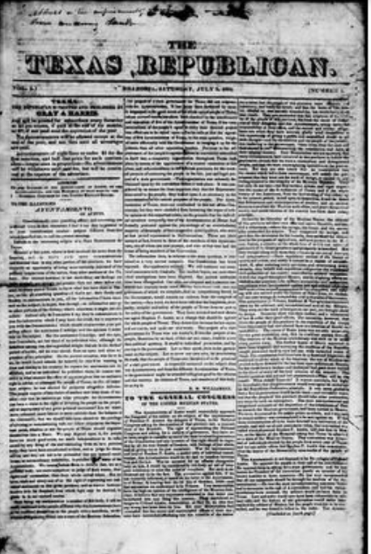
Unit 4: The Mexican National Era
Lesson 9:
Growing Tension in Texas Extension
Primary Source Lesson
Notes:
The Texas Republican. (Brazoria, Tex.), Vol. 1, No. 1, Ed. 1, Saturday, July 5, 1834, newspaper, July 5, 1834; Brazoria, Texas. (https://texashistory.unt.edu/ark:/67531/metapth80246/: accessed January 21, 2025), University of North Texas Libraries, The Portal to Texas History, https://texashistory.unt.edu; crediting The Dolph Briscoe Center for American History.

Slide 2

Primary Source Extension Activity Warm-up

Slide 3




Warm-up: Follow the directions to complete your warm-up
Imagine you are living in Texas in the early 1800s as issues increase in your region and across the country
Write your opinion about the issues you have seen happening around you.
Share with a partner.

Slide 4
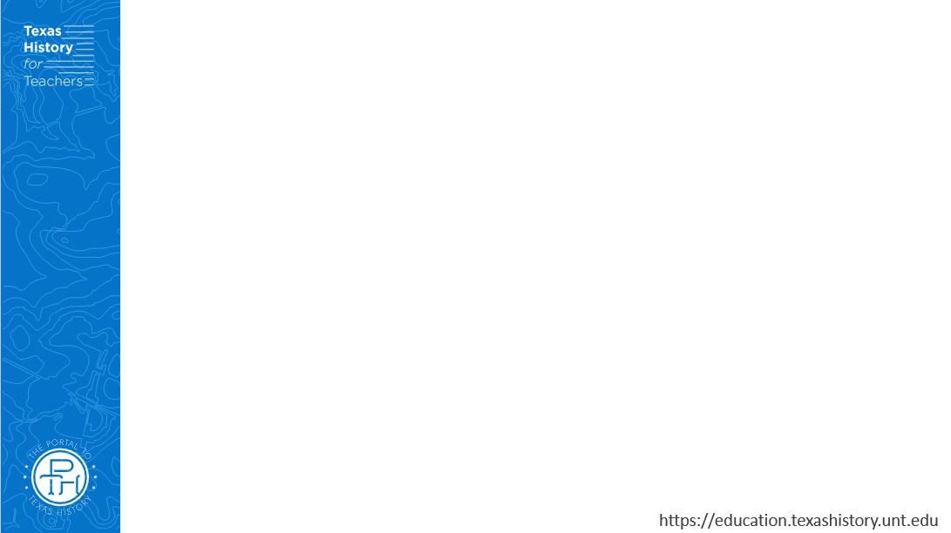
Share with the class
(Share your opinion from your warm-up)

Slide 5
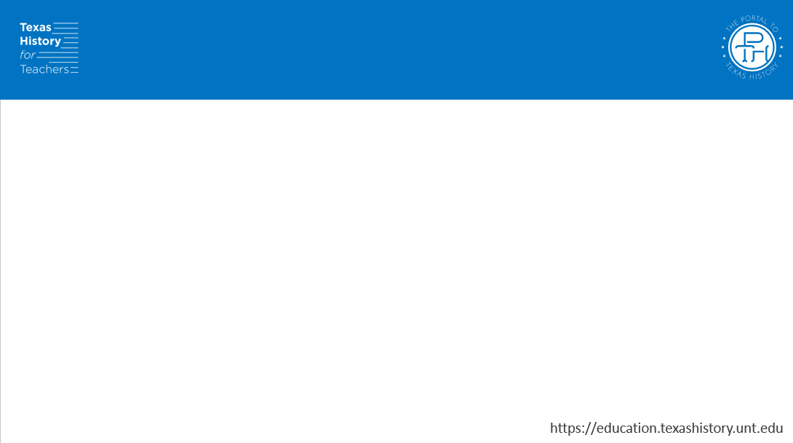
Essential Question
What were some of the different points of view about issues happening in Texas and across Mexico from 1826 to 1834?

Slide 6
In today’s lesson…
We will examine and analyze several primary source documents about issues happening in Texas and Mexico from 1826 to 1834.
I will evaluate each primary source for key elements including author, audience, and tone. I will identify excerpts that support my evaluation.

Slide 7
Primary Source Extension Activity

Slide 8
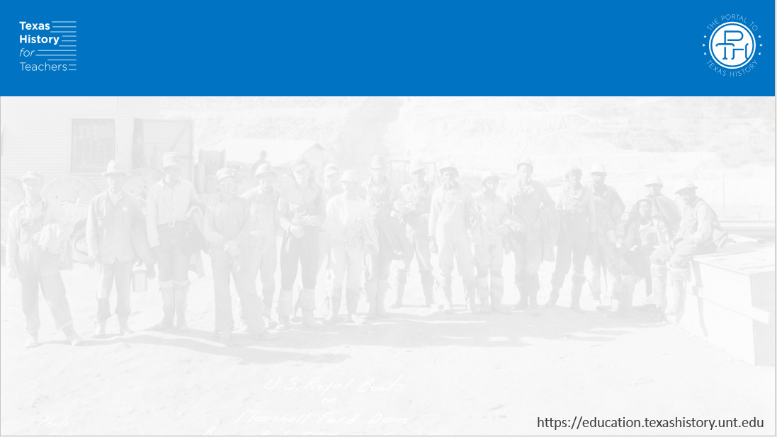
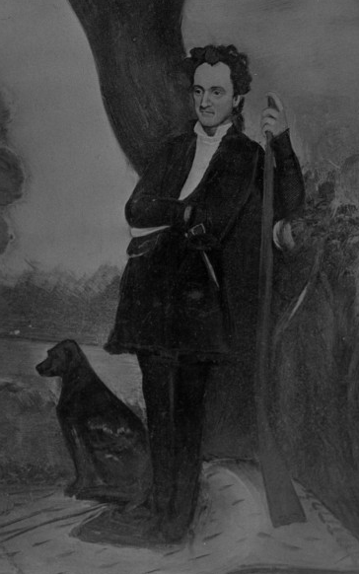
Document A
Excerpts of a letter from Stephen F. Austin to B. J. Thompson, one of the Fredonian Rebels.
December 24, 1826
Pictured: A Portrait of Stephen F. Austin
The Portal to Texas History
Notes:
Portrait of Stephen F. Austin, photograph, Date Unknown; (https://texashistory.unt.edu/ark:/67531/metapth55631/: accessed January 22, 2025), University of North Texas Libraries, The Portal to Texas History, https://texashistory.unt.edu; crediting Hardin-Simmons University Library.

Slide 9
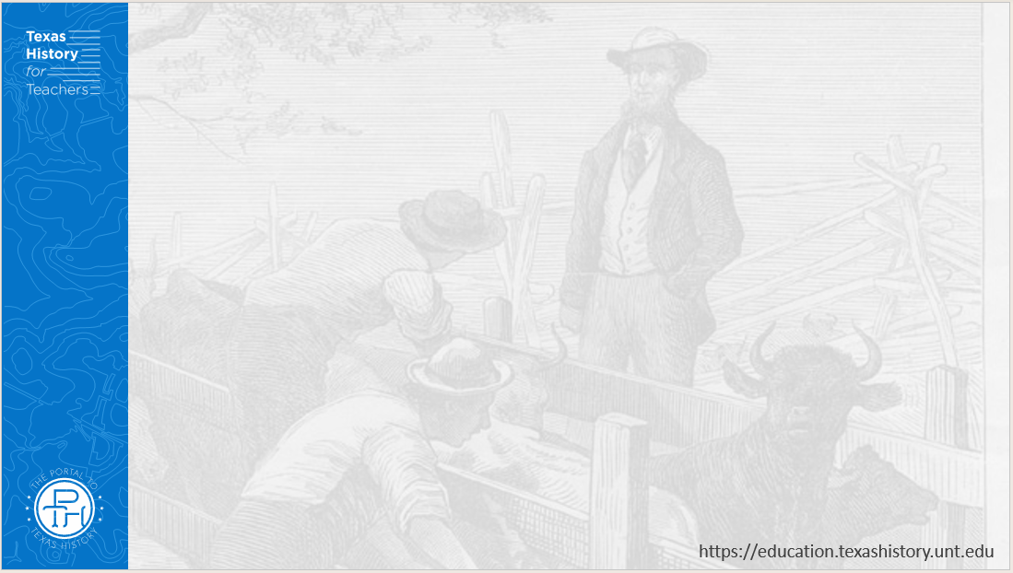
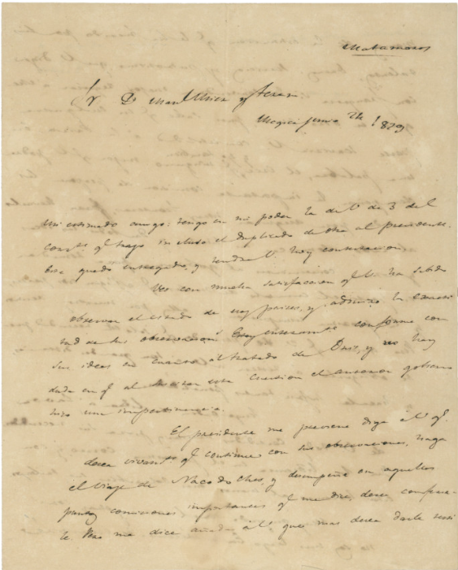
Document B
Excerpts of General Manuel Mier y Terán’s report to the Mexican government.
Nacogdoches, Texas, June 1828
A letter from Lorenzo de Zavala to Mier y Terán discussing protecting Texas’ borders.
The Portal to Texas History
Notes:
Zavala, Lorenzo de, 1788-1836. [Letter from Lorenzo de Zavala to Manuel Mier y Teran, June 24, 1829], letter, June 24, 1829; (https://texashistory.unt.edu/ark:/67531/metapth6003/: accessed January 29, 2025), University of North Texas Libraries, The Portal to Texas History, https://texashistory.unt.edu; crediting The Dolph Briscoe Center for American History.

Slide 10
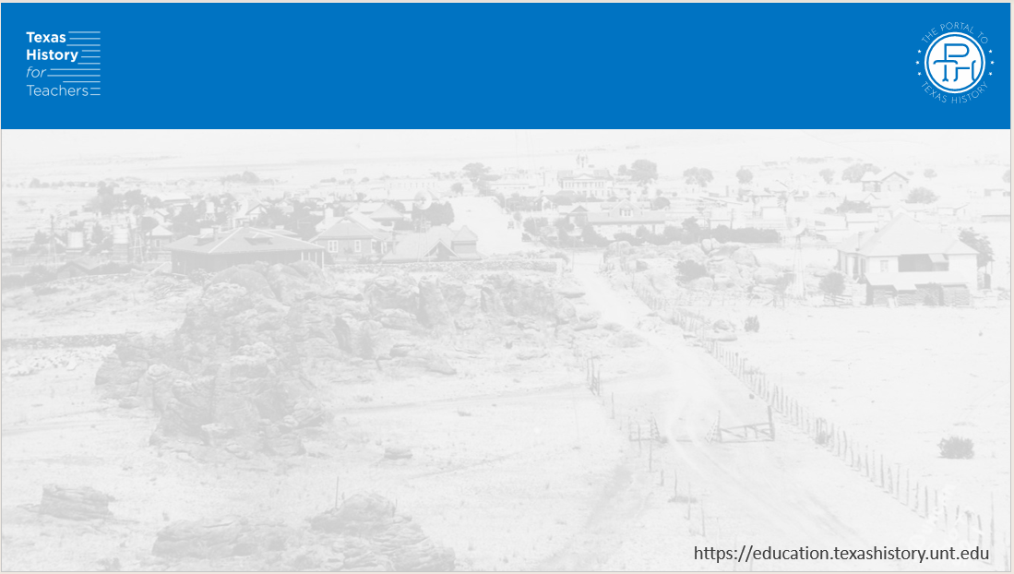
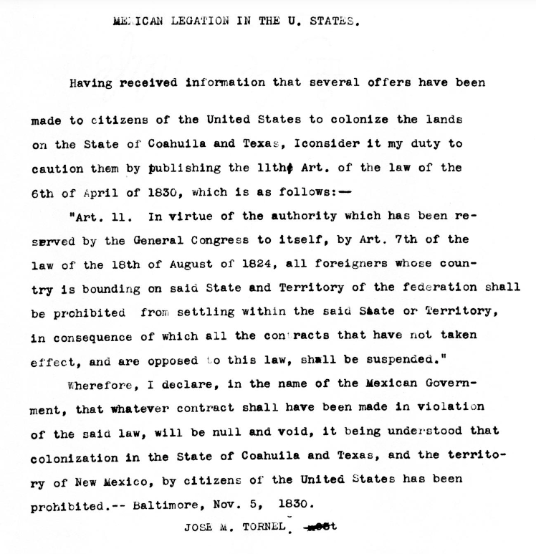
Document C
Excerpts of Article 11 of the Announcement of the Law of April 6, 1830
Published by the Mexican Congress, authored by Jose M. Tornel
November 5, 1830
The translated transcript of Article 11 from the Law of April 6, 1830.
The Portal to Texas History
Notes:
[Transcript of announcement concerning the Mexican law of April 6, 1830 made by José M. Tornel , November 5, 1830], text, November 5, 1830; (https://texashistory.unt.edu/ark:/67531/metapth216703/: accessed January 22, 2025), University of North Texas Libraries, The Portal to Texas History, https://texashistory.unt.edu; crediting The Dolph Briscoe Center for American History.

Slide 11
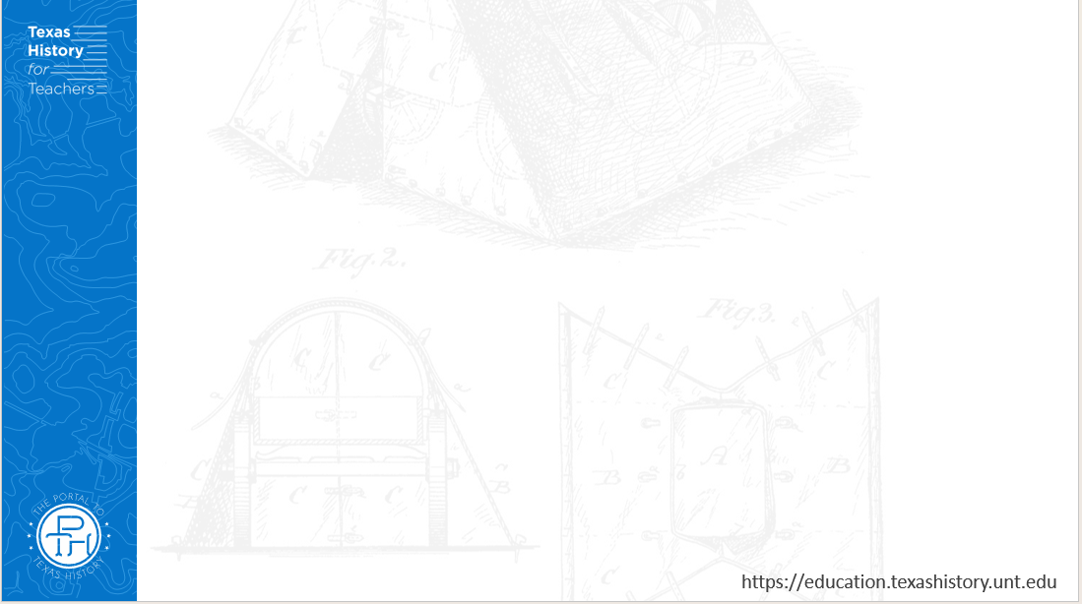
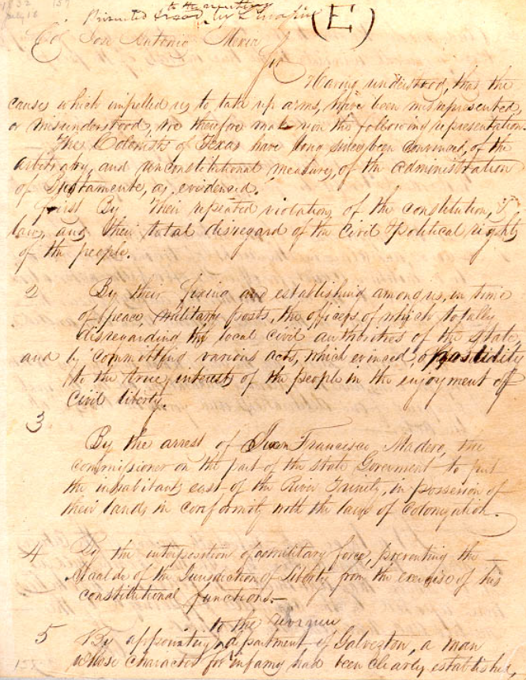
Document D
Excerpts from the Turtle Bayou Resolutions, written by the Anglo colonists who had taken part in the disturbances at Fort Anahuac.
Addressed to Mexican Colonel José Antonio Mexia, June 13, 1832.
The Turtle Bayou Resolutions
Texas State Library & Archives Commission
Notes:
Address to Colonel José Antonio Mexia, June 13, 1832. Mirabeau B. Lamar Papers #157, Archives and Information Services Division, Texas State Library and Archives Commission. https://www.tsl.texas.gov/treasures/republic/turtle/turtle-1.html

Slide 12
Document E
Excerpts from a newspaper article written by R. M. Williamson regarding Mexico’s response to the Anglo requests presented as a result of the Conventions of 1832 and 1833.
Published in The Texas Republican newspaper of Brazoria, Texas.
Saturday, July 5, 1834
The Texas Republican Newspaper
The Portal to Texas History
Notes:
The Texas Republican. (Brazoria, Tex.), Vol. 1, No. 1, Ed. 1, Saturday, July 5, 1834, newspaper, July 5, 1834; Brazoria, Texas. (https://texashistory.unt.edu/ark:/67531/metapth80246/: accessed January 21, 2025), University of North Texas Libraries, The Portal to Texas History, https://texashistory.unt.edu; crediting The Dolph Briscoe Center for American History.

Slide 13
Primary Source Extension Activity Exit Ticket

Slide 14
Exit Ticket: Follow the directions to complete your exit ticket
Choose ONE point of view from the options.
Finish the sentence stem answering how you think someone might answer from that point of view.
Share with a partner.

Slide 15
Share with the class 2
(Read the sentence stem and your response from your exit ticket)

