Slide 1
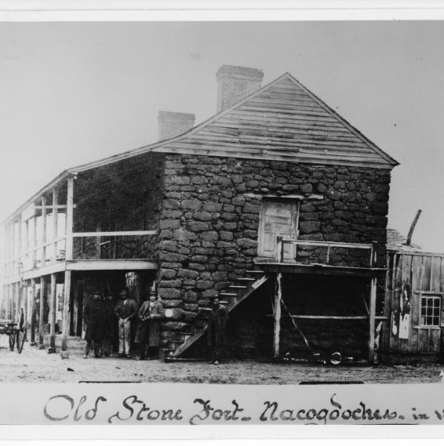
Unidad 4: La Era Nacional Mexicana
Lección 8:
Tensión creciente en Texas
Notes:
[Old Stone Fort at Nacogdoches], photograph, Date Unknown; (https://texashistory.unt.edu/ark:/67531/metapth38479/: accessed January 9, 2025), University of North Texas Libraries, The Portal to Texas History, https://texashistory.unt.edu; crediting University of Texas at Arlington Library.

Slide 2
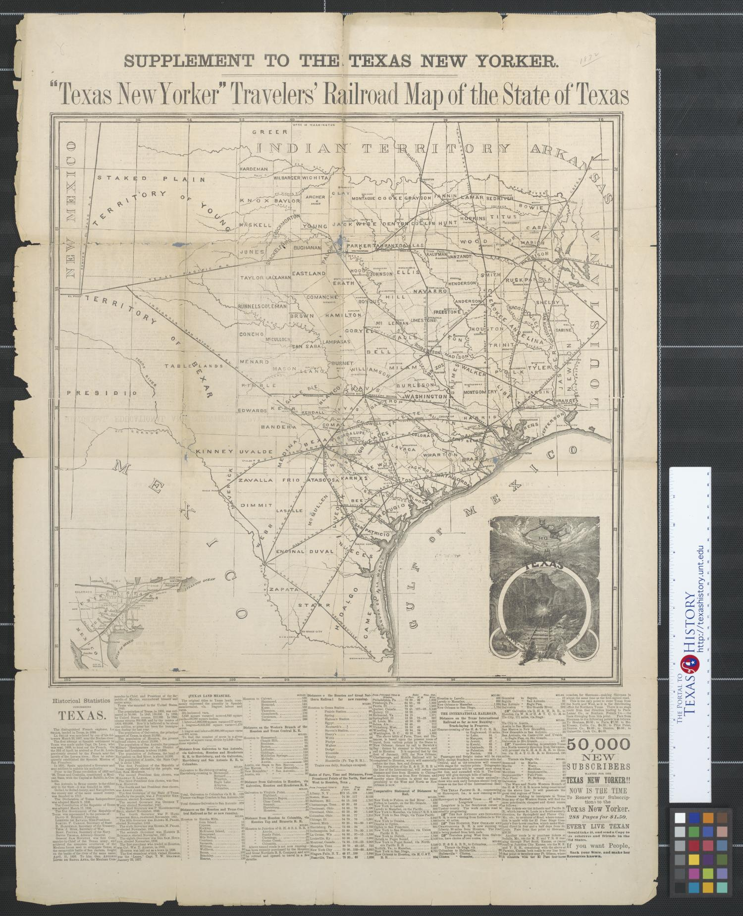




Calentamiento Sigue las instrucciones de abajo para completar tu calentamiento
Lee los cuatro eventos que PODRÍAMOS ver hoy en clase.
Elige dos que creas que realmente ocurrieron y dos que crees que no ocurrieron.
Comparte tus respuestas con un socio
https://education.texashistory.unt.edu

Slide 3
Comparte con la clase: 1
Un evento que creo que ocurrió es que __(leer un evento) ___
Un evento que creo que no ocurrió es que __(leer un evento) ___
https://education.texashistory.unt.edu

Slide 4
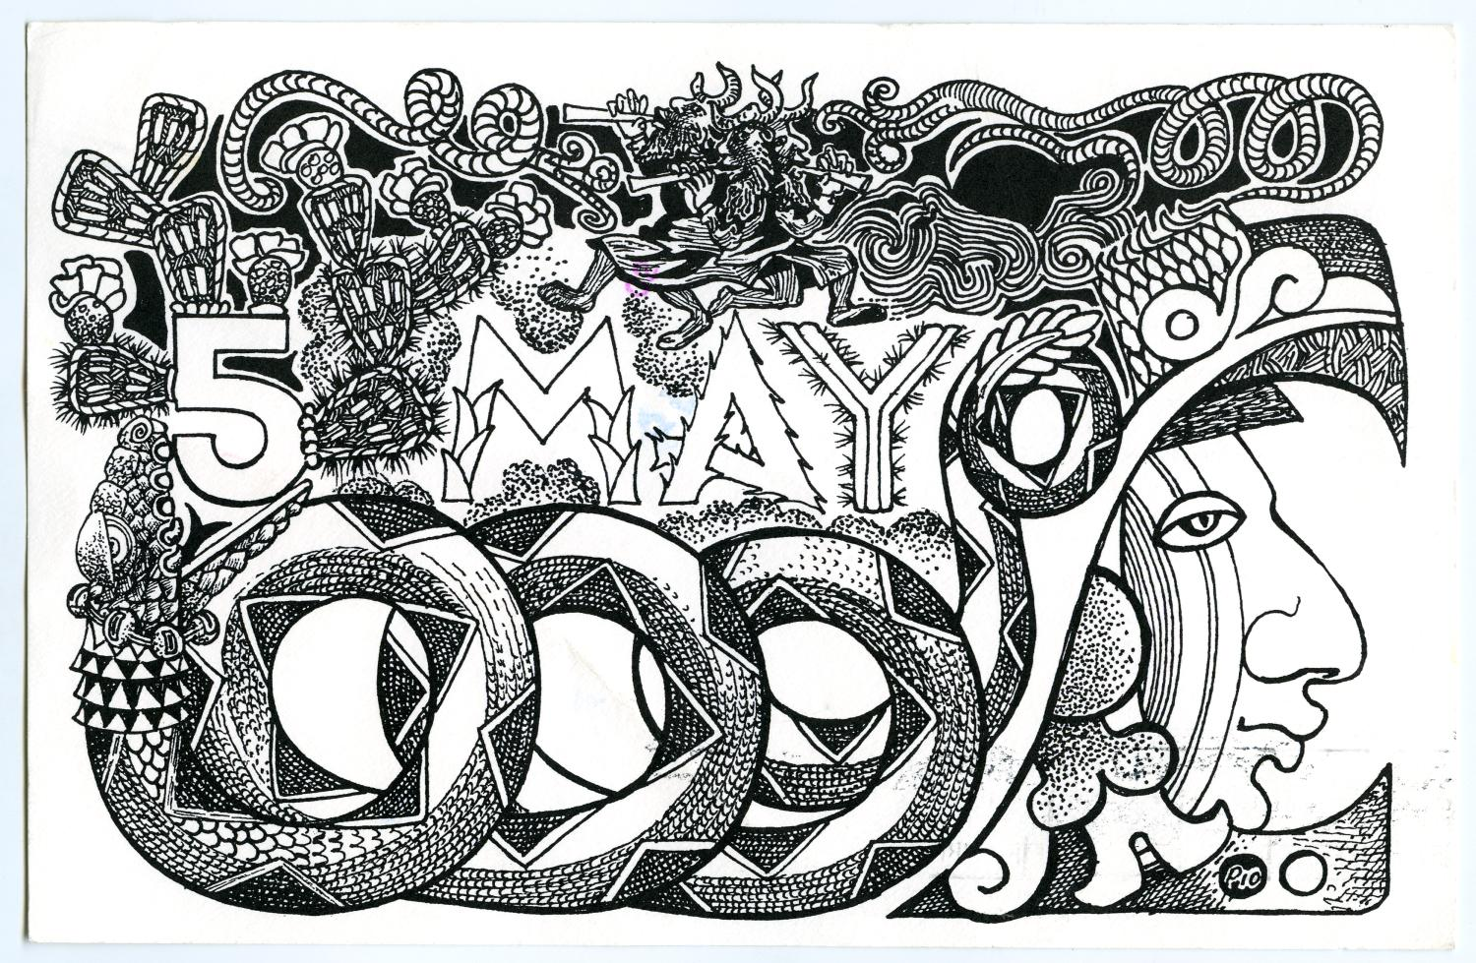
Preguntas esenciales
Cuáles fueron los seis acontecimientos significativos durante esta época que llevaron a un aumento de problemas y tensiones en Texas y en todo México? Cuál es la relación de causa y efecto entre cada evento?
https://education.texashistory.unt.edu

Slide 5
En la lección de hoy
Analizaremos seis eventos significativos que provocaron un aumento de la tensión en Texas y México.
Registraré información clave sobre cada evento, incluyendo su importancia para la época. Seré capaz de demostrar la relación de causa y efecto entre cada evento.
https://education.texashistory.unt.edu

Slide 6
Introducción
La Rebelión Fredoniana de 1826 preocupó a los líderes en Ciudad de México y generó nuevas tensiones entre la gente de Texas y el gobierno nacional de México.
Al mismo tiempo, crecían los desacuerdos políticos entre federalistas y centralistas en México. Muchos en todo el país estaban profundamente insatisfechos con el gobierno en Ciudad de México.
Los anglosajones y tejanos en Texas aún no lo sabían, pero la creciente tensión en el estado y el país les estaba acercando cada vez más a la guerra. . .
https://education.texashistory.unt.edu

Slide 7
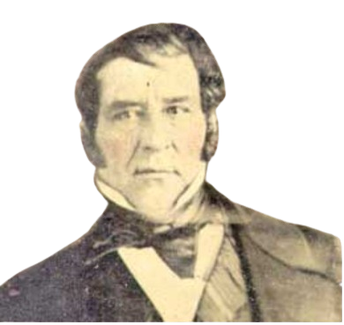
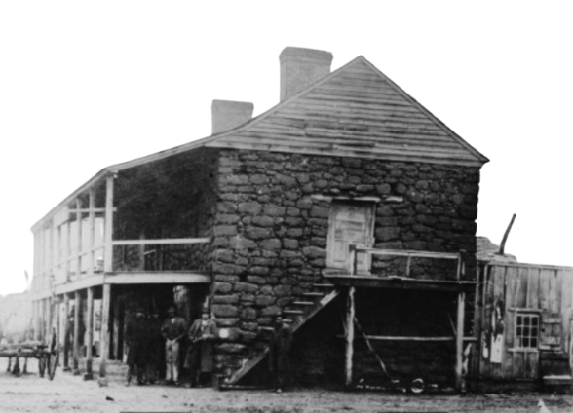
La rebelión fredoniana, 1826
Esperamos recordar esto de nuestra última tarea, pero por si acaso, aquí va un repaso rápido:
Un empresario angloamericano llamado Haden Edwards tomó un fuerte cerca de Nacogdoches, alegando que la tierra era independiente de México. Dijo que renombró la tierra como "La República de Fredonia.”
El ejército mexicano puso fin rápidamente a la rebelión con la ayuda de Stephen F. Austin y la milicia de Austin. Edwards y sus hombres huyeron de Texas. Este evento pasó a conocerse como la Rebelión Fredoniana.
Aunque la rebelión fue completamente infructuosa, preocupó gravemente al gobierno mexicano. Muchos en el gobierno estaban ansiosos por saber si otros empresarios angloamericanos compartían el deseo de Edwards de rebelarse contra México.
Haden Edwards
"El viejo fuerte de piedra" El portal a la historia de Texas
https://education.texashistory.unt.edu
Notes:
Portrait of Haden Edwards. Background removed. https://commons.wikimedia.org/wiki/File:Haden_Edwards.jpg
[Old Stone Fort at Nacogdoches], photograph, Date Unknown; (https://texashistory.unt.edu/ark:/67531/metapth38479/: accessed January 9, 2025), University of North Texas Libraries, The Portal to Texas History, https://texashistory.unt.edu; crediting University of Texas at Arlington Library.

Slide 8
La rebelión fredoniana Notas
Qué: Una pequeña rebelión anglosajona fallida contra el gobierno mexicano.
Quién: Un empresario angloamericano llamado Haden Edwards lideró la rebelión. Stephen F. Austin ayudó a detenerlo.
Dónde: Este de Texas – Nacogdoches
Por qué es significativo: México detuvo fácilmente la rebelión con la ayuda de Austin, pero esto provocó que el gobierno se preocupara por los anglosajones en Texas.
https://education.texashistory.unt.edu

Slide 9
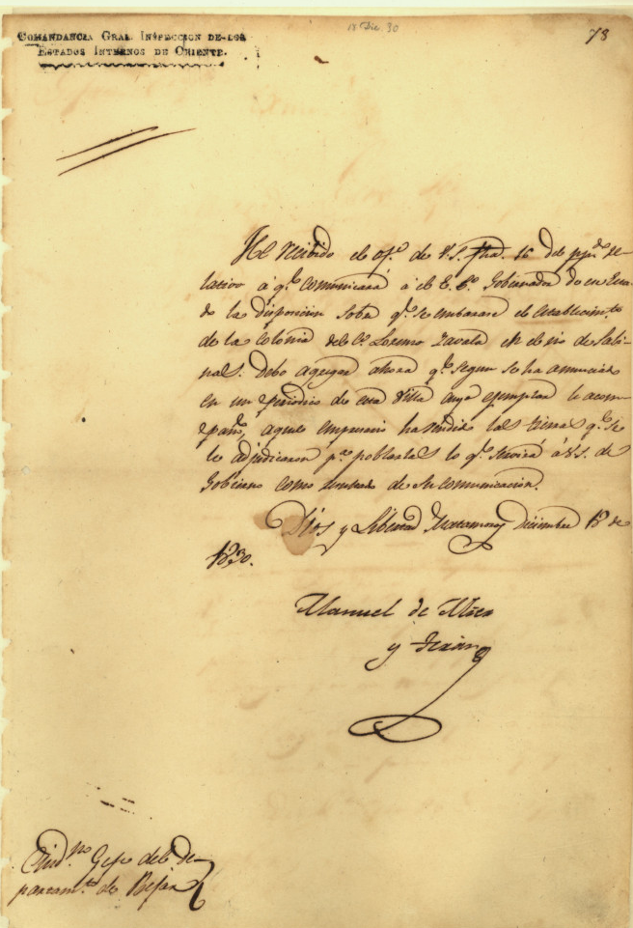
The Mier y Terán Report, 1828
La Rebelión Fredoniana inquietó tanto al gobierno mexicano que los líderes decidieron enviar a un general mexicano llamado Manuel de Mier y Terán para investigar la situación en Texas. Lo que Mier y Terán descubrió en su investigación preocupó aún más a México.
Mier y Terán señaló que ciertamente había muchos anglosajones honestos y respetuosos de la ley en Texas. Sin embargo, también hubo muchos problemas. Escribió que los anglosajones superaban en número a los tejanos por diez a uno. Afirmó que los gobiernos locales eran débiles, con muy pocos líderes del gobierno tejano para hacer cumplir las leyes. Los anglosajones que querían infringir las leyes podían hacerlo fácilmente, y algunos lo hicieron. Un ejemplo de esto fue el hecho de que muchos anglosajones continuaron trayendo a personas esclavizadas al estado aunque ahora era ilegal hacerlo.
Los descubrimientos de Terán le inquietaron mucho. Le dijo a México que había que hacer algo respecto a los colonos anglosajones, o que "Texas podría lanzar a toda la nación a la revolución”!
Una carta escrita por Manuel de Mier y Terán El portal a la historia de Texas
https://education.texashistory.unt.edu
Notes:
Mier y Terán, Manuel de. Manuel de Mier y Terán, Commandant General, to Ramón Músquiz, Political Chief of Dept. of Béxar], letter, December 18, 1830; (https://texashistory.unt.edu/ark:/67531/metapth5846/: accessed January 9, 2025), University of North Texas Libraries, The Portal to Texas History, https://texashistory.unt.edu; crediting Texas General Land Office.

Slide 10
El Informe Mier y Terán
Notas
Qué: Un informe que muestra que los anglosajones superaban en número a los tejanos en Texas en 10 a 1, y que había pocos funcionarios mexicanos, por lo que era fácil que la gente infringiera las leyes.
Quién: General Manuel Mier y Terán
Por qué es significativo: El informe de Terán mostró que existían muchos problemas relacionados con la inmigración anglosajona en Texas. Sugirió que México solucionara los problemas de inmediato.
https://education.texashistory.unt.edu

Slide 11
La Ley del 6 de abril de 1830
In response to the Mier y Terán report, Mexico decided to pass the Law of April 6, 1830, to attempt to gain more control over Anglo settlers in Texas. This law had many parts.
First, all immigration from the U.S. into Texas was now prohibited. Additionally, any currently unfulfilled empresario contracts would be cancelled. Next, Mexico enacted the taxes that had been postponed for six to ten years when the Empresario System began. This meant that there would now be tariffs, or taxes on goods from the U.S. The law also reinforced the fact that it was illegal to bring enslaved people into the state. Finally, it established military forts in Texas to ensure that this law and all other laws were followed.
The Law of April 6, 1830, angered many Anglos and Tejanos in Texas. Many feared that all these restrictions would harm the economic development of Texas. Stephen F. Austin himself wrote a letter to the Mexican president expressing his opposition to the Law of April 6, 1830. Like many others, he believed this law was harmful to Texas and its people.
https://education.texashistory.unt.edu

Slide 12
The Law of April 6, 1830 Notes
What: Laws that Mexico passed to try to fix the problems with the Empresario System in Texas:
Stopped all immigration from the U.S. into Texas
Cancelled unfulfilled empresario contracts
Enforced tariffs (taxes) on items from the U.S.
Established military forts in Texas to enforce the laws
Why is it Significant: Many Anglos and Tejanos were very upset with the laws, believing they would stop the growth and development of Texas and its economy.
https://education.texashistory.unt.edu

Slide 13
The Turtle Bayou Resolutions, 1832
A group of Anglo settlers met near present-day Houston at a place called Turtle Bayou in 1832. They wanted to discuss what to do about some growing tensions in the area. They focused specifically on a Mexican military fort that had been established nearby at a place called Anahuac two years earlier. Fort Anahuac was founded as part of the requirements of the Law of April 6, 1830. The military at Fort Anahuac was intended to enforce state and federal laws in Texas. From 1830 to 1832 there were a series of disagreements between some of the local Anglos and the soldiers at the fort, which resulted in a violent conflict in 1832.
The group of Anglos who met at Turtle Bayou in 1832 wrote a document to the Mexican government explaining their point of view about the conflict at Anahuac and outlining their goals and hopes moving forward. This document was called the Turtle Bayou Resolutions.
In the document, they stated that they were dissatisfied with the recent rise in Centralist power in the government. They claimed that was a major reason why they fought at Anahuac – because the leader of the fort was a Centralist. They stated their support for the Federalist Constitution of 1824 and for the popular Federalist leader, Antonio López de Santa Anna, who was fighting against the Centralist take-over of the Mexican government. These men were clear, they supported federalism in Texas and Mexico!
https://education.texashistory.unt.edu

Slide 14
The Turtle Bayou Resolutions Notes
What: A document explaining the Anglo point of view of the conflict at Fort Anahuac and showing support for the Federalists in the Mexican government.
Where: Near present-day Houston
Why is it Significant: Some Anglos in Texas were openly declaring support for Federalists in the ongoing debates between Centralists and Federalists across the country.
https://education.texashistory.unt.edu

Slide 15
The Conventions of 1832 & 1833
In 1832 and 1833, more than 50 Anglo delegates from across Texas met at San Felipe de Austin to discuss important issues related to the recent tensions that had been increasing across Texas and Mexico.
Stephen F. Austin was elected president of the conventions. At the conventions, the delegates made a list of requests that they wanted to present to the Mexican government. First, they requested that the government repeal the anti-immigration portion of the Law of April 6, 1830. This would allow U.S. citizens to resume immigrating to Texas. They also requested that the tariff, or tax on materials from the U.S., be removed. They also requested support in defense against Texas Indian attacks and land for public schools.
One of the biggest requests they made was for Texas to become its own state, separate from Coahuila. They were very confident about receiving approval. They even created a committee led by an Anglo man named Sam Houston to write a state constitution. They planned to submit the constitution to the federal Congress in Mexico City when they received approval for statehood.
With their list of requests in hand, Stephen F. Austin set off for Mexico City in 1833 to present the Anglo requests to the Mexican government.
https://education.texashistory.unt.edu

Slide 16
The Conventions of 182 & 1833 Notes
What: Two meetings of Anglo delegates to write a list of requests for the Mexican government.
Repeal the anti-immigration laws from the Law of April 6, 1830
Remove the tariff on U.S. goods
Grant separate statehood for Texas
Who: President of Convention: Stephen F. Austin
Where: San Felipe de Austin (near Houston)
Why is it Significant: Anglos in Texas were organizing in support of development and statehood for Texas.
https://education.texashistory.unt.edu

Slide 17
The Arrest of Stephen F. Austin, 1833
When the Convention of 1833 ended, Stephen F. Austin traveled the nearly one thousand miles to Mexico City to present the list of Anglo requests to the newly elected Mexican president – Antonio López de Santa Anna. Austin and many other Anglos were incredibly optimistic about this meeting. After all, Santa Anna supported Federalism and had made his name as a man of the people!
Things did not go as planned, however. At the time, the Centralists in the government and within the military were gaining more and more power. Santa Anna surprised many of his supporters when he decided to join the side of the Centralists in 1833. Now in power, the Centralists got rid of the Federalist Constitution of 1824, which had guaranteed powers and rights to the people and states. Many Federalists across Mexico were furious and felt betrayed.
When Santa Anna met with Austin, Santa Anna refused to address the requests that the Anglos in Texas had made. Angry and frustrated with the situation, Austin wrote to the Anglo leadership in Texas and told them to go ahead and begin setting up their own state government anyway. His letter was intercepted by Mexican officials, who viewed his actions as treason, or a crime against your own country. They arrested him and held him in prison without a trial for about a year and a half. During that time, turmoil across Mexico increased as a civil war broke out between the Federalists and Centralists in some states.
https://education.texashistory.unt.edu

Slide 18
The Arrest of Stephen F. Austin Notes
What: Austin was arrested and imprisoned for encouraging Anglos in Texas to start making their own state after President Santa Anna had denied the request.
Who: Stephen F. Austin, President Santa Anna
Where: Arrested in Saltillo, Coahuila. Imprisoned in Mexico City for 1 ½ years.
Why is it Significant: Austin’s time in prison caused him to be less supportive of the Mexican government.
https://education.texashistory.unt.edu

Slide 19
Exit Ticket Follow the directions below to complete your Exit Ticket
Read the four events we MIGHT see in class today.
Choose two that you think actually happened, and two that you think didn’t happen.
Share your responses with a partner
https://education.texashistory.unt.edu

Slide 20
Share with the class: 21
The event I chose in step 1 was _________________
The cause of this event was ______________
The effect of this event was ______________
https://education.texashistory.unt.edu

