Slide 1
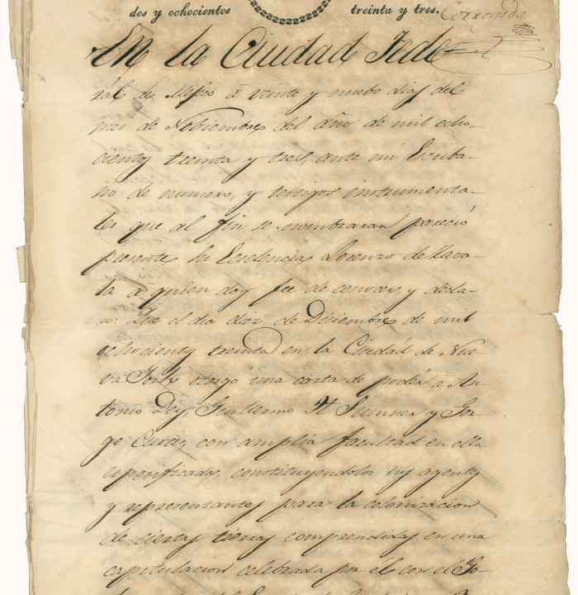
Unit 4 :
The Mexican National Era
Lesson 2:
How do we know what we know?
Notes:
Pena, Ignacio. [Official document regarding Zavala and colonization in Coahuila y Tejas, November 29, 1833], letter, September 29, 1833; (https://texashistory.unt.edu/ark:/67531/metapth5913/: accessed December 3, 2024), University of North Texas Libraries, The Portal to Texas History, https://texashistory.unt.edu; crediting The Dolph Briscoe Center for American History.

Slide 2





Warm-up
Follow the directions to complete your warm-up
Consider how people get information today, compared to in the past.
Complete the chart to the best of your knowledge.
Discuss with a partner
https://education.texashistory.unt.edu

Slide 3
Share with the class
When important things happen today, I tell people by _____
When important things happened in the 1800s , I would probably tell people by ________
https://education.texashistory.unt.edu

Slide 4
Share with the class 2
When important things happen in the world today, I find out by ______
When important things happened in the world in the 1800s, I would probably find out by ___________
https://education.texashistory.unt.edu

Slide 5
Essential Questions
What types of primary source materials do we use to study the events of the Mexican National Era? What information can we learn from these sources, and what biases might exist in them?
https://education.texashistory.unt.edu

Slide 6
In today’s lesson…
We will examine three primary source excerpts discussing key events in Texas history during the Mexican National Era.
I will analyze each source for facts, opinions, biases, and key information about the era, and answer comprehension questions for each.
https://education.texashistory.unt.edu

Slide 7
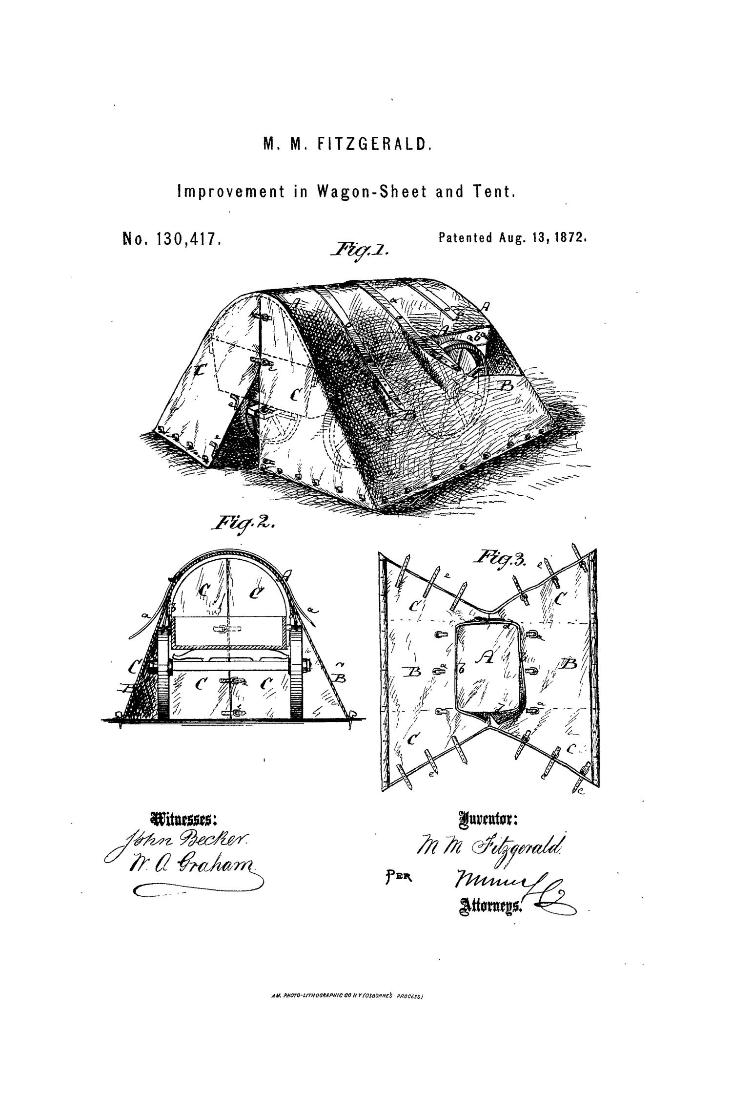
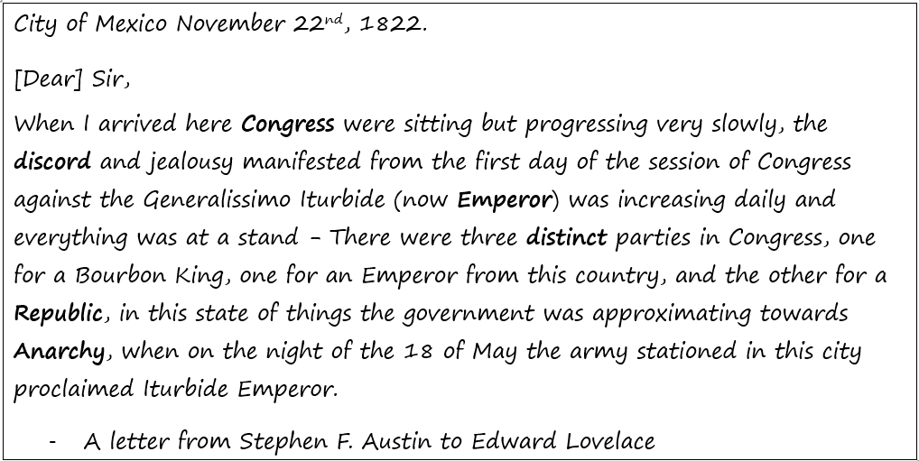
Part I: Challenges in Mexico
https://education.texashistory.unt.edu
Notes:
“Stephen F. Austin to Edward Lovelace, 11-22-1822.” Digital Austin Papers. Accessed October 5, 2021. https://digitalaustinpapers.org/document?id=APB0546.

Slide 8
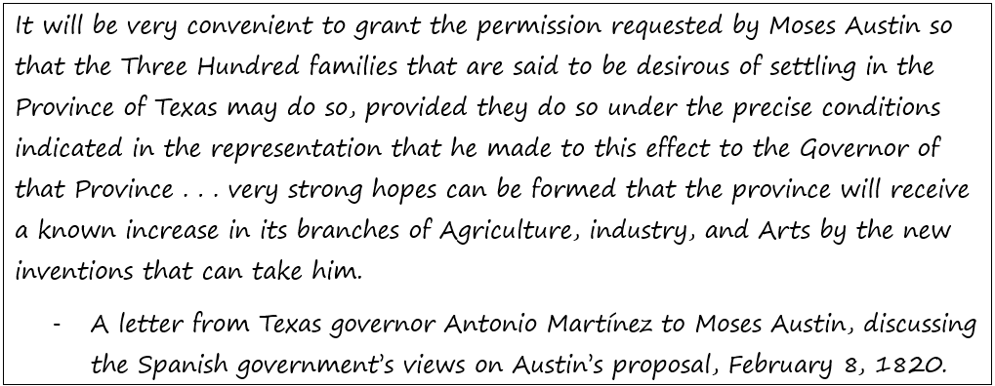
Part II: Challenges in Texas
Primary Source #1
https://education.texashistory.unt.edu

Slide 9
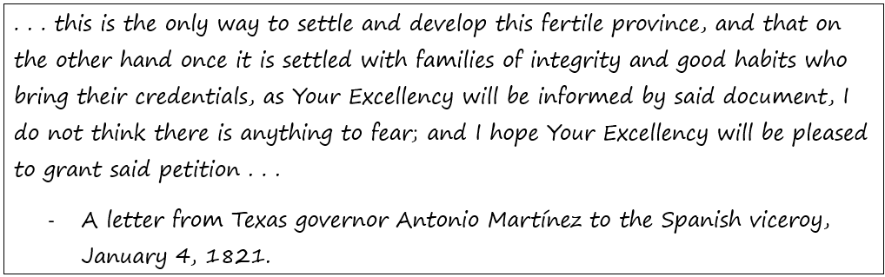
Part II: Challenges in Texas
Primary Source #2
https://education.texashistory.unt.edu

Slide 10

Exit Ticket
Follow the directions to complete your exit ticket.
Think of another type of source that could be used to study this era.
Complete the chart to the best of your knowledge.
Discuss with a partner
https://education.texashistory.unt.edu

Slide 11
Share with the class 3
Another type of primary source that could be used to study this era is ____
Some information we could learn from this type of source is ___________
A benefit of this type of source is ________, while a drawback is __________
https://education.texashistory.unt.edu

