Slide 1
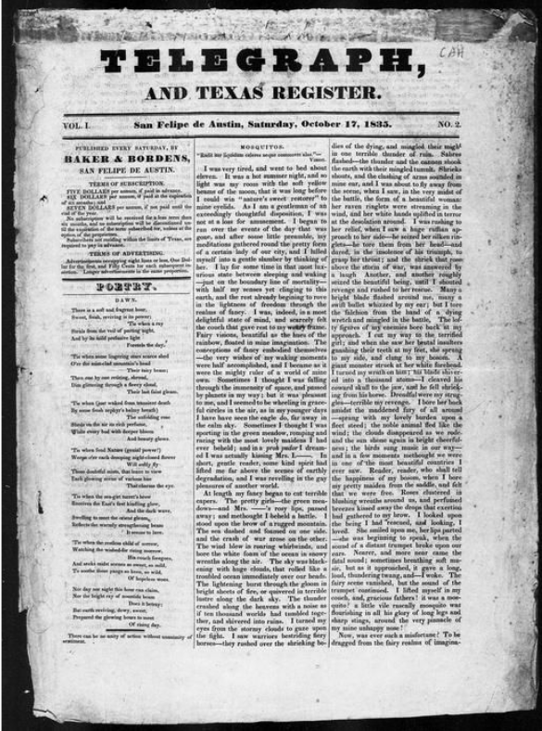
Unit 4:
The Mexican National Era
Lesson 12:
Looking Ahead
Notes:
Baker & Bordens. Telegraph and Texas Register (San Felipe de Austin [i.e. San Felipe], Tex.), Vol. 1, No. 2, Ed. 1, Saturday, October 17, 1835, newspaper, October 17, 1835; San Felipe de Austin, Texas. (https://texashistory.unt.edu/ark:/67531/metapth47875/: accessed February 5, 2025), University of North Texas Libraries, The Portal to Texas History, https://texashistory.unt.edu; crediting The Dolph Briscoe Center for American History.

Slide 2

Lesson Title
Warm-up

Slide 3





Warm-up:
Follow the directions to complete your warm-up
Observe the image on your warm-up.
Respond to the questions by making inferences and predictions based on the image.
Share your responses with a partner.

Slide 4

Share with the class
I think this image relates to our unit because ______
Based on this image, one thing I think might happen in the next unit is ________

Slide 5

Essential Question
What event took place in Gonzales, Texas, in October of 1835, and how do you predict it might be significant to Texas history?

Slide 6
In today’s lesson…
We will examine the cause, events, and significance of the Battle of Gonzales to Texas history.
I will read excerpts from a primary source document to understand one point of view of the Battle of Gonzales and make a prediction about what the consequences of the battle might be.

Slide 7
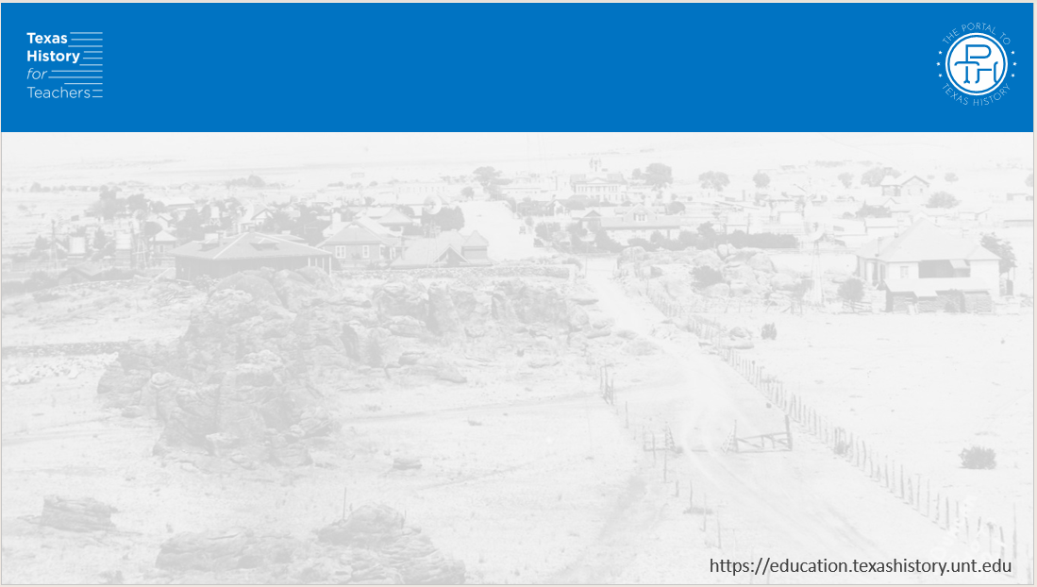
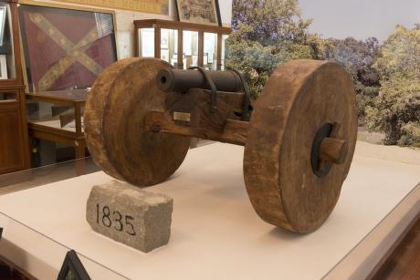
On the Road to Conflict
The cannon that the Mexican government lent to the people of Gonzales
Library of Congress
Notes:
Highsmith, Carol M, photographer. The "Come and Take It" Cannon, housed at the Gonzales Memorial Museum in Gonzales, Texas. Texas Gonzales United States, 2014. -04-23. Photograph. https://www.loc.gov/item/2014633597/.

Slide 8
Shots Fired!
The Battle of Gonzales
A reproduction of the flag created and flown by residents of Gonzales when the Mexican troops arrived to retrieve the cannon
Notes:
A reproduction of the “Come and Take It” flag from the Battle of Gonzales. https://commons.wikimedia.org/wiki/File:Come_and_take_it_Texas_flag.png

Slide 9
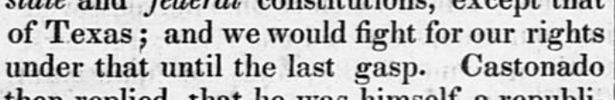
The Telegraph and Texas Register
Excerpts
The Telegraph and Texas Register
Volume 1, Number 2, Edition 1, Saturday, October 17, 1835
Article by David B. Macomb on the Battle of Gonzales
The Portal to Texas History
Notes:
Baker & Bordens. Telegraph and Texas Register (San Felipe de Austin [i.e. San Felipe], Tex.), Vol. 1, No. 2, Ed. 1, Saturday, October 17, 1835, newspaper, October 17, 1835; San Felipe de Austin, Texas. (https://texashistory.unt.edu/ark:/67531/metapth47875/: accessed February 5, 2025), University of North Texas Libraries, The Portal to Texas History, https://texashistory.unt.edu; crediting The Dolph Briscoe Center for American History.

Slide 10


Exit Ticket:
Follow the directions to complete your warm-up
Consider everything we have learned so far about the growing unrest in Mexico.
Make a prediction about what you think will happen next.
Share your responses with a partner.

Slide 11
Share with the class 2
After the Battle of Gonzales, I predict ______________ because ______________

