Slide 1

Mind Map
Sub-topic
1
Additional information
Sub-topic
2
Main Topic
Additional information
Sub-topic
3
Additional information
Additional information
https://education.texashistory.unt.edu

Slide 2

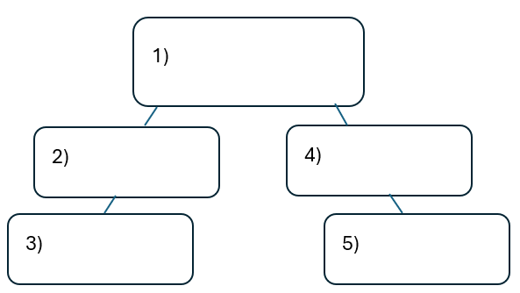


Warm-up:
Follow the directions on your warm-up
Use the word bank provided to fill in the small mind map on your warm-up.
Place each term where you think it fits best in your mind map.
Discuss with a partner.
https://education.texashistory.unt.edu

Slide 3
Share with the class
I think the primary topic in box number one is _______
I think the subtopic in box number two is ____, and box number three is ____
I think the subtopic in box number four is ____, and box number five is ____
https://education.texashistory.unt.edu

Slide 4
Essential Question
How do the key terms and concepts from Unit 4: The Mexican National Era connect to each other?
https://education.texashistory.unt.edu

Slide 5
In today’s lesson…
We will make connections between key terms and concepts within all of Unit 4: The Mexican National Era
I will create a Mind Map using terms and concepts from the class slides presentation.
https://education.texashistory.unt.edu

Slide 6
Topic & Subtopics
ONE of these items is the primary unit topic. The other two are subtopics. Choose the primary unit topic and write it in the middle of your paper. Write the other two around the main topic. Leave plenty of space.
Empresario System
Political Unrest
The Mexican National Era
https://education.texashistory.unt.edu

Slide 7
Add to your mind map
Place each item below where it fits on your mind map. Keep in mind, you can write some items in more than one place.
Goals
Causes
People
Events
https://education.texashistory.unt.edu

Slide 8
Make Connections 1
Connect each item below to one of the topics on your Mind Map.
There may be more than one place that these items connect. Be ready to explain where you put each one.
Federal Constitution of 1824
Colonization Laws & Requirements
Mexican Independence, 1821
Moses Austin
Populate Texas
Stephen F. Austin
https://education.texashistory.unt.edu

Slide 9
Make Connections 2
Connect each item below to one of the topics on your Mind Map.
There may be more than one place that these items connect. Be ready to explain where you put each one.
Speak Spanish
“The Old 300”
Texas joined with Coahuila
Improve the economy
Be Catholic
Erasmo Seguín
https://education.texashistory.unt.edu

Slide 10
Make Connections 3
Connect each item below to one of the topics on your Mind Map.
There may be more than one place that these items connect. Be ready to explain where you put each one.
States & Federal gov. share power
Grow plantation agriculture
Haden Edwards
Good moral character
Green DeWitt
Limits on slavery in TX
https://education.texashistory.unt.edu

Slide 11
Make Connections 4
Connect each item below to one of the topics on your Mind Map.
There may be more than one place that these items connect. Be ready to explain where you put each one.
Antonio López de Santa Anna
Advocate for Anglo colonization
“Father of TX”
President of Mexico
Grants rights to citizens
Martín de León
https://education.texashistory.unt.edu

Slide 12
Make Connections 5
Connect each item below to one of the topics on your Mind Map.
There may be more than one place that these items connect. Be ready to explain where you put each one.
Founded Gonzales
Founded San Felipe de Austin
Founded Victoria
Led Fredonian Rebellion
Federalists
Centralists
https://education.texashistory.unt.edu

Slide 13
Make Connections 6
Connect each item below to one of the topics on your Mind Map.
There may be more than one place that these items connect. Be ready to explain where you put each one.
Overthrew Federalist Gov.
Mier y Terán Report
Receive cannon for protection
Slavery prohibited in TX
Anglos outnumber Tejanos
Law of April 6, 1830
https://education.texashistory.unt.edu

Slide 14
Make Connections 7
Connect each item below to one of the topics on your Mind Map.
There may be more than one place that these items connect. Be ready to explain where you put each one.
Anglos breaking Texas laws
Civil War
Prohibit Anglo immigration
Federalist vs. Centralist
1824 constitution abolished
Conventions of 1832 & 1833
https://education.texashistory.unt.edu

Slide 15
Make Connections 7
Connect each item below to one of the topics on your Mind Map.
There may be more than one place that these items connect. Be ready to explain where you put each one.
Conflict at Fort Anahuac
Request separate statehood
Turtle Bayou Resolutions
“Come and Take it”
Support Federalists
Battle between Anglos and Mexican military
https://education.texashistory.unt.edu

Slide 16

Create Connections 6
Now take a few minutes to add any information you can think of to your Mind Map.
You can add facts, descriptions, explanations, cultural information, or anything else you can think of.
https://education.texashistory.unt.edu

Slide 17
Exit Ticket
Complete the sentence summarizing the main idea from our unit.
Discuss with a partner.
https://education.texashistory.unt.edu

Slide 18
Share your response
The ___________ is primarily characterized by __________
https://education.texashistory.unt.edu

