Slide 1
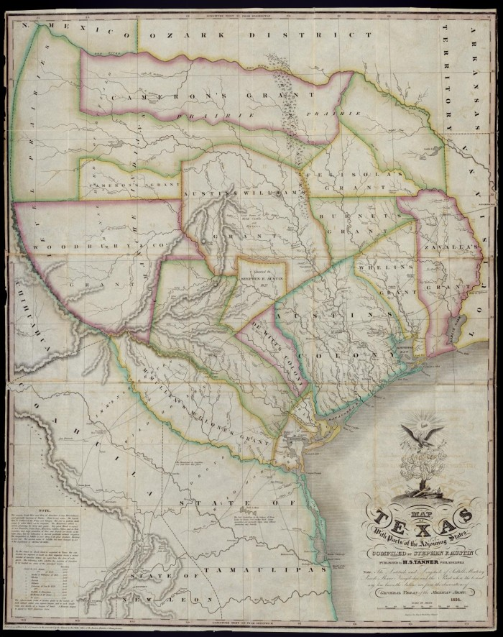
Unit 4: The Mexican National Era
Lesson 13:
Study Guide
Notes:
"Map of Texas with parts of the Adjoining States. Compiled by Stephen F. Austin.", map, Date Unknown; (https://texashistory.unt.edu/ark:/67531/metapth31277/: accessed November 27, 2024), University of North Texas Libraries, The Portal to Texas History, https://texashistory.unt.edu; crediting Star of the Republic Museum.

Slide 2
Warm-up Follow the directions to complete your warm-up
Read the list of social studies topics in the chart.
Circle or highlight any items that you think are likely to be on the unit 3 test.
Share with a partner.

Slide 3
Share with the class
One thing that I think is likely to be on the unit 4 test about the Mexican National Era is ______________________

Slide 4
Essential Question
What significant information do we need to know to be successful on the unit 4 test for the Mexican National Era?

Slide 5
In today’s lesson…
We will identify and review significant information for our upcoming test.
I will use my previous work and notes to complete my study guide. I will identify and match cause and effect relationships, create short answer responses, and answer practice test questions.

Slide 6
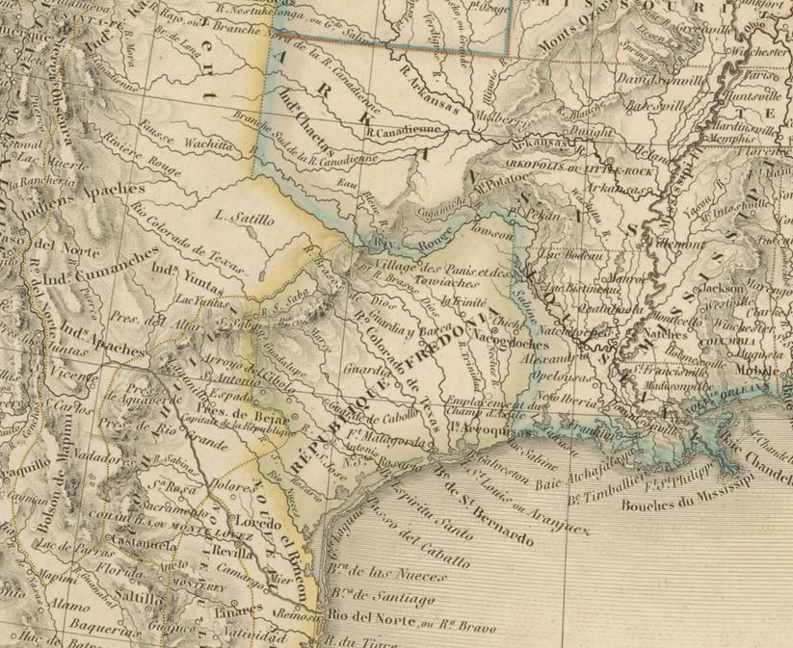
Part I: Key Terms & Definitions
Choose the correct key term from the unit that matches with the definition or explanation in the box on the right side of your chart.
A map of Texas showing the “Republic of Fredonia”
The Portal to Texas History
Notes:
Dufour, A. H. Amérique Du Nord. 1830. University of North Texas Libraries, The Portal to Texas History; crediting University of Texas at Arlington Library. https://texashistory.unt.edu/ark:/67531/metapth298341/.

Slide 7
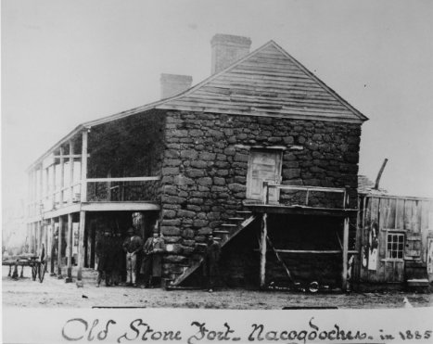
Part II: Matching
Match the event on the left side of your paper with its correct effect on the right.
The “Old Stone Fort” occupied by Haden Edwards during his failed Fredonian Rebellion.
The Portal to Texas History.
Notes:
[Old Stone Fort at Nacogdoches]. Photograph. University of North Texas Libraries, The Portal to Texas History; crediting University of Texas at Arlington Library. https://texashistory.unt.edu/ark:/67531/metapth38479/.

Slide 8
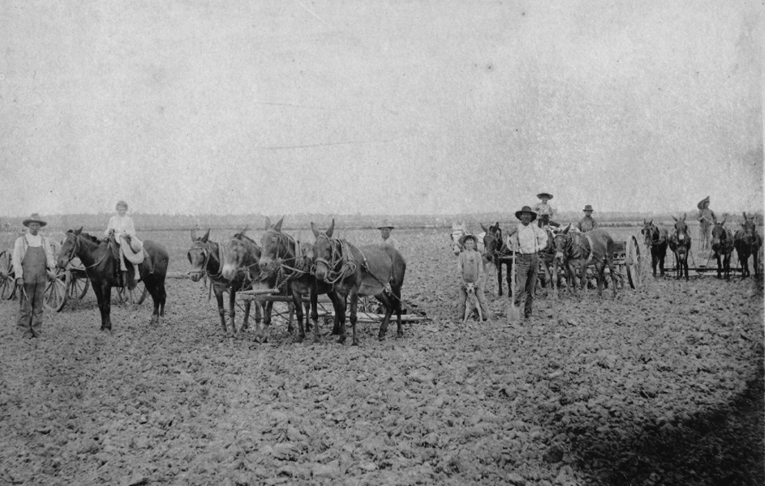
Part III: Practice Test Questions
The practice test questions are based on the various types of questions on the 8th grade social studies STAAR.
A photograph of a farm scene from the late 1800s, Texas
The Portal to Texas History
Notes:
[Farm scene]. Photograph. University of North Texas Libraries, The Portal to Texas History; crediting Heritage House Museum. https://texashistory.unt.edu/ark:/67531/metapth36838/.

Slide 9
Exit Ticket Follow the directions to complete your exit ticket
Read the list of social studies topics in the chart.
Circle or highlight any items that you think are likely to be on the unit 3 test.
Share with a partner.

Slide 10
Share with the class 2
One thing the study guide helped me remember or understand is ________
One question I still have is _______
One thing I will do to prepare for this test is ____

