Slide 1
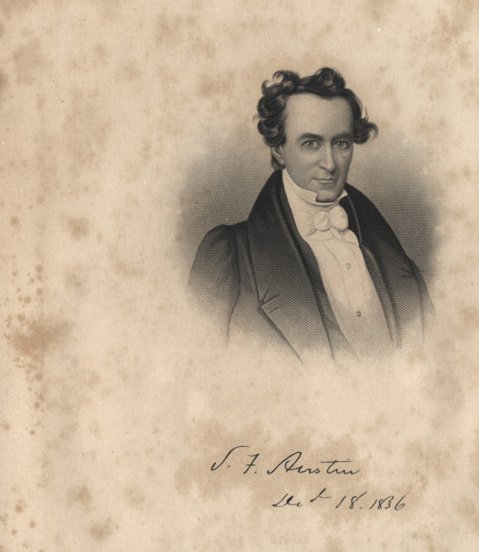
Unit 4:
The Mexican National Era
Lesson 7:
Significant Empresarios
Notes:
[Engraving of Stephen F. Austin], artwork, December 16, 1836; (https://texashistory.unt.edu/ark:/67531/metapth11276/: accessed January 7, 2025), University of North Texas Libraries, The Portal to Texas History, https://texashistory.unt.edu; crediting Palestine Public Library.

Slide 2






Warm-up
https://education.texashistory.unt.edu

Slide 3

Warm-up:
Follow the directions to complete your warm-up
Read the scenario presented.
Write how you think you would respond if you were Stephen F. Austin.
Share with a partner.
https://education.texashistory.unt.edu

Slide 4
Share with the class
My men and I
support the rebellion /
oppose the rebellion
because ___________
https://education.texashistory.unt.edu

Slide 5
Essential Questions
Who were the most significant empresarios who helped settle and develop Texas during the Mexican National Era?
How and why were they significant?
https://education.texashistory.unt.edu

Slide 6
In today’s lesson…
We will review the prominent people who helped establish the Empresario System in Texas and learn about three more significant empresarios.
I will answer comprehension and analysis questions based on a reading passage about the three significant empresarios.
https://education.texashistory.unt.edu

Slide 7
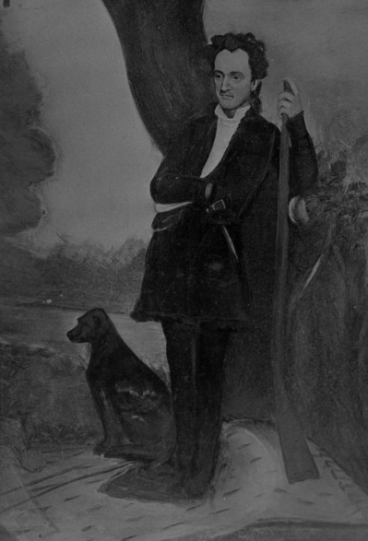
Part I: The First Empresarios
Read the passage on your worksheet then answer the question that follows:
Stephen F. Austin is considered by many in American history to be the “Father of Texas.”
Why do you think some people have given him this nickname? Do you think it is accurate to call Austin “the Father of Texas?”
Why or why not?
Stephen F. Austin
https://education.texashistory.unt.edu
Notes:
Portrait of Stephen F. Austin, photograph, Date Unknown; (https://texashistory.unt.edu/ark:/67531/metapth55631/: accessed January 13, 2025), University of North Texas Libraries, The Portal to Texas History, https://texashistory.unt.edu; crediting Hardin-Simmons University Library.

Slide 8
Share with the class 2
I think some people may consider Stephen F. Austin “the Father of Texas” because _____
I think the nickname is / is not / is partially accurate because ______________
https://education.texashistory.unt.edu

Slide 9
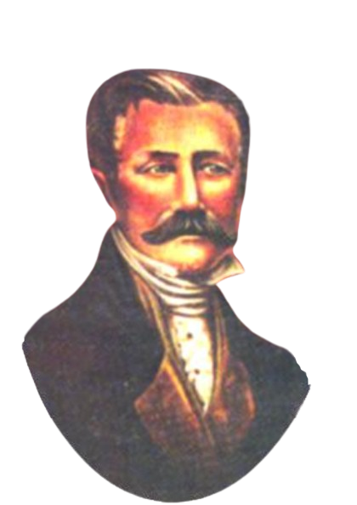
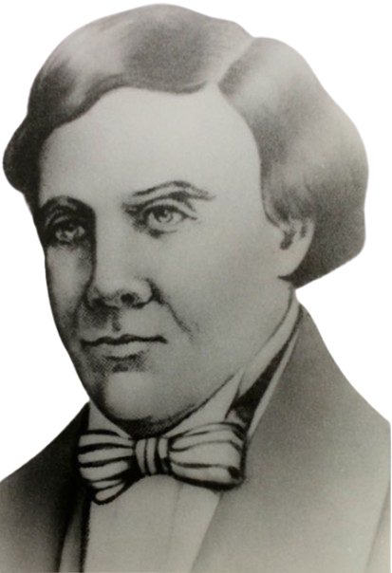
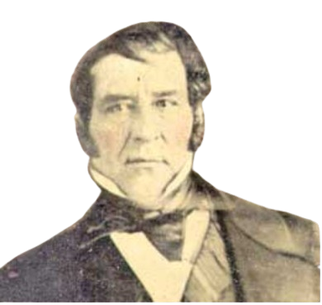
Part II: Other Significant Empresarios
Green Dewitt
Haden Edwards
Martin De León
https://education.texashistory.unt.edu
Notes:
Green Dewitt portrait. Circa 1820. This media file is in the public domain in the United States. This applies to U.S. works where the copyright has expired, often because its first publication occurred prior to January 1, 1929, and if not then due to lack of notice or renewal. See this page for further explanation. https://commons.wikimedia.org/wiki/File:Green_dewitt.jpg
Martin De Leon Portrait. Circa 1820. This media file is in the public domain in the United States. This applies to U.S. works where the copyright has expired, often because its first publication occurred prior to January 1, 1929, and if not then due to lack of notice or renewal. See this page for further explanation. https://commons.wikimedia.org/wiki/File:Martin_De_Leon.jpg
Haden Edwards Portrait. Circa 1820. This media file is in the public domain in the United States. This applies to U.S. works where the copyright has expired, often because its first publication occurred prior to January 1, 1930, and if not then due to lack of notice or renewal. See this page for further explanation. https://commons.wikimedia.org/wiki/File:Haden_Edwards.jpg

Slide 10
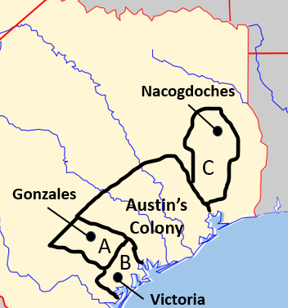
Part III: Review and Comprehension Questions
Answer the questions based on the reading.
A larger view of the map for question 1 is presented here.
https://education.texashistory.unt.edu
Notes:
Blank map of Texas, cropped to highlight the region of Texas in the 1820s and edited to include the locations of land grants for several empresarios. Permission is granted to copy, distribute and/or modify this document under the terms of the GNU Free Documentation License, Version 1.2 or any later version published by the Free Software Foundation; with no Invariant Sections, no Front-Cover Texts, and no Back-Cover Texts. A copy of the license is included in the section entitled GNU Free Documentation License. https://commons.wikimedia.org/wiki/File:Texas_blank_map.svg

Slide 11
Exit Ticket
https://education.texashistory.unt.edu

Slide 12
Exit Ticket:
Follow the directions to complete your exit ticket
Read the three FALSE statements in the boxes.
In the space provided, rewrite each sentence to make it correct.
Share with a partner.
https://education.texashistory.unt.edu

Slide 13
Share with the class 3
I rewrote the
first / second / third sentence to say ___________
https://education.texashistory.unt.edu

