Slide 1
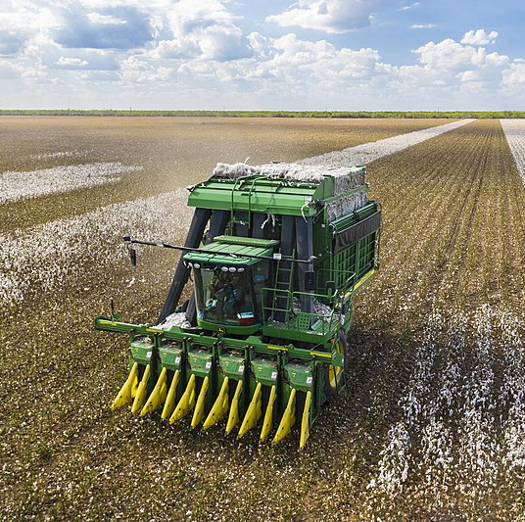
Unit 4: The Mexican National Era
Lesson 11:
Texas Today
Cotton Harvester
Batesville, TX
Notes:
Aerial view of a cotton picking harvester, during the Ernie Schirmer Farms cotton harvest which has family, fellow farmers, and workers banding together for the long days of work, in Batesville, TX, on August 23, 2020. Photos taken during visit by United States Department of Agriculture (USDA). USDA Photo and Media by Lance Cheung. U.S. Department of Agriculture. https://commons.wikimedia.org/wiki/File:Cotton_harvester_in_Batesville,_Texas_field_-_angle_view.jpg

Slide 2
Warm-up Follow the directions below to complete your warm-up
Use the pie chart to answer the questions on your warm-up
Record your answers in the space provided.
Discuss with a partner

Slide 3
Share with the class:
This chart shows us _____
One thing I observe about the information in this chart is _____
One question I have about this chart is _______

Slide 4
Essential Question
In what ways can we see the effects of the Empresario System on the Texas economy today?

Slide 5
In Today’s Lesson
We will examine five charts and graphs on the modern Texas economy and climate related to the significance of cotton cultivation in the state.
I will make observations, conclusions, and inferences about information in each chart or graph and record my responses on my work.

Slide 6
Texas Today Stations Activity

Slide 7
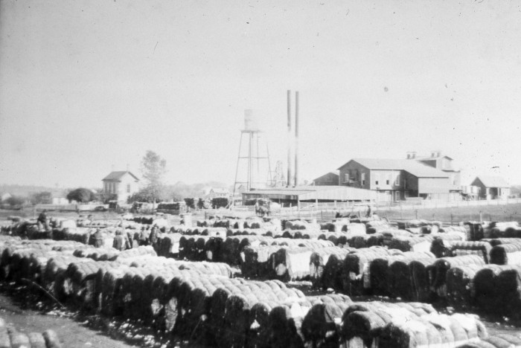
Cotton & the Lone Star State
Selz Cotton Gin, Pilot Point, Texas
The Portal to Texas History
Notes:
[Many round bales of cotton at Selz Cotton Gin], photograph, Date Unknown; (https://texashistory.unt.edu/ark:/67531/metapth25319/: accessed February 4, 2025), University of North Texas Libraries, The Portal to Texas History, https://texashistory.unt.edu; crediting Denton Public Library.

Slide 8
Station 1
Notes:
USDA National Agricultural Statistics Service, Crop Production reports. January 8, 2025 https://www.ers.usda.gov/topics/crops/cotton-and-wool/cotton-sector-at-a-glance

Slide 9
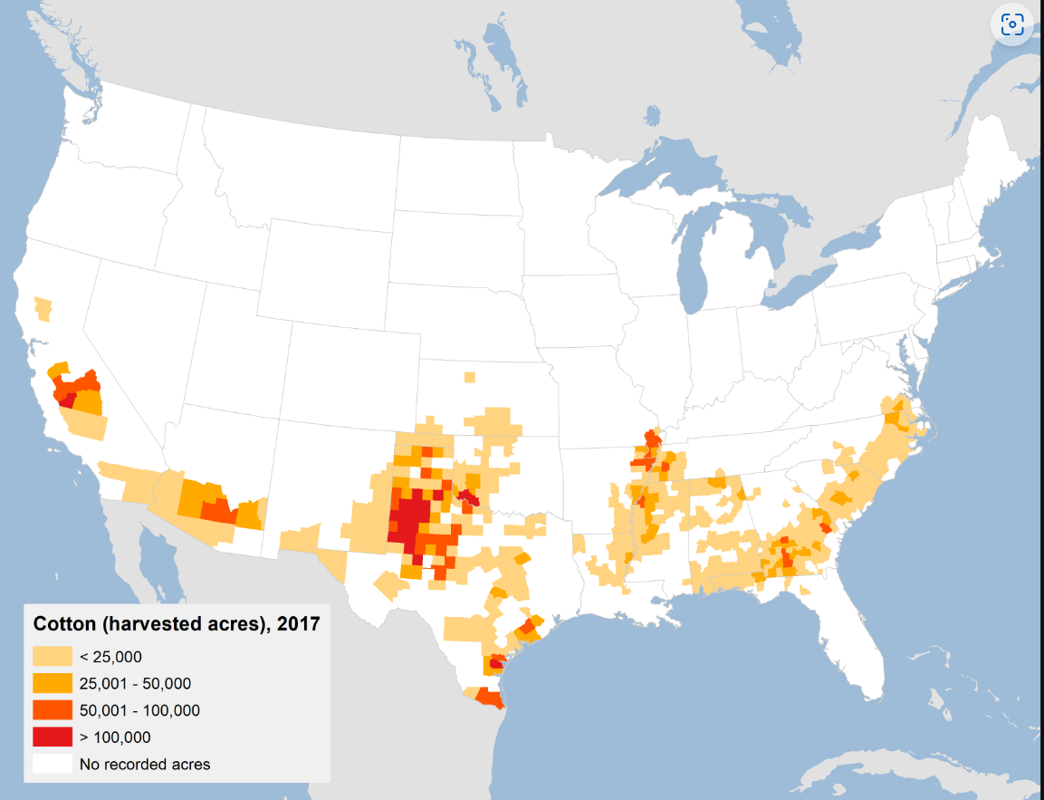
Station 2 Acres of Cotton Harvested in the United States, 2017
Notes:
USDA National Agricultural Statistics Service, Crop Production reports. January 8, 2025 https://www.ers.usda.gov/topics/crops/cotton-and-wool/cotton-sector-at-a-glance

Slide 10
Station 3
Notes:
U.S. Department of Agriculture, Economic Research Service Agriculture Industry Grows Texas

Slide 11
Station 4
Notes:
U.S. Department of Agriculture National Agricultural Statistics Service, Annual Cotton Review, Monthly Crop Production Reports Annual Cotton Review

Slide 12
Station 5
Notes:
National Integrated Drought Information System, The National Oceanic and Atmospheric Administration. Texas | Drought.gov

Slide 13
Exit Ticket Follow the directions below to complete your exit ticket
Read the five events listed on your exit ticket.
Put the events in the correct chronological order
Discuss with a partner

Slide 14
Share with the class: 2
The
(first) (second) (third) (fourth) (fifth)
event was _____

