Slide 1
Unit 4:
The Mexican National Era
Lesson 1:
The Big Picture
Notes:
“Connected Map of Austin’s Colony, 1833 – 1837.” [1892] #1944, Map Collection, Archives and Records Program, Texas General Land Office, Austin.

Slide 2






The Big Picture
Warm-up
https://education.texashistory.unt.edu

Slide 3

Warm-up:
Follow the directions to complete your warm-up
Read each item in the answer bank.
Circle or highlight all items that you think are true for Texas as we enter the new era of this unit.
Choose one item and write what you think could have caused it to happen.
Share with a partner.
https://education.texashistory.unt.edu

Slide 4
Share with the class
One thing I think is true of Texas at the beginning of the Mexican National Era is that ________
I think this was caused by _______
https://education.texashistory.unt.edu

Slide 5
Essential Question
What are the major issues, concerns, and goals of Mexico, many Tejanos, and some Anglo-Americans during the Mexican National Era?
https://education.texashistory.unt.edu

Slide 6
In today’s lesson…
We will examine the historical context of major issues in the world, in the U.S.A., in Mexico, and in Texas during the Mexican National Era.
I will read a short passage identifying the primary issues of this unit and summarize the cause of each of these concerns.
https://education.texashistory.unt.edu

Slide 7
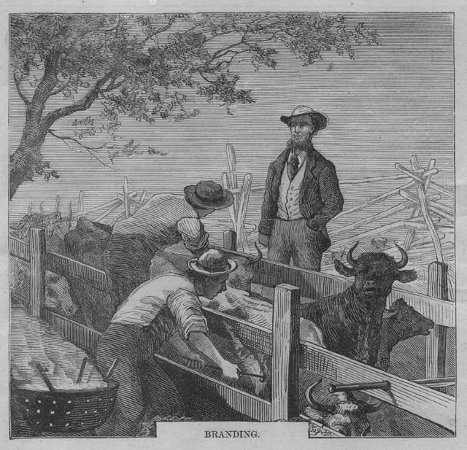
Part I:
Analyze an Image
What do you observe?
What can you infer?
What do you predict?
Infer: Make an educated guess based on evidence.
https://education.texashistory.unt.edu
Notes:
“Connected Map of Austin’s Colony, 1833 – 1837.” [1892] #1944, Map Collection, Archives and Records Program, Texas General Land Office, Austin.

Slide 8
Part II:
Essential Ideas Reading Passage
https://education.texashistory.unt.edu

Slide 9
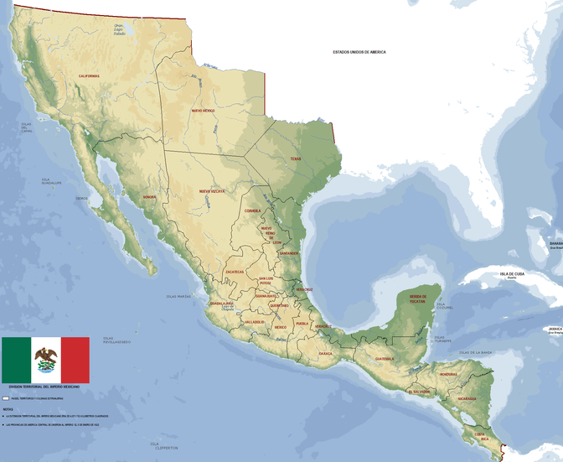
First Paragraph: Mexican Independence
Map: First Mexican Empire
https://education.texashistory.unt.edu
Notes:
First Mexican Empire Map 1821. I, the copyright holder of this work, release this work into the public domain. This applies worldwide. https://commons.wikimedia.org/wiki/File:Mapa_de_Mexico_(Imperio_Mexicano)_1821.PNG

Slide 10
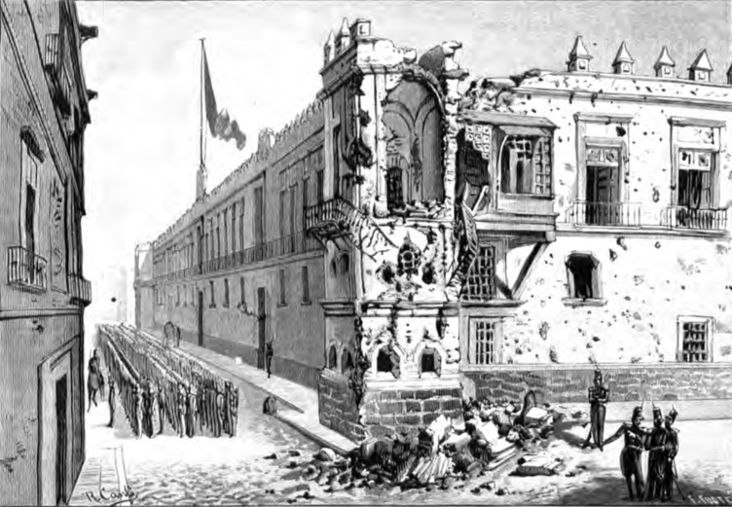
Second Paragraph: Instability in the New Country
The National Palace Damaged by the Federalist Revolt
https://education.texashistory.unt.edu
Notes:
Mexican National Palace Damaged by Juan de Dios Arias. Damage sustained to the Mexican National Palace in the wake of the Federalist Revolt of 1840. México a través de los siglos Tomo IV México independiente (1821 - 1855) This work is in the public domain in the United States because it was published (or registered with the U.S. Copyright Office) before January 1, 1929. https://commons.wikimedia.org/wiki/File:Mexican_National_Palace_Damaged.png

Slide 11
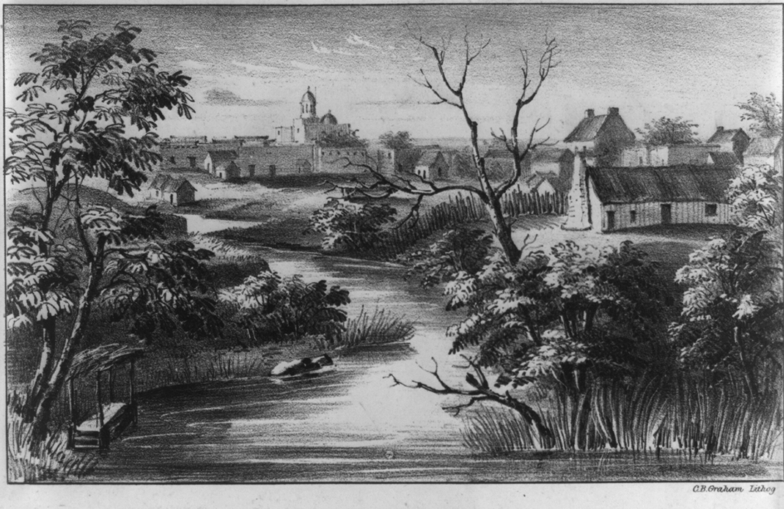
Third Paragraph: A Weak & Vulnerable Texas
San Antonio de Bexar, 1846
The Library of Congress
https://education.texashistory.unt.edu
Notes:
San Antonio De Bexar. 1846. Lithograph. Library of Congress Prints and Photographs Division. https://www.loc.gov/pictures/item/2022633317/.

Slide 12
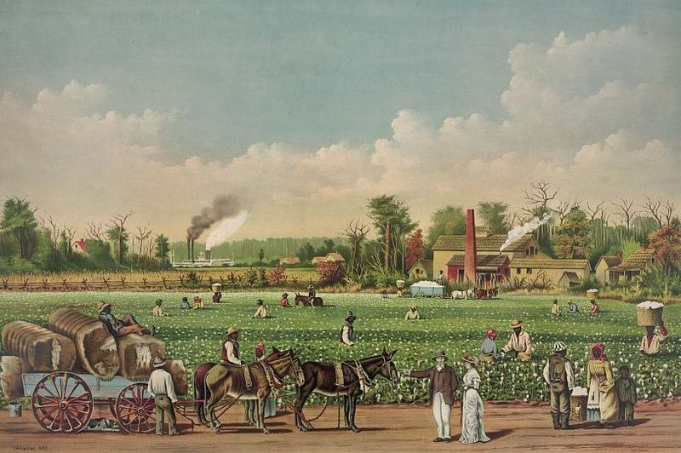
Fourth Paragraph: Cotton is King
A cotton plantation in the Mississippi River.
Library of Congress
https://education.texashistory.unt.edu
Notes:
Cotton plantation on the Mississippi, 1884. Library of Congress. https://www.loc.gov/pictures/item/91722891/

Slide 13
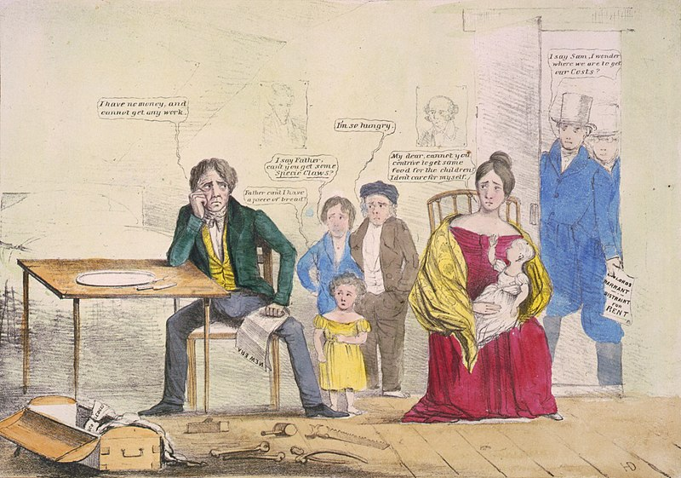
Fifth Paragraph: Financial Panic
A political cartoon of one of the financial panics of the 1800s
Library of Congress
https://education.texashistory.unt.edu
Notes:
US Whig poster showing unemployment in 1837. This media file is in the public domain in the United States. This applies to U.S. works where the copyright has expired, often because its first publication occurred prior to January 1, 1929, and if not then due to lack of notice or renewal. See this page for further explanation. This image is available from the United States Library of Congress's Prints and Photographs division
under the digital ID cph.3g03240

Slide 14
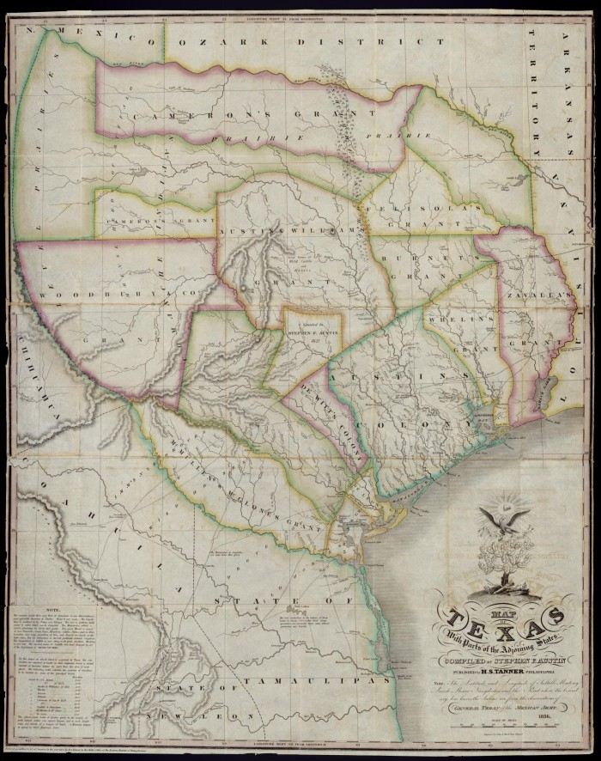
Conclusion:
Texas & the Mexican National Era
A Map of Texas
By Stephen F. Austin
The Portal to Texas History
https://education.texashistory.unt.edu
Notes:
"Map of Texas with parts of the Adjoining States. Compiled by Stephen F. Austin.", map, Date Unknown; (https://texashistory.unt.edu/ark:/67531/metapth31277/: accessed November 27, 2024), University of North Texas Libraries, The Portal to Texas History, https://texashistory.unt.edu; crediting Star of the Republic Museum.

Slide 15
The Big Picture
Exit Ticket
https://education.texashistory.unt.edu

Slide 16
Exit Ticket:
Follow the directions to complete your warm-up
Read each option for how Mexico could address the issues facing Texas.
Consider the pros and cons of each option.
Record why each option could be good and bad.
Share with a partner.
https://education.texashistory.unt.edu

Slide 17
Share with the class 2
One option that could address the issues in Texas is __________.
This could be a good option because _________
This could be a bad option because _________
https://education.texashistory.unt.edu

