Slide 1

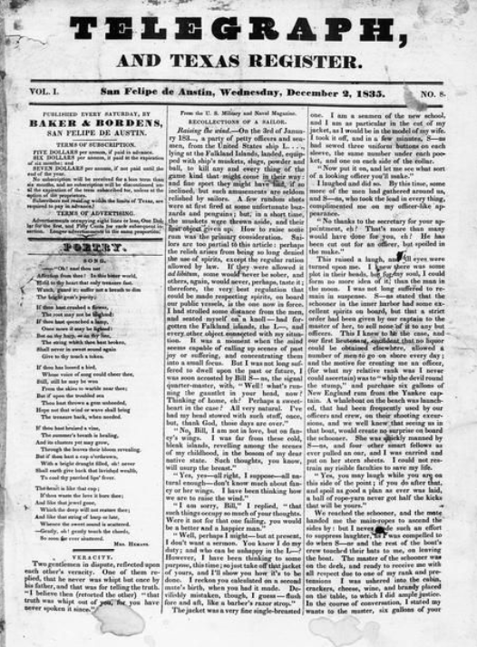
Unit 4: Mexican National Era
Lesson 10:
The Bigger Picture
Notes:
Baker & Bordens. Telegraph and Texas Register (San Felipe de Austin [i.e. San Felipe], Tex.), Vol. 1, No. 8, Ed. 1, Wednesday, December 2, 1835, newspaper, December 2, 1835; San Felipe de Austin, Texas. (https://texashistory.unt.edu/ark:/67531/metapth47896/: accessed January 28, 2025), University of North Texas Libraries, The Portal to Texas History, https://texashistory.unt.edu; crediting The Dolph Briscoe Center for American History.

Slide 2




Warm-up Follow the directions to complete your warm-up
Think about the scenario presented in the warm-up.
Circle or highlight the headlines you would expect to see in a Texas newspaper at the time
Discuss with a partner

Slide 3
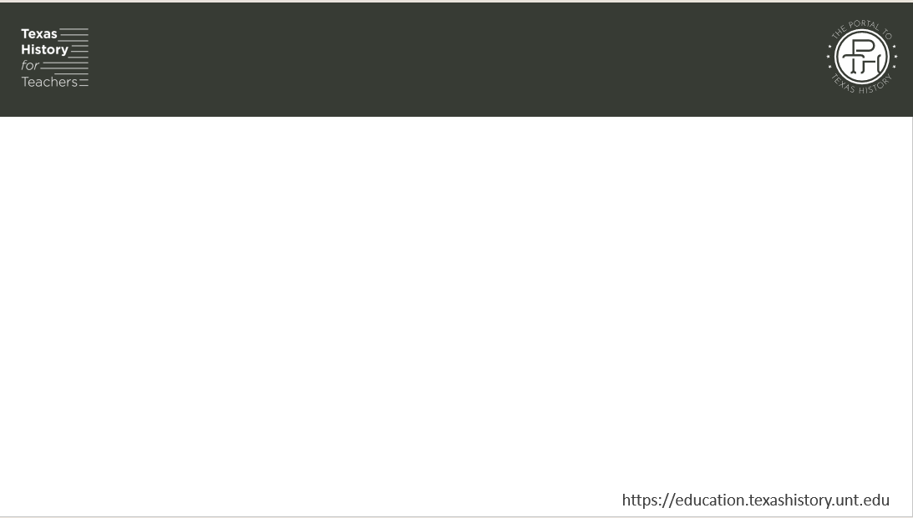
Share with the class
One headline I would expect to see in a Texas newspaper in 1835 is “__________________”

Slide 4

Essential Questions
What role did newspapers play in Austin’s colony? How did one prominent Texas newspaper present information about the overthrow of the federalist government in 1835?

Slide 5

In today’s lesson…
We will examine primary source materials to determine one Texan’s point-of-view about the centralist abolition of the Federal Constitution of 1824.
I will make inferences and conclusions about how some in Texas viewed the political unrest across Mexico in 1835 according to an article in the Telegraph and Texas Register newspaper.

Slide 6
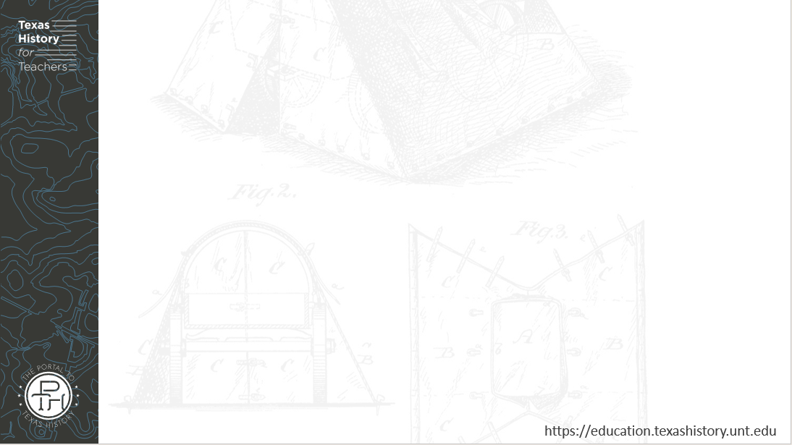
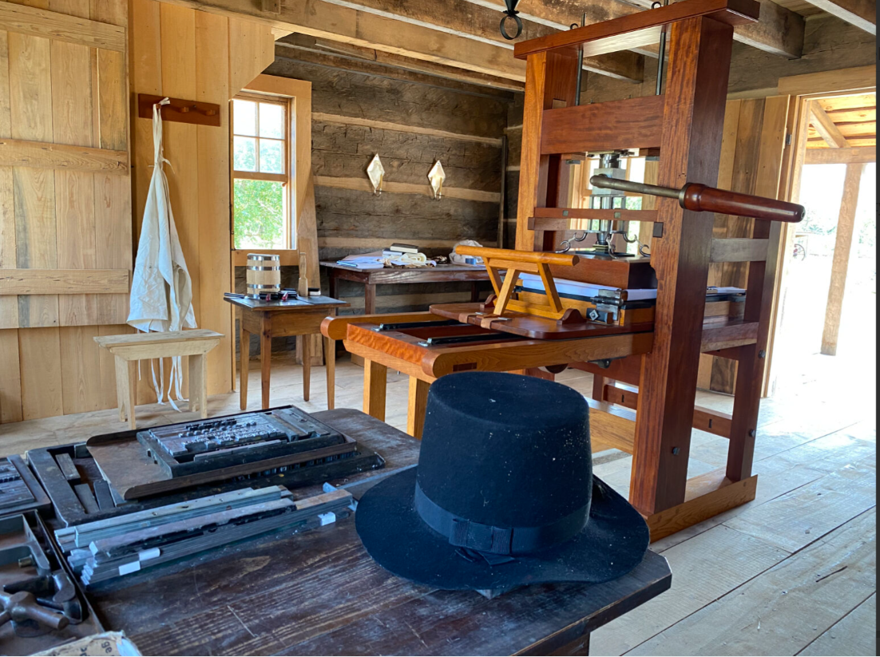
Staying Informed as Tension Grew Across Mexico
The San Felipe de Austin historic site printing press exhibit
The Texas Historical Commission
Notes:
A view of the printing press exhibit at the San Felipe de Austin historic site and museum. The Texas Historical Commission. https://thc.texas.gov/historic-sites/san-felipe-de-austin

Slide 7

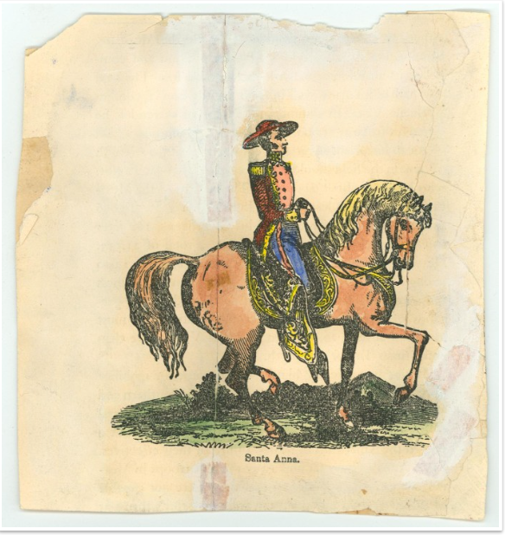
The Centralist Takeover & its Consequences
A hand-colored picture of Santa Anna in 1836 on horseback.
The Portal to Texas History
Notes:
Santa Anna on horseback, image, Date Unknown; (https://texashistory.unt.edu/ark:/67531/metapth31618/: accessed January 29, 2025), University of North Texas Libraries, The Portal to Texas History, https://texashistory.unt.edu; crediting Star of the Republic Museum.

Slide 8
Exit Ticket Follow the directions to complete your Exit Ticket
Consider what we have learned so far in the Mexican National Era.
How do you predict the people of Texas will respond to the unrest across Mexico?
Discuss with a partner

Slide 9
Share with the class 2
I predict the people of Texas will _________________________ because ____________________

