Slide 1
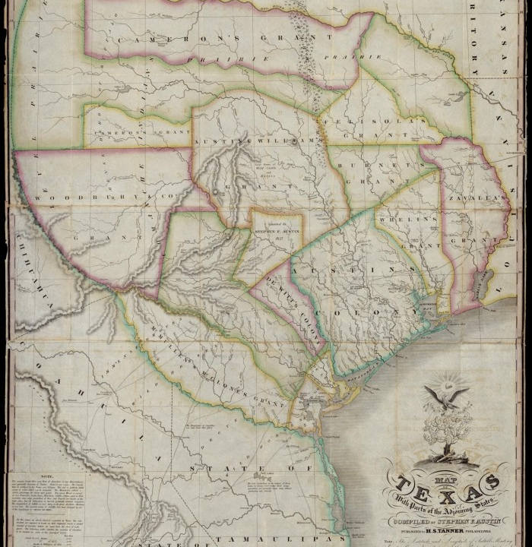
Unit 4: The Mexican National Era
Lesson 5:
The Empresario System Notes
Notes:
"Map of Texas with parts of the Adjoining States. Compiled by Stephen F. Austin.", map, Date Unknown; (https://texashistory.unt.edu/ark:/67531/metapth31277/: accessed December 19, 2024), University of North Texas Libraries, The Portal to Texas History, https://texashistory.unt.edu; crediting Star of the Republic Museum.

Slide 2

The Empresario System Warm-up
https://education.texashistory.unt.edu

Slide 3




Warm-up Follow the directions to complete your warm-up
Consider the scenario on your warm-up.
Write your responses in the chart.
Discuss with a partner
https://education.texashistory.unt.edu

Slide 4
Share with the class
One reason inviting Anglo immigrants into Texas could be a good idea is __________
One concern I have about inviting Anglos into Texas is _____________
One way to address my concern is by requiring Anglos to ___________________
https://education.texashistory.unt.edu

Slide 5
Essential Questions
What were the Mexican, Tejano, and Anglo motivations for supporting the Empresario System in Texas?
What were the requirements for Anglos settling in Texas?
https://education.texashistory.unt.edu

Slide 6
In today’s lesson…
We will identify reasons different groups supported the empresario system and the requirements set for the Anglos immigrating to Texas.
I will record significant information on my guided notes explaining the motivations and requirements for Anglo immigration to Texas.
https://education.texashistory.unt.edu

Slide 7
The Empresario System
https://education.texashistory.unt.edu

Slide 8
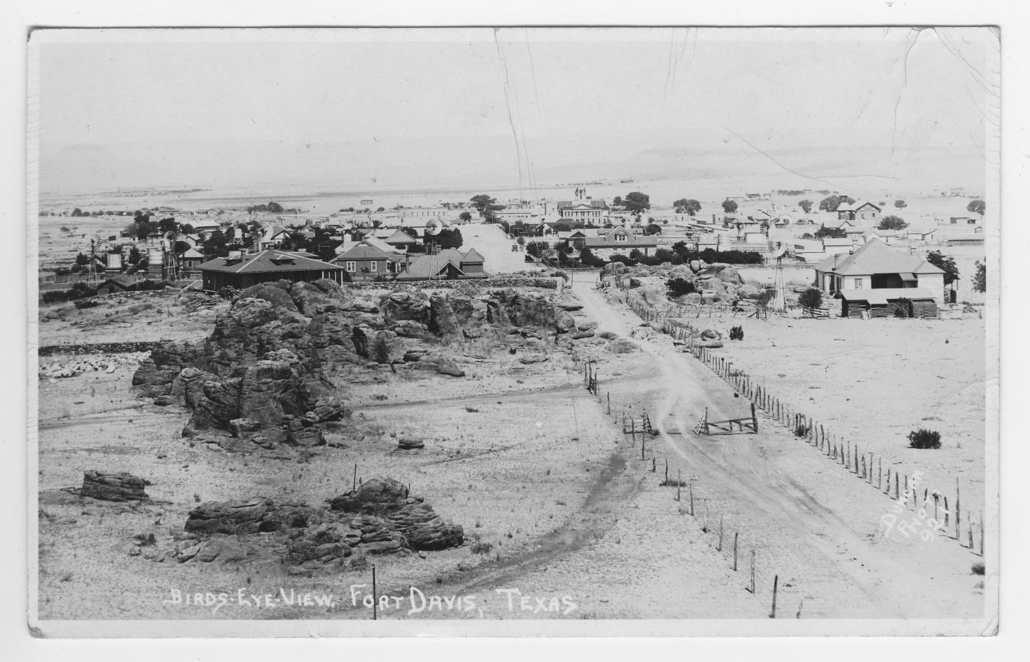
Goals of the Empresario System
Mexico’s Goals | Tejano Goals | Anglo Goals
Strengthen Mexico’s position in Texas. | Increase the non-Indian population of Texas Grow the economy | Get cheap land to grow the cash crop cotton on plantations in Texas
https://education.texashistory.unt.edu

Slide 9
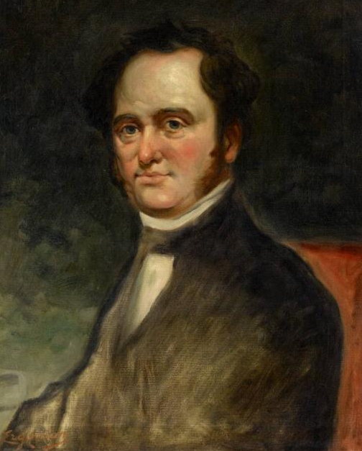
Moses Austin
1820: The first Anglo-American to work with the Spanish government to settle other Anglos in Texas
The Museum of Fine Arts Houston
https://education.texashistory.unt.edu
Notes:
Erganian, Sarkis. Portrait of Moses Austin (1761–1821). ca. 1900-23. Oil on canvas, 28 1/4 × 22 1/4 in. The Museum of Fine Arts Houston. https://emuseum.mfah.org/objects/110006/portrait-of-moses-austin-17611821#

Slide 10
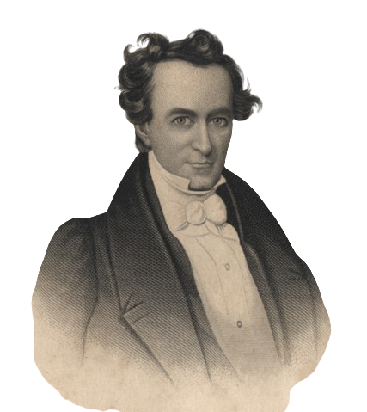
Stephen F. Austin
1821: The first and most successful Anglo-American empresario to settle Anglos in Texas
Considered “The Father of Texas” by some in American history
Settled the first 300 families: “The Old 300”
The Portal to Texas History
https://education.texashistory.unt.edu
Notes:
[Engraving of Stephen F. Austin]. The background removed. December 16, 1836. Artwork. University of North Texas Libraries, The Portal to Texas History; crediting Palestine Public Library. https://texashistory.unt.edu/ark:/67531/metapth11276/.

Slide 11
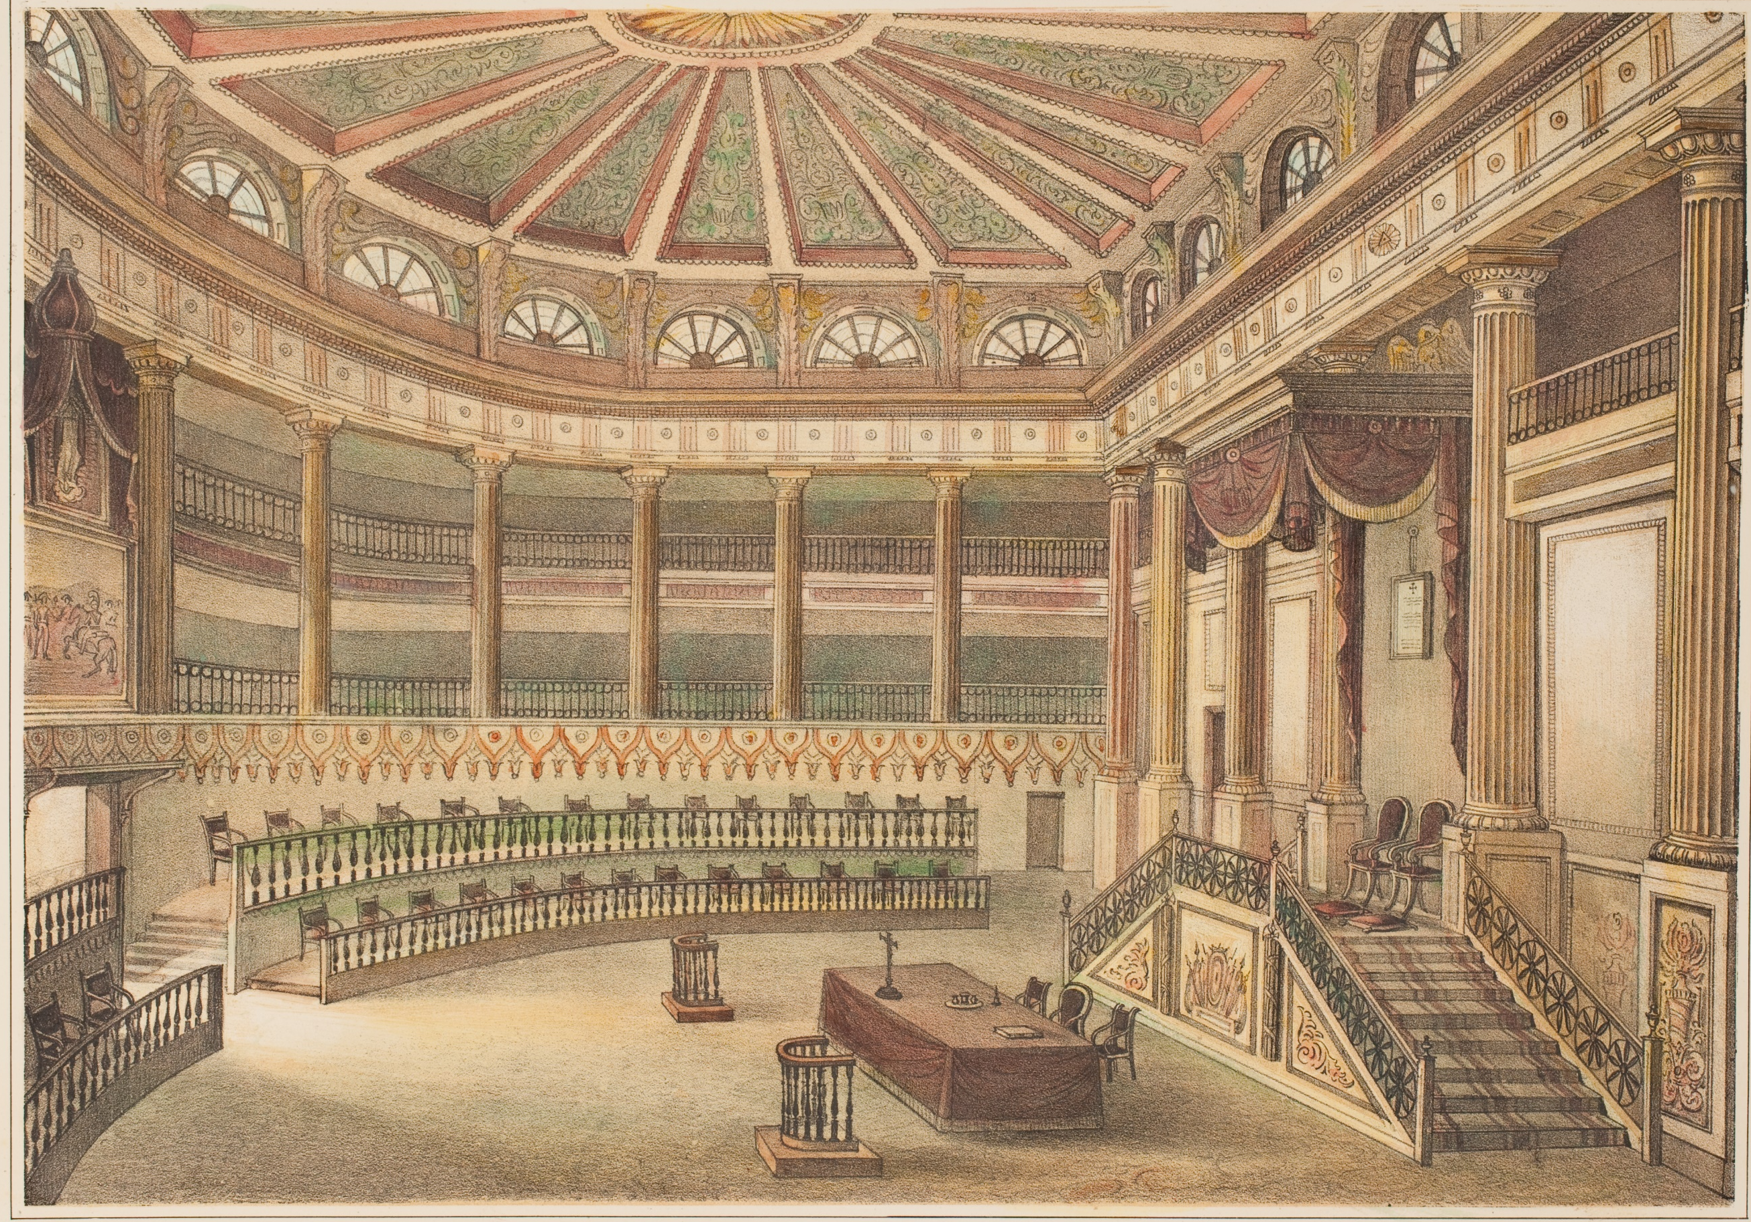
Erasmo Seguín
A Tejano official in San Antonio
Advocated for Anglo colonization in the Mexican congress.
Helped Austin establish his colony in Texas
Mexican Congress Room
DeGolyer Library, SMU
https://education.texashistory.unt.edu
Notes:
Camara de los Diputados. Album pintoresco, de la republica Mexicana. Lehnert, Pierre Frederic. DeGolyer Library, Southern Methodist University. https://digitalcollections.smu.edu/digital/collection/mex/id/626

Slide 12
Land Grants
Anglo settlers received land grants:
4,000 or more acres of land.
More people (family & enslaved people) = More land
Map of Austin’s Colony
Texas General Land Office, Austin
https://education.texashistory.unt.edu
Notes:
“Connected Map of Austin’s Colony, 1833-1837.” [1892], #1944, Map Collection, Archives and Records Program, Texas General Land Office, Austin

Slide 13
Requirements to Settle in Texas
https://education.texashistory.unt.edu

Slide 14
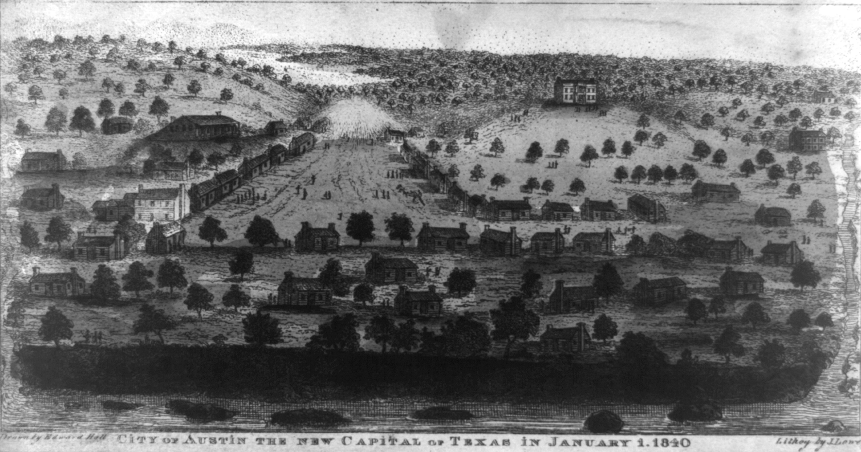
Requirements to settle in Austin’s Colony
Become Catholic (Not strictly enforced)
Provide reference letters showing good character
Surveying fees: 12.5 cents per acre
1 year of supplies
City of Austin, 1840, The Library of Congress
https://education.texashistory.unt.edu
Notes:
[City of Austin the New Capital of Texas in January 1. 1840]. 1840. Lithograph. Library of Congress Prints and Photographs Division. https://www.loc.gov/pictures/item/2021651297/.

Slide 15
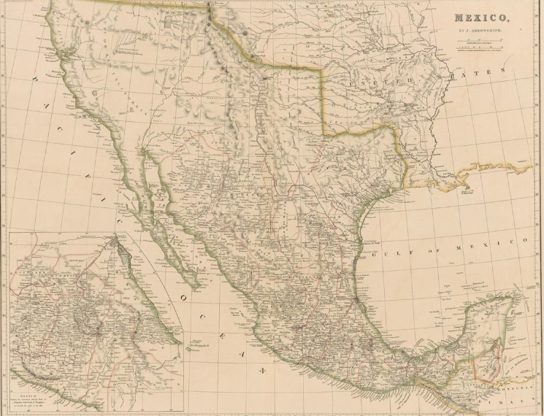
National Colonization Laws of 1823 & 1824
States have the power to control colonization.
Set restrictions on the location and amount of land settlers could receive.
Empresarios must learn Spanish.
The federal government has power to stop immigration for national security.
Map of Mexico, The Portal to Texas History
https://education.texashistory.unt.edu
Notes:
Arrowsmith, John. Mexico. 1832; University of North Texas Libraries, The Portal to Texas History; crediting University of Texas at Arlington Library. https://texashistory.unt.edu/ark:/67531/metapth231564/.

Slide 16
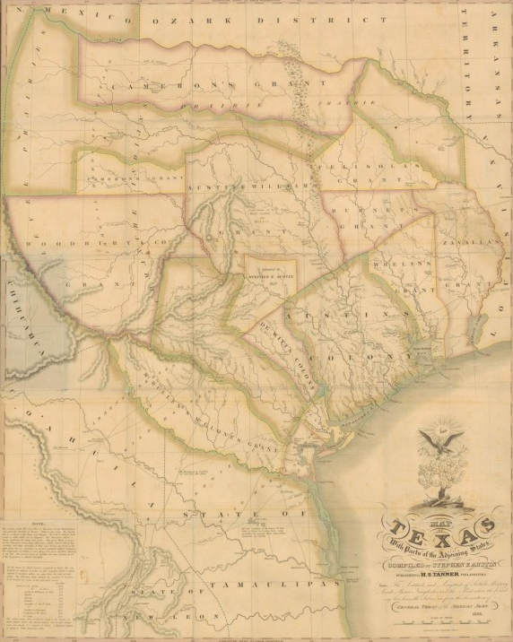
State Colonization Law of 1825 Coahuila y Tejas
Settlers take an oath to the Mexican government
No taxes for 10 years
Grants Mexican citizenship to Anglo settlers in Texas
Empresarios must settle at least 100 families
After 6 years, unfulfilled contracts would be cancelled.
Map of Texas
The Portal to Texas History
https://education.texashistory.unt.edu
Notes:
Tanner, Henry Schenck, 1786-1858. Map of Texas with parts of the adjoining states., map, 1836; Philadelphia, Pennsylvania. (https://texashistory.unt.edu/ark:/67531/metapth298324/: accessed November 27, 2024), University of North Texas Libraries, The Portal to Texas History, https://texashistory.unt.edu; crediting University of Texas at Arlington Library.

Slide 17
Slavery & the Empresario System
https://education.texashistory.unt.edu

Slide 18
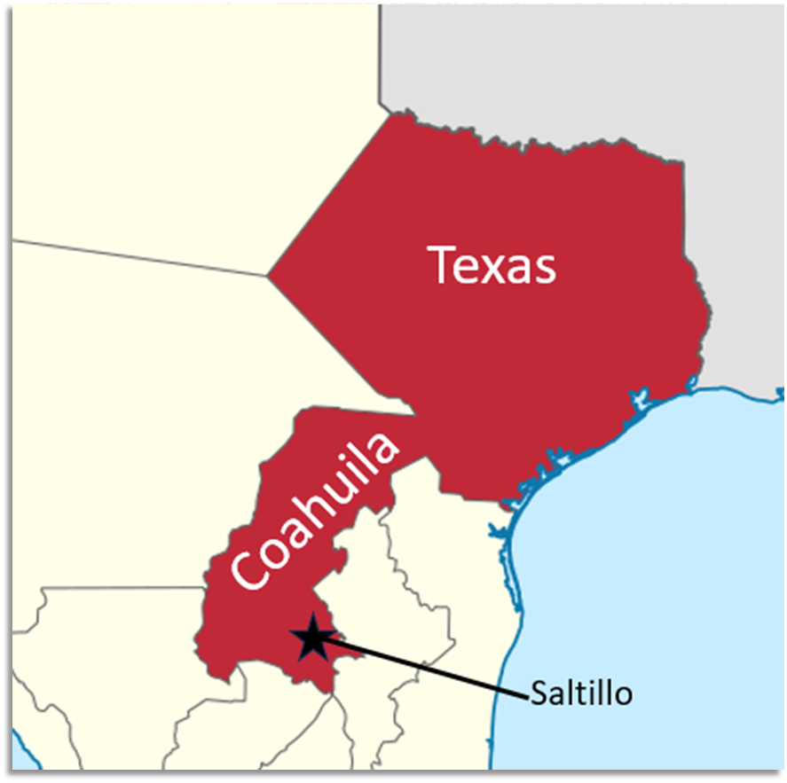
State Constitution of Coahuila y Tejas of 1827
Article 13: Tried to abolish slavery in the state over time.
Current enslaved people will remain enslaved.
Children of the enslaved are free.
After 1827, no more enslaved people can be brought to the state from the U.S.
https://education.texashistory.unt.edu
Notes:
Map of the states and territories of Mexico as they were from November 24 1824 to 1830. Permission is granted to copy, distribute and/or modify this document under the terms of the GNU Free Documentation License, Version 1.2 or any later version published by the Free Software Foundation; with no Invariant Sections, no Front-Cover Texts, and no Back-Cover Texts. A copy of the license is included in the section entitled GNU Free Documentation License. This file is licensed under the Creative Commons Attribution-Share Alike 3.0 Unported license.The image has been edited to zoom in on the state of Coahuila y Tejas and the capital of the state has been added to the image. https://commons.wikimedia.org/wiki/File:Mexico_1824-11-24_to_1830.png

Slide 19
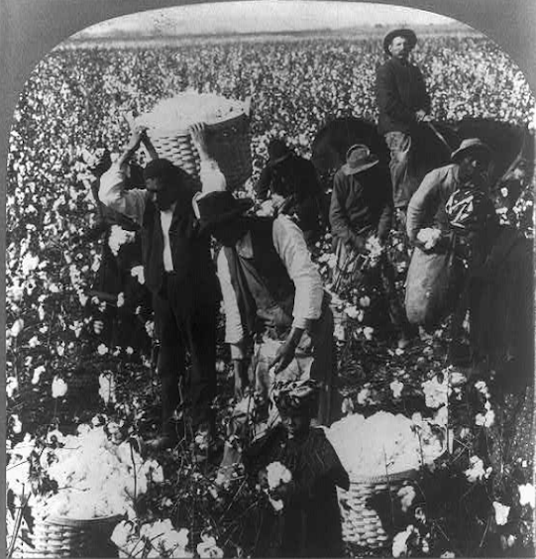
“Decree No. 56” May 5, 1828
All contracts signed in foreign countries between emigrants and their laborers are valid in Texas.
Tejanos and Anglos worked to get this law passed in the state government.
Some Anglos in the U.S. created 99-year contracts for the enslaved people. This allowed many Anglos to get around the laws prohibiting slavery in Coahuila y Tejas.
Library of Congress
https://education.texashistory.unt.edu
Notes:
Berry, Kelley & Chadwick, Publishers. In the domain of King Cotton, near Dallas, Texas. Texas Dallas, ca. 1907. Philadelphia, U.S.A.: Berry, Kelley & Chadwick, publishers. Photograph. https://www.loc.gov/item/00652640

Slide 20
Effects of the Empresario System
https://education.texashistory.unt.edu

Slide 21
The Development of Texas
1821 – 1825: Approximately 3,000 new settlers in Texas (300 Anglo families and enslaved people)
More roads and new towns like San Felipe de Austin and Gonzales.
Increased trade with the U.S. via New Orleans.
https://education.texashistory.unt.edu
Notes:
Texan Farm in Montgomery County. 1843 pencil sketch by William Bollaert. The Newberry Library, Chicago, Vault, Oversize Ayers Art, Bollaert #49

Slide 22
The Empresario System Exit Ticket
https://education.texashistory.unt.edu

Slide 23
Exit Ticket Follow the directions to complete your exit ticket
Read the list of requirements.
Place a checkmark next to all requirements for Anglo settlers.
Discuss with a partner
https://education.texashistory.unt.edu

Slide 24
Share with the class
One requirement for the Empresario System was that Anglo settlers must _____________________________
I think the requirement that will be the most difficult for Anglos to follow is __________ because _________
https://education.texashistory.unt.edu

