Slide 1
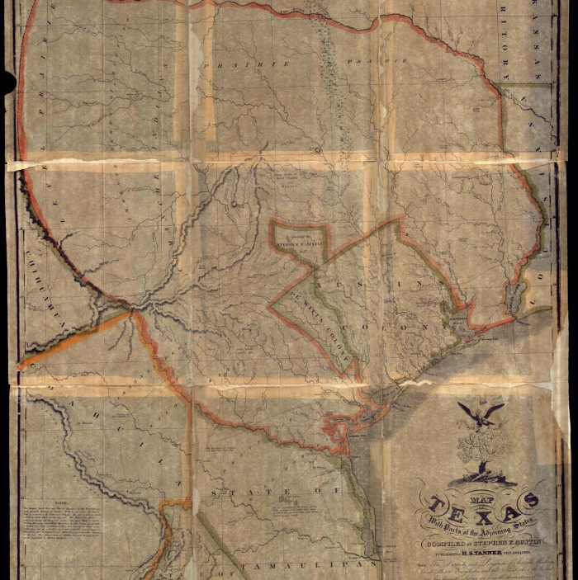
Unit 4:
The Mexican National Era
Lesson 3:
Vocabulary
Notes:
"Map of Texas With Parts of the Adjoining States", map, Date Unknown; (https://texashistory.unt.edu/ark:/67531/metapth32928/: accessed December 3, 2024), University of North Texas Libraries, The Portal to Texas History, https://texashistory.unt.edu; crediting Star of the Republic Museum.

Slide 2
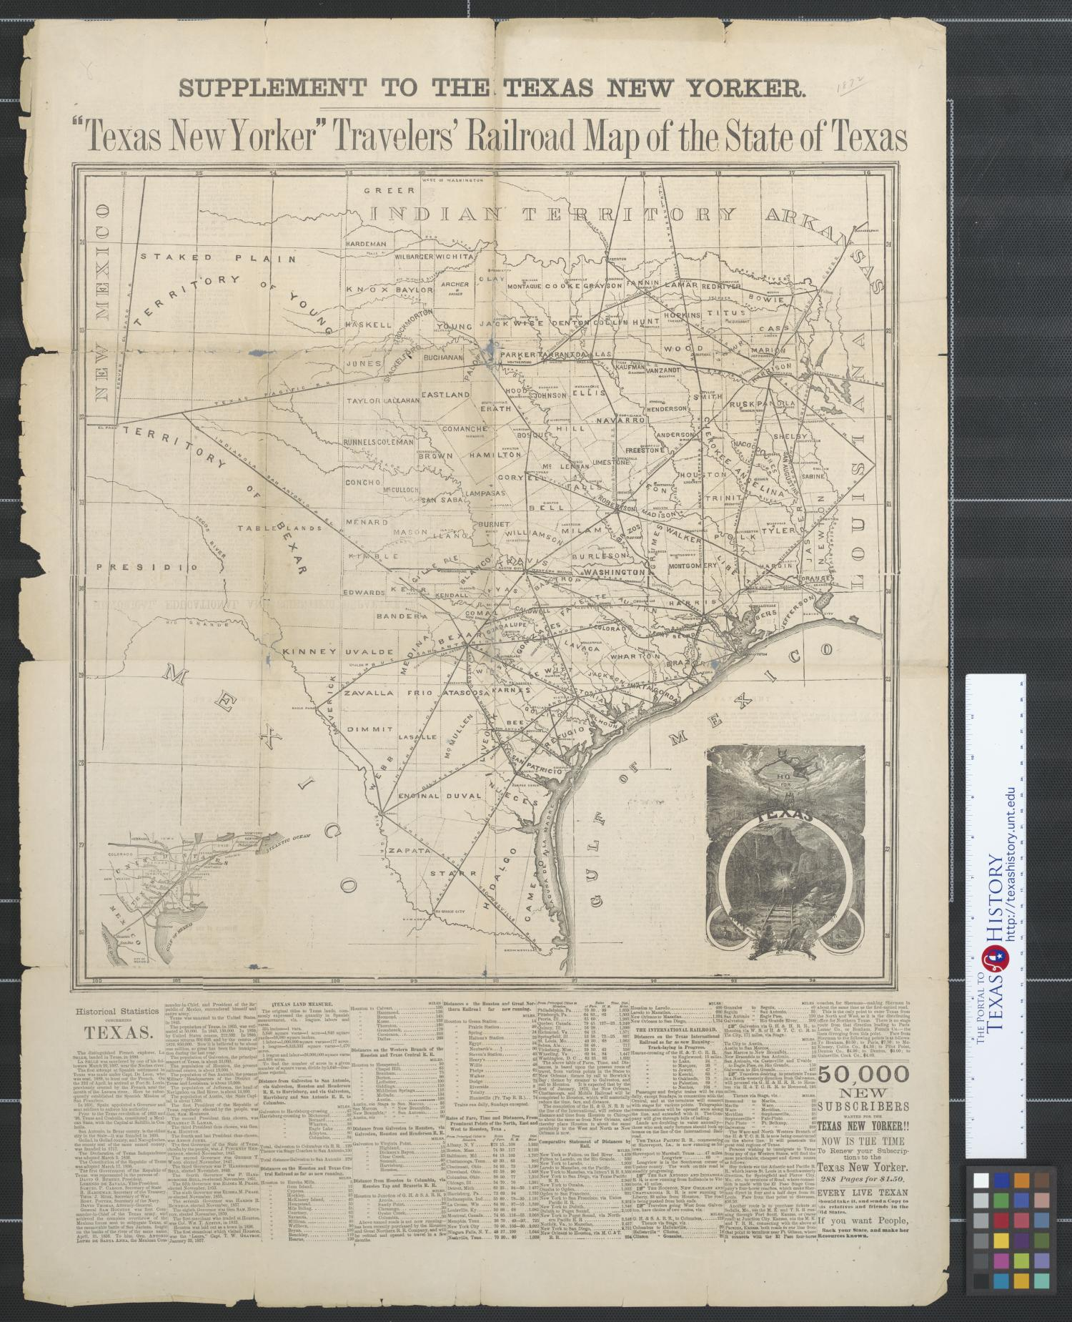







Warm-up
Follow the directions below to complete your warm-up
Read the list of possible topics we could see in this unit.
Based on what we have learned so far, place a checkmark next to any item you think we are likely to see in this lesson.
Share your response with a partner.
https://education.texashistory.unt.edu

Slide 3
Share with the class: day 1
In today’s vocabulary lesson, we will probably see vocabulary terms about __________ and ______________
https://education.texashistory.unt.edu

Slide 4
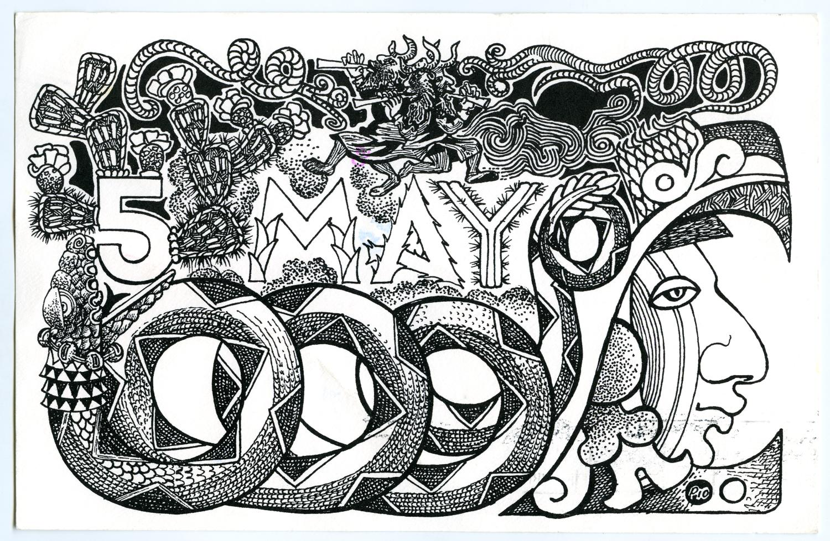
Essential Question
What key terms do we need to know in order to be successful in this unit?
https://education.texashistory.unt.edu

Slide 5
In Today’s Lesson
We will identify, define, and exemplify the key terms of Unit 4: The Mexican National Era.
I will use the information and context of several short passages to identify and record the definition of each term and provide examples of the term in the context of our unit.
https://education.texashistory.unt.edu

Slide 6

Economy (n)
When Mexico won its independence from Spain in 1821, there were many challenges facing the brand-new nation. One significant challenge was the economy.
Fighting a war is expensive. Mexico had taken out loans to pay for the high cost of the war for independence. As a result, Mexico was in debt after the war and eager to improve its economy – or everything related to a how a country and its people make and spend money.
The economy was also a significant challenge to the Mexican population of Texas, or Tejanos. The war had dramatically decreased the Tejano population in Texas. Tejanos were eager to find a way to grow the state’s population and increase economic activity and opportunity in their state.
https://education.texashistory.unt.edu

Slide 7
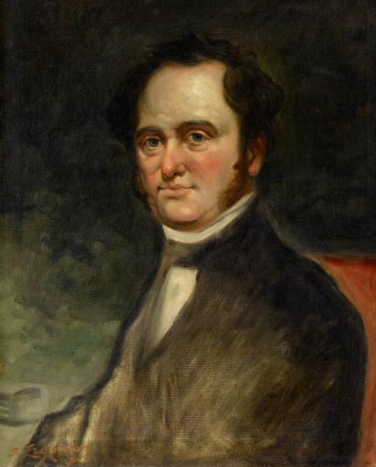
Immigration (n)
In 1821, the Mexican population of Texas, or Tejanos, was very small. There were only about 4,000 Tejanos in Texas after Mexico gained its independence. That might sound like a lot, but to put it in perspective, that’s only about the size of two modern-day 5A Texas high schools…in the whole state!
To increase the population of Texas, the Tejano leadership supported a plan to encourage immigration from the United States into Texas. Immigration is the act of permanently moving from one country to another. Many Tejanos believed that inviting Anglo-American immigrants to Texas could help grow the population and improve the economy.
An Anglo-American man named Moses Austin proposed immigrating to Texas and bringing other Anglo-American immigrants from the United States to settle in the region. The Tejanos, eager for more people to live and work in their state, saw Austin’s proposal for Anglo-American immigration as having great potential for success!
Moses Austin
The Museum of Fine Arts, Houston
https://education.texashistory.unt.edu
Notes:
Erganian, Sarkis. Portrait of Moses Austin (1761–1821). ca. 1900-23. Oil on canvas, 28 1/4 × 22 1/4 in. The Museum of Fine Arts Houston. https://emuseum.mfah.org/objects/110006/portrait-of-moses-austin-17611821#.

Slide 8
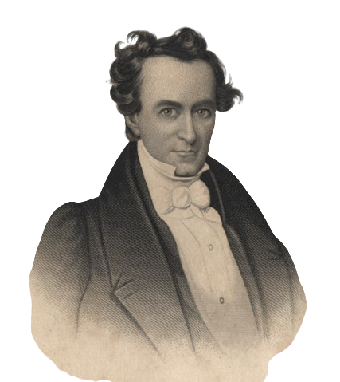
Empresario (n)
The primary way Mexico hoped to grow the population of Texas and improve its economy was by inviting empresarios to Texas. An Empresario was a land agent - or someone who received a contract with the Mexican government to settle a certain number of people in Texas. Most of the empresarios who settled in Texas were from the United States, though there were some Mexican empresarios.
Empresarios like Stephen F. Austin placed advertisements in American newspapers, offering thousands of acres of Texas land for incredibly low prices. In return for the cheap land, settlers agreed to develop the land, typically through plantation agriculture growing cash crops like cotton. The more people the settlers brought with them, the more land they received.
Stephen F. Austin was the most successful empresario, settling thousands of people in Texas during the 1820s and 1830s. This dramatically grew the Texas population and greatly improved its economy throughout the Mexican National Era.
Empresario Stephen F. Austin
The Portal to Texas History
https://education.texashistory.unt.edu
Notes:
[Engraving of Stephen F. Austin]. December 16, 1836. Artwork. University of North Texas Libraries, The Portal to Texas History; crediting Palestine Public Library. The Background has been removed for this slide. https://texashistory.unt.edu/ark:/67531/metapth11276/

Slide 9
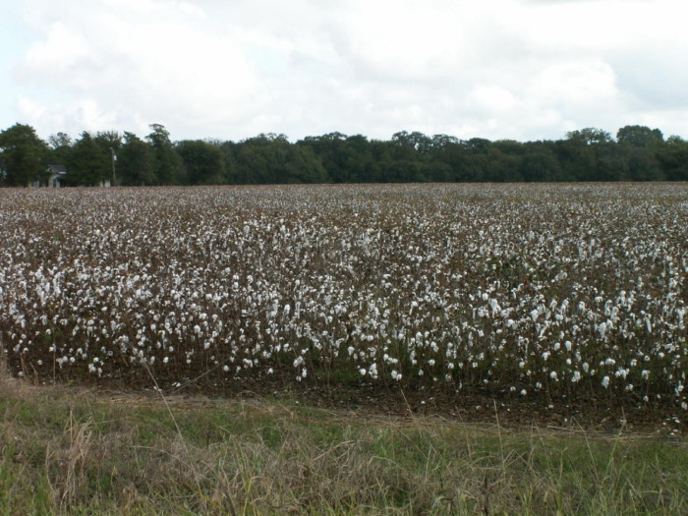
Cash Crop (n)
Many of the Anglo-American settlers who wanted to immigrate to Texas were interested in establishing large farms called plantations. Land in east Texas was fertile and would be excellent for plantation agriculture.
When Moses Austin proposed bringing other Anglo-American settlers to Texas, many plantations in the American south were experiencing enormous success growing cash crops. A cash crop is a highly profitable plant that is grown on plantations. These cash crops were often grown through the work of enslaved laborers. One of the most profitable cash crops at the time was cotton.
Many Anglo-Americans who wanted to immigrate to Texas were hoping to take part in plantation agriculture growing cotton – the cash crop that was making so many plantation owners in the United States incredibly wealthy.
Texas cotton field
The Portal to Texas History
https://education.texashistory.unt.edu
Notes:
Bell, Jim. [Cotton Field], photograph, Date Unknown; (https://texashistory.unt.edu/ark:/67531/metapth121189/: accessed November 25, 2024), University of North Texas Libraries, The Portal to Texas History, https://texashistory.unt.edu; crediting Private Collection of Jim Bell.

Slide 10


Constitution (n)
After Mexico won its independence from Spain in 1821, the people of Mexico had to undertake the enormous task of forming their own government. There are many ways to form a government, and many different types of governments that you could choose from.
One way that a country can form a government is by writing a constitution. A constitution is a document that sets up a government, tells how it will work, who will be in charge, and what powers they will have. Constitutions often include the rights and powers of the people and states.
Creating a constitution is an incredibly challenging task because there are almost always different groups of people who have different ideas about how a country should run. In this unit, we will see how the people of Mexico went about the significant task of creating their own constitution and how this process influenced Texas.
https://education.texashistory.unt.edu

Slide 11

Federalism (n)
When the people of Mexico set out to write a constitution to create their own government, one of the types of governments they considered was a Federalist government. Federalism is a type of government in which the national, or federal, government shares its powers with the state governments.
In a federalist system, the nation’s leaders in Mexico City would have certain powers, while each state would also have certain powers. States would be able to write their own constitutions, elect their own state leaders, and make decisions that were best for their own state, as long as their decisions didn’t go against the federal government.
Opponents of federalism were called centralists. Centralists did NOT support the federalist system. Centralists wanted all the government’s power to be centralized, meaning they wanted power to belong primarily to the people in the national government. They did not believe the states should have much power. Arguments between Federalists and Centralists would eventually cause a lot of conflict within Mexico during this era.
Federal government
State governments
https://education.texashistory.unt.edu

Slide 12

Republic (n)
As the people of Mexico worked to set up their own government, another element that they considered including was a form of government known as a republic. In a republic, the people vote to elect representatives to speak for them and represent their interests in government.
In a federal republic, the states within a country all have their own state governments that share powers with the federal, or national, government. The people of each state elect representatives from their state to support their state’s specific needs and interests in their state and national governments
At the time, Texas didn’t have enough people to be its own state, so Texas was combined with the larger, more populated neighboring state, Coahuila. In a republic, representation is often based on population, so the larger your population, the more representatives you have in government. This meant that Coahuila had more power than Texas in their combined state government. As a result, one of Texas’ goals was to grow enough that it could become its own state in the Mexican federal republic.
https://education.texashistory.unt.edu

Slide 13
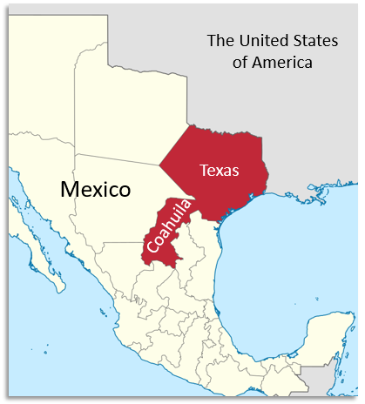
Congress (n)
One important responsibility of government is to create laws to maintain order and keep people safe. Imagine a country without laws…people could do anything anytime anywhere with no consequences. It would likely become chaotic and even dangerous!
A congress is an elected group of people responsible for making laws. In a federal republic, each state has its own congress to pass laws and address issues specific to their own state. There is also a national congress where representatives from each state across the country meet to ensure that their state’s needs and issues are addressed at the national level.
When Mexico became a country, the Tejano population of Texas was too small for Texas to become its own state. Texas was joined with its more populated neighbor state, Coahuila. Because Coahuila had more people, it also had more representatives in the state congress than Texas. This often posed a challenge to the Tejanos and Anglos in Texas as they tried to pass laws that they believed would be best for Texas.
https://education.texashistory.unt.edu

Slide 14

Exit Ticket
Follow the directions below to complete your Exit ticket
Read the items in the answer bank.
Circle or highlight any and all items that are connected to the vocabulary terms and major themes in this unit.
Share your response with a partner.
https://education.texashistory.unt.edu

Slide 15
Share with the class: 2day 1
One term that is related to this unit is ____________.
I chose this term because _______________.
https://education.texashistory.unt.edu

