Slide 1
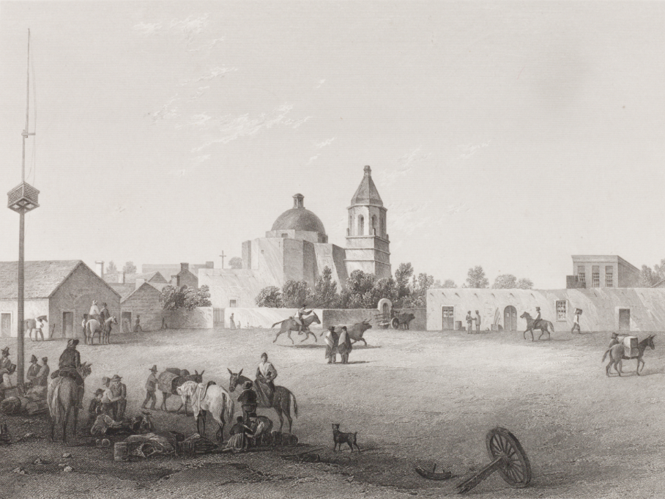
Unit 4:
Mexican National Era
Lesson 4:
What’s the Story?
San Antonio Military Plaza
Notes:
Schott, Arthur. Military Plaza: San Antonio, artwork, Date Unknown; (https://texashistory.unt.edu/ark:/67531/metapth31151/: accessed December 13, 2024), University of North Texas Libraries, The Portal to Texas History, https://texashistory.unt.edu; crediting Star of the Republic Museum.

Slide 2

What’s the Story?
Warm-up
https://education.texashistory.unt.edu

Slide 3





Warm-up:
Follow the directions to complete your warm-up
Read each event in the middle of your chart.
Make your best educated guess:
  What might have caused the event?
  What might be the effect?
Discuss with a partner
https://education.texashistory.unt.edu

Slide 4
Share with the class
Choose one event to share. Read that event to the class, then use the sentence stems below to share your response
One thing that might have caused this is __________
One possible effect of this might be __________
https://education.texashistory.unt.edu

Slide 5
Essential Question
What are the defining characteristics and most significant events of the Mexican National Era?
https://education.texashistory.unt.edu

Slide 6
In today’s lesson…
We will examine a chronology of events that took place during the Mexican National Era and identify their significance to Texas history.
I will read short passages about each event, identify key information, explain cause and effect relationships, and determine why the event is significant to Texas history.
https://education.texashistory.unt.edu

Slide 7

What’s the Story?
Lesson
https://education.texashistory.unt.edu

Slide 8
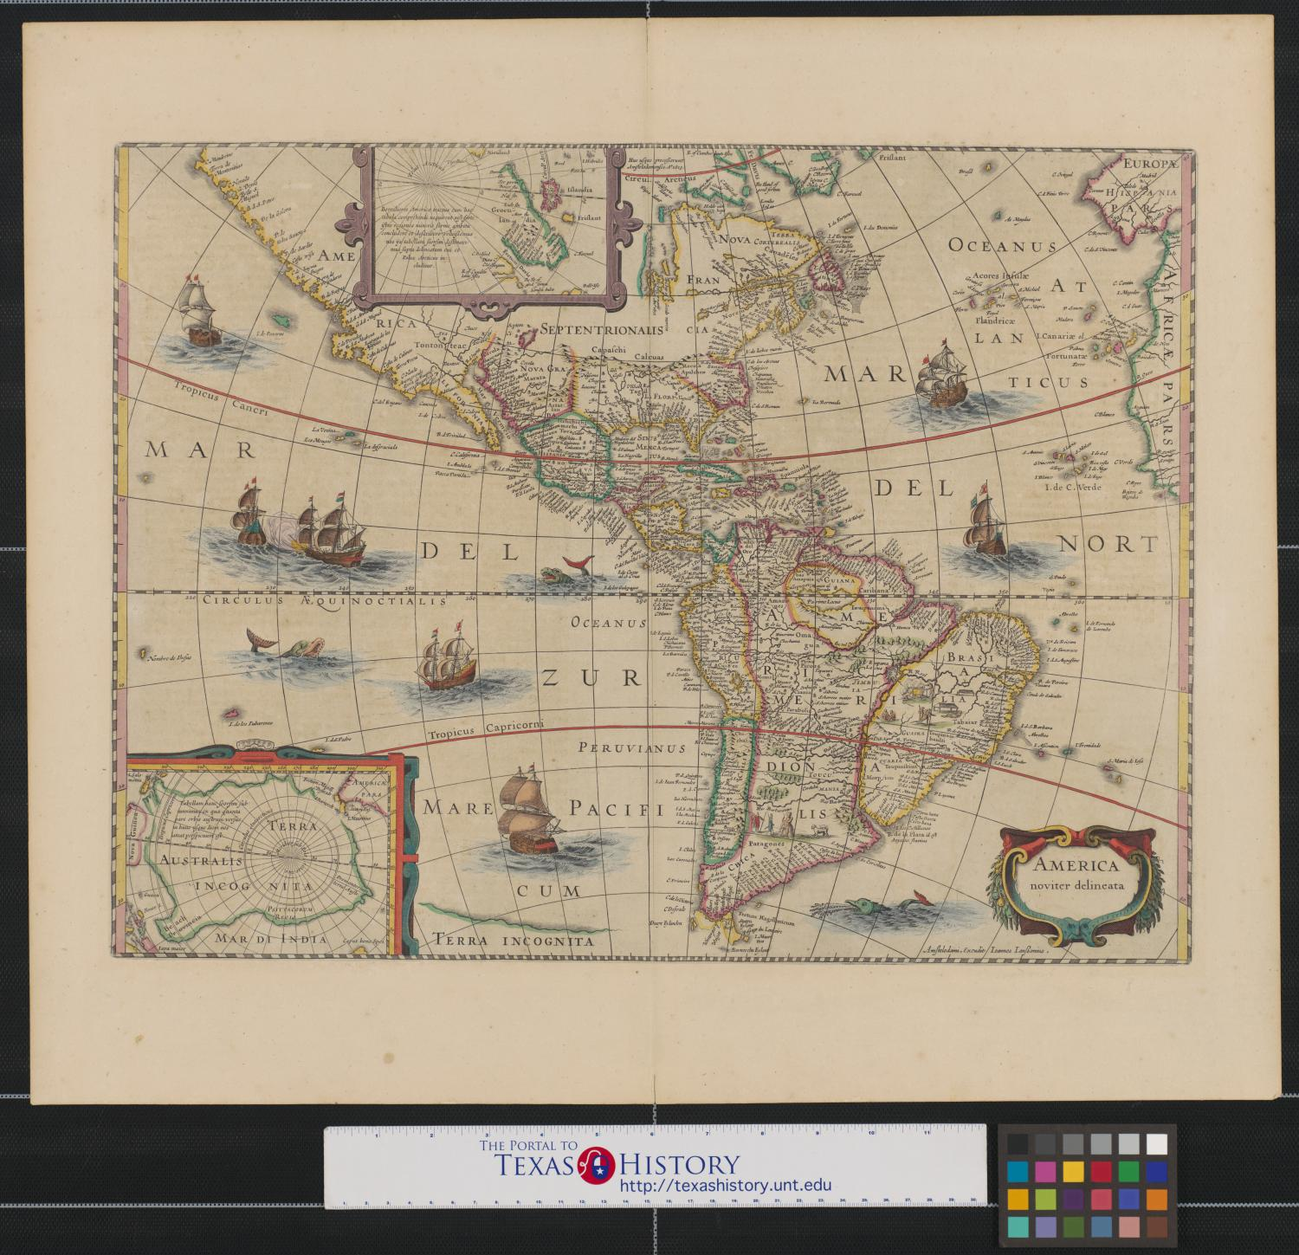
Directions for the Lesson
Read each short passage for information about an event or events from the Mexican Era.
Record information about each reading in the correct place on your timeline assignment.
Read the specific, step-by-step directions for Part I on your paper.
https://education.texashistory.unt.edu

Slide 9
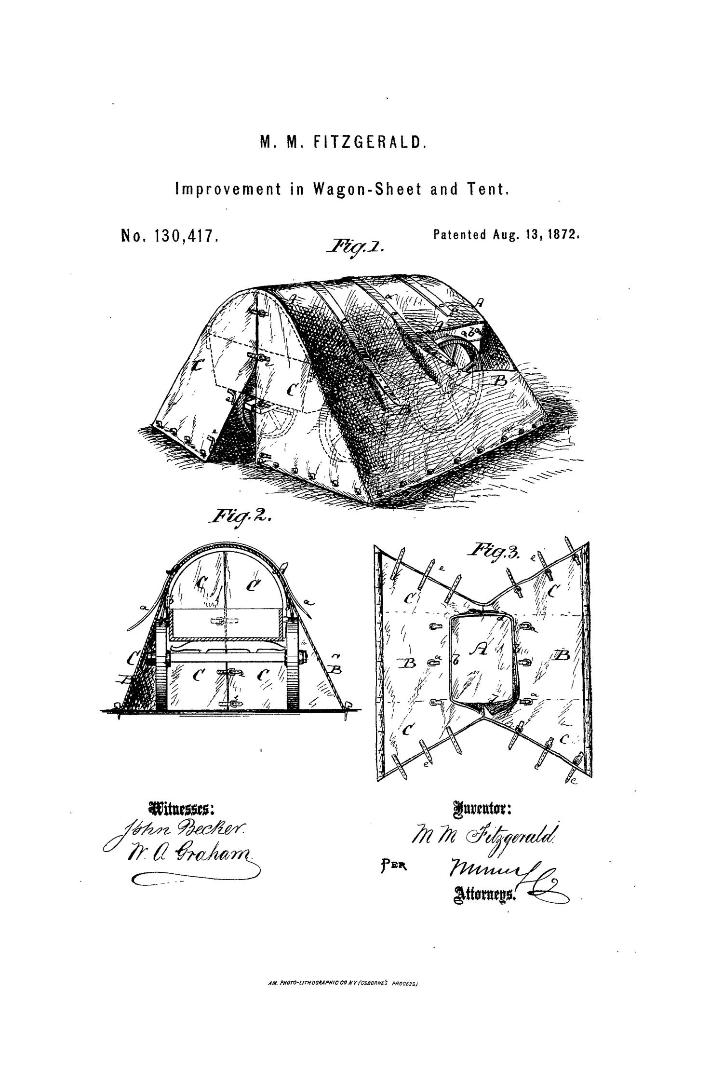
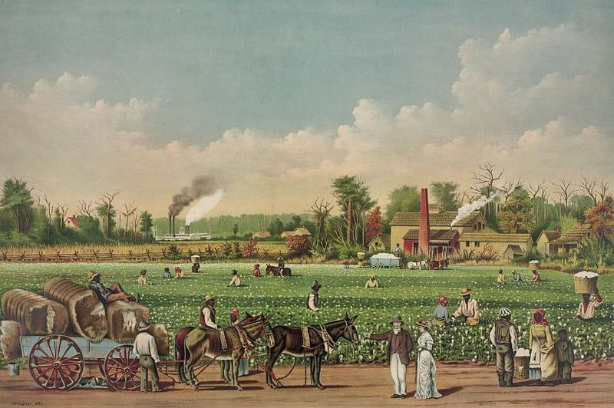
1) The Economy & the Cotton Revolution
A Cotton Plantation on the Mississippi River
The Library of Congress
https://education.texashistory.unt.edu
Notes:
A cotton plantation on the Mississippi, 1884. Currier & Ives : a catalogue raisonné / compiled by Gale Research. Detroit, MI : Gale Research, c1983, no. 1394. https://www.loc.gov/pictures/resource/pga.00675/

Slide 10
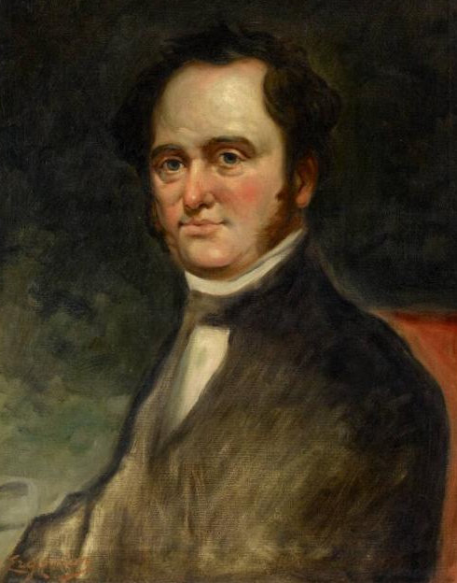
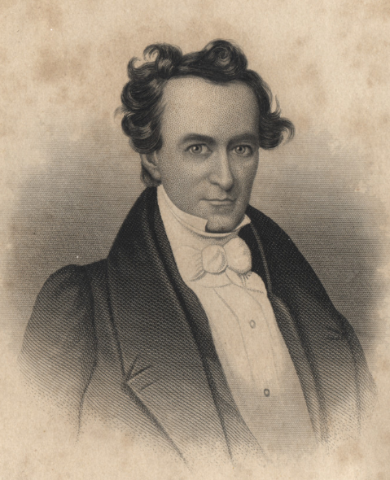
2) The Empresario System & the “Old 300”
Moses Austin
Museum of Fine Arts, Houston
Stephen F. Austin
The Portal to Texas History
https://education.texashistory.unt.edu
Notes:
Erganian, Sarkis. Portrait of Moses Austin (1761–1821). ca. 1900-23. Oil on canvas, 28 1/4 × 22 1/4 in. The Museum of Fine Arts Houston. https://emuseum.mfah.org/objects/110006/portrait-of-moses-austin-17611821#
[Engraving of Stephen F. Austin]. December 16, 1836. Artwork. University of North Texas Libraries, The Portal to Texas History; crediting Palestine Public Library. https://texashistory.unt.edu/ark:/67531/metapth11276/

Slide 11
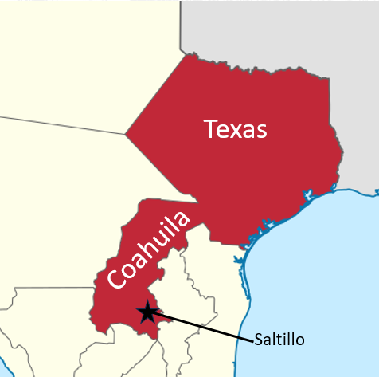
3) Political Challenges in Texas
https://education.texashistory.unt.edu
Notes:
Map of the states and territories of Mexico as they were from November 24 1824 to 1830. Permission is granted to copy, distribute and/or modify this document under the terms of the GNU Free Documentation License, Version 1.2 or any later version published by the Free Software Foundation; with no Invariant Sections, no Front-Cover Texts, and no Back-Cover Texts. A copy of the license is included in the section entitled GNU Free Documentation License. This file is licensed under the Creative Commons Attribution-Share Alike 3.0 Unported license.The image has been edited to zoom in on the state of Coahuila y Tejas and the capital of the state has been added to the image. https://commons.wikimedia.org/wiki/File:Mexico_1824-11-24_to_1830.png

Slide 12
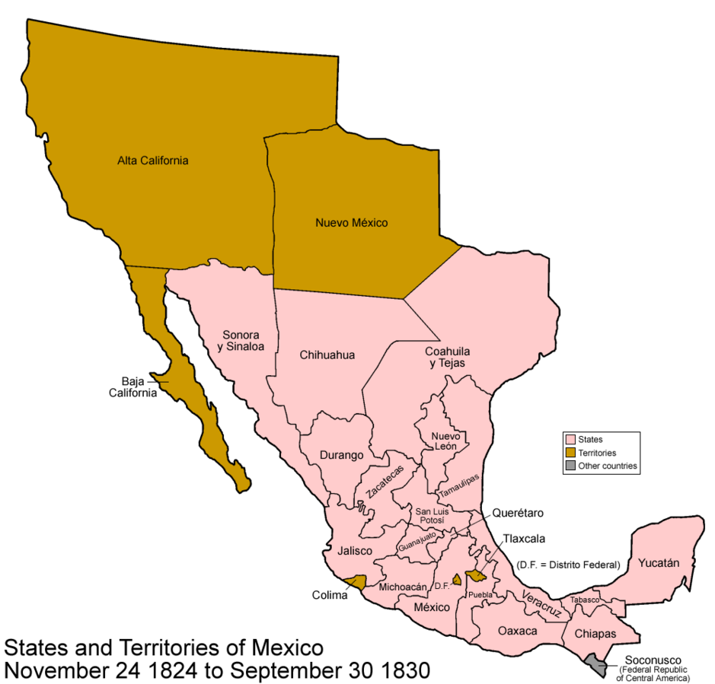
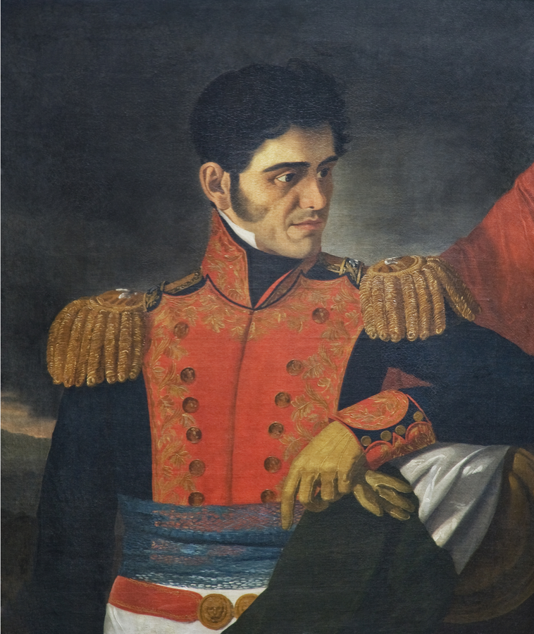
4) Political Challenges in Mexico
Antonio López de Santa Anna
Museo Nacional de Historia
https://education.texashistory.unt.edu
Notes:
Carlos Paris. Portrait of Antonio López de Santa Anna (1794-1876) Museo Nacional de Historia. This work is in the public domain in its country of origin and other countries and areas where the copyright term is the author's life plus 100 years or fewer. You must also include a United States public domain tag to indicate why this work is in the public domain in the United States. https://commons.wikimedia.org/wiki/File:Antonio_L%C3%B3pez_de_Santa_Anna,_siglo_XIX,_%C3%B3leo_sobre_tela.png
Mexico States and Territories, 1824 – 1830. This file is licensed under the Creative Commons Attribution-Share Alike 3.0 Unported license. https://commons.wikimedia.org/wiki/File:Mexico_1824-11-24_to_1830.png

Slide 13
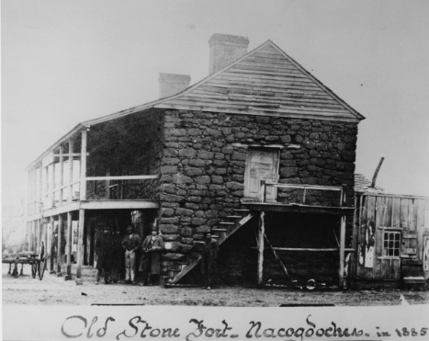
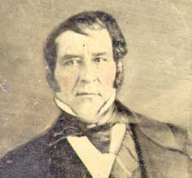
5) Trouble in Texas: The Fredonian Rebellion
Haden Edwards
The Old Stone Fort Occupied in the Fredonian Rebellion – The Portal to Texas History
https://education.texashistory.unt.edu
Notes:
[Old Stone Fort at Nacogdoches]. Photograph. University of North Texas Libraries, The Portal to Texas History; crediting University of Texas at Arlington Library. https://texashistory.unt.edu/ark:/67531/metapth38479/
The Empresario Haden Edwards. This media file is in the public domain in the United States. This applies to U.S. works where the copyright has expired, often because its first publication occurred prior to January 1, 1929, and if not then due to lack of notice or renewal. See this page for further explanation. https://commons.wikimedia.org/wiki/File:Haden_Edwards.jpg

Slide 14
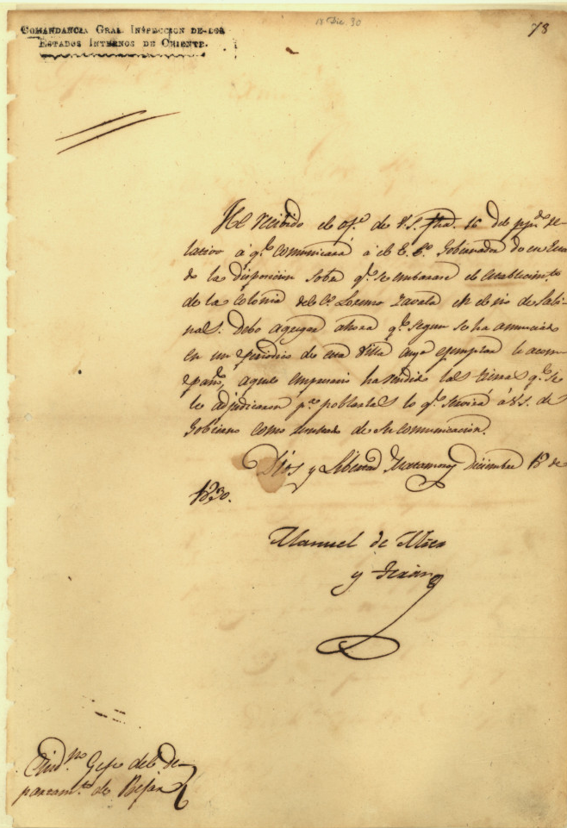
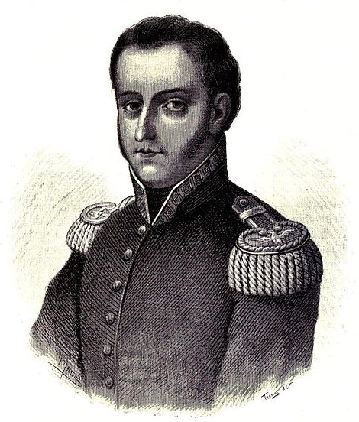
6) The Mier y Terán Report
General Manuel Mier y Terán
A letter written by Mier y Terán
The Portal to Texas History
https://education.texashistory.unt.edu
Notes:
Mier y Terán, Manuel de. Manuel de Mier y Terán, Commandant General, to Ramón Músquiz, Political Chief of Dept. of Béxar], letter, December 18, 1830; (https://texashistory.unt.edu/ark:/67531/metapth5846/: accessed December 16, 2024), University of North Texas Libraries, The Portal to Texas History, https://texashistory.unt.edu; crediting Texas General Land Office.
Imagen extraida del libro de Vicente Riva Palacio, Julio Zárate (1880) "México a través de los siglos" Tomo III: "La guerra de independencia" (1808 - 1821) Source: Vicente Riva Palacio, Julio Zárate (1880) "México a través de los siglos" Tomo III: "La guerra de independencia" (1808 - 1821) This work is in the public domain in its country of origin and other countries and areas where the copyright term is the author's life plus 100 years or fewer. You must also include a United States public domain tag to indicate why this work is in the public domain in the United States. https://commons.wikimedia.org/wiki/File:Manuel_de_Mier_y_Ter%C3%A1n.jpg

Slide 15
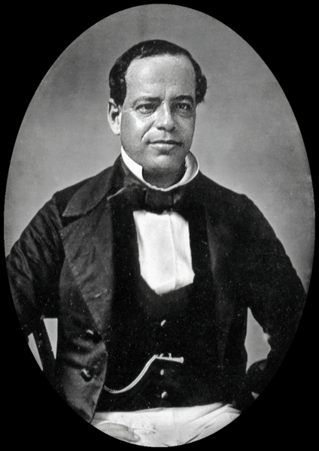
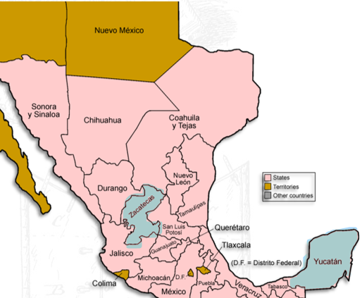
7) Growing Challenges to the Empresario System
States pictured in blue led the initial rebellions against Santa Anna’s centralist government
General Antonio Lopez de Santa Anna
SMU Digital Collections
https://education.texashistory.unt.edu
Notes:
Daguerreotype of Antonio López de Santa Anna, circa 1853. SMU Digital Collections.
This is a retouched picture, which means that it has been digitally altered from its original version. Modifications: elliptical crop, levels adjustment, removed minor artifacts. https://commons.wikimedia.org/wiki/File:Antonio_Lopez_de_Santa_Anna_c1853.png
Mexico States and Territories, 1824 – 1830. This file is licensed under the Creative Commons Attribution-Share Alike 3.0 Unported license. The image has been zoomed to better show the states that have been highlighted in blue. https://commons.wikimedia.org/wiki/File:Mexico_1824-11-24_to_1830.png

Slide 16
What’s the Story?
Exit Ticket
https://education.texashistory.unt.edu

Slide 17

Exit Ticket:
Follow the directions to complete your warm-up
Read the question
Determine which statement best describes the defining characteristics of the Mexican National Era
Discuss with a partner
https://education.texashistory.unt.edu

Slide 18
Share with the class 2
Read the answer choice that provides the best summary of the defining characteristics of the Spanish Colonial Era.
https://education.texashistory.unt.edu

