Slide 1
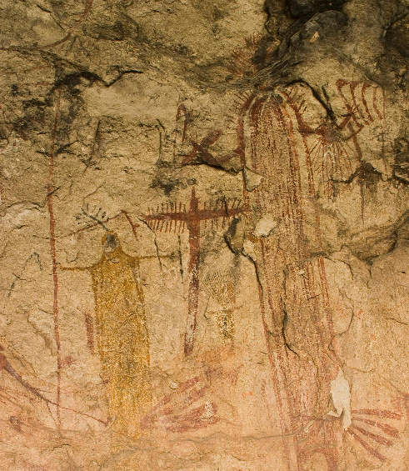
Unit 1: Natural Texas and Its People
Lesson 2:
How do we know what we know?

Slide 2

How do we know what we know? Warm-up
https://education.texashistory.unt.edu

Slide 3





Warm-up: Follow the directions below to complete your warm-up
Read the scenario.
Examine the list of items
Write your answer in the box provided.
While you wait for class to begin, share your responses with a shoulder partner.
Do not complete the Exit Ticket yet.
https://education.texashistory.unt.edu

Slide 4
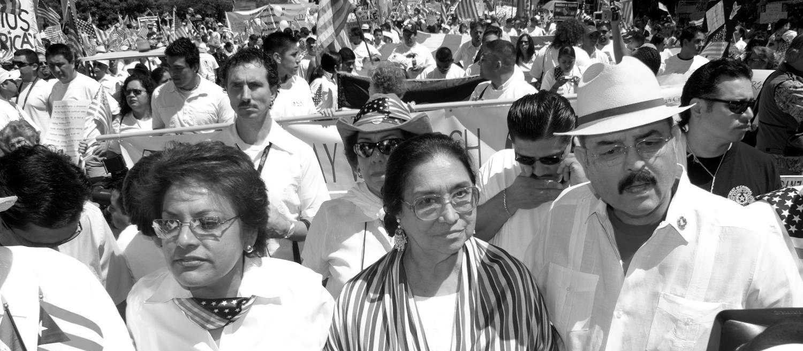
Warm-up: Share with the class
Directions: Use the sentence stem example below to share your answer with the class
“Based on the (specific item in the list), I can infer that the person who buried the box probably __________.”
https://education.texashistory.unt.edu

Slide 5
Essential Question
How do people today obtain* information about the past?
*Obtain: to get
https://education.texashistory.unt.edu

Slide 6
In today’s lesson…
We will examine and categorize different types of historical sources, discussing both their strengths and weaknesses.
I will make inferences about early Texas people by analyzing three American Indian artifacts.
https://education.texashistory.unt.edu

Slide 7
How do we know what we know? Lesson
https://education.texashistory.unt.edu

Slide 8
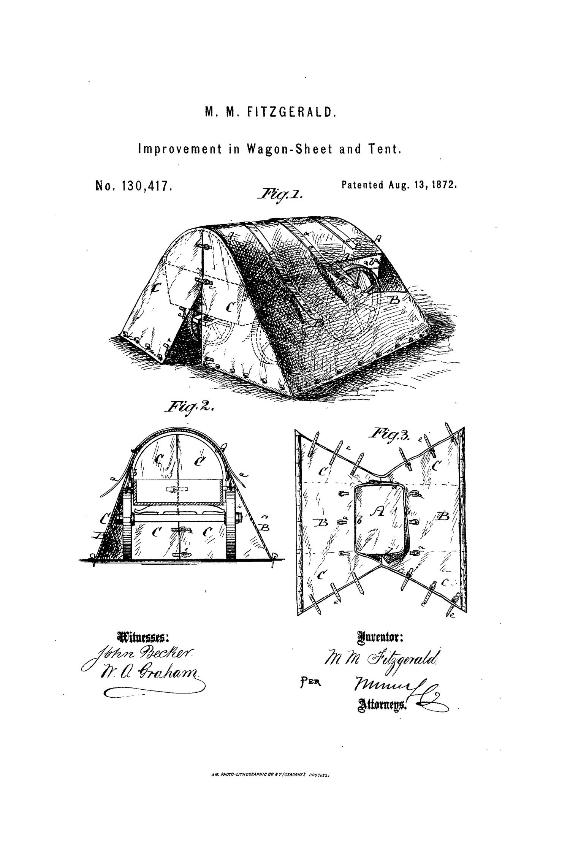

Has this ever happened to you?
You’re sitting in your social studies class, listening to your teacher tell you something that happened hundreds of years ago. You think, “But, how do we really know?” Your teacher wasn’t there. Where did we get the information?
How do you think we discover information about the past?
https://education.texashistory.unt.edu

Slide 9
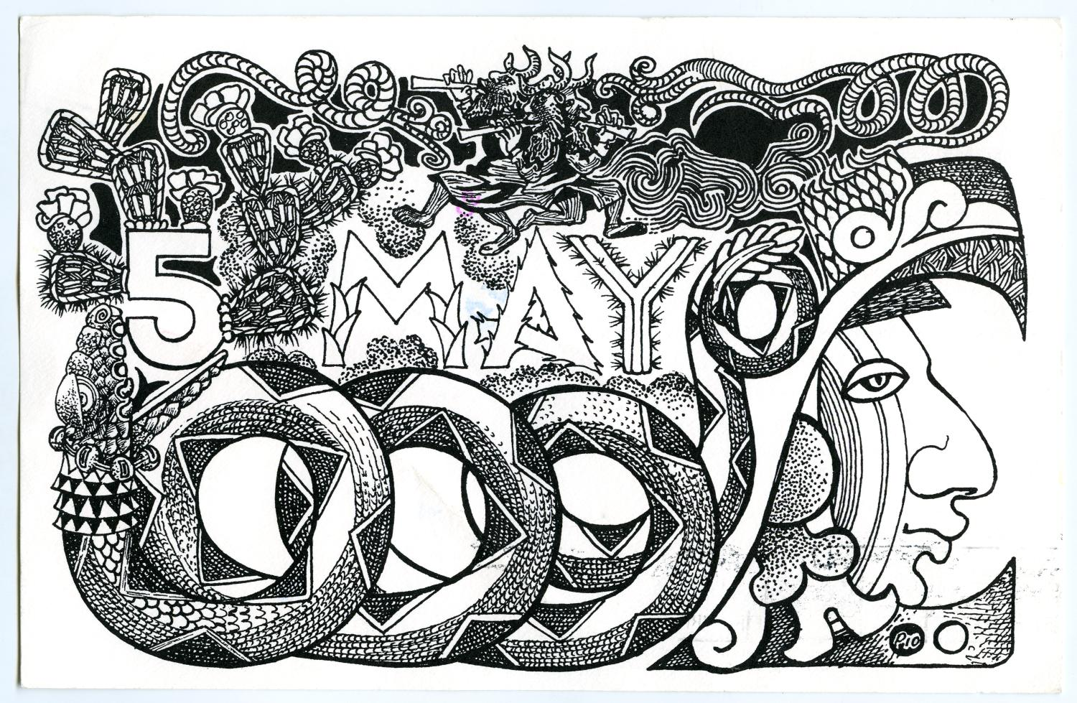
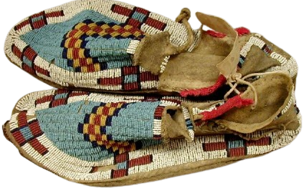
Artifacts
Make a prediction before you read. . .
What do you think the term “artifact” means based on this image and what we have talked about so far?
“I think artifact means __________ because __________”
https://education.texashistory.unt.edu
Notes:
Pair of beaded moccasins. The Portal to Texas History. https://texashistory.unt.edu/ark:/67531/metapth8340/.

Slide 10
Studying history with artifacts
Directions: Read the passage about artifacts and answer the questions that follow. Be prepared to share your responses with the class.
“An artifact is __________.”
“One example of an artifact from the reading activity is __________”
https://education.texashistory.unt.edu

Slide 11
Artifacts in your life
Directions: Share your answer to number three about artifacts in your life.
“An item in my life that could be an artifact for future people to study is _______. Future people might infer that I _______ based on this item.
https://education.texashistory.unt.edu

Slide 12
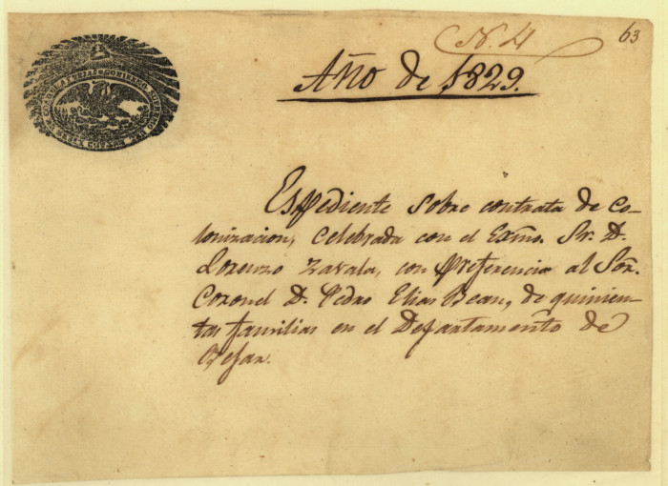
Primary Source
Make a prediction before you read. . .
What do you think the term “primary source” means based on this image and what we have talked about so far?
“I think primary source means ________ because ________”
https://education.texashistory.unt.edu
Notes:
Zavala, Lorenzo de. “Expediente of Lorenzo de Zavala’s 1829 Colonization Contract.” The Portal to Texas History, August 25, 2005. https://texashistory.unt.edu/ark:/67531/metapth5849.

Slide 13
What is a primary source?
Directions: Read the passage about primary and secondary sources. Share an example of a primary or secondary source from the list.
“One example of a primary source is __________.”
“One example of a secondary source is __________”
https://education.texashistory.unt.edu

Slide 14
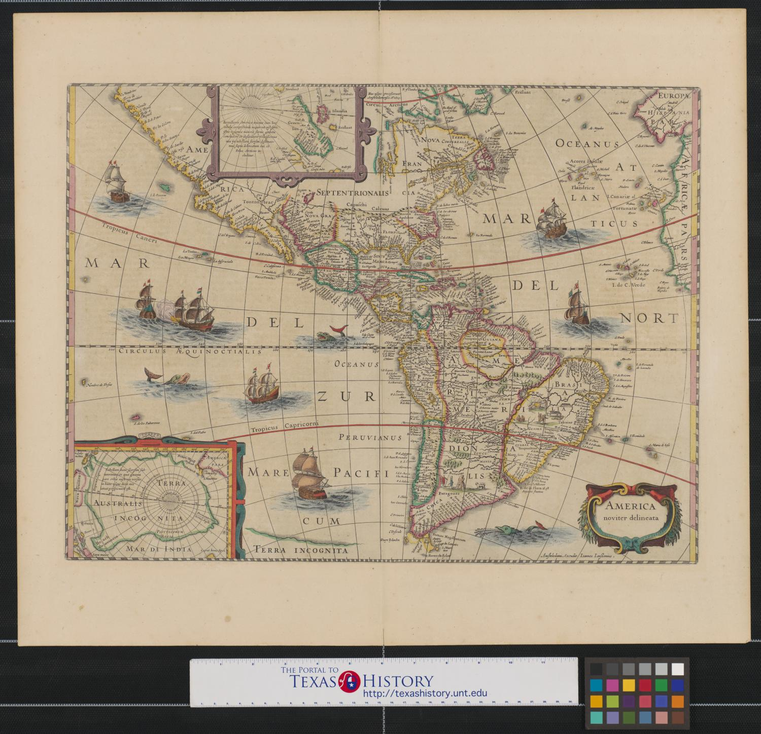

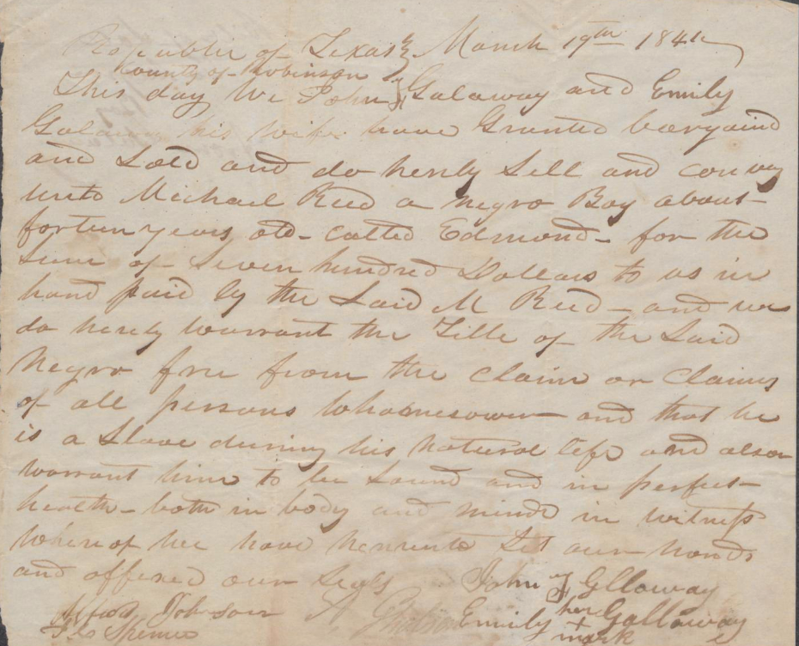
Using Primary Sources to Understand an Event
Read the passage about a specific event happening at a school. Answer the questions that follow.
https://education.texashistory.unt.edu
Notes:
Galloway, John, and Emily Galloway. “Bill of Sale for Negro Boy from Galaway.” The Portal to Texas History, September 15, 2017. https://texashistory.unt.edu/ark:/67531/metapth880958/.

Slide 15
Share your responses
“Bias means ________”
“Bias influenced how the students talked about the incident in the hall when _____”
“I think I could get the most accurate account of events by ______”
https://education.texashistory.unt.edu

Slide 16
Primary Sources Benefits and Drawbacks
Statement | Benefit | Drawback
Primary sources usually present only one person’s point of view of an historic event
2. Primary sources give us a firsthand account of an event
3. Primary sources help us understand past peoples’ experiences
4. Primary sources often contain biases that don’t reflect the whole truth
https://education.texashistory.unt.edu

Slide 17
Writing Exercise
Example sentence structure:
Primary sources are helpful because they provide us with a firsthand account of an event, however we should be aware that they also might present only one point of view.
https://education.texashistory.unt.edu

Slide 18
Evaluating Primary Sources
Use the images on your worksheet to complete the chart.
The images can also be found on this presentation to see them better.
https://education.texashistory.unt.edu

Slide 19
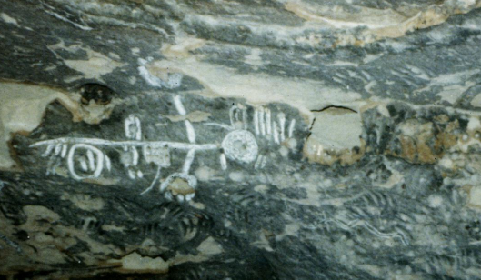
Figure 1: Indian petroglyphs, The Portal to Texas History
https://education.texashistory.unt.edu
Notes:
--Indian Petroglyphs. 1968. Photograph, 3.5 x 3.5 in. (8.89 x 8.89 cm). The Portal to Texas History. https://texashistory.unt.edu/ark:/67531/metapth40097/

Slide 20
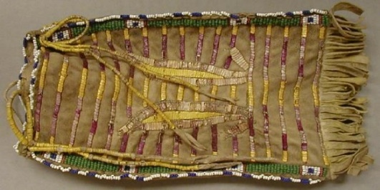
Figure 2: Elongated, rectangular buckskin beaded Indian bag, The Portal to Texas History
https://education.texashistory.unt.edu
Notes:
--Elongated, rectangular buckskin beaded Indian bag. Leather, 23 x 10.7. The Portal to Texas History. https://texashistory.unt.edu/ark:/67531/metapth8349/

Slide 21
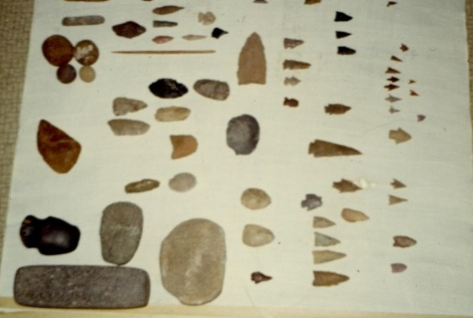
Figure 3: Indian stone tool artifacts from the Buddy Webb family, The Portal to Texas History
https://education.texashistory.unt.edu
Notes:
--Indian Artifacts from the Buddy Webb Family. 1968. Photograph, 3.5 x 3.5 in (8.89 x 8.89 cm). The Portal to Texas History. https://texashistory.unt.edu/ark:/67531/metapth89212/.

Slide 22
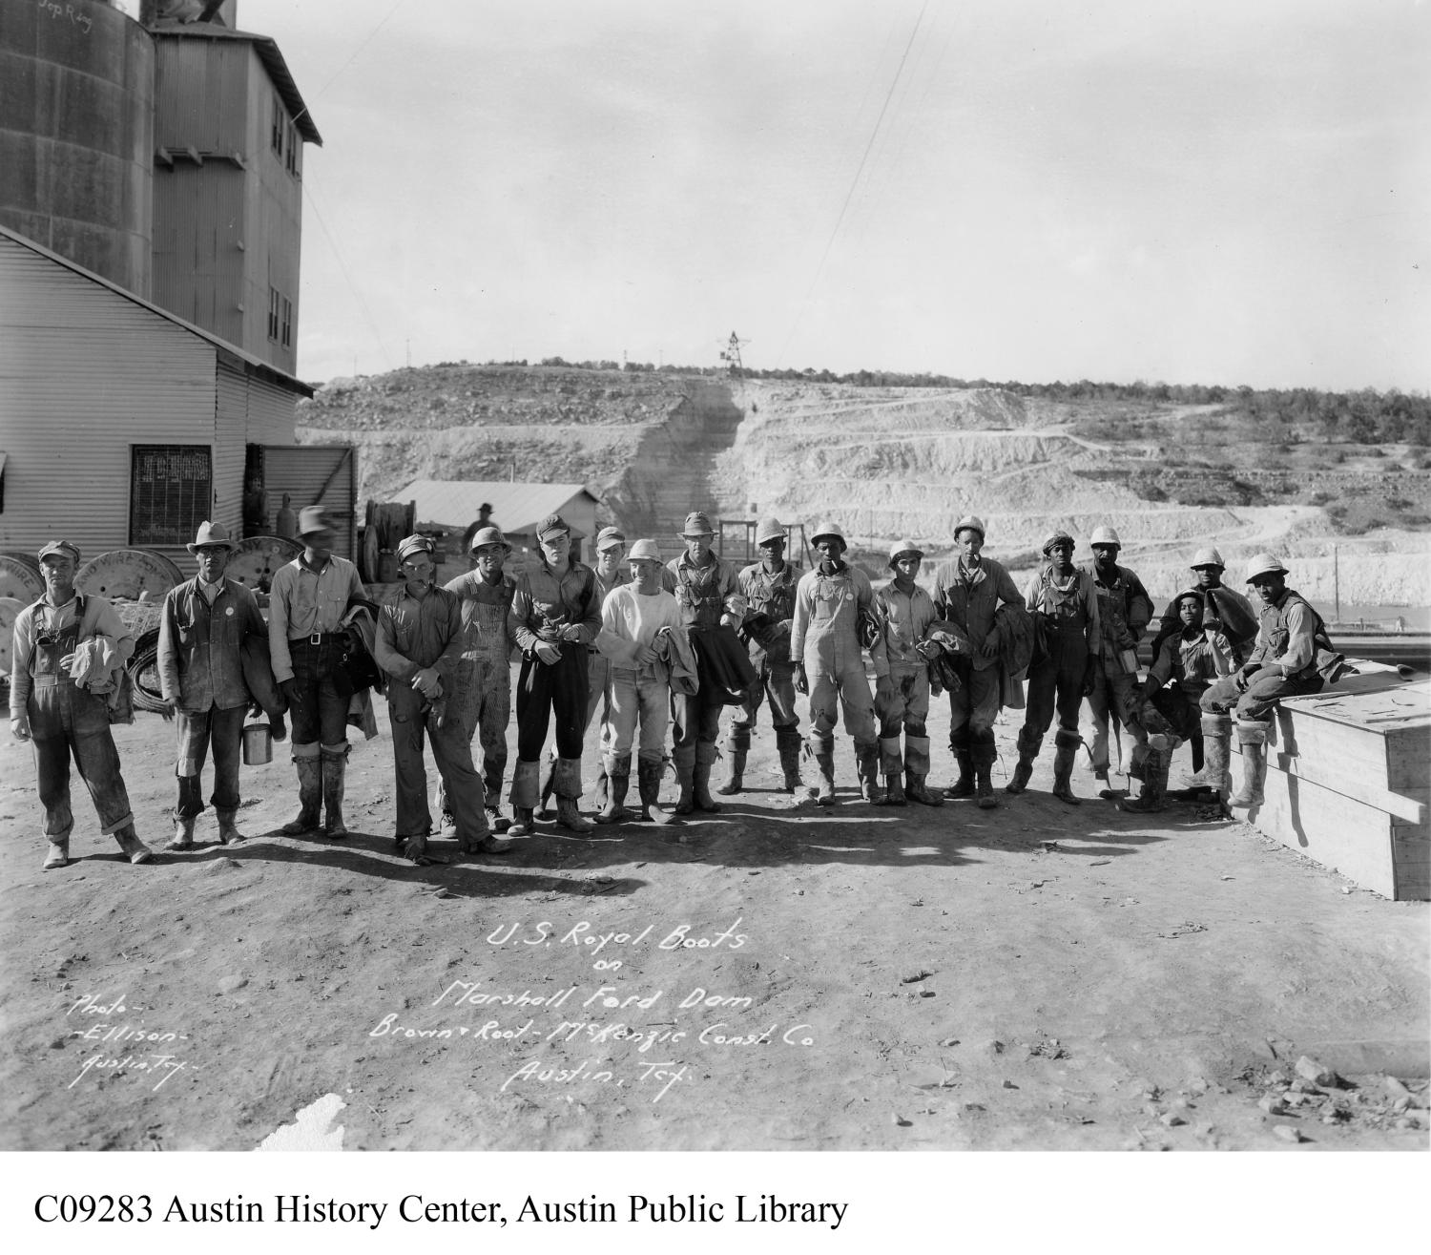
Share with the class
First Item:
Petroglyphs
(rock art)
Second Item:
Beaded bag
Third Item:
Stone tools
“One thing I inferred about the (name of item) was that _________
“One question I had about the (name of item) was _________”
https://education.texashistory.unt.edu

Slide 23
Important Note:
Why is there not much written information from American Indians in the past?
“There is not much written information from American Indians in the past because _____”
https://education.texashistory.unt.edu

Slide 24
Important Note: 2
What do you think the difficulties of only using artifacts to study past people might be?
“I think one of the difficulties of only using artifacts to study past people is _________”
https://education.texashistory.unt.edu

Slide 25
How do we know what we know? Exit Ticket
https://education.texashistory.unt.edu

