Slide 1
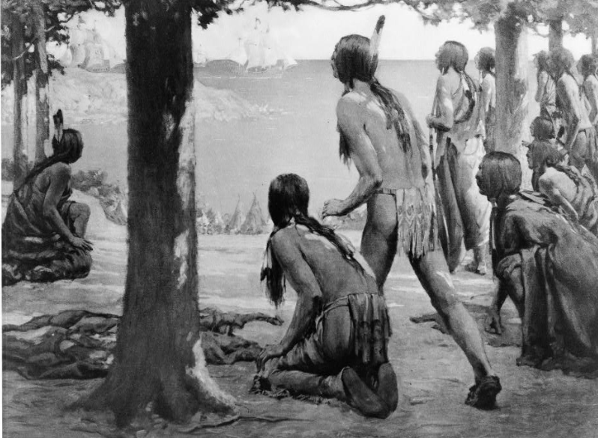
Unit 1:
Natural Texas and Its People
Lesson 8:
Looking Ahead
Notes:
--The Coming of white man. 1914. Paintings and reproductions. https://www.loc.gov/item/93500490/.

Slide 2

Looking Ahead
Warm-up
https://education.texashistory.unt.edu

Slide 3

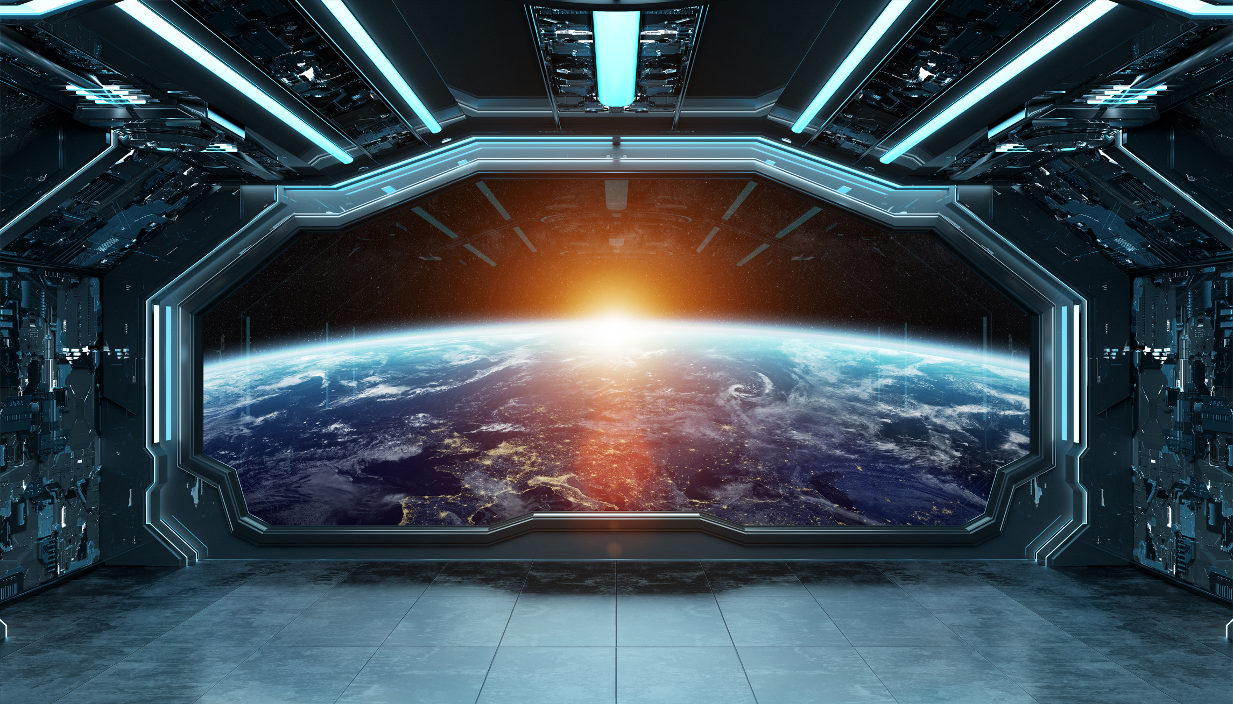


Warm-up
Follow the directions to complete your warm-up
Imagine your experience landing on another planet with human life.
Record your responses to the prompts in your warm-up.
Discuss with a partner.
https://education.texashistory.unt.edu
Notes:
--Microsoft PowerPoint Stock Images

Slide 4
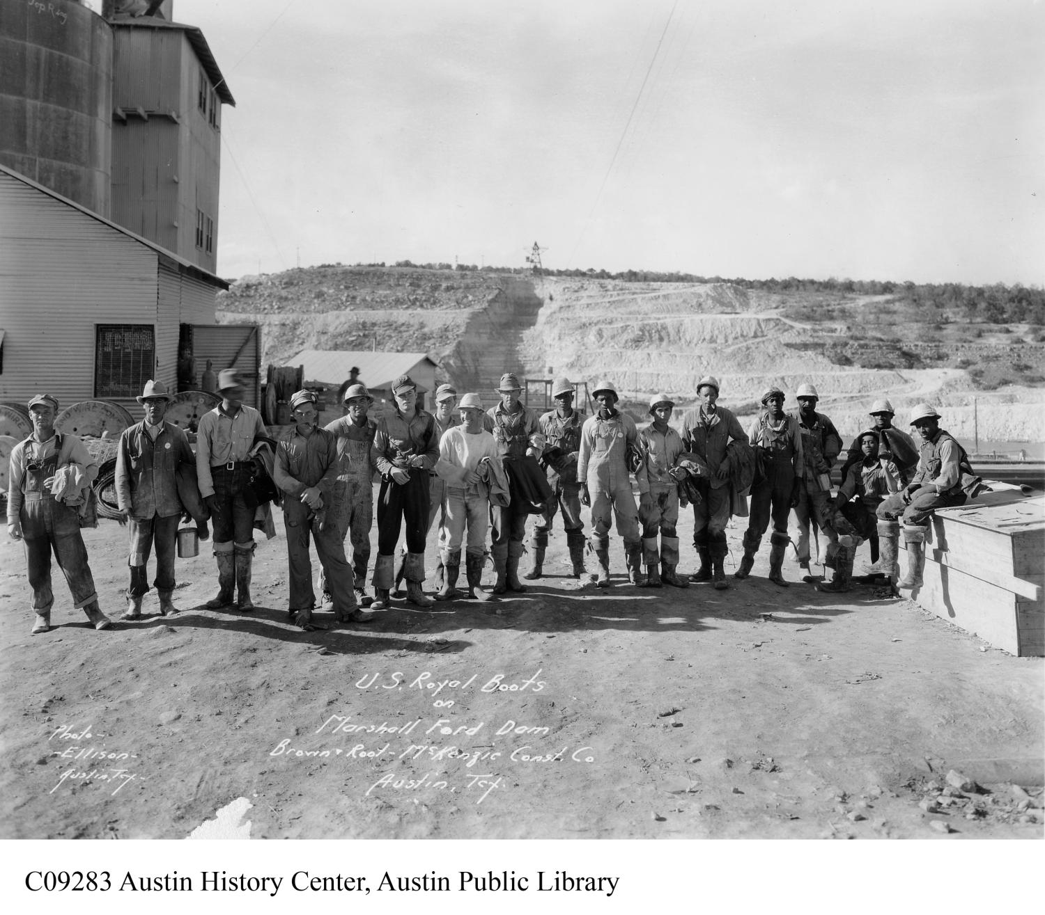
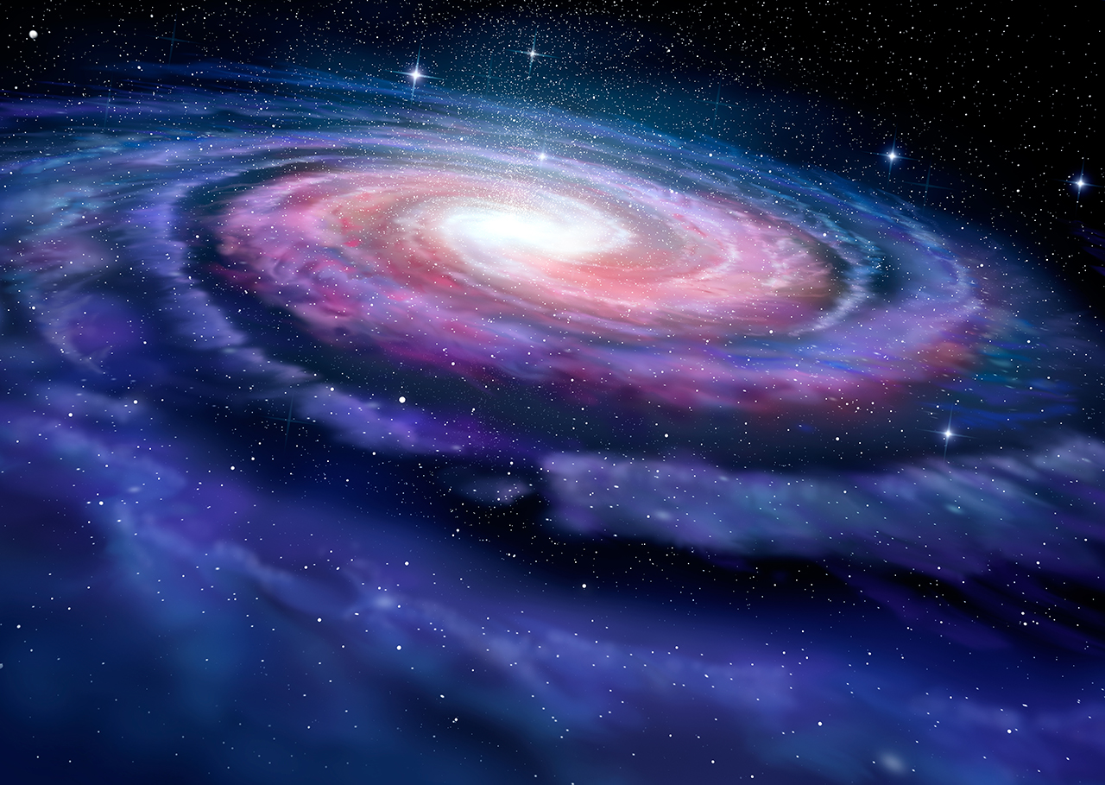
Share with the class
Read your response for the class
https://education.texashistory.unt.edu
Notes:
--Microsoft PowerPoint stock image

Slide 5
Essential Question
How might the arrival of new people from a different culture affect American Indians in Texas and the course of Texas history?
https://education.texashistory.unt.edu

Slide 6
In today’s lesson…
We will examine and anticipate the outcome of the first encounters between Spanish explorers and American Indians in Texas.
I will analyze a primary source document about the first encounter between Texas Indians and Spanish explorers.
https://education.texashistory.unt.edu

Slide 7
The End of an Era
Part I
https://education.texashistory.unt.edu

Slide 8
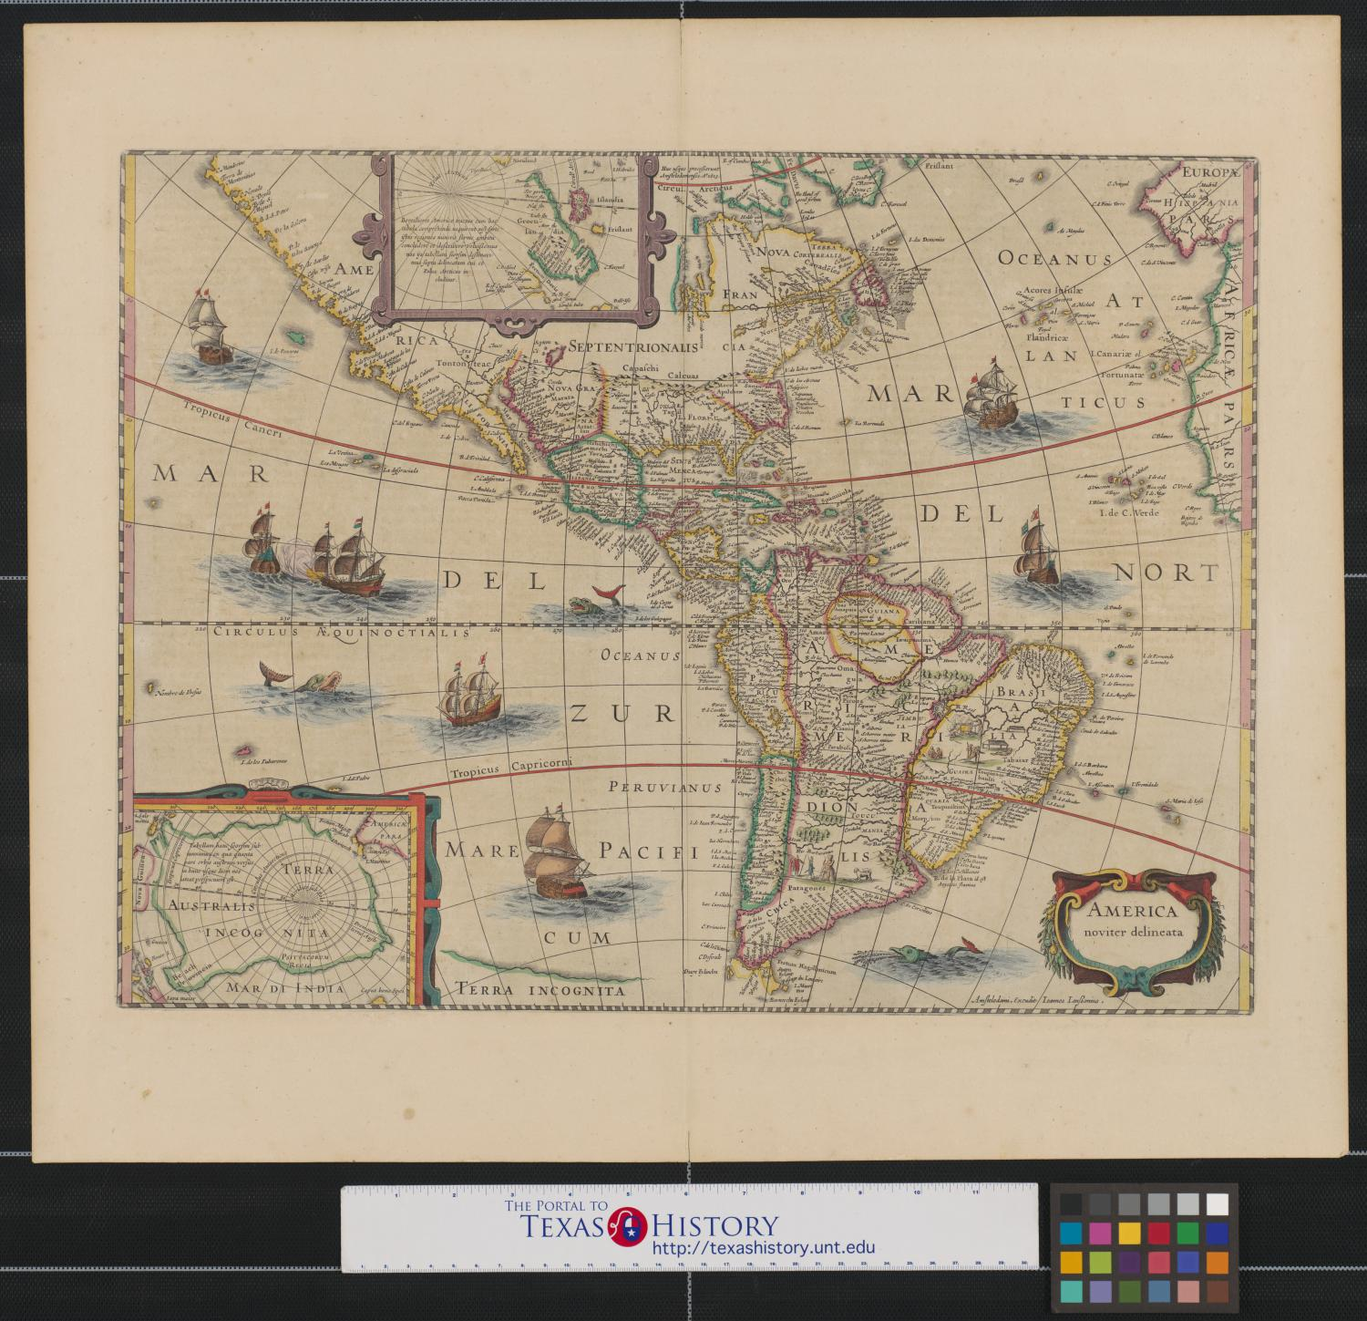
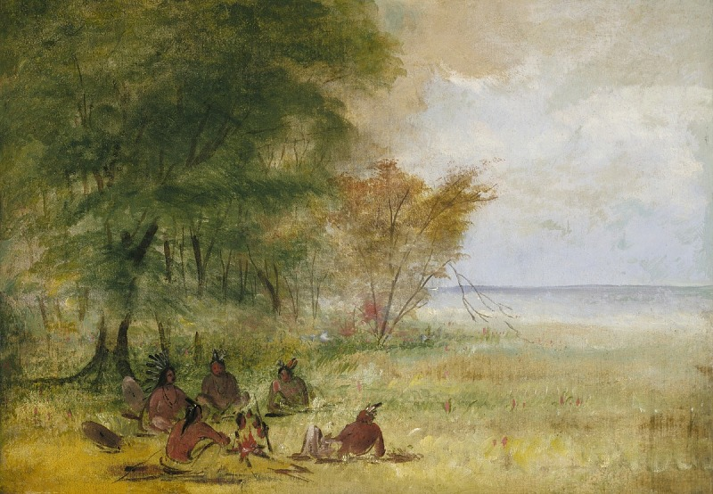
Part I: The End of an Era
For 12,000 years on the land we now call Texas, American Indians had lived, worked, played, established communities, raised families, ran their governments, formed alliances, and fought their enemies. This era of Texas history was a time characterized by Indigenous people living their lives, without any influence from outside of the Americas.
A gathering of American Indians
https://education.texashistory.unt.edu
Notes:
-- Sioux Indian Council, Chiefs in Profound Deliberation. Oil on canvas. George Catlin. Smithsonian American Art Museum, Gift of Mrs. Joseph Harrison, Jr. Sioux Indian Council, Chiefs in Profound Deliberation | Smithsonian Institution

Slide 9
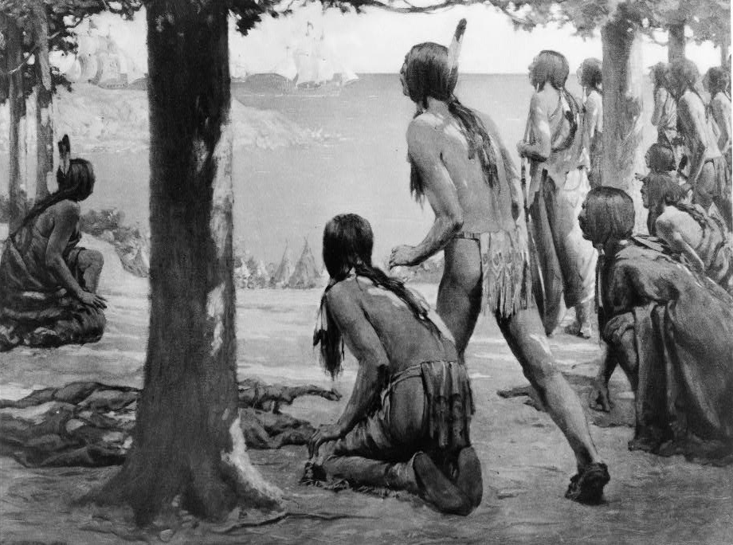
Part I: The End of an Era 2
Then, on what probably seemed like any other November day in 1528, a group of American Indians along the coast encountered unknown people from a far-off place. This encounter set off a chain of events that would change Texas history forever.
American Indians view far off ships in the distance
https://education.texashistory.unt.edu
Notes:
--The Coming of white man. 1914. Paintings and reproductions. https://www.loc.gov/item/93500490/.

Slide 10
Answer the Comprehension Questions
Use the sentence stems to share your prediction
I think the unknown people are _________
I think the outcome of the encounter will be_________
https://education.texashistory.unt.edu

Slide 11
Two Worlds Collide
Part II
https://education.texashistory.unt.edu

Slide 12
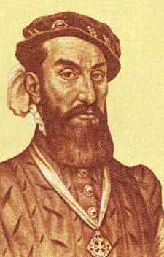
Part II: Two Worlds Collide
In November of 1528, a group of Spanish explorers met members of the Karankawa tribe of the Coastal Plains. The Spanish men were shipwrecked, lost, and starving. One of the survivors, a man named Alvar Nuñez Cabeza de Vaca, would later write a book about his experience. In his book, he detailed this first encounter between the Spanish and the Indigenous people of Texas.
Cabeza de Vaca
https://education.texashistory.unt.edu
Notes:
--Portrait of Cabeza de Vaca. Wikimedia Public Domain. File:Cabeza de Vaca Portrait.jpg - Wikimedia Commons

Slide 13

Part II: Two Worlds Collide 2
They . . . saw that three Indians, with bows and arrows, were following and calling to him, while he did the same to them by signs. So he came to where we were, the Indians remaining behind, seated on the beach. Half an hour after a hundred Indian archers joined them, and our fright was such that, whether tall or little, it made them appear giants to us. They stood still close to the first ones, near where we were.
The Journey of Alvar Nuñez Cabeza de Vaca and His Companions from Florida to the Pacific, 1528-1536, The Portal to Texas History, University of North Texas
https://education.texashistory.unt.edu
Notes:
--Portrait of Cabeza de Vaca. Wikimedia Public Domain. File:Cabeza de Vaca Portrait.jpg - Wikimedia Commons

Slide 14
Answer the Comprehension Questions 2
Use the sentence stems to share your answer to number three
I think the early people might have felt _________ because ____________
https://education.texashistory.unt.edu

Slide 15
Another Point of View
Part III - Advanced
https://education.texashistory.unt.edu

Slide 16
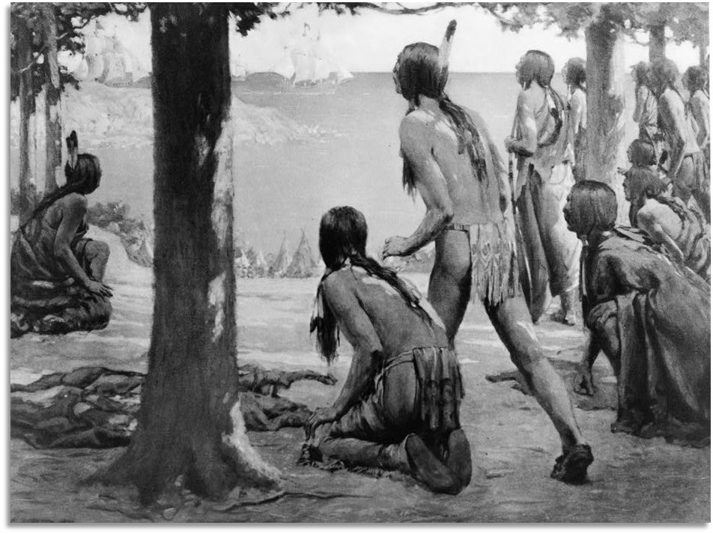
Part III: Another Point of View
Follow the instructions to write about the encounter from another point of view.
https://education.texashistory.unt.edu
Notes:
----The Coming of white man. 1914. Paintings and reproductions. https://www.loc.gov/item/93500490/.

Slide 17
Looking Ahead
Exit Ticket
https://education.texashistory.unt.edu

Slide 18
Exit Ticket
Follow the directions to complete your Exit Ticket
Consider the space travel encounter in our Warm-up from the opposite perspective. You are the person on the far-off planet and strangers arrive at your home.
Write your response in the box provided.
Discuss with a partner.
https://education.texashistory.unt.edu

Slide 19
Share with the class 2
Read your response for the class
https://education.texashistory.unt.edu
Notes:
--Microsoft PowerPoint stock image

