Slide 1
Mind Map
Sub-topic
1
Additional information
Sub-topic
2
Main Topic
Additional information
Sub-topic
3
Additional information
Additional information
https://education.texashistory.unt.edu

Slide 2
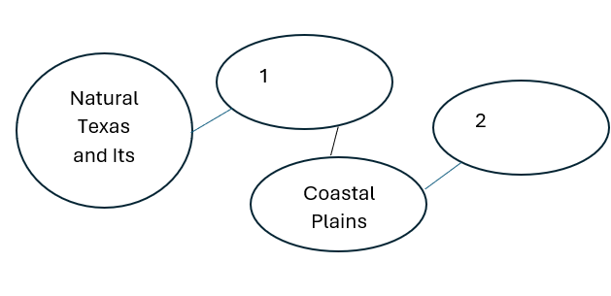
Warm-up: Follow the directions on your warm-up
Use the answer choices on your warm-up to fill in the missing information on this Mind Map.
Discuss with a partner.
https://education.texashistory.unt.edu

Slide 3
Share with the class
Natural Texas and Its People connects to number 1:_____________, which connects to the Coastal Plains, which connects to number 2: ____________.
https://education.texashistory.unt.edu

Slide 4
Essential Question
How do the key terms and concepts from Unit 1: Natural Texas and Its People connect to each other?
https://education.texashistory.unt.edu

Slide 5
In today’s lesson…
We will make connections between key terms and concepts within all of Unit 1: Natural Texas and Its People
I will create a Mind Map using terms and concepts from the class slides presentation.
https://education.texashistory.unt.edu

Slide 6
Unit Topic & Subtopics
Which of the titles in the boxes below is the main topic of our unit?
Draw a circle in the middle of your Mind Map and write the main topic inside.
Texas Regions
American Indians
Natural Texas & its People
https://education.texashistory.unt.edu

Slide 7
Make Connections
Connect each item below to the topic on your Mind Map.
Some items will connect directly to the main topic. Some will connect to other items from this slide.
Coastal Plains
Hot & arid
Mountains & Basins
North Central Plains
Great Plains
Marshy swampland
https://education.texashistory.unt.edu

Slide 8
Make Connections 2
Connect each item below to the topic on your Mind Map.
Some items will connect directly to the main topic. Some will connect to other items from this slide or previous slides.
Some items could be placed in more than one location on your map.
Caddo
Least precipitation
Flat, rolling grasslands
Coahuiltecan
Jumano
Wichita
https://education.texashistory.unt.edu

Slide 9
Make Connections 3
Connect each item below to the topic on your Mind Map.
Some items will connect directly to the main topic. Some will connect to other items from this slide or previous slides.
Some items could be placed in more than one location on your map.
Harsh climate
Fertile soil
Comanche
Humid
Tigua
Karankawa
https://education.texashistory.unt.edu

Slide 10
Make Connections 4
Connect each item below to the topic on your Mind Map.
Some items will connect directly to the main topic. Some will connect to other items from this slide or previous slides.
Some items could be placed in more than one location on your map.
Small grass huts
Teepees
Kiowa
Apache
Atakapa
Piney Woods
https://education.texashistory.unt.edu

Slide 11
Make Connections 5
Connect each item below to the topic on your Mind Map.
Some items will connect directly to the main topic. Some will connect to other items from this slide or previous slides.
Some items could be placed in more than one location on your map.
High elevation
Bison
Alligators
Palo Duro Canyon
Hunter- gatherers
Most precipitation
https://education.texashistory.unt.edu

Slide 12
Make Connections 6
Connect each item below to the topic on your Mind Map.
Some items will connect directly to the main topic. Some will connect to other items from this slide or previous slides.
Some items could be placed in more than one location on your map.
Migrated to TX in 1700s
Adobe Pueblos
Large grass shelters
Nomadic
Sedentary
Agriculture
https://education.texashistory.unt.edu

Slide 13
Create Connections 6
Now take a few minutes to add any information you can think of to your Mind Map.
You can add facts, descriptions, explanations, cultural information, or anything else you can think of.
https://education.texashistory.unt.edu

Slide 14
Exit Ticket
Complete the sentence summarizing the main idea from our unit.
Discuss with a partner.
https://education.texashistory.unt.edu

Slide 15
Share your response
The _______ of Texas is significant because it is directly connected to __________
https://education.texashistory.unt.edu

