Slide 1
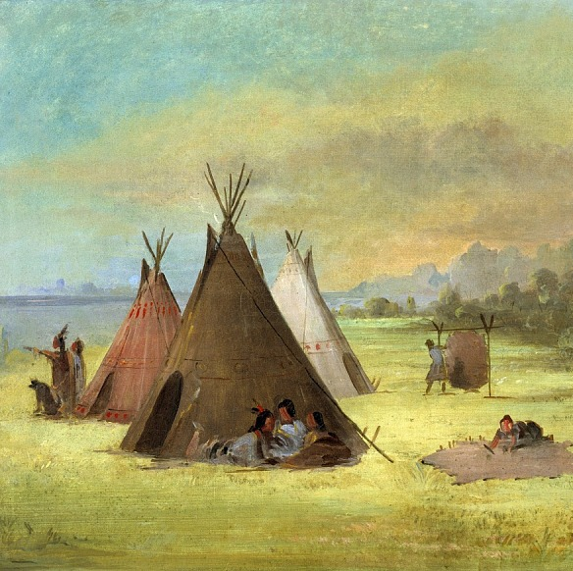
Unit 1: Natural Texas and Its People
Lesson 1:
The Big Picture
Notes:
Catlin, George. Indian Encampment, Comanche (or Kiowa) Dressing Skins, Red River, 1846-48. Oil on canvas, Smithsonian American Art Museum and its Renwick Gallery. https://www.si.edu/object/indian-encampment-comanche-or-kiowa-dressing-skins-red-river:saam_1985.66.597.

Slide 2





Helpful Action Guide
Look for these icons on each slide to help you know what to do.
Think
Consider, infer, compare, etc.
Look
Notice, examine, etc.
Write
Explain, summarize, define, etc.
Speak
Share with a partner or the class
https://education.texashistory.unt.edu

Slide 3
The Big Picture
Warm-up
https://education.texashistory.unt.edu

Slide 4

Warm-up:
Follow the directions below to complete your warm-up
Read each scenario under the column titled “What’s the issue?”
Think about how you would respond to each situation today and 1000 years ago.
Write your answers on your warm-up sheet.
While you wait for class to begin, share your responses with a shoulder partner.
Do not complete the Exit Ticket yet.
https://education.texashistory.unt.edu

Slide 5
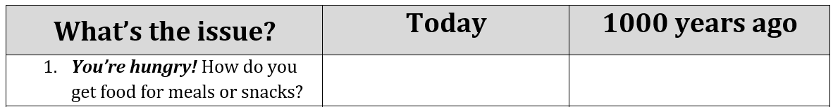
Warm-up:
Share with the class
Directions: Use the sentence stem example below to share your answer with the class
“When I’m hungry today, I _________, but 1000 years ago I would have probably __________.”
https://education.texashistory.unt.edu

Slide 6
Essential Question
What are the major themes of Unit 1: Natural Texas and Its People?
https://education.texashistory.unt.edu

Slide 7
In today’s lesson…
We will identify the main idea of this unit by analyzing a primary source and reading a short passage
I will make inferences and predictions about an image and summarize the main idea of a short passage.
https://education.texashistory.unt.edu

Slide 8
The Big Picture
Lesson
https://education.texashistory.unt.edu

Slide 9
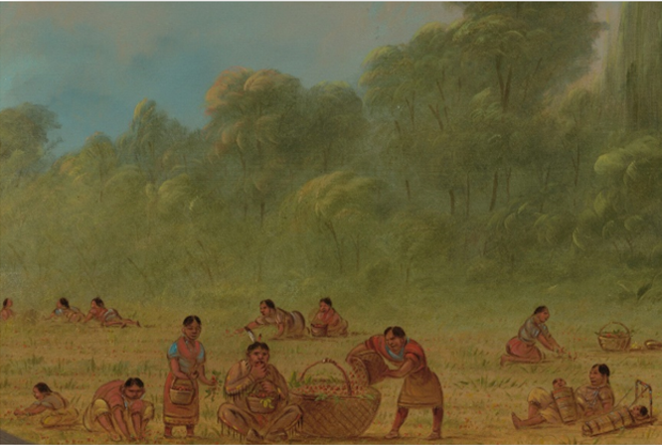
The Big Picture:
What are the major themes of this unit?
Analyze an Image:
Describe three things you notice in the image
Based on the image, what are two things you predict we might learn in this unit?
https://education.texashistory.unt.edu
Notes:
--Catlin, George. Caddoe Indians Gathering Wild Strawberries. 1861-69. Oil on card mounted on paperboard. National Gallery of Art. https://www.nga.gov/collection/art-object-page.50519.html.

Slide 10
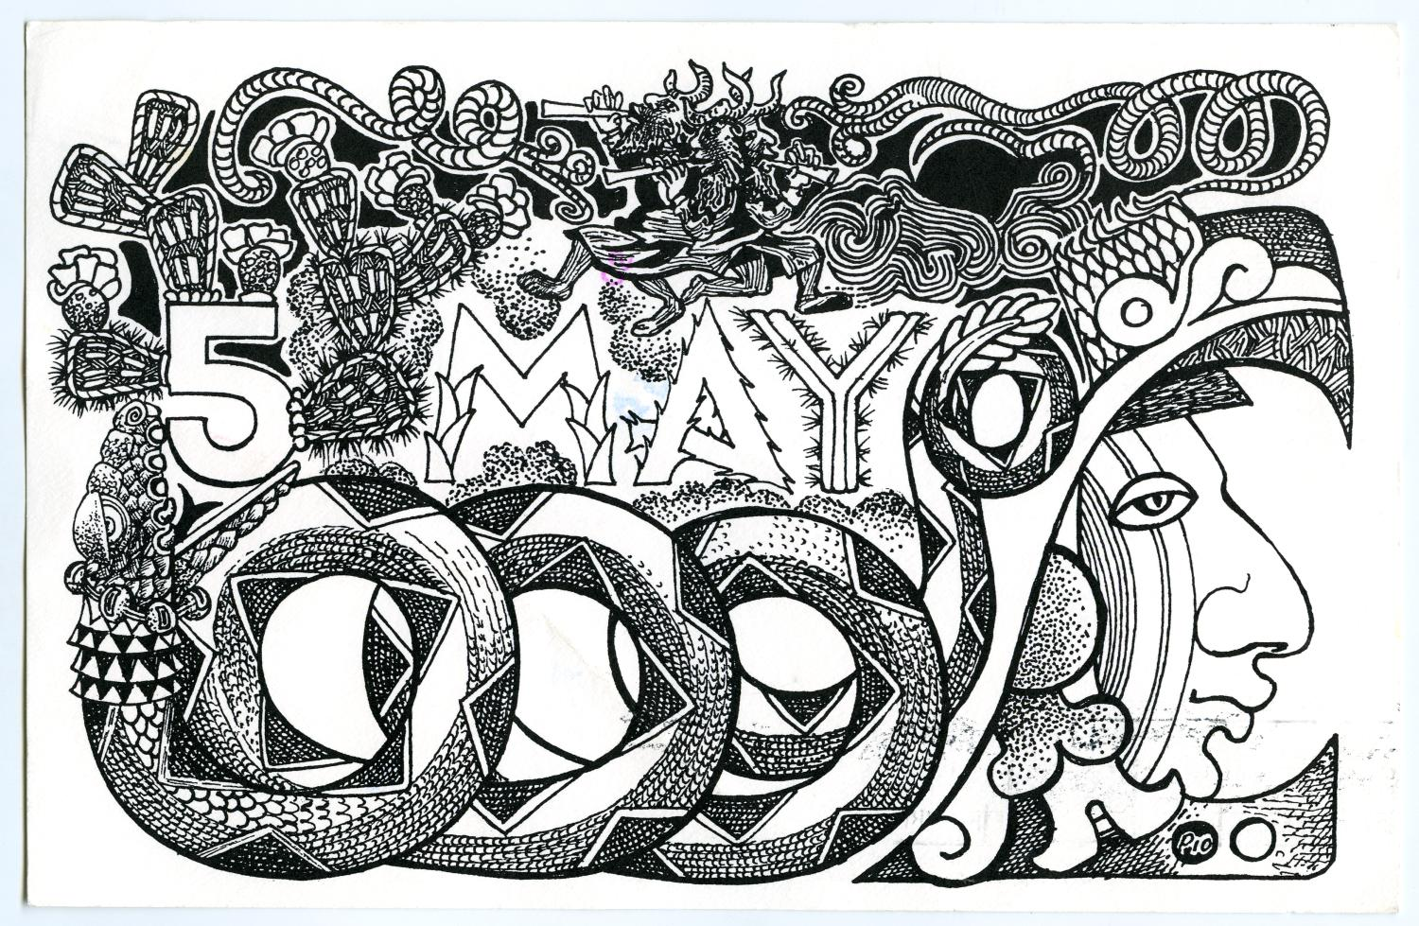
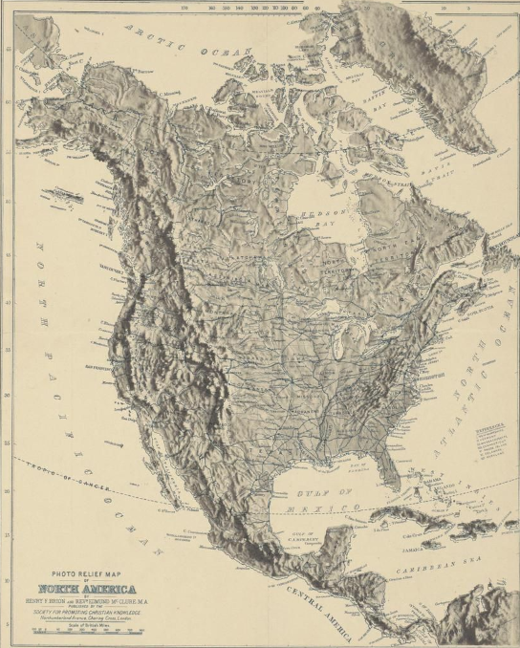

The First People in Texas
Background
The first evidence of human life in Texas dates back to approximately 12,000 years ago. These first people migrated into Texas from the Great Plains, most likely following herds of animals that they depended on for food. As they migrated into Texas, they spread out in search of resources and good places to live.
https://education.texashistory.unt.edu
Notes:
--Brion, Henry F. and Edmond McClure. Photo Relief Map of North America. 1885. The Portal to Texas History. https://texashistory.unt.edu/ark:/67531/metapth50293.

Slide 11
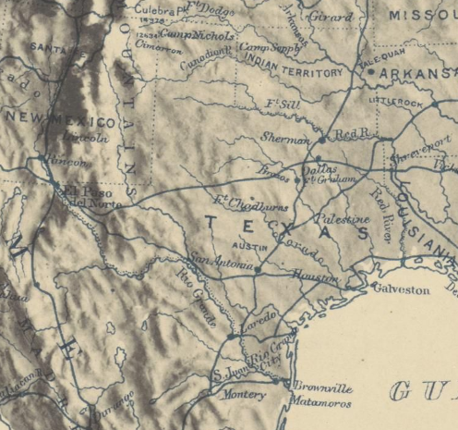
The First People in Texas
Background 2
It’s important to note that “Texas” as we know it now didn’t exist back then. The land was there, of course, but there were no borders to distinguish it from any other land around. These first people most likely didn’t call it Texas. In fact, the state we know now with its unique borders wouldn’t exist until thousands of years after these first people. In this unit, we will call it Texas because that’s how we understand the location of the land.
https://education.texashistory.unt.edu
Notes:
--Brion, Henry F. and Edmond McClure. Photo Relief Map of North America. 1885. The Portal to Texas History. https://texashistory.unt.edu/ark:/67531/metapth50293.

Slide 12
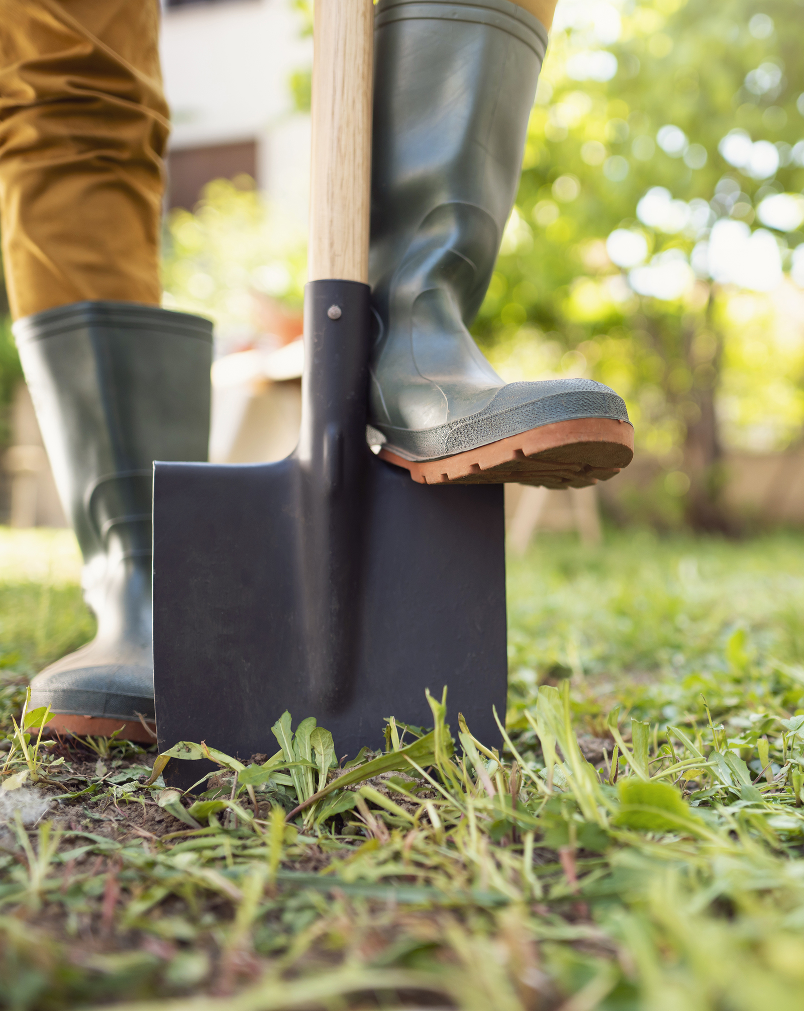
Let’s dig deeper!
Consider all the information you know so far…
The image
The class information
What you already know
Answer questions 1 through 4, making inferences* about the image based on your knowledge.
*Inferences: Educated guesses
Notes:
-- Microsoft Office Stock Image

Slide 13

Essential Ideas Reading Passage
First Read Through
Follow along as your teacher reads the passage.
Highlight or draw a star next to information you think is important.
Write a Question Mark next to anything you that you have questions about.
https://education.texashistory.unt.edu
Notes:
--Catlin, George. Caddoe Indians Gathering Wild Strawberries. 1861-69. Oil on card mounted on paperboard. National Gallery of Art. https://www.nga.gov/collection/art-object-page.50519.html.

Slide 14
Essential Ideas Reading Passage
Second Read Through
Follow along as your classmates read the passage.
After each paragraph, write a three- to five-word summary of the paragraph in your own words
After all three paragraphs, try to determine what ideas or themes are common in all of them. Discuss with the class.
https://education.texashistory.unt.edu
Notes:
--Catlin, George. Caddoe Indians Gathering Wild Strawberries. 1861-69. Oil on card mounted on paperboard. National Gallery of Art. https://www.nga.gov/collection/art-object-page.50519.html.

Slide 15
Essential Ideas Reading Passage
Final Read Through
Read through the passage a final time to yourself.
Answer the questions that follow using context clues from the passage.
Use your short summaries in the margins to write your own summary of the entire passage. Discuss with the class.
https://education.texashistory.unt.edu
Notes:
--Catlin, George. Caddoe Indians Gathering Wild Strawberries. 1861-69. Oil on card mounted on paperboard. National Gallery of Art. https://www.nga.gov/collection/art-object-page.50519.html.

Slide 16
The Big Picture
Exit Ticket
https://education.texashistory.unt.edu

Slide 17
Special Note:
In the 8th grade, you will take a Social Studies STAAR test that has several new types of questions on it.
Our Exit Tickets introduce these new types of questions. Practice now to become an expert on how to answer these questions in 8th grade!
https://education.texashistory.unt.edu

Slide 18

Exit Ticket
Read the passage.
Answer the question based on excerpts* from the passage.
*Excerpt: A short part of a larger text
https://education.texashistory.unt.edu
Notes:
-- Microsoft Office Stock Image

