Slide 1
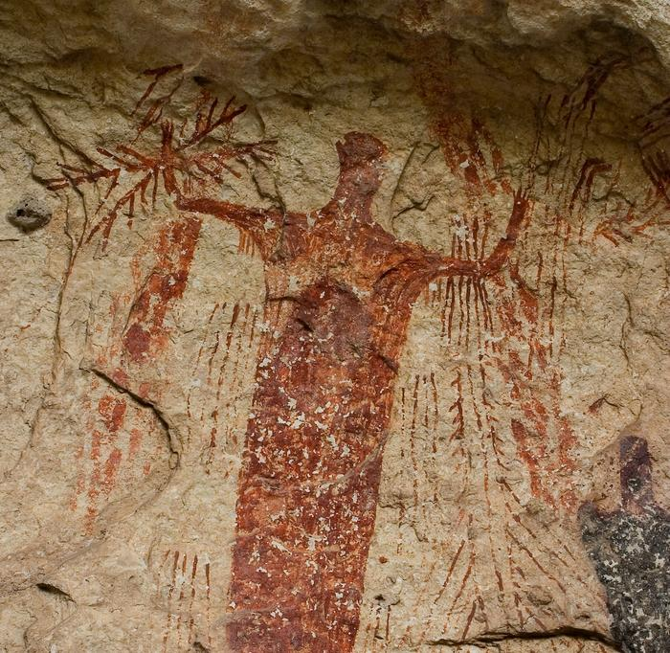
Unit 1:
Natural Texas and its People
Extension Lesson
Voices of Texas History
Notes:
--Mallory, Randy. [A pictograph of a humanoid figure], photograph, January 2005; (https://texashistory.unt.edu/ark:/67531/metadc1979768/: accessed July 30, 2024), University of North Texas Libraries, The Portal to Texas History, https://texashistory.unt.edu; crediting UNT Libraries Special Collections.

Slide 2




Warm-up
Follow the directions to complete your warm-up
Consider a significant person, place, thing, event, etc. from your life.
Draw an image that represents your significant thing.
Do NOT share with a partner. You’ll see why in the exit ticket.
https://education.texashistory.unt.edu

Slide 3
Essential Question
What is one way early people of Texas told their stories, and how does it help us learn about their lives today?
https://education.texashistory.unt.edu

Slide 4
In today’s lesson…
Day 1
We will examine an early American Indian artifact called pictographs.
I will read a passage about a specific collection of pictographs in south Texas from thousands of years ago and answer comprehension questions.
https://education.texashistory.unt.edu

Slide 5
Before you read
https://education.texashistory.unt.edu

Slide 6
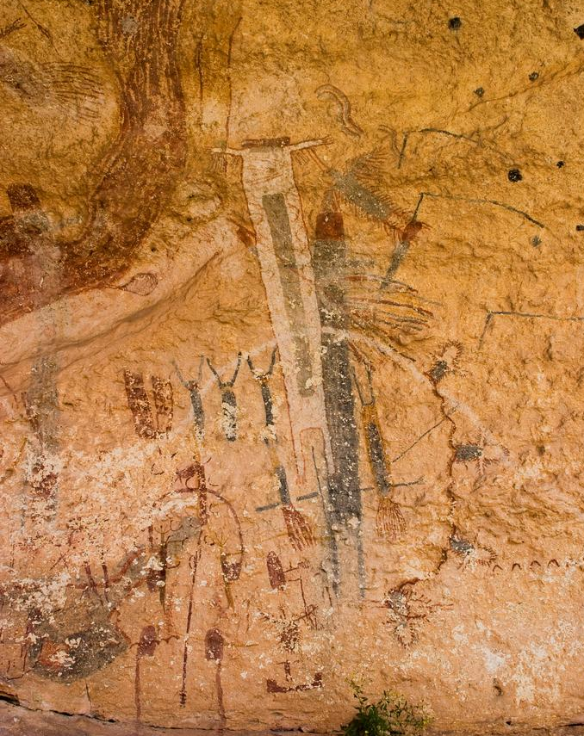
Consider
What do you see?
What do you notice?
What do you think this is?
How do you think it was made?
What can you infer about the people who created this?
https://education.texashistory.unt.edu
Notes:
--Mallory, Randy. [Prehistoric paintings on cavern walls], photograph, January 2005; (https://texashistory.unt.edu/ark:/67531/metadc1979766/: accessed July 30, 2024), University of North Texas Libraries, The Portal to Texas History, https://texashistory.unt.edu; crediting UNT Libraries Special Collections.

Slide 7
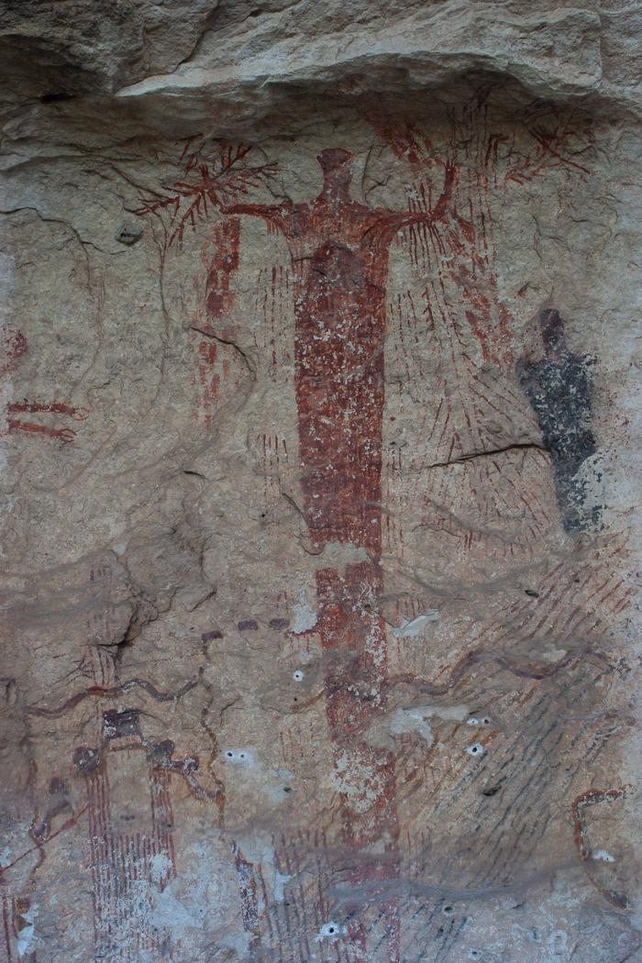
Consider 1
What do you see?
What do you notice?
What do you think this is?
How do you think it was made?
What can you infer about the people who created this?
https://education.texashistory.unt.edu
Notes:
--Mallory, Randy. [Prehistoric paintings on cavern walls], photograph, January 2005; (https://texashistory.unt.edu/ark:/67531/metadc1979766/: accessed July 30, 2024), University of North Texas Libraries, The Portal to Texas History, https://texashistory.unt.edu; crediting UNT Libraries Special Collections.

Slide 8
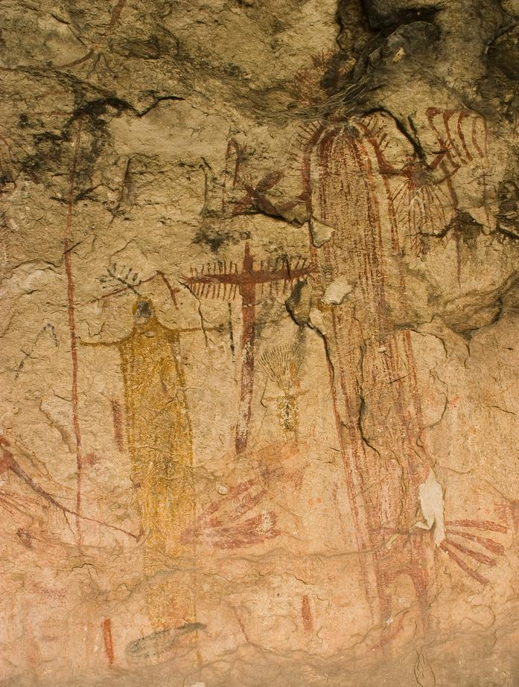
Consider 2
What do you see?
What do you notice?
What do you think this is?
How do you think it was made?
What can you infer about the people who created this?
https://education.texashistory.unt.edu
Notes:
--Mallory, Randy. [Prehistoric paintings on cavern walls], photograph, January 2005; (https://texashistory.unt.edu/ark:/67531/metadc1979766/: accessed July 30, 2024), University of North Texas Libraries, The Portal to Texas History, https://texashistory.unt.edu; crediting UNT Libraries Special Collections.

Slide 9
Reading Activity
https://education.texashistory.unt.edu

Slide 10
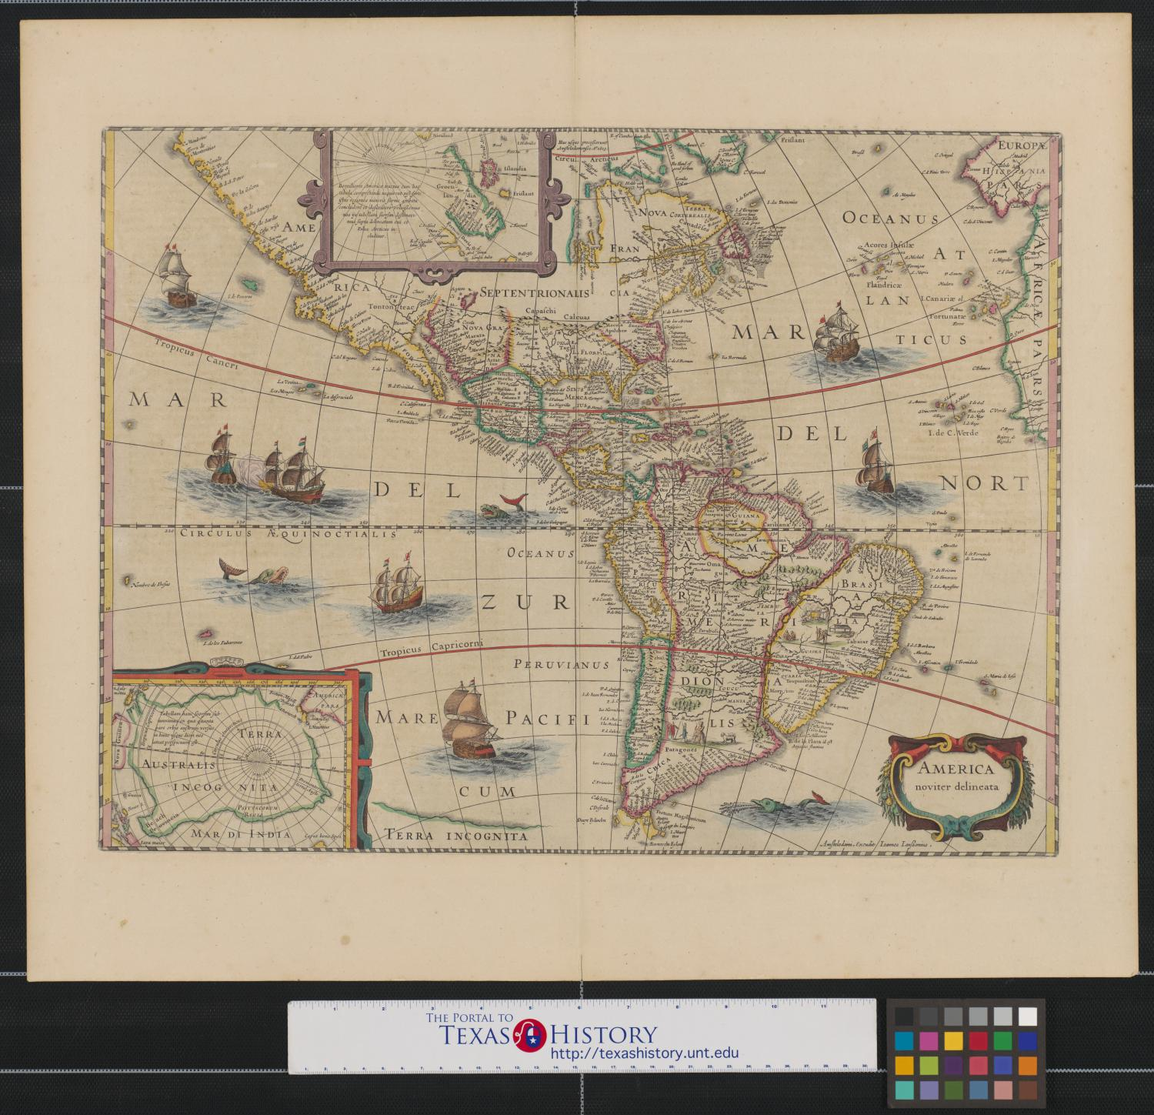
Exit Ticket
Follow the directions to complete your exit ticket
Choose one of the following options:
Look at your own warm-up drawing as though you are someone from the future who has never seen it before. Make inferences about the drawing.
Swap your exit ticket with a shoulder partner. Look at their warm-up respectfully. Make inferences about the image.
https://education.texashistory.unt.edu

Slide 11

Share with the class
Note: If you swapped images with a partner, be sure to get their consent before sharing your inferences about their image. Be respectful in what you share.
The image I analyzed might represent _____________
One inference I made about the image is _____________
https://education.texashistory.unt.edu

