Slide 1
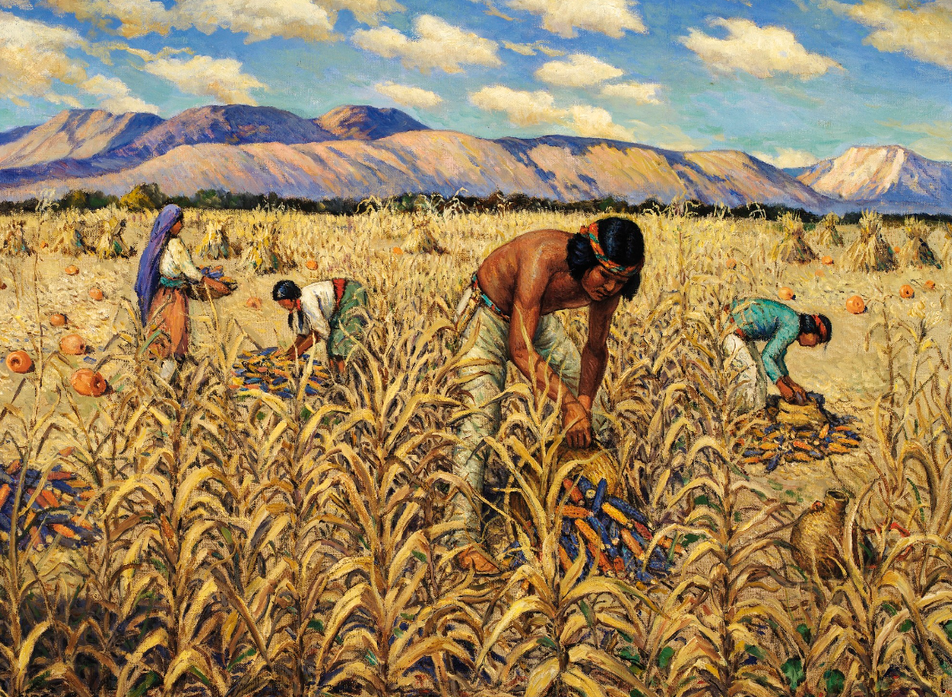
Unit 1:
Natural Texas and Its People
Lesson 6:
What’s the story?
Notes:
--Moon, Carl. Corn Harvest at Santo Domingo. 1938-40. Oil on canvas, 24 x 30 in. (61 x 76.2 cm). Smithsonian American Art Museum. https://americanart.si.edu/artwork/corn-harvest-santo-domingo-71833.

Slide 2

How do we know what we know?
Warm-up
https://education.texashistory.unt.edu

Slide 3

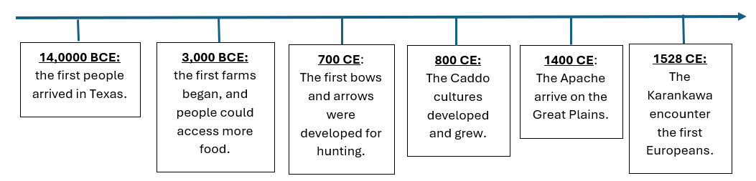



Warm-up:
Follow the directions below to complete your warm-up
Observe the information on the timeline. Write your responses to the questions on your warm-up.
Discuss your response with a partner as you wait to share with the class.
https://education.texashistory.unt.edu

Slide 4
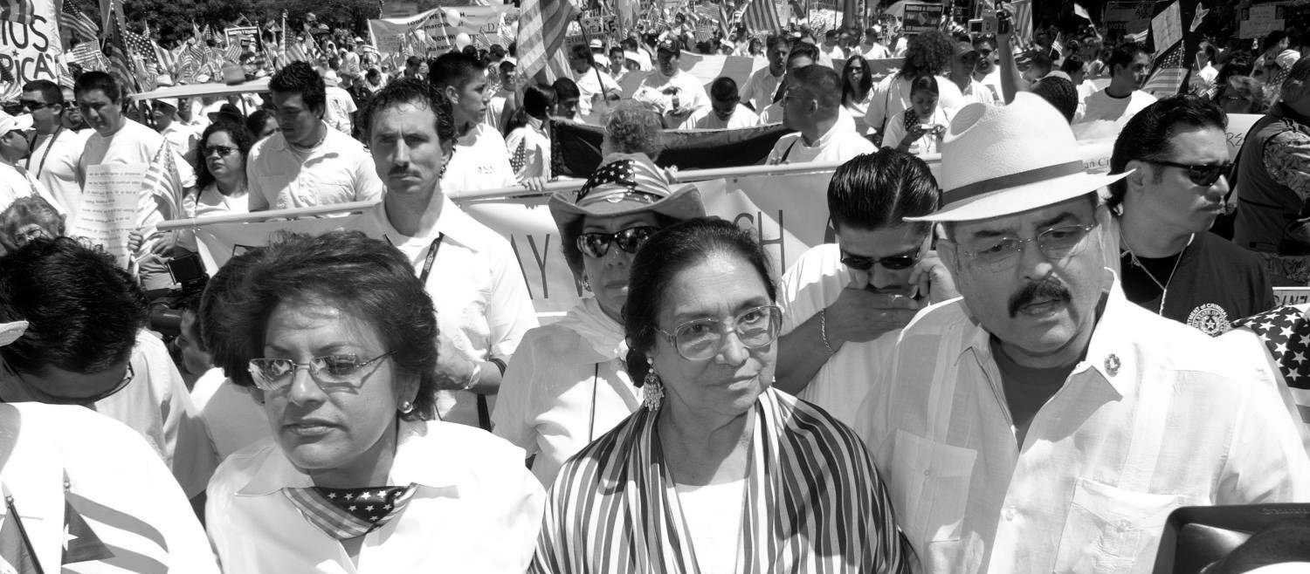
Warm-up:
Share with the class
Directions: Use the sentence stems below to share your answer with the class
“One comment I have about this timeline is ________________.”
“One question I have about this timeline is ________________.”
https://education.texashistory.unt.edu

Slide 5
Essential Question
What were the dynamics* between various tribes of Texas in the 1500s, prior to the arrival of the Spanish?
*Dynamics: The patterns of behavior and interactions between people
https://education.texashistory.unt.edu

Slide 6
In today’s lesson…
We will examine the dynamics of the different tribes in Texas at the beginning of the 1500s, or the 16th century.
I will make and support claims about the various tribes of Texas based on my reading passage.
https://education.texashistory.unt.edu

Slide 7
What’s the story?
Lesson
https://education.texashistory.unt.edu

Slide 8
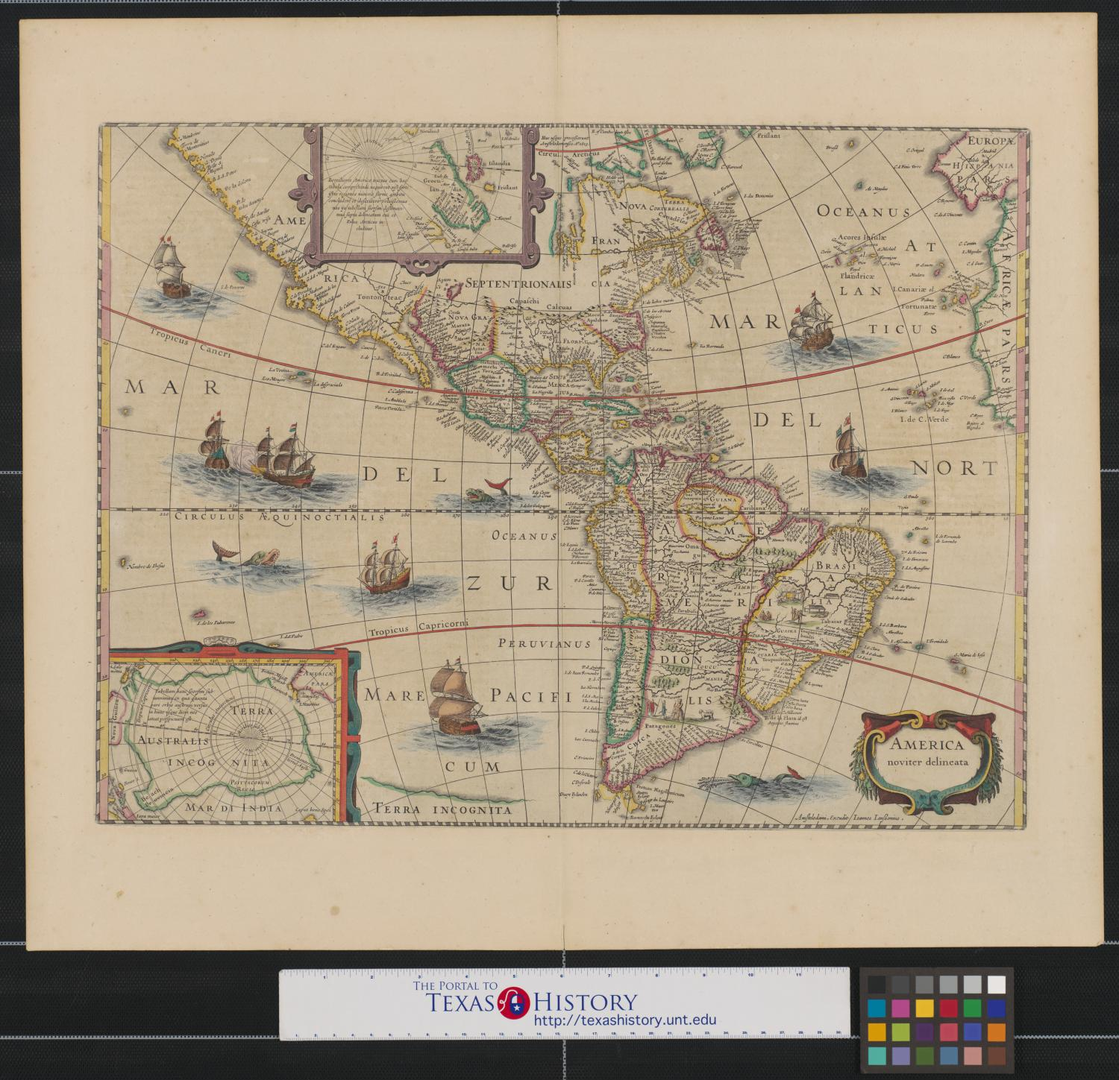
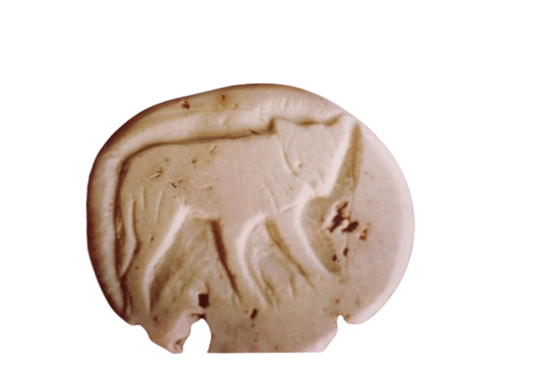
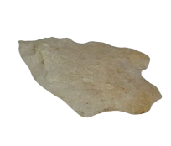
Part I: Early Texas People in Our Minds Today
Before we read:
A stone carved with the image of a small canine
True or False
Early American Indians were all basically the same, and they had nothing in common with us today.
An arrowhead carved from stone
https://education.texashistory.unt.edu
Notes:
--Edwards, Nancy. [Canine artifact], photograph, 1969; (https://texashistory.unt.edu/ark:/67531/metapth39676/: accessed July 12, 2024), University of North Texas Libraries, The Portal to Texas History, https://texashistory.unt.edu; crediting Marfa Public Library.
--Arrowhead collected on the Cherokee Indian Reservation, Swayney, N.C., by Frans M. Olbrechts for the Bureau of American Ethnology, Smithsonian Institution. National Museum of American History. http://n2t.net/ark:/65665/ng49ca746a5-579c-704b-e053-15f76fa0b4fa

Slide 9
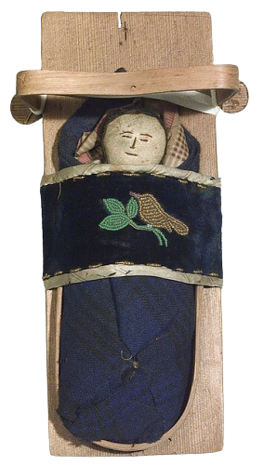
Part I: Early Texas People in Our Minds Today 2
After we read:
Highlight the sentences or phrases from the reading that support your answers on the worksheet.
An American Indian child’s toy baby doll with cradleboard.
https://education.texashistory.unt.edu
Notes:
----Doll with cradle/cradleboard. National Museum of the American Indian. Smithsonian. http://n2t.net/ark:/65665/ws6c70cb4a6-3fcf-4594-b988-ea187d367d4a

Slide 10
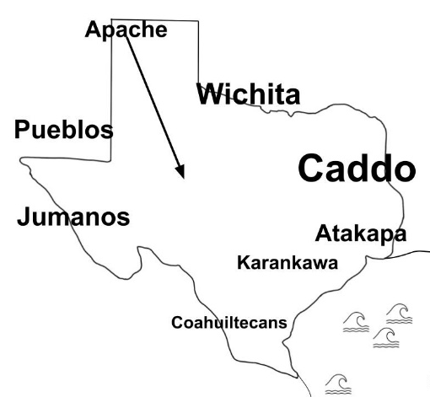
Part II: American Indians Before the Spanish Arrive2
Before we read:
Make a prediction:
Of all the tribes visible on the map, which do you think was the most powerful in the 1500s? Why?
Tribes in Texas in the early 1500s
https://education.texashistory.unt.edu
Notes:
----Doll with cradle/cradleboard. National Museum of the American Indian. Smithsonian. http://n2t.net/ark:/65665/ws6c70cb4a6-3fcf-4594-b988-ea187d367d4a

Slide 11
Comprehension Questions
Use the map on your worksheet and the reading on the previous page to answer the questions that follow.
Highlight or circle where you find the information in the passage.
After you highlight the information, write the number for the question it answers.
Discuss with a partner.
https://education.texashistory.unt.edu

Slide 12
What’s the Story?
Exit Ticket
https://education.texashistory.unt.edu

Slide 13
Exit Ticket:
Follow the directions below to complete your warm-up
The lesson today told us about the many American Indian tribes that lived in Texas for thousands of years before anyone else arrived. It mentioned that in the 1500s, people from Europe begin entering and exploring Texas. How do you think the arrival of the Europeans might affect the lives of American Indians in Texas?
Write your answer.
Discuss your response with a partner.
https://education.texashistory.unt.edu

Slide 14
Exit Ticket:
Share with the class
Directions: Use the sentence stems below to share your answer with the class
“I think the arrival of the Spanish might affect the lives of American Indians in Texas by ___________.”
https://education.texashistory.unt.edu

