Slide 1
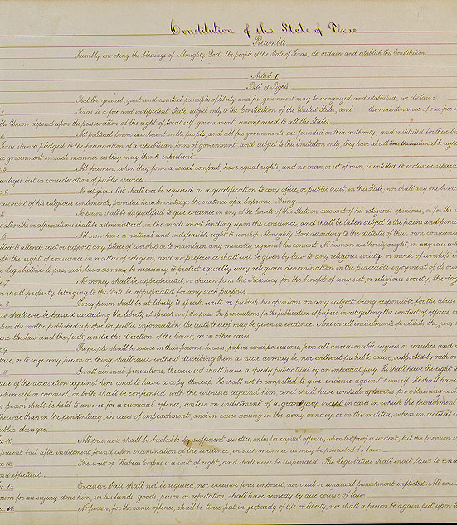
Unit 9: Reconstruction
Lesson 7:
The Constitution of 1876
The Constitution of 1876
Texas State Library & Archives
Notes:
Texas Constitution of 1876. Accessed 10/8/25. Texas State Library and Archives Commission. https://www.tsl.texas.gov/treasures/constitution/1875-01.html

Slide 2
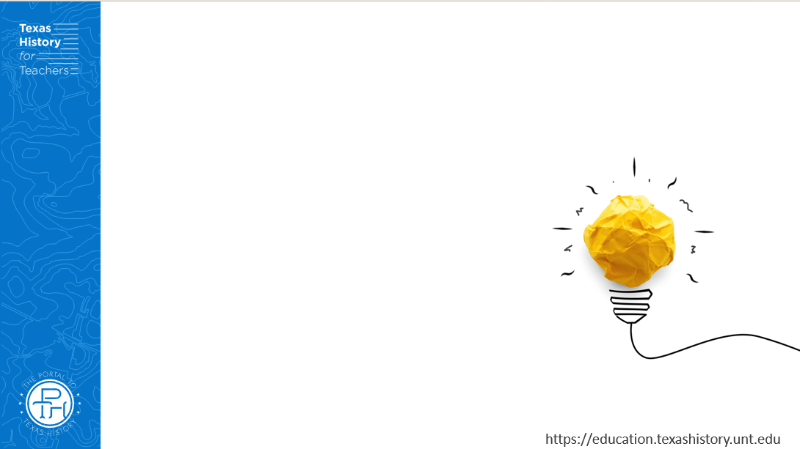



Warm-up: Follow the directions to complete your warm-up
Read the introduction scenario on your warm-up.
Select all statements that you think are true, related to the Constitution of 1876.
Share with a partner.

Slide 3
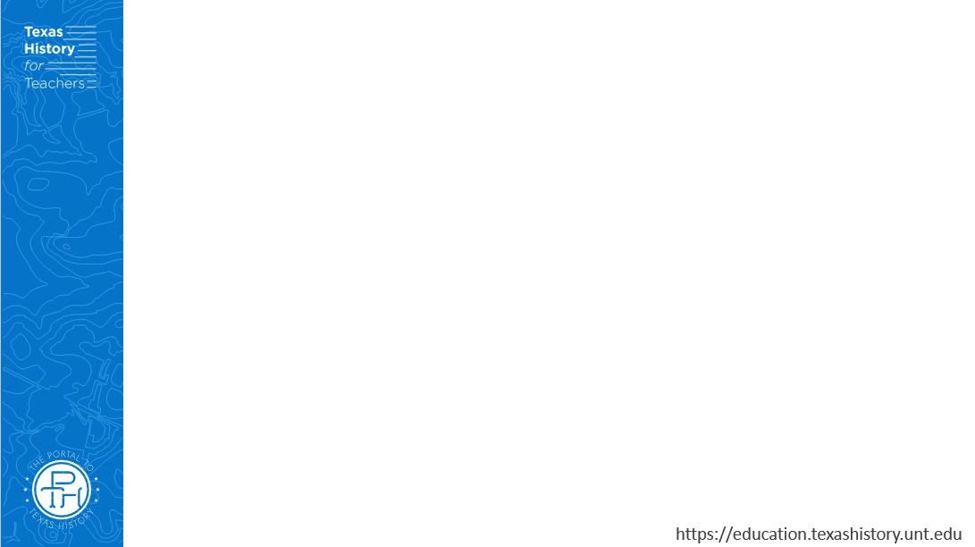
Share with the class
One statement that I think is true for the type of Constitution the delegates wanted to create is that _________

Slide 4
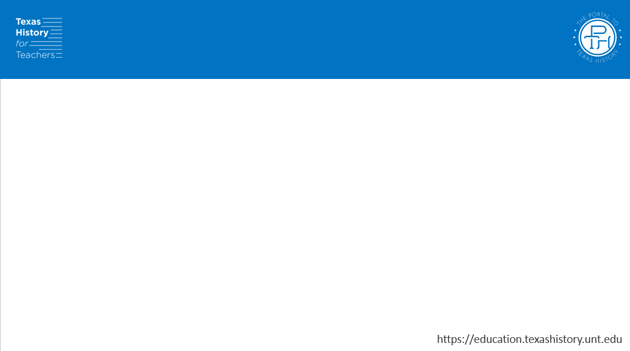
Essential Question
What are the seven principles of government that provide the foundation of the Texas Constitution of 1876, and how did the Constitution uphold those principles?

Slide 5
In today’s lesson…
We will examine the meaning and important seven key principles of government.
I will categorize different excerpts from the Texas Constitution of 1876 based on the principles they uphold or represent.

Slide 6
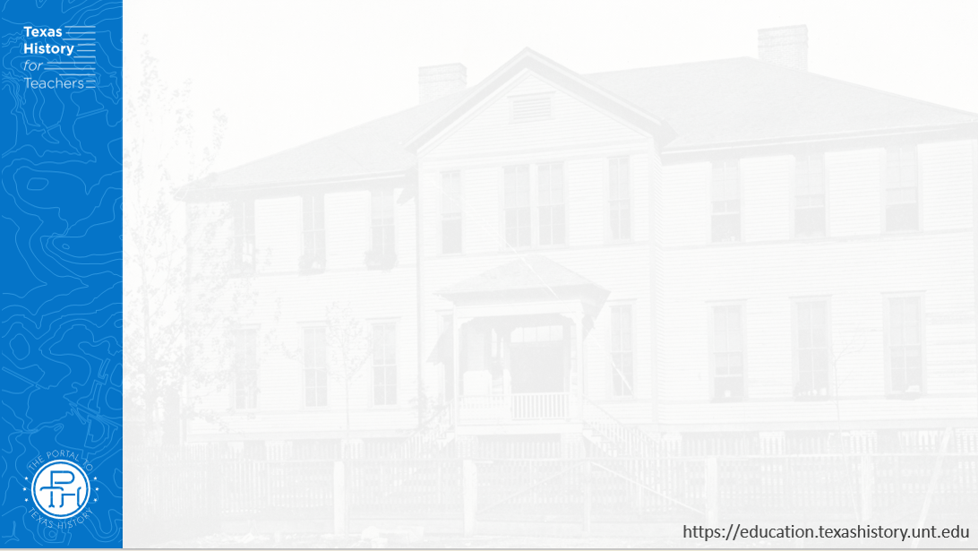

Limited Government

Slide 7
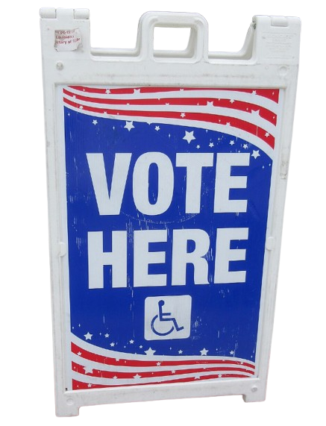
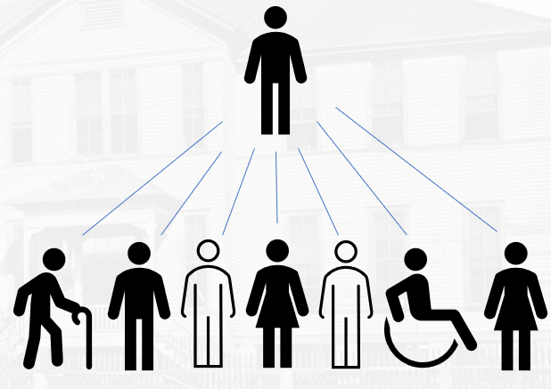
Republicanism
Notes:
Vote Here sign, Louisiana, March 2025. Accessed 10/8/25. Wikimedia Commons. Background removed for this slideshow. https://commons.wikimedia.org/wiki/File:Vote_Here_sign,_Louisiana,_March_2025.jpg

Slide 8
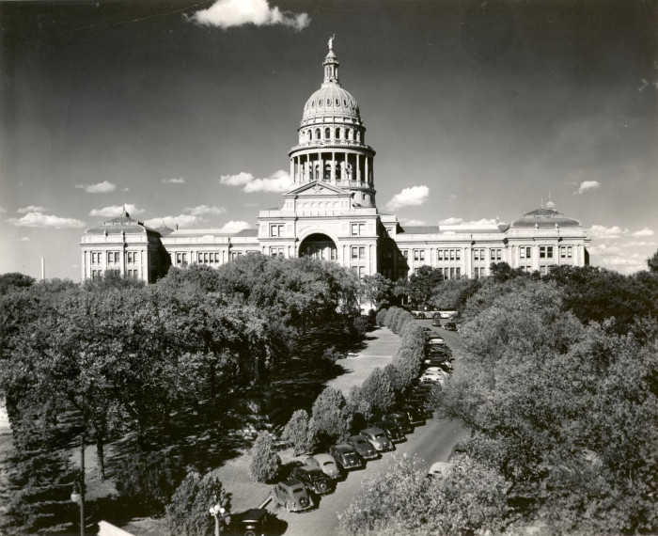
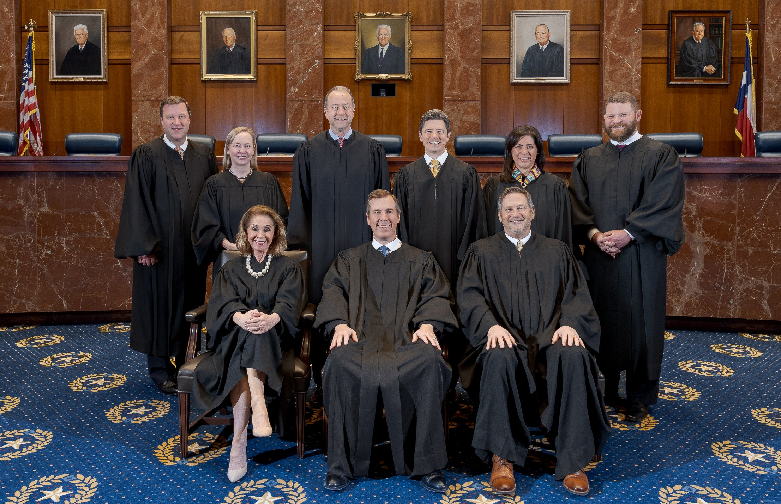
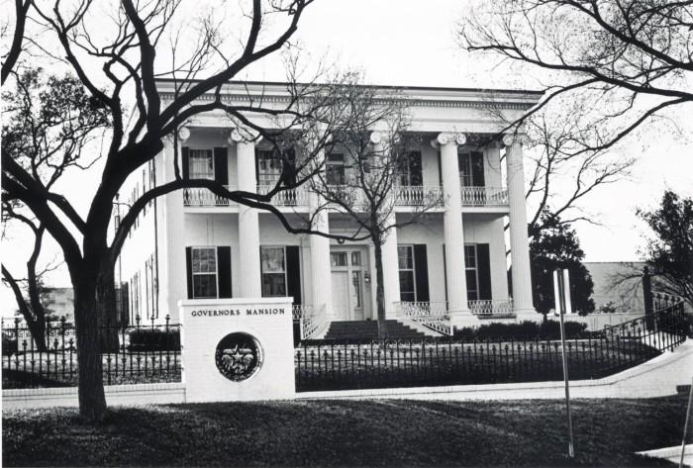
Separation of Powers
The Supreme Court Justices, 2025
The Judicial Branch
Austin, Texas
The Supreme Court of Texas
The Capitol Building
The Legislative Branch
Austin, Texas
The Portal to Texas History
The Governor’s Mansion
The Executive Branch
Austin, Texas
The Portal to Texas History
Notes:
Boone Photo Co. [Texas State Capitol], photograph, 1947; (https://texashistory.unt.edu/ark:/67531/metapth124092/: accessed October 8, 2025), University of North Texas Libraries, The Portal to Texas History, https://texashistory.unt.edu; crediting Austin History Center, Austin Public Library.
Horberger, Carl. [Governor's Mansion with fence], photograph, 1971; (https://texashistory.unt.edu/ark:/67531/metapth124768/: accessed October 8, 2025), University of North Texas Libraries, The Portal to Texas History, https://texashistory.unt.edu; crediting Austin History Center, Austin Public Library.
The Supreme Court of Texas, 2025. Accessed 10/8/25. https://txcourts.gov/supreme

Slide 9
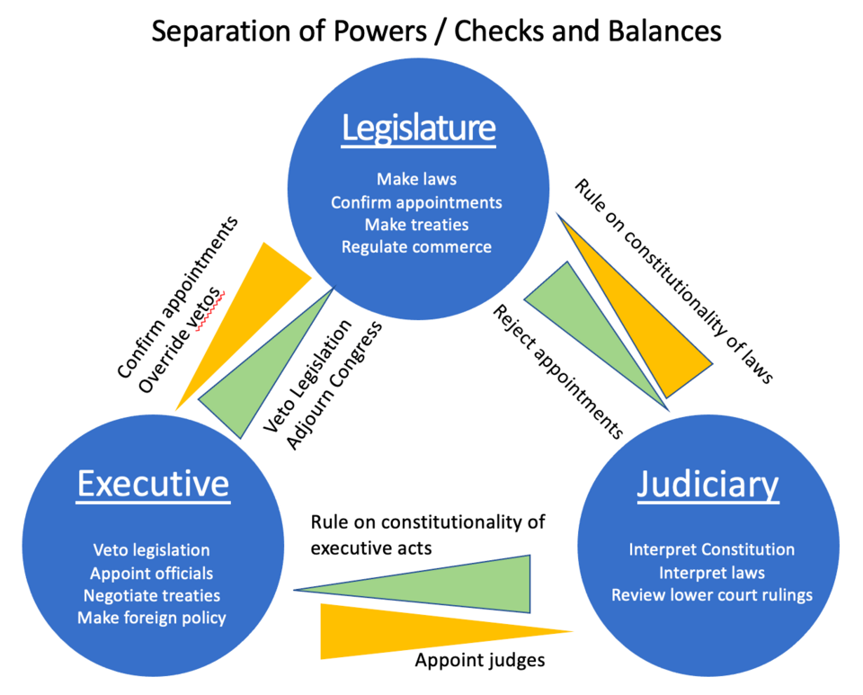
Checks and Balances
vetoes
Notes:
Checks and Balances infographic. Accessed on 10/8/25. https://commons.wikimedia.org/wiki/File:Separation_of_powers.png

Slide 10
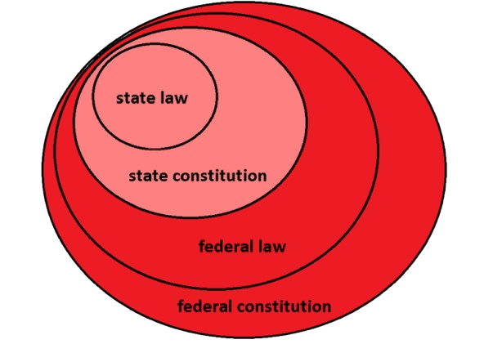
Federalism
Notes:
Federalism diagram. Accessed on 10/8/25. https://commons.wikimedia.org/wiki/File:Federalism.png

Slide 11
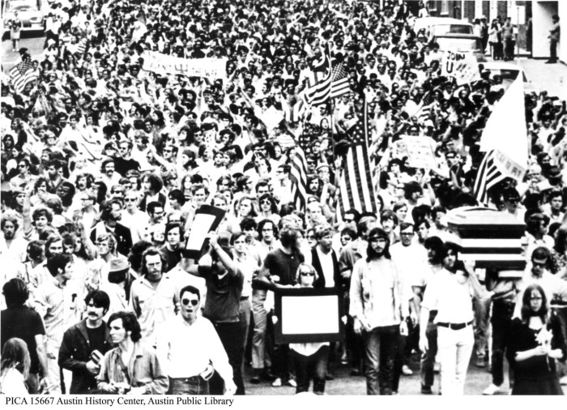
Popular Sovereignty
A Peaceful Assembly in Austin, 1986.
The Portal to Texas History
Notes:
Student Protest March, photograph, [1970..1975]; (https://texashistory.unt.edu/ark:/67531/metapth124372/: accessed October 8, 2025), University of North Texas Libraries, The Portal to Texas History, https://texashistory.unt.edu; crediting Austin History Center, Austin Public Library.
Vote Here sign, Louisiana, March 2025. Accessed 10/8/25. Wikimedia Commons. Background removed for this slideshow. https://commons.wikimedia.org/wiki/File:Vote_Here_sign,_Louisiana,_March_2025.jpg

Slide 12




Individual Rights
Notes:
Religious Symbols. Accessed 10/8/25. https://commons.wikimedia.org/wiki/File:Religious_Symbol.png

Slide 13
Exit Ticket: Follow the directions to complete your exit ticket
Match the political principle on the left with its correct description on the right.
Share with a partner.

Slide 14
Share with the class 2
The political principle of _______ means that ____________

