Slide 1
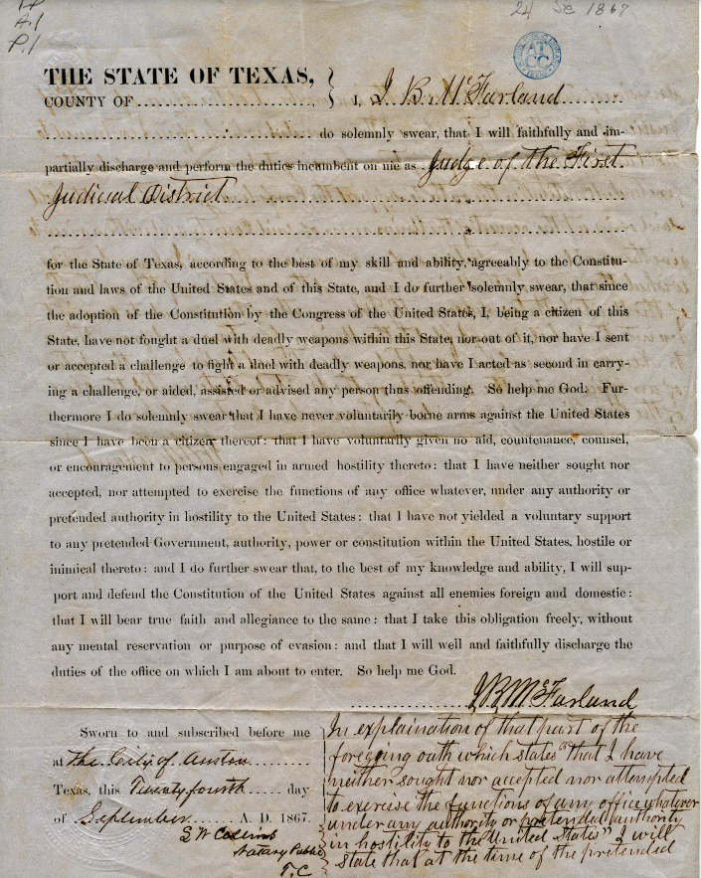
Unit 9: Reconstruction
Lesson 2:
How do we know what we know?

Slide 2
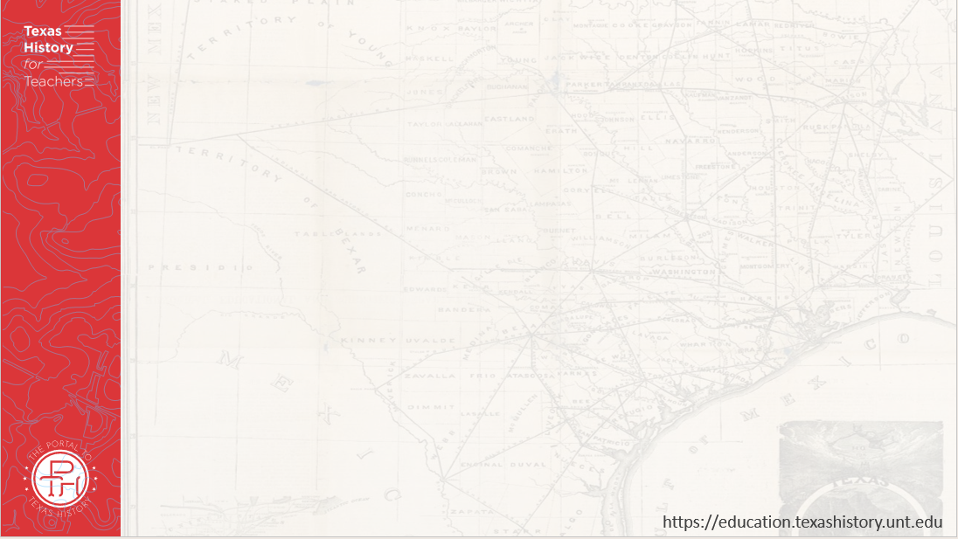




Warm-up Follow the directions below to complete your warm-up
Choose one point of view from the chart.
How would someone with that point of view likely feel about how Reconstruction should be carried out?
Discuss with a partner.

Slide 3

Share with the class:
The point of view I chose to consider was ______
I think someone with this point of view would likely write a journal entry that says, “ ________”

Slide 4
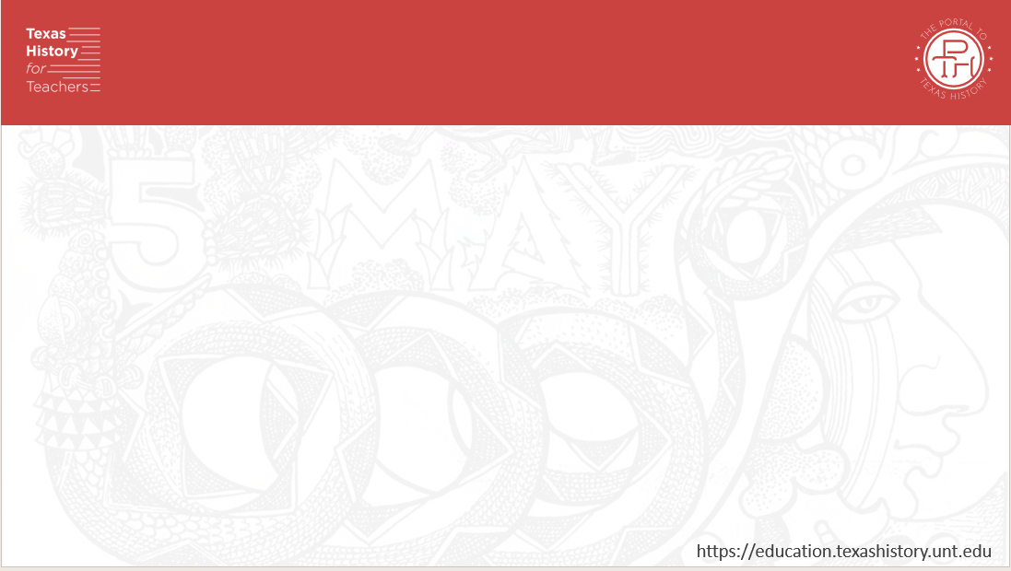
Essential Question
What are some of the primary sources historians use to understand the Reconstruction era, what topics are covered in these sources, and what are the different points of view on each topic?

Slide 5
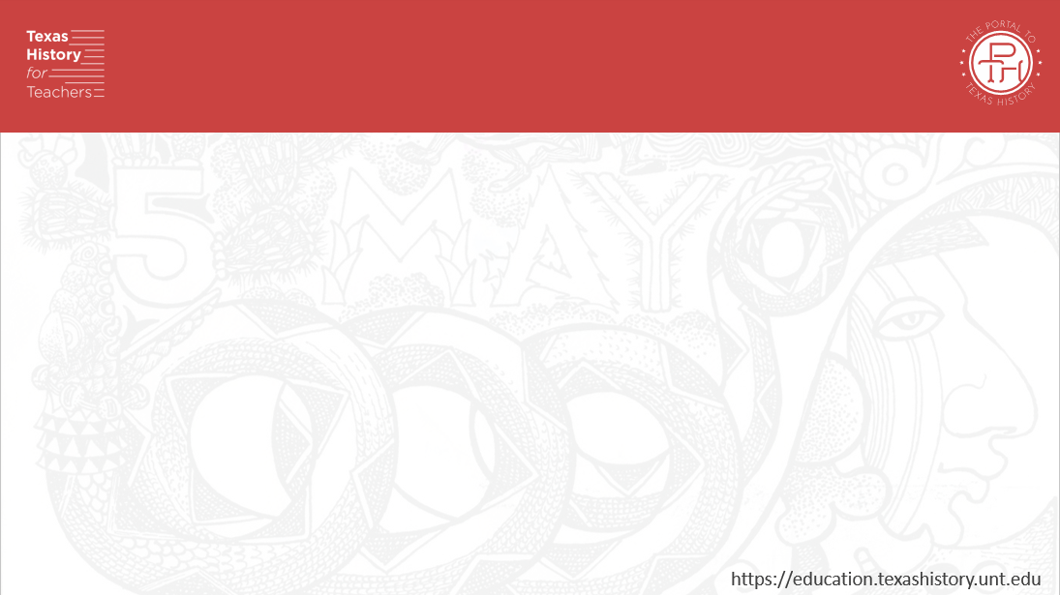
In Today’s Lesson
We will examine a variety of primary source materials on significant issues including immigration, development, westward expansion, American Indians, Freedmen, women’s rights, and political power during Reconstruction.
I will identify the main idea of each of my chosen sources and determine each source’s unique point of view on various topics related to Reconstruction.

Slide 6
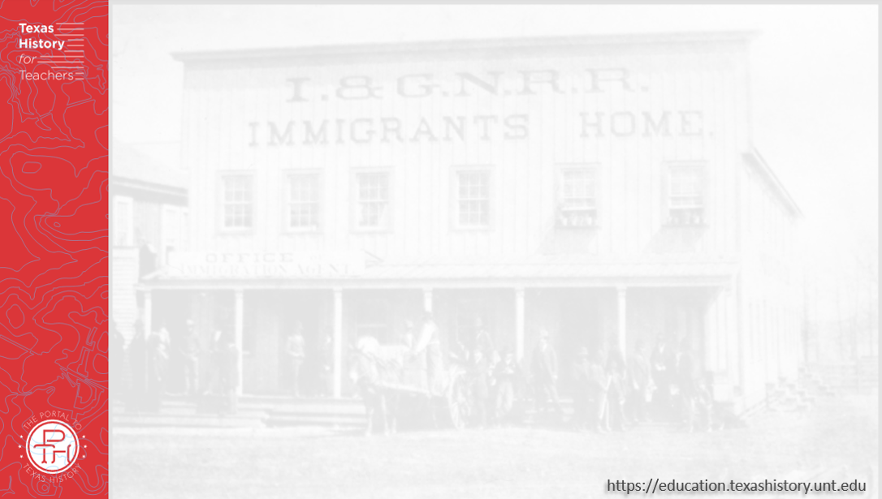
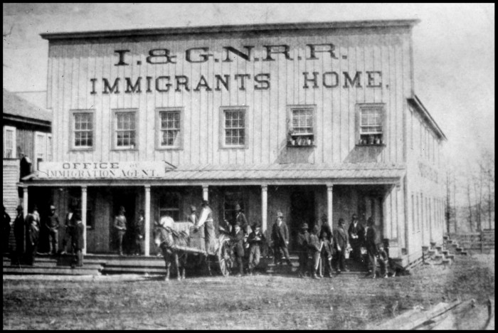
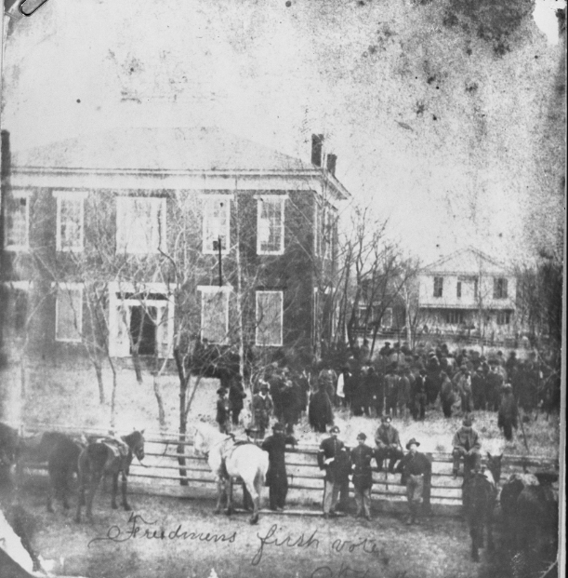
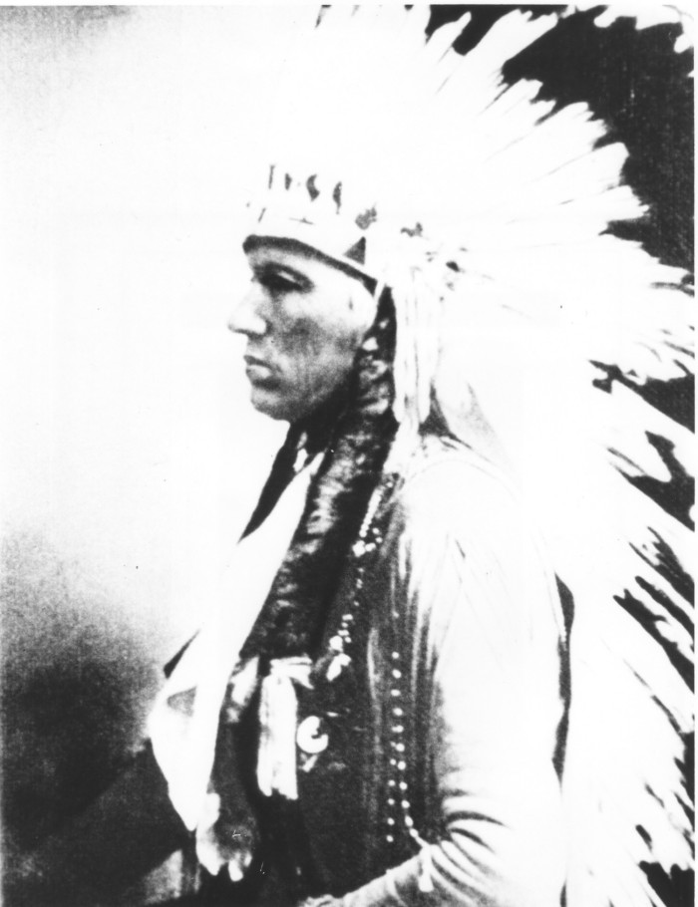
Part I: An Era of Change
A lodging house built in Texas by the Great Northern Railroad Company for its immigrant workers.
The Portal to Texas History
“Freedmen’s First Vote”
Anderson County, Texas
The Portal to Texas History
Comanche Chief Quanah Parker, son of Cynthia Ann Parker.
The Portal to Texas History
Notes:
[I&GN Railroad Immigrants Home], photograph, 1890~; (https://texashistory.unt.edu/ark:/67531/metapth26339/: accessed September 23, 2025), University of North Texas Libraries, The Portal to Texas History, https://texashistory.unt.edu; crediting Palestine Public Library.
Quanah Parker in Headdress, photograph, Date Unknown; (https://texashistory.unt.edu/ark:/67531/metapth19941/: accessed September 23, 2025), University of North Texas Libraries, The Portal to Texas History, https://texashistory.unt.edu; crediting Tarrant County College NE, Heritage Room.
[Freedmens First Vote - Anderson County Courthouse], photograph, 1869; (https://texashistory.unt.edu/ark:/67531/metapth26465/: accessed September 23, 2025), University of North Texas Libraries, The Portal to Texas History, https://texashistory.unt.edu; crediting Palestine Public Library.

Slide 7
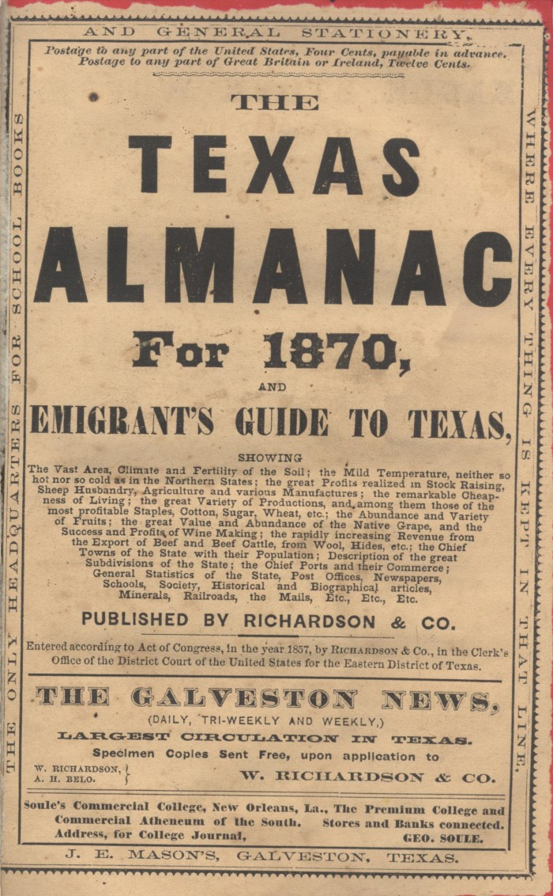
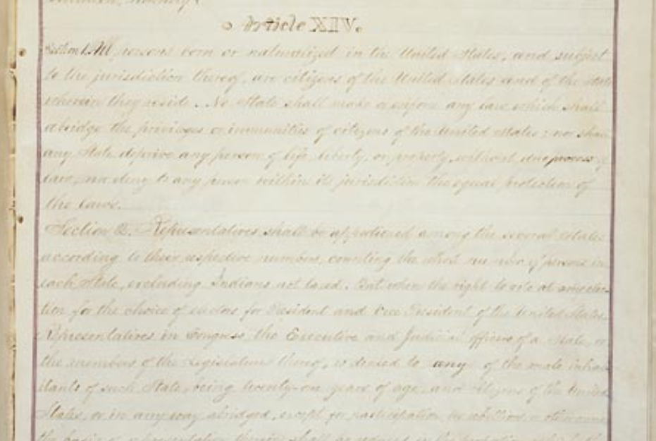
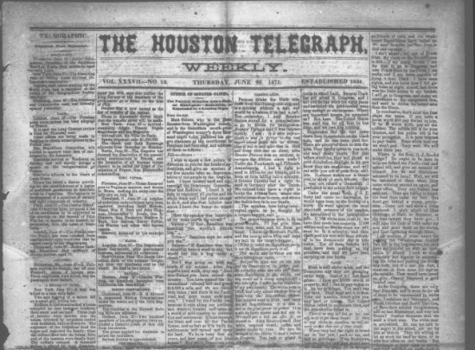
Part II: Primary Source Analysis
The Fourteenth Amendment
The National Archives
The Houston Telegraph
Thursday, June 29, 1871
The Portal to Texas History
The Texas Almanac, 1870
The Portal to Texas History
Notes:
The Fourteenth Amendment. Accessed Sept. 10, 2025. https://www.archives.gov/milestone-documents/14th-amendment
The Texas Almanac for 1870, and Emigrant's Guide to Texas, book, January 1870; Galveston, Texas. (https://texashistory.unt.edu/ark:/67531/metapth123775/: accessed September 10, 2025), University of North Texas Libraries, The Portal to Texas History, https://texashistory.unt.edu; crediting Texas State Historical Association.
Chew, J. C. The Houston Telegraph (Houston, Tex.), Vol. 37, No. 10, Ed. 1 Thursday, June 29, 1871, newspaper, June 29, 1871; Houston, Texas. (https://texashistory.unt.edu/ark:/67531/metapth234974/: accessed September 11, 2025), University of North Texas Libraries, The Portal to Texas History, https://texashistory.unt.edu; crediting The Dolph Briscoe Center for American History.

Slide 8

Exit Ticket Follow the directions below to complete your exit ticket
Choose ONE primary source material you analyzed in today’s lesson.
Complete the graphic organizer based on your chosen source.
Discuss with a partner.

Slide 9
Share with the class: 2
The point of view represented in my source is ________
The main idea of this source is _____
Overall, this source was primarily positive / negative / neutral because ______

