Slide 1
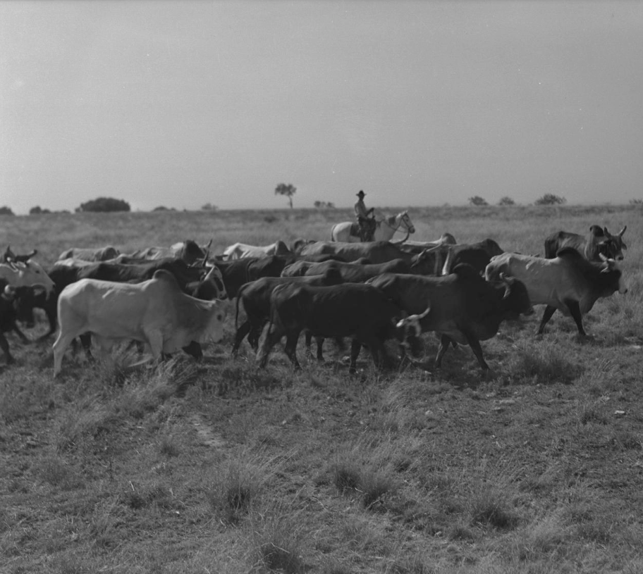
Unit 9: Reconstruction
Lesson 9:
Looking Ahead
Cowboy herding cattle
The Portal to Texas History
Notes:
Casey, Steve. [Photograph of a Cowboy Herding Cattle]. 1939. University of North Texas Libraries, The Portal to Texas History; crediting Dublin Historical Museum. https://texashistory.unt.edu/ark:/67531/metapth531517/

Slide 2
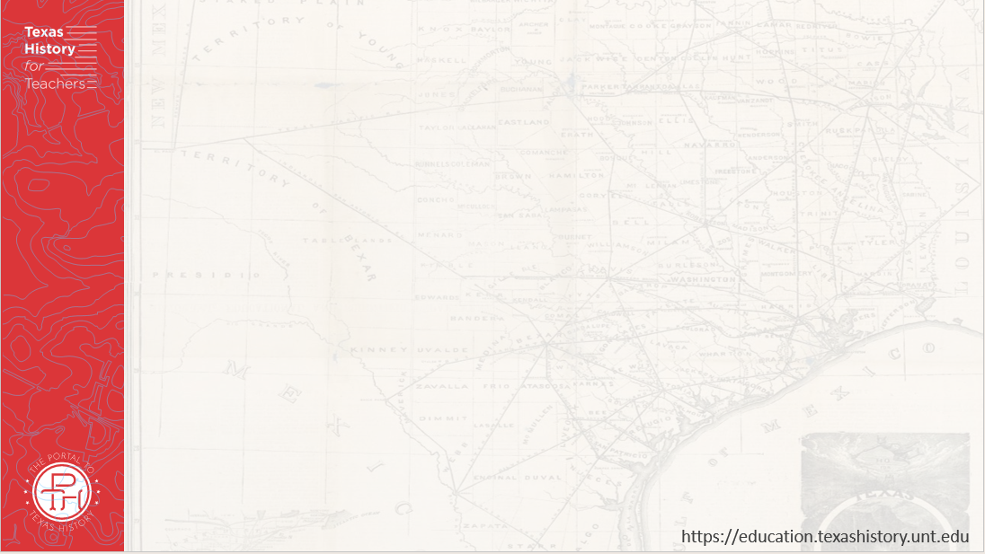
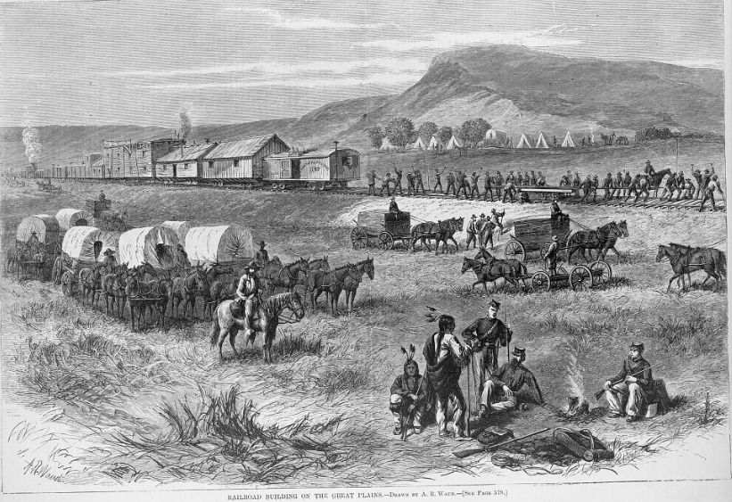
Warm-up Use the image to complete your warm-up

Slide 3
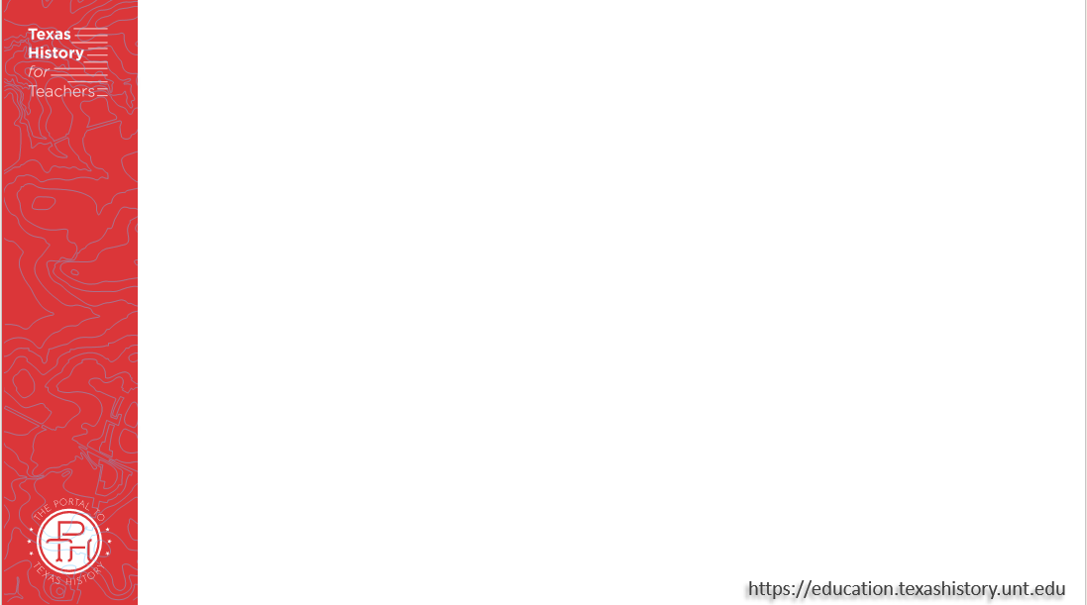

Share with the class:
One thing I observe about the image is _________
Based on the image, I predict we will see _____________ in the next unit.

Slide 4
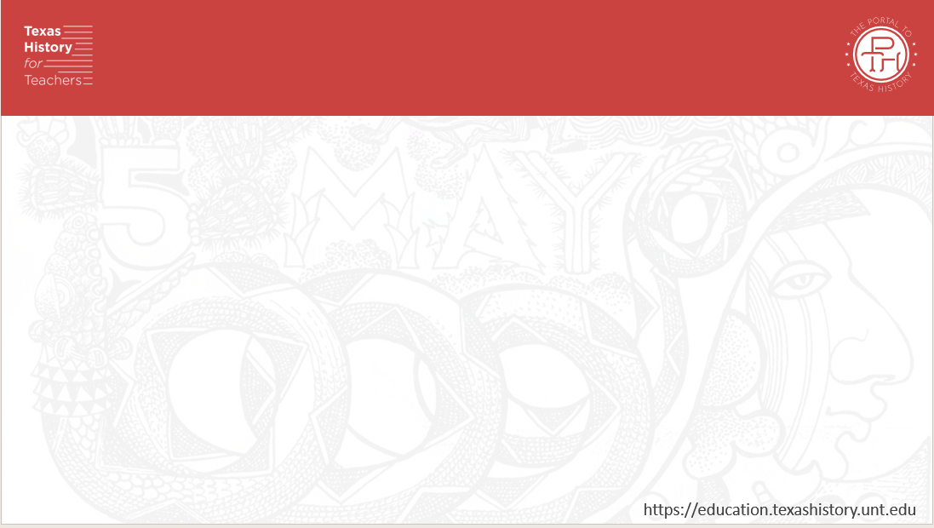
Essential Question
What significant events and major defining themes will we see in the next unit: Cotton, Cattle, and Railroads?

Slide 5
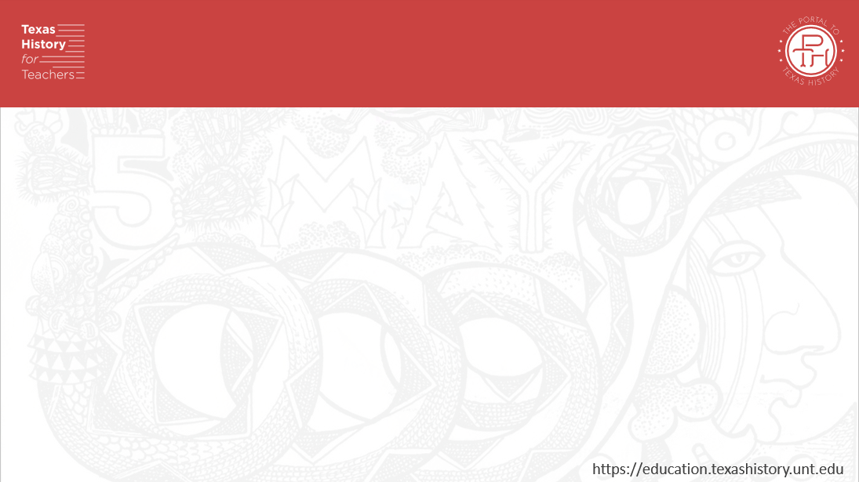
In Today’s Lesson
We will analyze four primary source materials which discuss major themes and topics of the next unit: Cotton, Cattle, and Railroads.
I will make observations, inferences, and predictions about the next unit based on the four primary source materials used in the lesson.

Slide 6
So, Texas rejoined the Union & Reconstruction is over . . . Now what?
Notes:
Waud, Alfred R. Railroad building on the great plains / drawn by A.R. Waud ; A.R. Waud. 1875. Wood engraving. Library of Congress Prints and Photographs Division. https://www.loc.gov/item/2003663113/.

Slide 7
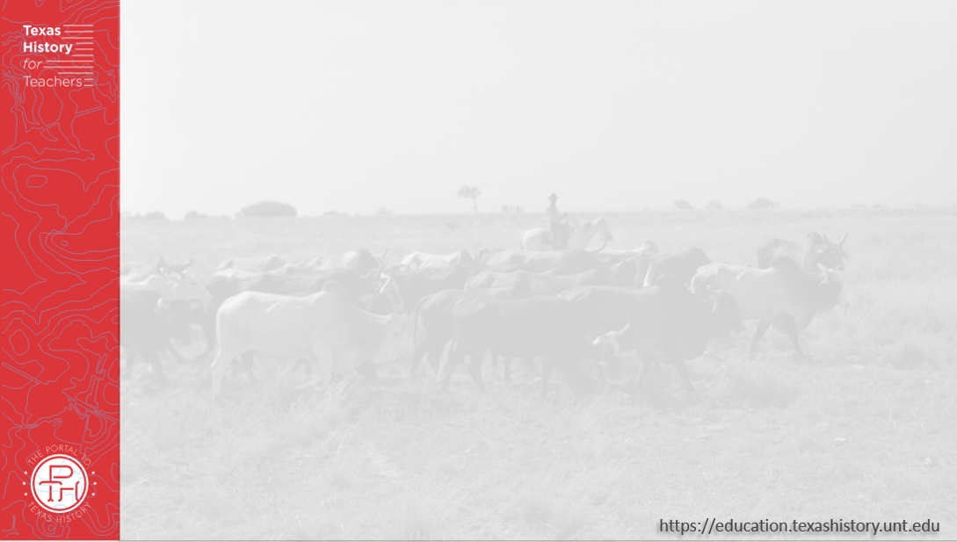
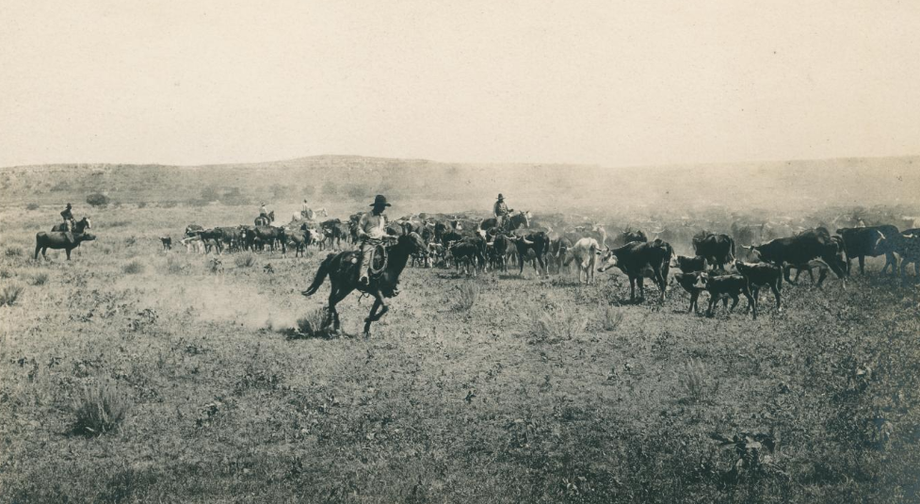
Primary Source #1: Cattle Drives
Cowhands guiding a herd of cattle, 1910
The Portal to Texas History
Notes:
Smith, Erwin E. [Cowhands guiding a herd of cattle]. ca. 1910. Photograph. University of North Texas Libraries, The Portal to Texas History; crediting UNT Libraries Special Collections. https://texashistory.unt.edu/ark:/67531/metadc1151055

Slide 8
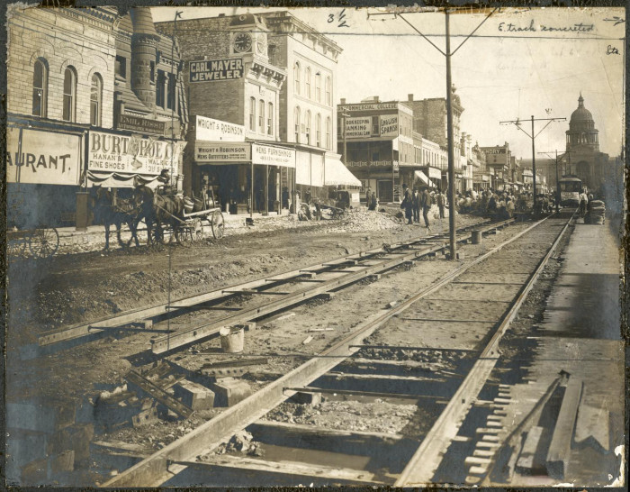
Primary Source #2: Railroads in Texas
Workers building a railroad on Congress Avenue leading to the Capitol building Austin, 1890s.
The Portal to Texas History
Notes:
[East track concreted], photograph, [1890..1899]; (https://texashistory.unt.edu/ark:/67531/metapth125060/: accessed October 14, 2025), University of North Texas Libraries, The Portal to Texas History, https://texashistory.unt.edu; crediting Austin History Center, Austin Public Library.

Slide 9
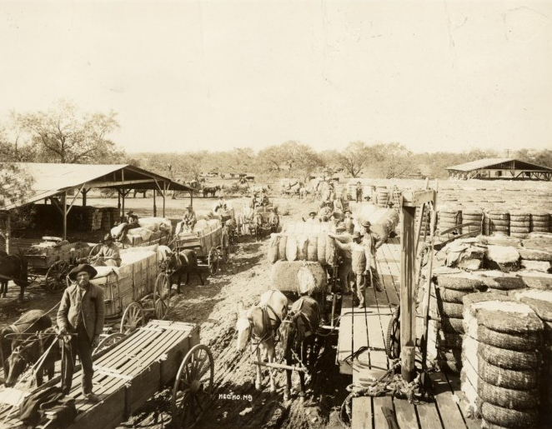
Primary Source #3: Cotton in Texas
Men working to unload bales of cotton at a cotton gin in Austin, Texas, circa 1900.
The Portal to Texas History
Notes:
Caswell, W. T. Austin Cotton Gin, photograph, 1900~; (https://texashistory.unt.edu/ark:/67531/metapth125145/: accessed October 14, 2025), University of North Texas Libraries, The Portal to Texas History, https://texashistory.unt.edu; crediting Austin History Center, Austin Public Library.

Slide 10
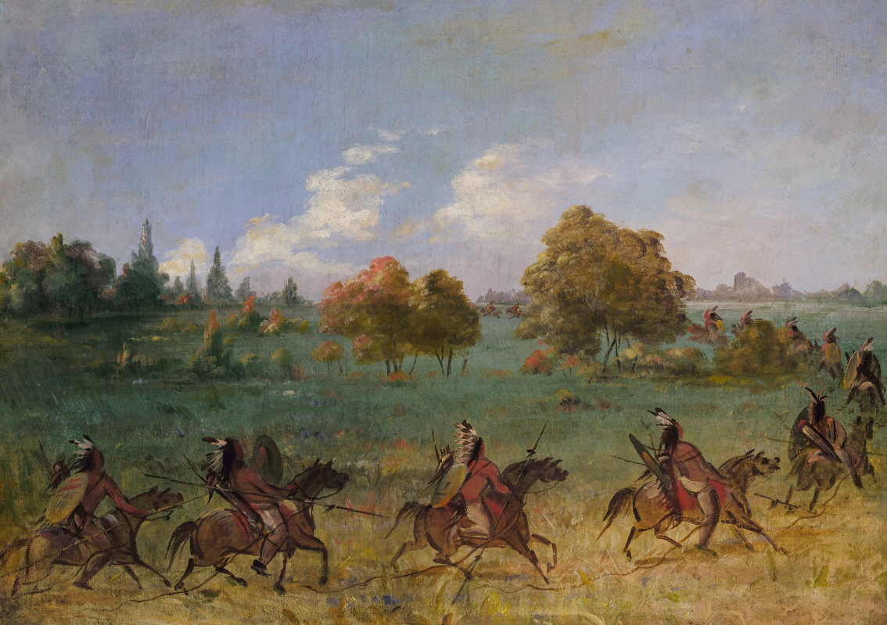
Primary Source #4: Texas Indians and the Frontier
A Comanche War Party on the Plains
Smithsonian American Art Museum
Notes:
Catlin, George. Comanche War Party on the March, Fully Equipped. 1846-1848, oil on canvas 20 x 27 3/8 in. (50.8 x 69.4 cm). Smithsonian American Art Museum, Gift of Mrs. Joseph Harrison, Jr., 1985.66.596 https://americanart.si.edu/artwork/comanche-war-party-march-fully-equipped-4014.

Slide 11

Exit Ticket Follow the directions to complete your exit ticket.
Choose THREE statements that are true for the next unit: Cotton, Cattle, and Railroads.
Share with a partner.

Slide 12
Share with the class: 2
One topic or major theme we will see in the next unit is _______

