Slide 1
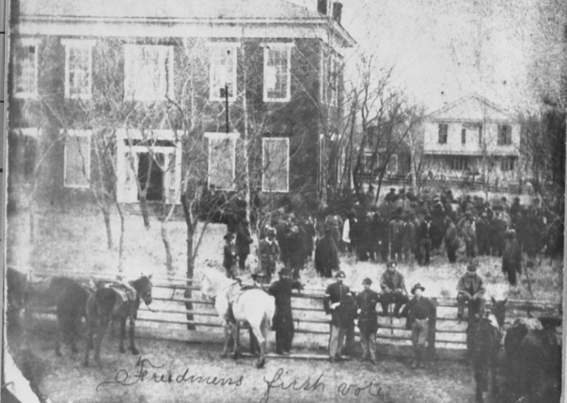
Unit 9:
Reconstruction
Lesson 6:
Reconstruction Guided Notes
The Freedmen’s First Vote, Anderson County, Texas
The Portal to Texas History
Notes:
[Freedmens First Vote - Anderson County Courthouse], photograph, 1869; (https://texashistory.unt.edu/ark:/67531/metapth26465/: accessed September 8, 2025), University of North Texas Libraries, The Portal to Texas History, https://texashistory.unt.edu; crediting Palestine Public Library.

Slide 2
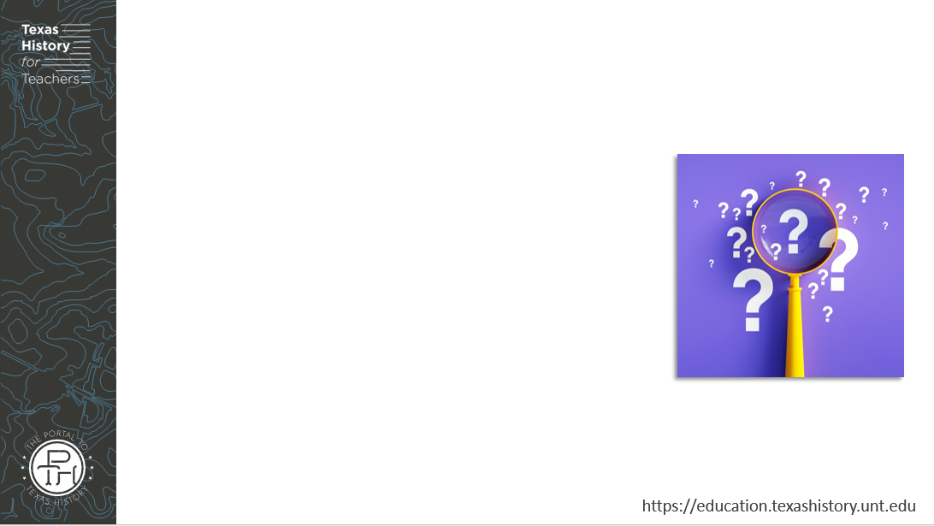



Warm-up
Follow the directions to complete your warm-up
Consider the three different points of view presented in the graphic organizer
Complete the graphic organizer based on the three points of view.
Discuss with a partner

Slide 3
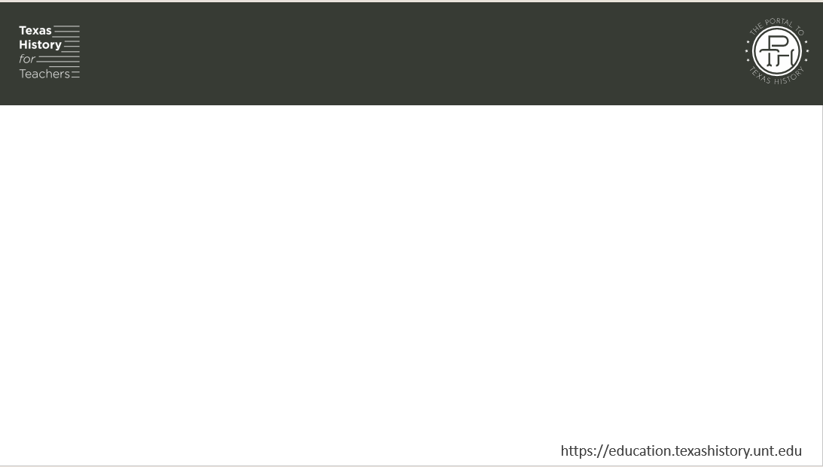
Share with the class
I think Southern ex-Confederates / Northerners in Congress / Freedmen in the South would want Reconstruction to focus on ________ _____________________________

Slide 4

Essential Question
What were the three primary phases of Reconstruction, and what were the key events and defining characteristics of each phase?

Slide 5

In today’s lesson…
We will examine the three phases of Reconstruction, the significant developments, and the defining characteristics of each phase.
I will complete my guided notes, comparing the goals, policies, and effects of each phase of Reconstruction in Texas.

Slide 6
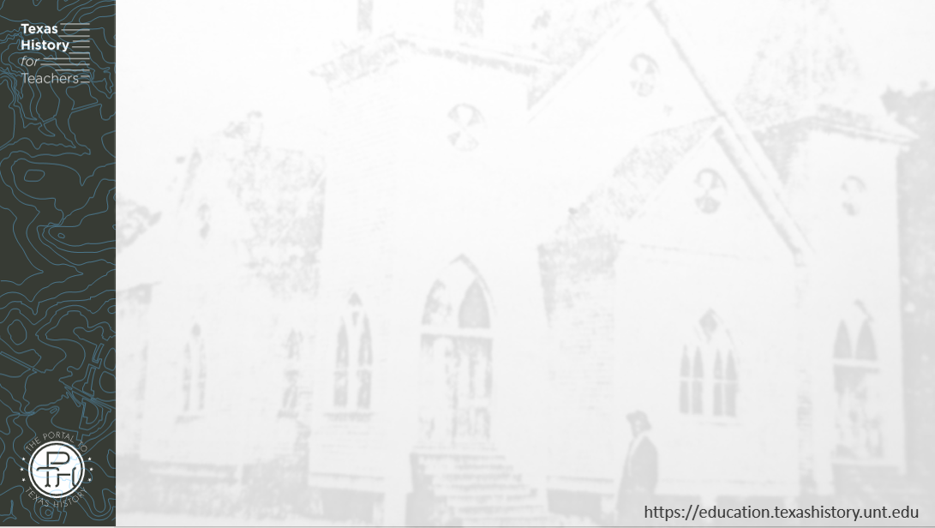
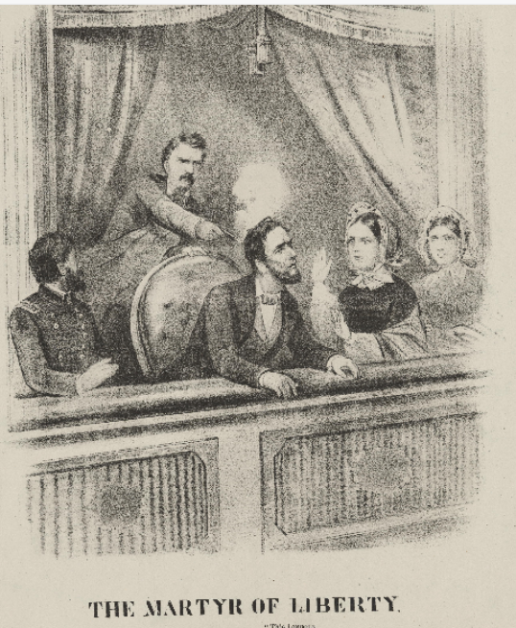
The Assassination of Abraham Lincoln
Lincoln was elected for a second term as president in November 1864.
Confederate General Robert E. Lee surrendered April 9, 1865
Lincoln was assassinated on April 15, 1865.
Vice President Andrew Johnson (a Southerner) was sworn in as president.
“The Martyr of Liberty”
The Library of Congress
Notes:
The Martyr of Liberty. United States Washington D.C. Washington, . N. D. Photograph. https://www.loc.gov/item/scsm000402/

Slide 7

Presidential Reconstruction
1865 - 1867

Slide 8
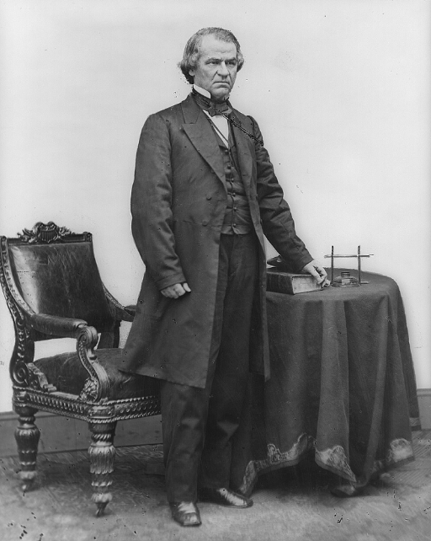
Presidential Reconstruction 2
Ex-Confederates pardoned
  Must take loyalty oath to the U.S.
High-ranking ex-Confederates must personally request pardon from President Johnson
Southern states must
  Write new constitutions
  Ratify the 13th Amendment
President Andrew Johnson
The Library of Congress
Notes:
Brady, Mathew B. Andrew Johnson, full-length portrait, standing, facing right, with table and chair. n.d. Photograph. https://www.loc.gov/item/96524285/

Slide 9
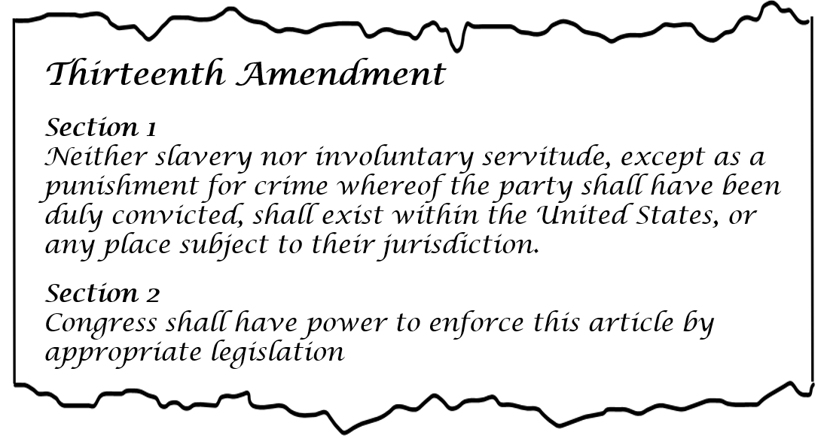
The Thirteenth Amendment
Notes:
13th Amendment to the U.S. Constitution: Abolition of Slavery (1865). Milestone Documents. The National Archives. Accessed 10/6/25. https://www.archives.gov/milestone-documents/13th-amendment

Slide 10
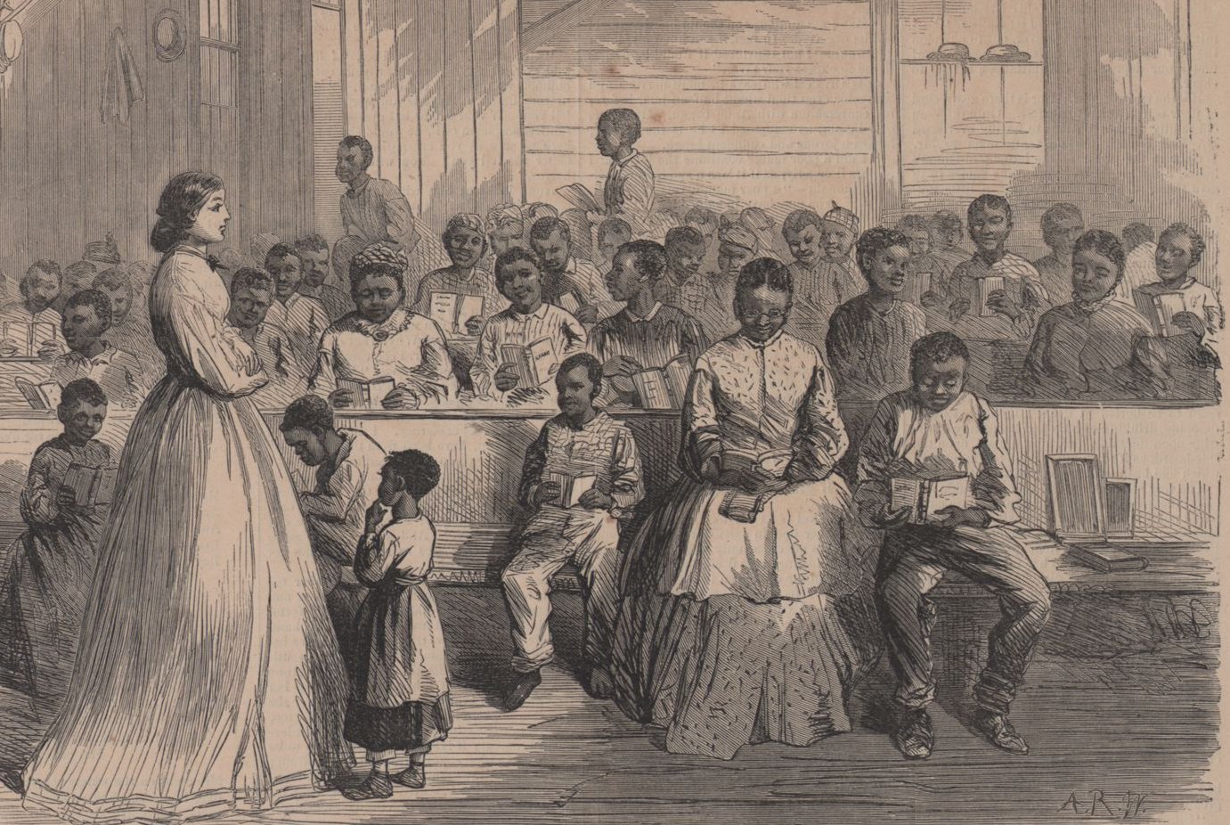
Freedmen’s Bureau
Established 1865
Provided support to freed Black Southerners:
  Medical services
  Legal support
  Education
  Family reunification
  Protection
Freedmen’s School
New York Public Library Digital Collection
Notes:
Schomburg Center for Research in Black Culture, Photographs and Prints Division, The New York Public Library. "Noon at the Primary school (top) and Primary school for Freedmen, in charge of Mrs. Green, at Vicksburg, Mississippi (bottom)." New York Public Library Digital Collections. Accessed February 26, 2025. https://digitalcollections.nypl.org/items/510d47db-c675-a3d9-e040-e00a18064a99

Slide 11
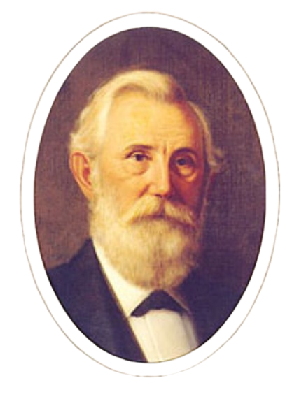
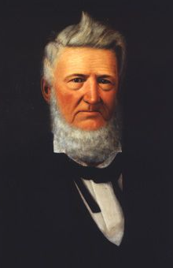
Texas Constitution of 1866
Declared secession void.
Recognized but did not ratify the 13th Amendment.
Ex-Confederates returned to power.
Ex-Confederate Senator Oran Roberts
Texas State Library and Archives
Ex-Confederate Senator David G. Burnet
State Preservation Board
Notes:
Oran Roberts. Portraits of Texas Governors. Texas State Library and Archives. Accessed Sept. 18, 2025. https://www.tsl.texas.gov/governors/west/index.html
Huddle, William H. David G. Burnet. 1888. Oil on canvas. Capitol Historical Artifact Collection, State Preservation Board. https://tspb.texas.gov/prop/tc/tc-collection/governors/index.html.

Slide 12
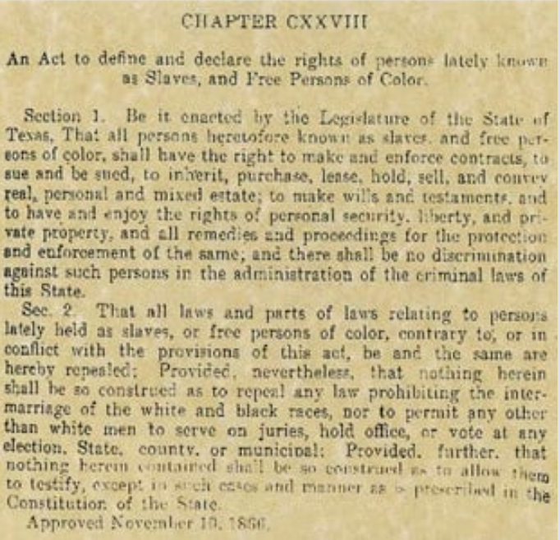
The Black Codes
TX legislature passed laws restricting the rights of Black Texans.
Denied the right to:
  Vote
  Serve on juries.
  Testify against whites.
  Attend public schools.
  Marry whites.
The Texas Black Codes, 1866.
The Texas State Historical Association.
Notes:
The Texas Black Codes, 1866. Made available under the Fair Use law 17 U.S. Code § 107 - Limitations on exclusive rights: Fair use | U.S. Code | US Law | LII / Legal Information Institute Accessed Sept. 18, 2025. https://www.tshaonline.org/handbook/entries/black-codes

Slide 13
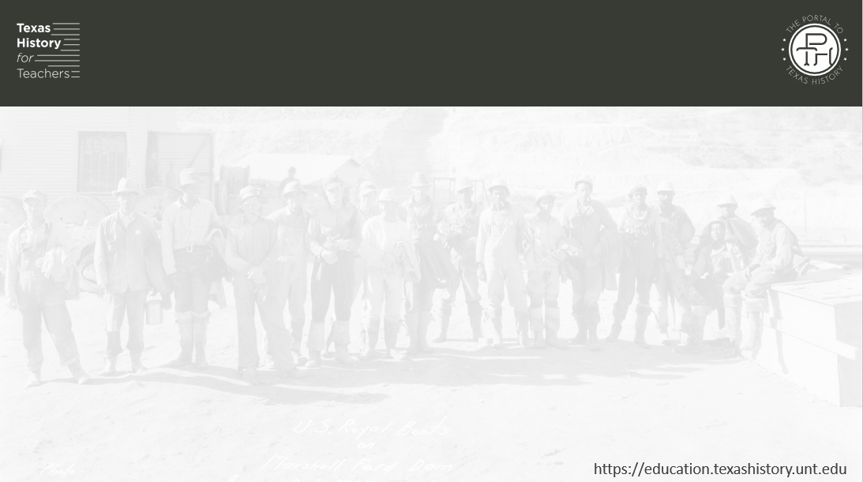
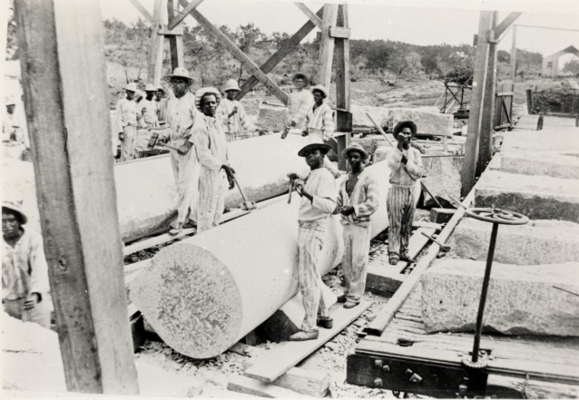
Vagrancy Laws
  Laws regulating and requiring Black Texans to work
  Employees could deduct wages for disobedience and wasting time.
  Authorities could arrest and fine people for being idle (lazy) or not having a permanent home.
  Courts could force people to work if they could not pay the fine.
Convict laborers shaping columns west of Austin.
The Portal to Texas History
Notes:
Convict Laborers Shaping Columns, photograph, 1885~; (https://texashistory.unt.edu/ark:/67531/metapth124103/: accessed September 10, 2025), University of North Texas Libraries, The Portal to Texas History, https://texashistory.unt.edu; crediting Austin History Center, Austin Public Library.
Convict Laborers Shaping Columns, photograph, 1885~; (https://texashistory.unt.edu/ark:/67531/metapth124103/: accessed September 10, 2025), University of North Texas Libraries, The Portal to Texas History, https://texashistory.unt.edu; crediting Austin History Center, Austin Public Library.

Slide 14
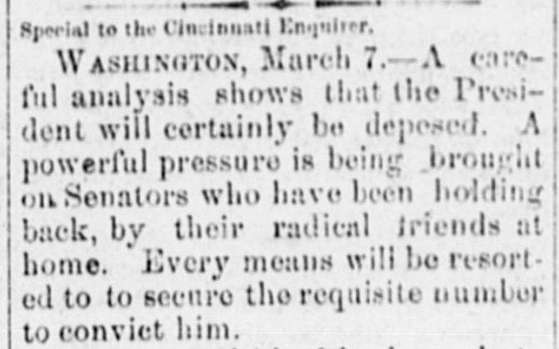
Response to Presidential Reconstruction
U.S. Congress was mostly Northern Republicans.
1868: Congress impeached President Johnson and took over Reconstruction.
Congress Passed “Reconstruction Acts.”
President Johnson was impeached, but NOT convicted. He remained in office, though he held little power.
The Portal to Texas History
Notes:
Dallas Herald. (Dallas, Tex.), Vol. 15, No. 28, Ed. 1 Saturday, March 28, 1868, newspaper, March 28, 1868; Dallas, Texas. (https://texashistory.unt.edu/ark:/67531/metapth294459/: accessed September 18, 2025), University of North Texas Libraries, The Portal to Texas History, https://texashistory.unt.edu; .

Slide 15
Congressional Reconstruction
1867 - 1874

Slide 16
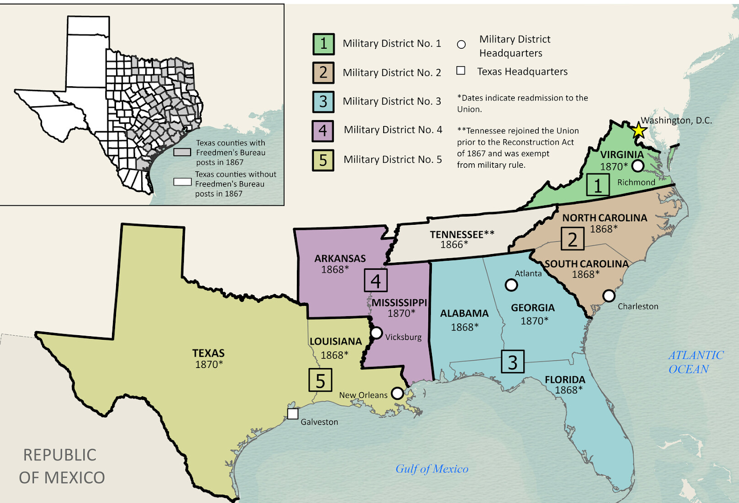
Reconstruction Acts
Southern states must:
Create new constitutions
Grant voting rights to Black people
End Black Codes
Ratify the 13th and 14th Amendments
Submit to Federal authority under martial law
The military districts of the South under martial law.
The Texas General Land Office
Notes:
Snider, Ben, Lila Rakoczy, and Kelsey Bonnell. Military Reconstruction. 2024. Texas GLO Map Database and Store. https://historictexasmaps.com/object/97345

Slide 17
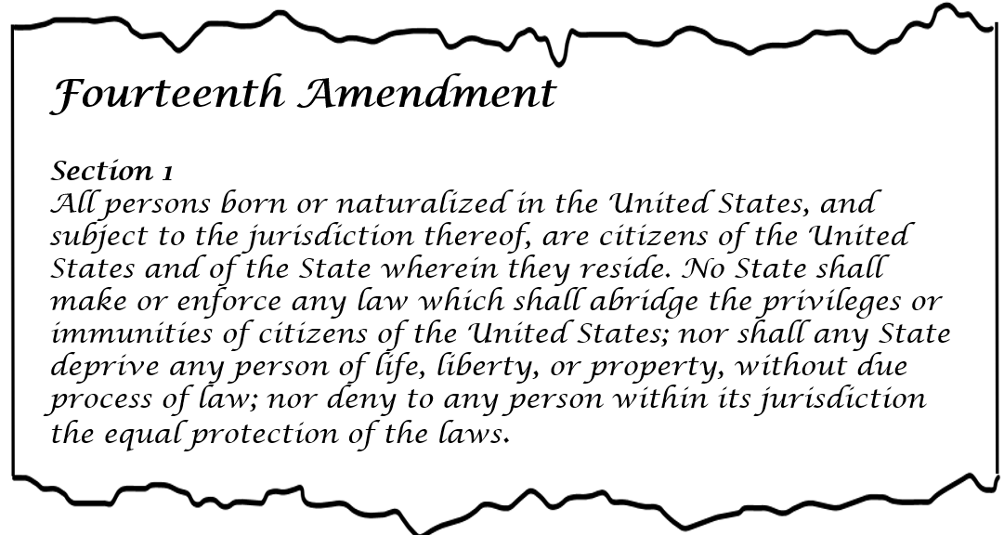
The Fourteenth Amendment
Notes:
14th Amendment to the U.S. Constitution: Civil Rights (1868). Milestone Documents. The National Archives. Accessed 10/6/25. https://www.archives.gov/milestone-documents/14th-amendment

Slide 18
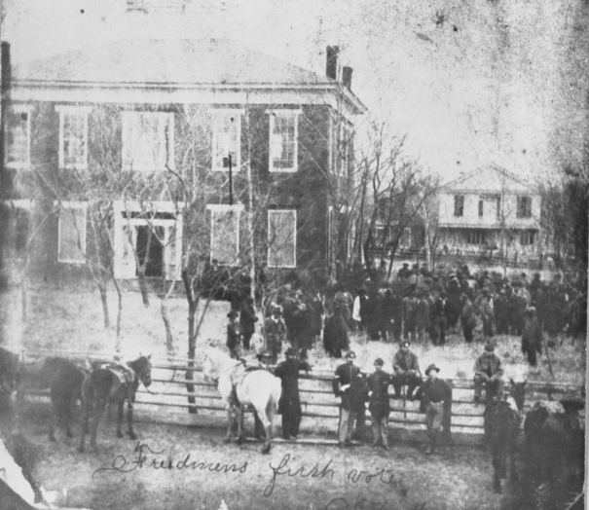
Texas Under Congressional Reconstruction
New Constitution of 1869 replaced the Constitution of 1866
Increased political participation of Black men.
Political power in Texas was now concentrated at the state level in Austin, not the local level.
Increased taxes to pay for education, State Police force, and expansion of the court system.
Freedmen’s First Vote
Anderson County, Texas, 1869
The Portal to Texas History
Notes:
Freedmens First Vote - Anderson County Courthouse. 1869. The Portal to Texas History. https://texashistory.unt.edu/ark:/67531/metapth26465/

Slide 19
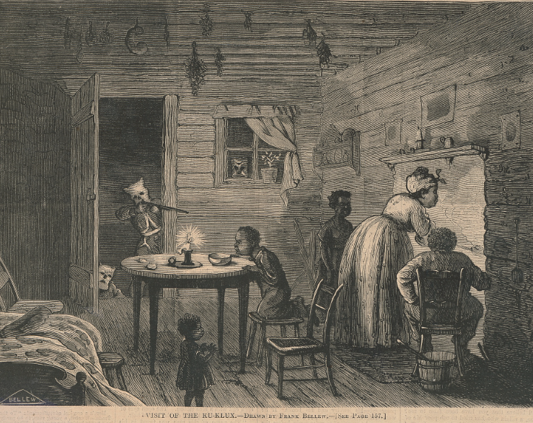
Response to Congressional Reconstruction
Education expanded
People angry at high taxes
Ex-Confederates worked to regain power in Texas
The Ku Klux Klan: A terrorist organization established in 1865 that used violence and intimidation against Black Texans and their allies.
“The Visit of the Ku Klux”
The Library of Congress
Notes:
Bellew, Frank. Visit of the Ku-Klux / drawn by Frank Bellew. 1872. Wood engraving. Library of Congress Prints and Photographs Division. https://www.loc.gov/item/2001695506/

Slide 20
“Redeemer” Reconstruction
1874 - 1877

Slide 21
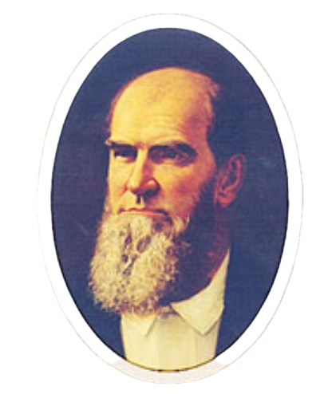
The “Redeemers” in Texas
Redeemers were Southern ex-Confederates who wanted to “redeem” Texas from Republican control and return political power to the local governments, rather than the state government.
Redeemer Governor Richard Coke
Texas State Library and Archives Commission
Notes:
Governor Richard Coke. Portraits of Texas Governors. Texas State Library and Archives Commission. Accessed 9/18/2025. https://www.tsl.texas.gov/governors/west/index.html#Coke

Slide 22
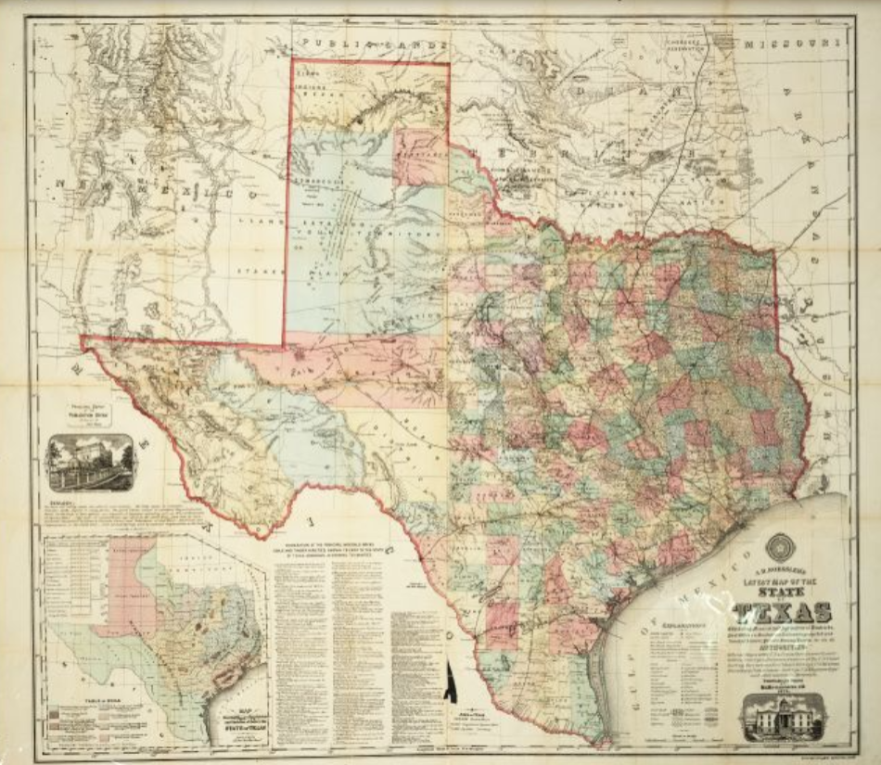
The “Redeemers” in Texas 2
The new Constitution of 1876 replaced the Constitution of 1869.
  Sul Ross helped author doc.
Reduced power of state government, returned power to local governments.
Abolished State Police
Reduced number of courts
Decentralized public schools
An 1874 map of Texas for the Bureau of Immigration.
The Portal to Texas History
Notes:
Roessler, A. R. New Map of Texas Prepared and Published for the Bureau of Immigration of the State of Texas. 1874. 37 x 41 cm. The Portal to Texas History. https://texashistory.unt.edu/ark:/67531/metapth29788/

Slide 23
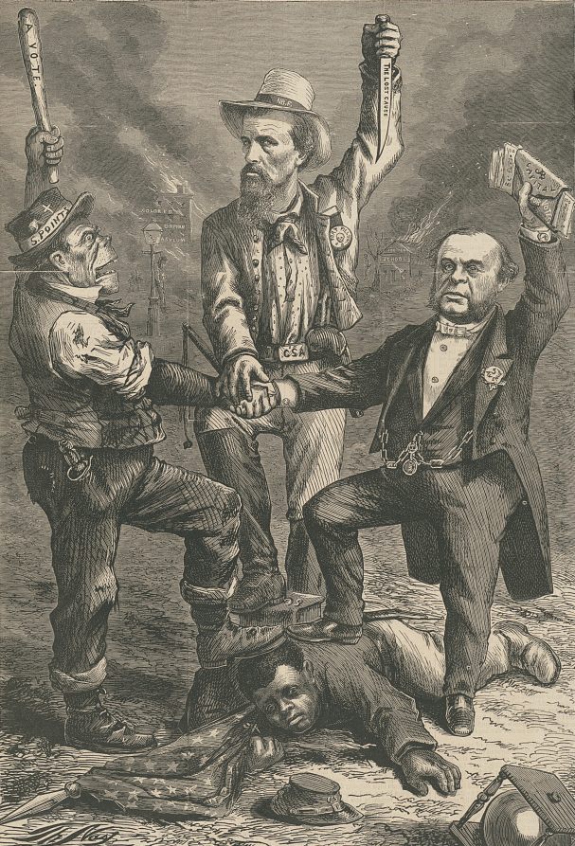
The End of Reconstruction 1877
Freedmen’s Bureau ended in 1870 due to lack of resources
Federal Troops withdrew from Southern states
Martial Law ended
Full political power returned to the states.
Ex-Confederates regained significant control of Southern states like Texas.
“This is a white man’s government”
Political Cartoon
The Library of Congress
Notes:
Nast, Thomas, Artist. "This is a white man's government" "We regard the Reconstruction Acts so called of Congress as usurpations, and unconstitutional, revolutionary, and void" - Democratic Platform / / Th. Nast. United States, 1868. Photograph. https://www.loc.gov/item/98513794/.

Slide 24
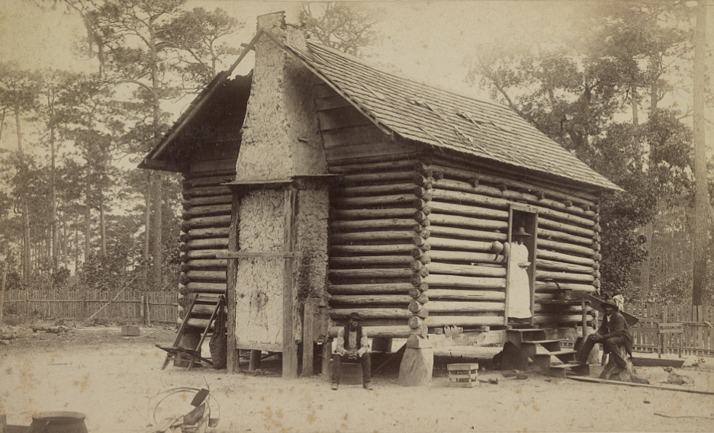
Significance of the Reconstruction Era on Texas
Development of Railroads
Increase in population
  800,000 in 1870
  2 million in 1890
Decentralized Texas government.
Many poor farmers became sharecroppers: renting land to farm, often getting trapped in cycles of debt.
A sharecroppers cabin
The Library of Congress.
Notes:
Launey & Goebel. Savannah, Ga., early Negro life. 1867 -90. Photograph. https://www.loc.gov/item/2015650291/

Slide 25
Exit Ticket
Follow the directions to complete your exit ticket
Think about the three phases of Reconstruction, and the events and characteristics of each phase.
Complete the graphic organizer based on the three phases.
Discuss with a partner

Slide 26
Share with the class 2
__(read one statement)_ was part of Presidential / Congressional / Redeemer Reconstruction.

