Slide 1
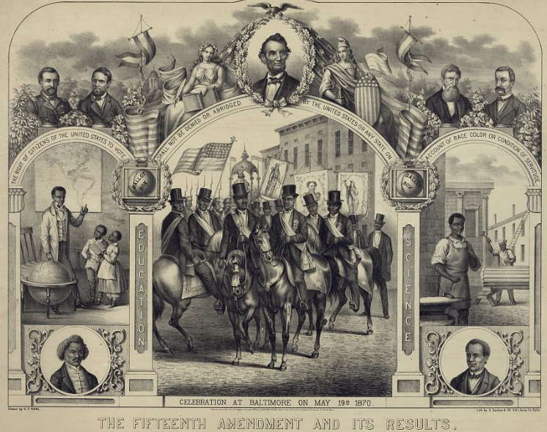
Unit 9:
Reconstruction
Review Lesson:
Study Guide
Notes:
E. Sachse & Co, G. F Kahl, and Schneider & Fuchs. The Fifteenth Amendment and its results / drawn by G.F. Kahl. ca. 1870. Lithograph. Library of Congress Prints and Photographs Division. https://www.loc.gov/item/2003690774/

Slide 2




Warm-up
Follow the directions to complete your warm-up
Read each statement in the graphic organizer.
Circle or highlight all topics you think we will see on our Unit 9 test
Discuss with a partner

Slide 3
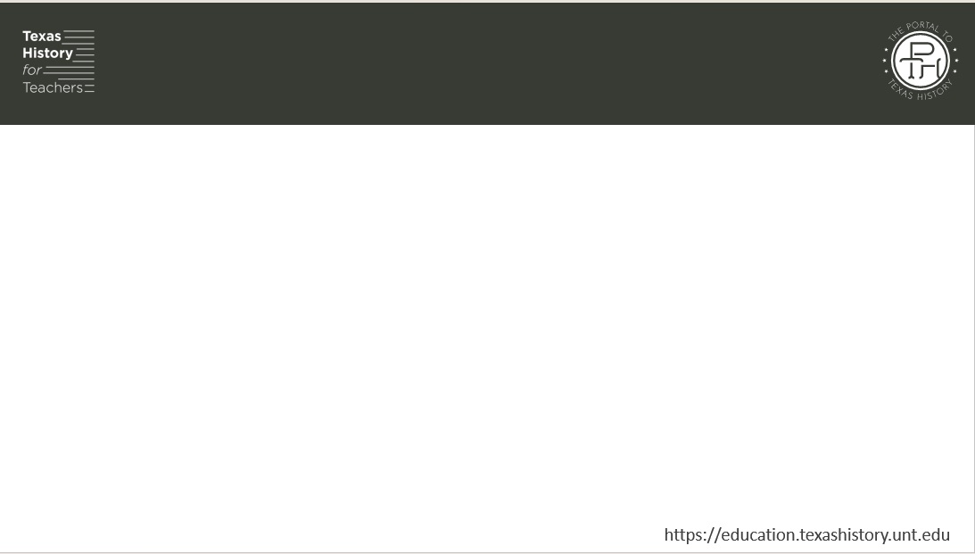
Share with the class
One thing I expect to see on the Unit 9 test is ____________

Slide 4

Essential Question
What is the key information we need to know to be successful on our Unit 9 test?

Slide 5

In today’s lesson…
We will review key terms, people, events, themes, and characteristics of the Reconstruction Era to prepare for our Unit 9 test.
I will identify the definitions and significance of key terms, match statements of cause with their significant effect, and answer practice test questions.

Slide 6
Part I: Significant Terms
The Library of Congress
Notes:
E. Sachse & Co, G. F Kahl, and Schneider & Fuchs. The Fifteenth Amendment and its results / drawn by G.F. Kahl. ca. 1870. Lithograph. Library of Congress Prints and Photographs Division. https://www.loc.gov/item/2003690774/

Slide 7

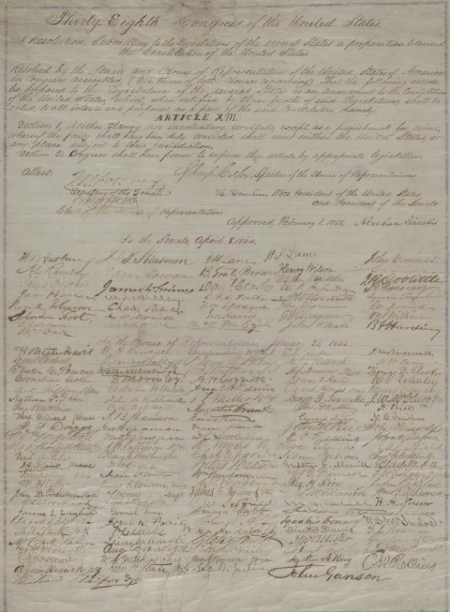
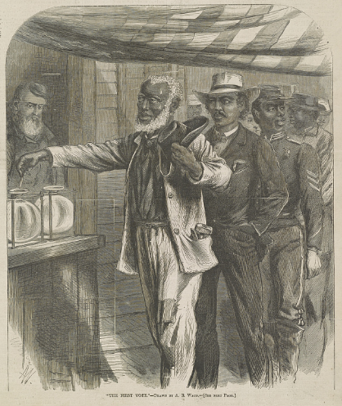
Part II: Cause and Effect Matching
The First Vote
The Library of Congress
The Thirteenth Amendment
The Library of Congress
Notes:
Lincoln, Abraham. Abraham Lincoln papers: Series 3. General Correspondence. 1837 to 1897: Congress, Wednesday,Joint Resolution Submitting 13th Amendment to the States; signed by Abraham Lincoln and Congress. February 1, 1865. Manuscript/Mixed Material. https://www.loc.gov/item/mal4361100/
Waud, Alfred R. "The first vote" / AW monogram ; drawn by A.R. Waud. 1867. Wood engraving. Library of Congress Prints and Photographs Division. https://www.loc.gov/item/00651117/

Slide 8
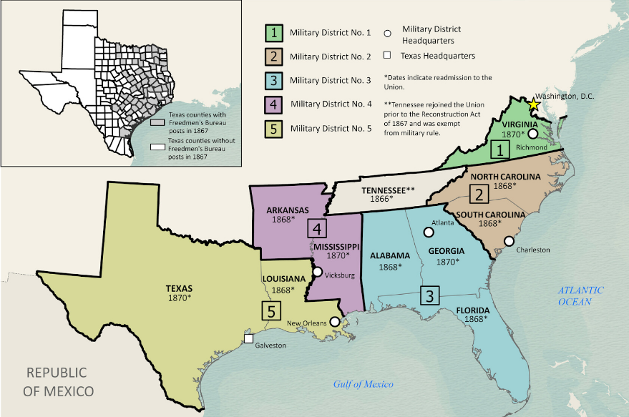
Part III: Practice Test Questions
Texas General Land Office
Notes:
Snider, Ben, Lila Rakoczy, and Kelsey Bonnell. Military Reconstruction. 2024. Texas GLO Map Database and Store. https://historictexasmaps.com/object/97345

Slide 9
Exit Ticket
Follow the directions to complete your exit ticket
Respond to each question or prompt to assess your readiness for our unit 9 test.
Discuss with a partner

Slide 10
Share with the class 2
(You may share one of your responses with the class)

