Slide 1
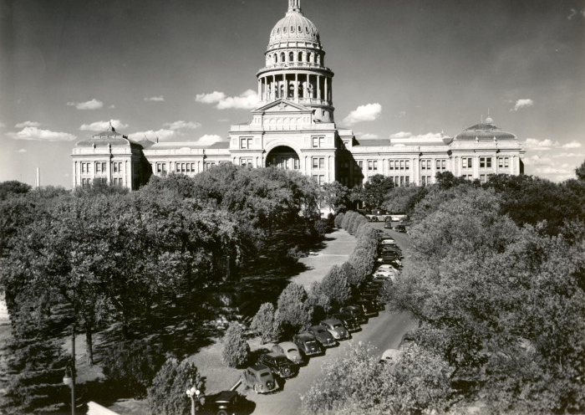
Unit 9: Reconstruction
Lesson 8:
Texas Today
The Texas State Capitol in Austin
The Portal to Texas History
Notes:
Boone Photo Co. [Texas State Capitol], photograph, 1947; (https://texashistory.unt.edu/ark:/67531/metapth124092/: accessed October 9, 2025), University of North Texas Libraries, The Portal to Texas History, https://texashistory.unt.edu; crediting Austin History Center, Austin Public Library.

Slide 2




Warm-up Follow the directions below to complete your warm-up
Respond to each question in the graphic organizer with your opinions of government responsibilities.
Share with a partner .

Slide 3

Share with the class:
I think the primary purpose of government is _________
I think the government should be responsible for ___________
I think the government should not be responsible for ___________

Slide 4

Essential Question
What are the three levels of government in Texas, what are the responsibilities of each level, and who are some of the officials at each level?

Slide 5

In Today’s Lesson
We will examine the purpose, responsibilities, and people involved in the state, county, and municipal levels of government.
I will answer questions about each level of government based on information presented in the readings.

Slide 6

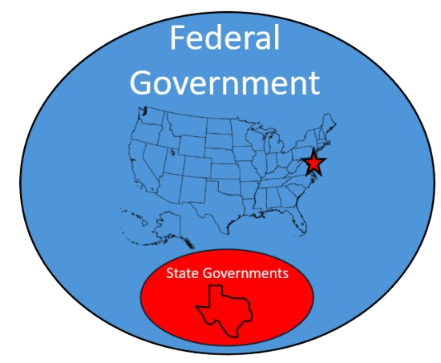
Levels of Government: Federalism
Notes:
Blank map of the states. Wikimedia Commons. Accessed 10/9/25. https://commons.wikimedia.org/wiki/File:Blank_map_of_states.png

Slide 7
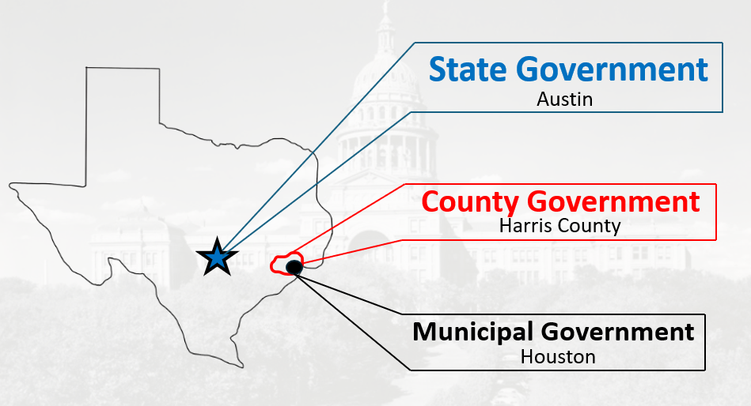
State Government Levels

Slide 8
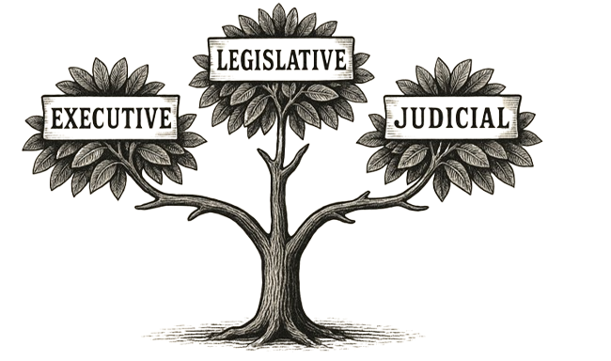
Levels of State Government

Slide 9
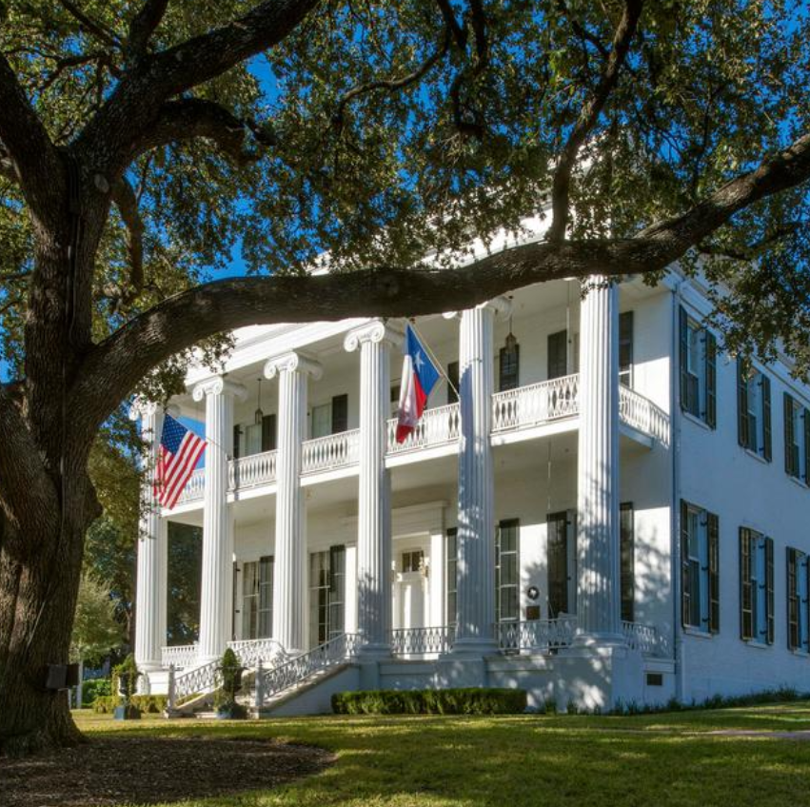
Executive Branch
The Governor’s Mansion
The Portal to Texas History
Notes:
Texas. State Preservation Board. Texas State Preservation Board Strategic Plan: Fiscal Years 2021-2025, report, June 1, 2020; Austin, Texas. (https://texashistory.unt.edu/ark:/67531/metapth1454300/: accessed October 13, 2025), University of North Texas Libraries, The Portal to Texas History, https://texashistory.unt.edu; crediting UNT Libraries Government Documents Department.

Slide 10
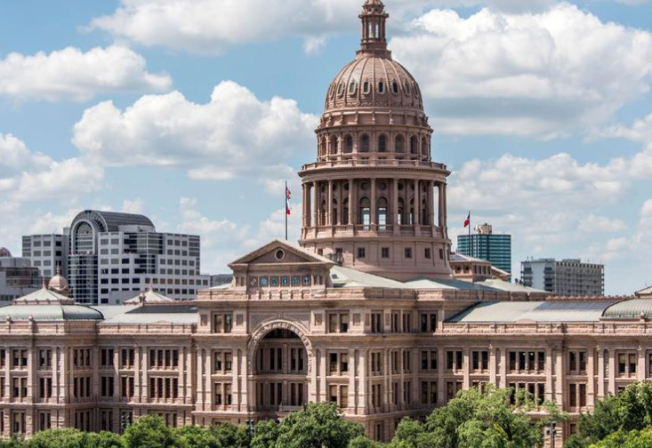
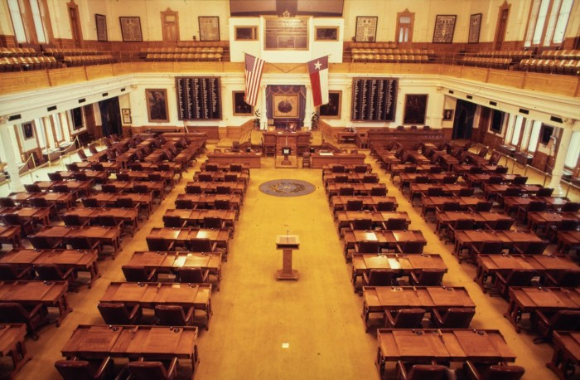
Legislative Branch
The Texas Capitol
The Portal to Texas History
The Texas House of Representatives
The Portal to Texas History
Notes:
Texas. State Preservation Board. Texas State Preservation Board Strategic Plan: Fiscal Years 2021-2025, report, June 1, 2020; Austin, Texas. (https://texashistory.unt.edu/ark:/67531/metapth1454300/: accessed October 13, 2025), University of North Texas Libraries, The Portal to Texas History, https://texashistory.unt.edu; crediting UNT Libraries Government Documents Department.
WBAP-TV (Television station : Fort Worth, Tex.). [Texas House of Representatives, 3], photograph, 197X; (https://texashistory.unt.edu/ark:/67531/metadc1611819/: accessed October 13, 2025), University of North Texas Libraries, The Portal to Texas History, https://texashistory.unt.edu; crediting UNT Libraries Special Collections.

Slide 11
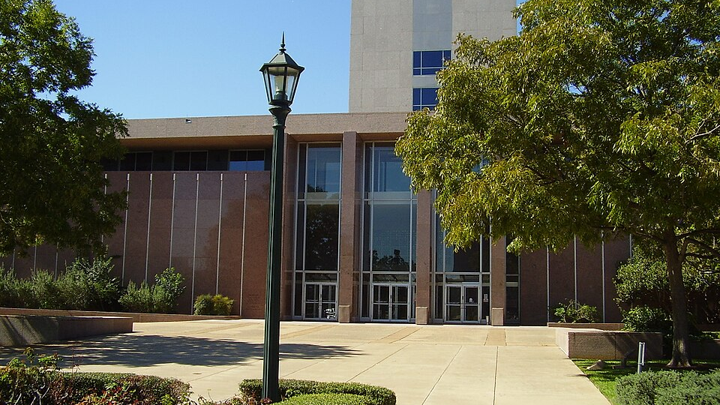
Texas Supreme Court
Notes:
Texas Supreme Court Building. Accessed 10/13/25. https://commons.wikimedia.org/wiki/File:TexasSupremeCourtBuilding.JPG

Slide 12
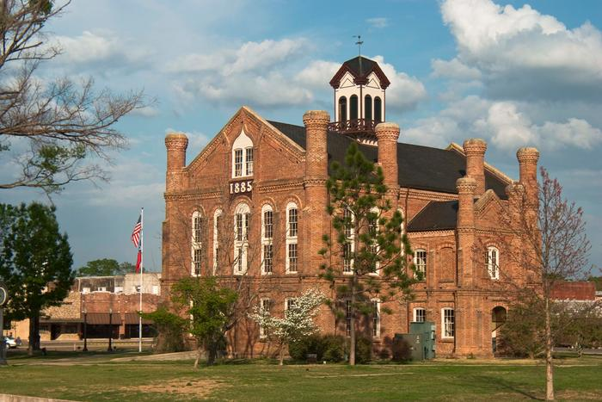
County Government The Historic Shelby County Courthouse The Portal to Texas History
Notes:
Mallory, Randy. [Monuments of Justice: The Historic Shelby County Courthouse], photograph, 199X; (https://texashistory.unt.edu/ark:/67531/metadc1980277/: accessed October 13, 2025), University of North Texas Libraries, The Portal to Texas History, https://texashistory.unt.edu; crediting UNT Libraries Special Collections.

Slide 13
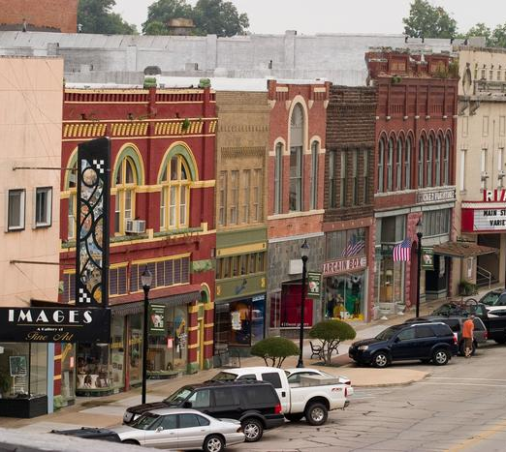
Municipal Government
The Historic Downtown of Denison
The Portal to Texas History
Notes:
Mallory, Randy. [Downtown area in Denison], photograph, September 2007; (https://texashistory.unt.edu/ark:/67531/metadc1978977/: accessed October 13, 2025), University of North Texas Libraries, The Portal to Texas History, https://texashistory.unt.edu; crediting UNT Libraries Special Collections.

Slide 14
Exit Ticket Follow the directions below to complete your exit ticket
Complete the sentence stem to demonstrate something you learned about each level of government.
Share with a partner .

Slide 15
Share with the class: 2
One thing I learned about the state level of government is ____
One thing I learned about the county level of government is _____
One thing I learned about the municipal level of government is ____

