Slide 1
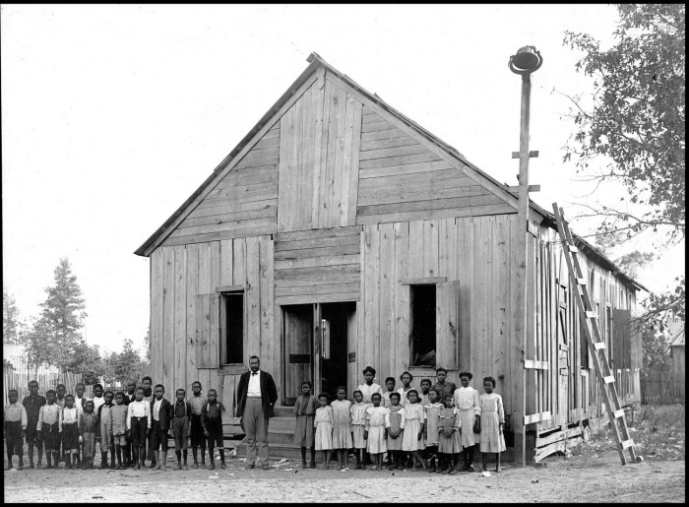
Unit 9: Reconstruction
Lesson 1:
The Big Picture
African American Schoolhouse. The Portal to Texas History
Notes:
American Lumberman. [African American School House], photograph, 1907; (https://texashistory.unt.edu/ark:/67531/metapth204411/: accessed September 10, 2025), University of North Texas Libraries, The Portal to Texas History, https://texashistory.unt.edu; crediting The History Center.

Slide 2




Warm-up Follow the directions to complete your warm-up
Read each statement in the graphic organizer.
Choose up to SIX statements that you think are true as we begin this new unit.
Discuss with a partner

Slide 3

Share with the class
One statement that I think is true about the Reconstruction era is __________

Slide 4

Essential Question
What are the key events, major themes, and defining characteristics of the Reconstruction era of Texas history?

Slide 5

In today’s lesson…
We will identify the main ideas, themes, key events, and defining characteristics of the Reconstruction era of Texas history.
I will analyze a primary source image, then use a reading passage to identify major themes and significant information related to this era. I will answer comprehension questions about the passage.

Slide 6
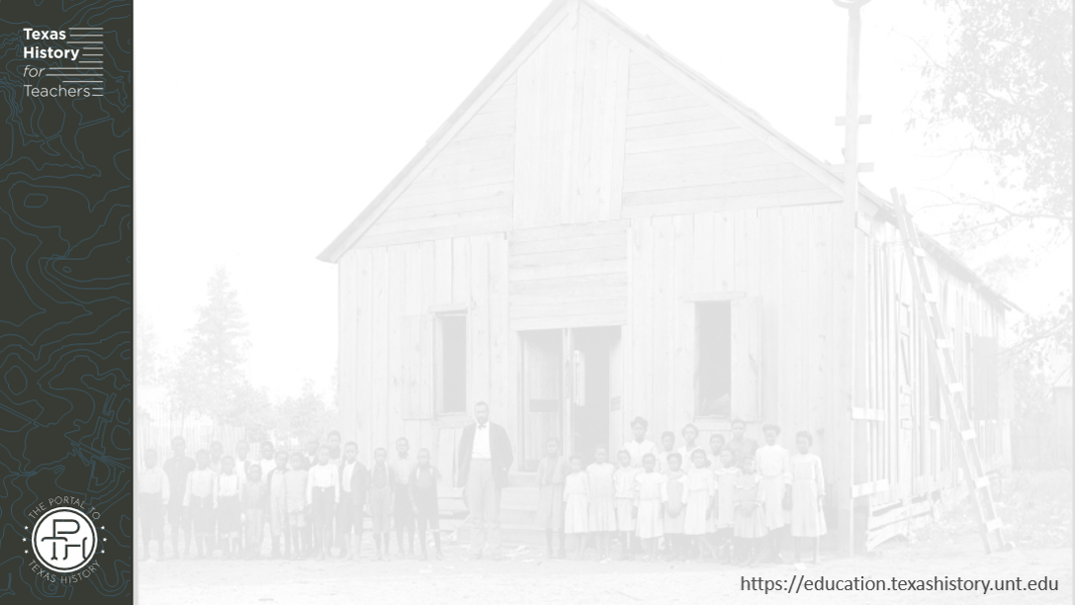
Part I: Analyze an Image
African American school house in East Texas.
The Portal to Texas History
Notes:
American Lumberman. [African American School House], photograph, 1907; (https://texashistory.unt.edu/ark:/67531/metapth204411/: accessed September 10, 2025), University of North Texas Libraries, The Portal to Texas History, https://texashistory.unt.edu; crediting The History Center.

Slide 7

Part II: Essential Ideas Reading Passage

Slide 8
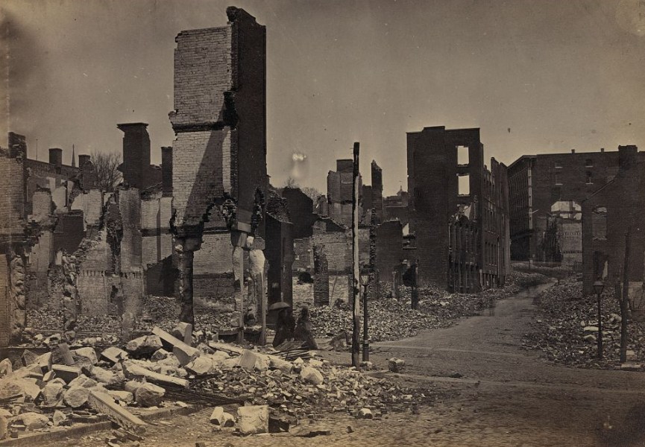
Paragraph 1: The Effects of the Civil War
The Ruins of Richmond, Virginia, After the Civil War
The Library of Congress
Notes:
Russell, Andrew J. Ruins in Richmond, cor. Carey and Governor Sts. 1865. Photograph. Library of Congress Prints and Photographs. https://www.loc.gov/item/91787187/

Slide 9
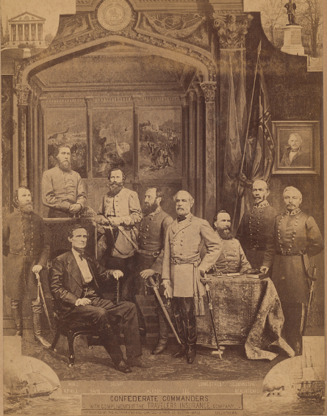
Paragraph II: The Ex-Confederates
An image of the most significant Confederate leaders during the Civil War:
President Jefferson Davis, seated, surrounded by Confederate commanders from left to right, General John Bell Hood, General A.P. Hill, Major General Jeb Stuart, General Stonewall Jackson, General Robert E. Lee, General James Longstreet, General Joseph Eggleston Johnston and General Pierre Gustave Toutant-Beauregard
The Library of Congress
Notes:
Notman Photo Co. President Jefferson Davis, seated, surrounded by Confederate commanders from left to right, General John Bell Hood, General A.P. Hill, Major General Jeb Stuart, General Stonewall Jackson, General Robert E. Lee, General James Longstreet, General Joseph Eggleston Johnston and General Pierre Gustave Toutant-Beauregard, in uniforms with swords / Notman Photo. Co., Albany, N.Y. 1885. Photograph. Library of Congress Prints and Photographs Division. https://www.loc.gov/item/2021644151/

Slide 10
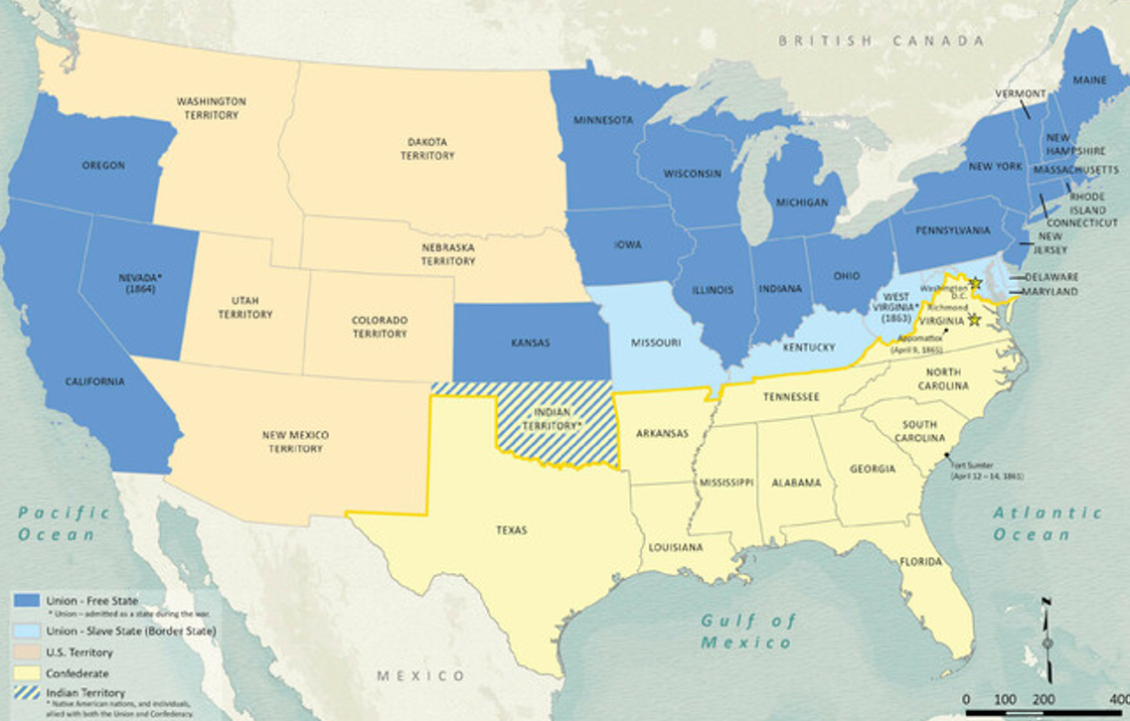
Paragraph III: The Southern States
Texas General Land Office
Notes:
Wang, Thomas, Lila Rakoczy, and James Harkins. American Civil War Political Loyalties. 2022. Texas General Land Office, GIS Educational Maps. Map Database and Store. https://historictexasmaps.com/object/97091

Slide 11
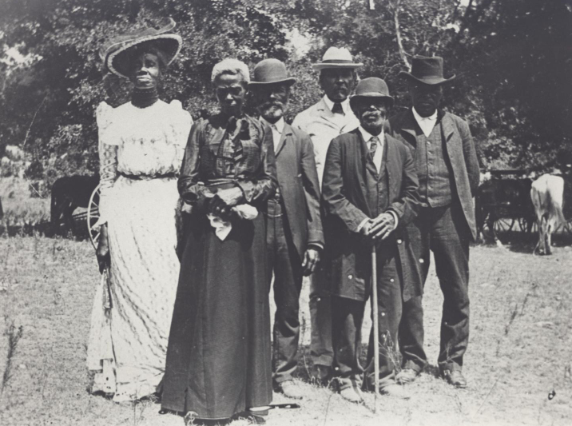
Paragraph IV: The Freed People
Emancipation Day Celebration in Austin, Texas
The Portal to Texas History
Notes:
Stephenson, Mrs. Charles (Grace Murray). Emancipation Day Celebration, June 19, 1900. June 19, 1900. Photograph. University of North Texas Libraries, The Portal to Texas History; crediting Austin History Center, Austin Public Library. https://texashistory.unt.edu/ark:/67531/metapth124053.

Slide 12
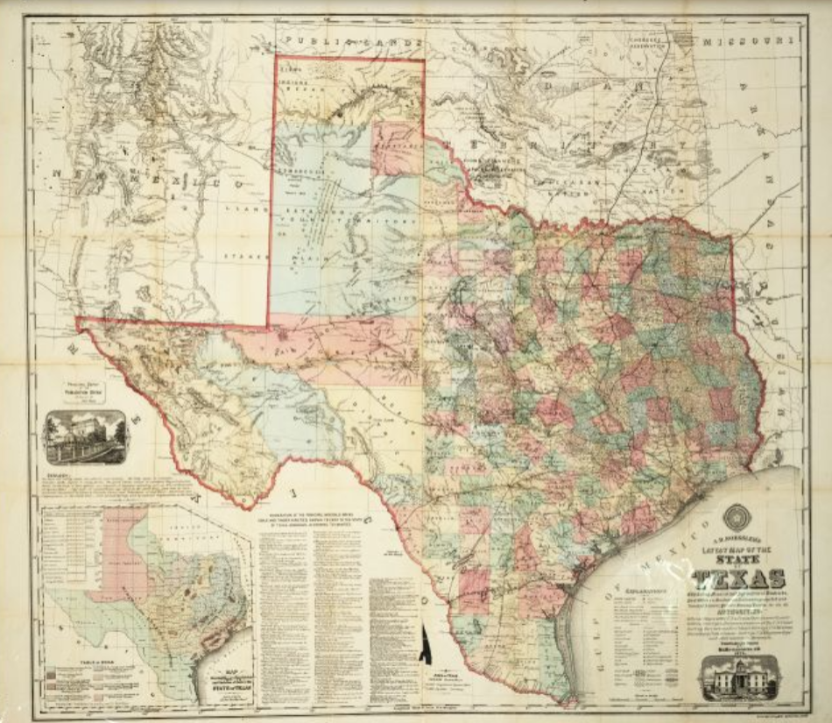
Paragraph V: Texas & Reconstruction
An 1874 map of Texas
The Portal to Texas History
Notes:
Roessler, A. R. New Map of Texas Prepared and Published for the Bureau of Immigration of the State of Texas. 1874. 37 x 41 cm. The Portal to Texas History. https://texashistory.unt.edu/ark:/67531/metapth29788/

Slide 13
Part III: Comprehension Questions

Slide 14
Exit Ticket Follow the directions to complete your exit ticket
Choose the statement that best summarizes the defining characteristics of the Reconstruction Era.
Discuss with a partner

Slide 15
Share with the class 2
(Read your chosen answer)

