Slide 1
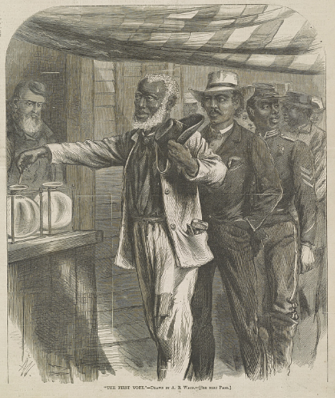
Unit 9:
Reconstruction
Lesson 3:
Vocabulary
“The First Vote,” 1867. Library of Congress
Notes:
Waud, Alfred R. "The first vote" / AW monogram ; drawn by A.R. Waud. 1867. Wood engraving. Library of Congress Prints and Photographs Division. https://www.loc.gov/item/00651117/

Slide 2




Warm-up:
Follow the directions to complete your warm-up
Assess your prior knowledge of the four vocabulary terms on your warm-up.
Write your level of understanding for each term.
Share with a partner.

Slide 3

Share with the class
One vocabulary term we will learn in this unit is ______.
(Read your chosen response for this term)

Slide 4

Essential Question
What are the key terms we need to know to understand this unit on Reconstruction, and what is the meaning of these terms in the context of our unit?

Slide 5
In today’s lesson…
We will identify, define, and exemplify the key terms of the Reconstruction era.
I will use the information and context of several short passages to identify and record the definition of each term and provide examples of the term in the context of our unit.

Slide 6
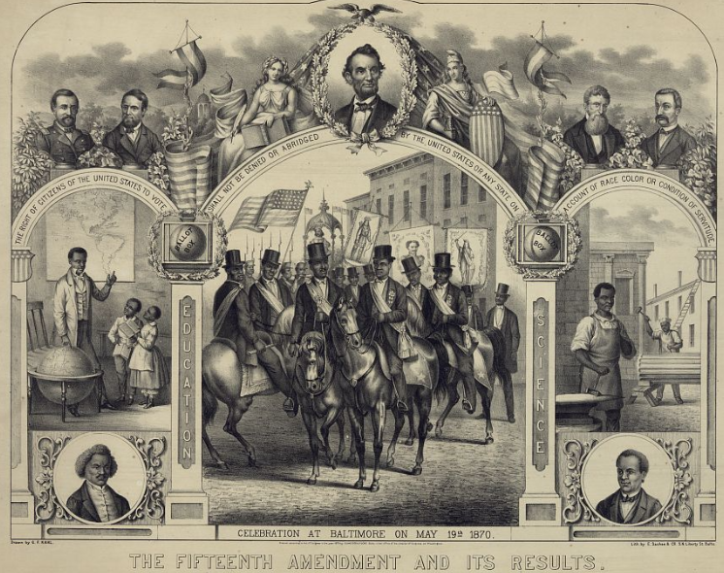
Reconstruction (n)
The Civil War had divided the United States for four bloody years. To move forward as a nation, people in the U.S. government had different plans for how to reconstruct, or rebuild, the governments and economies of the South.
Some wanted Reconstruction to be lenient on ex-Confederates, pardoning them and allowing them back into the Union. Others wanted the ex-Confederates to be punished for rebelling against the U.S. government.
These opposing views caused a lot of conflict during the Reconstruction Era.
The Fifteenth Amendment and its Results.
The Library of Congress.
Notes:
E. Sachse & Co, G. F Kahl, and Schneider & Fuchs. The Fifteenth Amendment and its results / drawn by G.F. Kahl. ca. 1870. Lithograph. Library of Congress Prints and Photographs Division. https://www.loc.gov/item/2003690774/

Slide 7
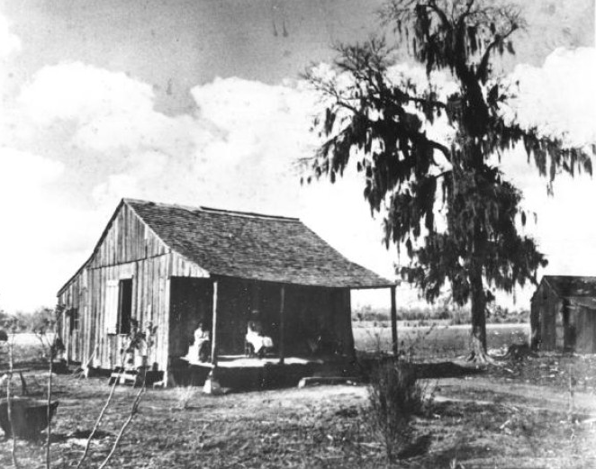
Sharecropper (n)
After the Civil War, most newly freed Black Southerners had no money to buy their own land. This was also true for many poor white Southerners. As a result, these groups often worked as sharecroppers.
Sharecroppers were farmers who would rent land from landowners. They would also rent any farming equipment, housing, or food that they needed from the landowner. They would pay for these items after the harvest with a portion of their crops. Any profits from whatever crops were left was theirs to keep.
Often there was little or no money left, which meant that sharecroppers often became trapped in a cycle of debt.
A sharecropper’s cabin near Houston
The Portal to Texas History
Notes:
[A tenant's or share-cropper's cabin.], photograph, Date Unknown; (https://texashistory.unt.edu/ark:/67531/metapth1393/: accessed September 10, 2025), University of North Texas Libraries, The Portal to Texas History, https://texashistory.unt.edu; crediting Fort Bend Museum.

Slide 8
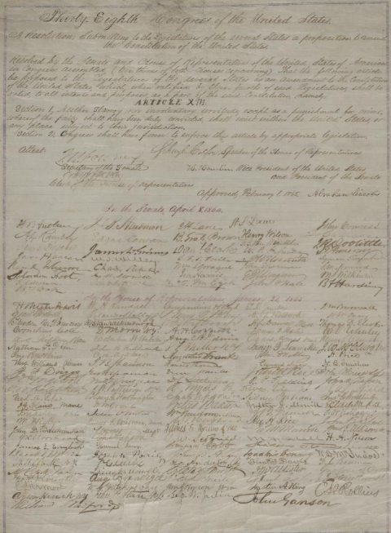
Amendment (n)
When the Founding Fathers wrote the United States Constitution in the 1780s, the document only outlined the powers of the government. Many Americans wanted them to add more information about the specific rights of the people.
In response, the Founding Fathers wrote ten amendments to the Constitution to protect individual rights like the freedoms of speech and religion. These amendments were additions made to the original document. Amending the Constitution is the process of editing the document by adding new information.
During Reconstruction, the U.S. government amended the Constitution three times by adding the 13th, 14th, and 15th amendments, which addressed the rights of the newly freed people, including their right to citizenship and vote in elections.
The Thirteenth Amendment
The Library of Congress
Notes:
Lincoln, Abraham. Abraham Lincoln papers: Series 3. General Correspondence. 1837 to 1897: Congress, Wednesday,Joint Resolution Submitting 13th Amendment to the States; signed by Abraham Lincoln and Congress. February 1, 1865. Manuscript/Mixed Material. https://www.loc.gov/item/mal4361100/

Slide 9
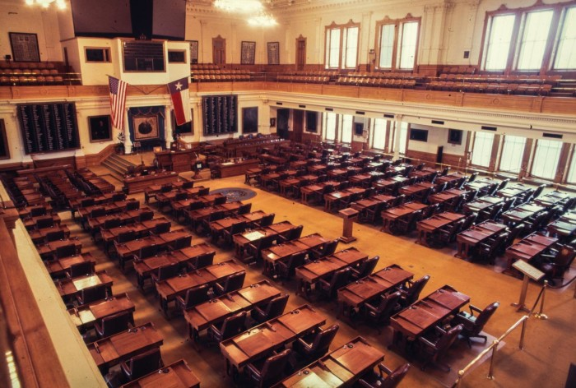
Ratify (v)
During the Reconstruction Era, Congress passed three new amendments to the Constitution. The 13th, 14th, and 15th amendments abolished slavery, granted citizenship to the freed people, and guaranteed the right to vote for freed Black men.
After Congress passed the new amendments, the amendments then went to the state governments to be ratified or officially approved. After three fourths of the state legislatures voted to ratify the amendments, then they officially became part of the U.S. Constitution.
In order to be accepted back into the Union, the South had to ratify the new amendments to the Constitution.
The Chamber of the House of Representatives
Texas Legislature
The Portal to Texas History
Notes:
WBAP-TV (Television station : Fort Worth, Tex.). [Texas House of Representatives], photograph, 197X; (https://texashistory.unt.edu/ark:/67531/metadc1611814/: accessed September 12, 2025), University of North Texas Libraries, The Portal to Texas History, https://texashistory.unt.edu; crediting UNT Libraries Special Collections.

Slide 10
Franchise (n)
When the United States was founded, most states limited the franchise, or the right to vote, to White, property-owning men. Over time, more groups have been enfranchised, giving them the right to vote also.
After the Civil War, the 15th Amendment to the Constitution guaranteed the right to vote to all men “regardless of race, color, or previous condition of servitude.” This meant that formerly enslaved men were now enfranchised, or able to vote.
At the same time, one of the punishments for the ex-Confederates was that they were disenfranchised. Their right to vote was removed because they had waged war against the United States.
“The First Vote”
The Library of Congress
Notes:
Waud, Alfred R. "The first vote" / AW monogram ; drawn by A.R. Waud. 1867. Wood engraving. Library of Congress Prints and Photographs Division. https://www.loc.gov/item/00651117/

Slide 11
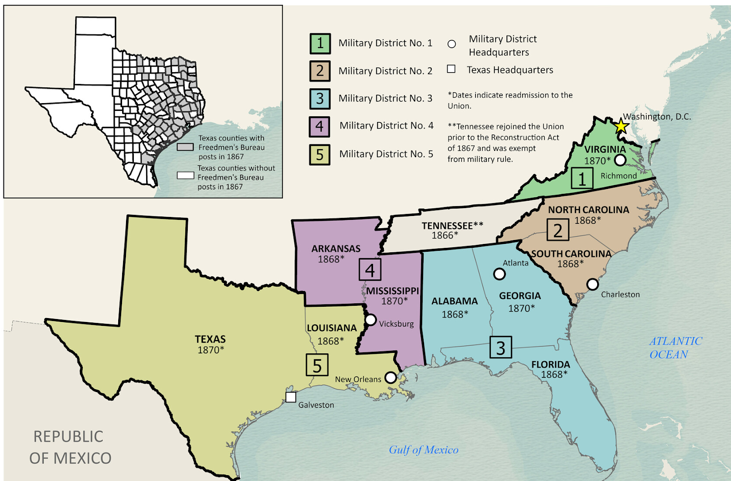
Martial Law (n)
Many Northern Republicans in Congress wanted to punish the Southern states for rebelling against the U.S. government. They also wanted to gain more control over Southern governments during Reconstruction.
One way Congress punished the South and gained control of Southern governments was by establishing martial law in the Southern states. Under martial law, the normal state governments were suspended, and the U.S. military was put in control of all Southern governments.
Military Reconstruction Districts
The Texas General Land Office
Notes:
Snider, Ben, Lila Rakoczy, and Kelsey Bonnell. Military Reconstruction. 2024. Texas GLO Map Database and Store. https://historictexasmaps.com/object/97345

Slide 12
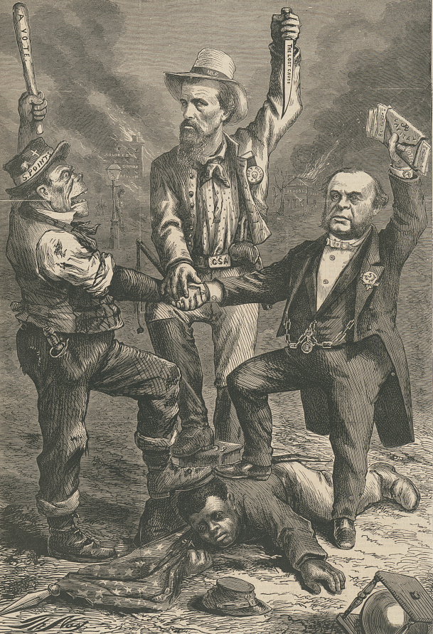
Redemption (n)
In the 1870s, many ex-Confederates began regaining the right to vote and hold office by taking the required loyalty oath to the U.S. government. As a result, ex-Confederates were regaining power in state governments across the South.
Back in power, these ex-Confederates began the process of what they called “redeeming” their governments. They believed they were fixing the problems created when the federal government was in control during martial law. This “redemption” included rewriting state constitutions to return power to local governments and limiting the rights of the freed people.
A political cartoon titled, “This is a White Man’s Government.” The Library of Congress.
Notes:
Nast, Thomas, Artist. "This is a white man's government" "We regard the Reconstruction Acts so called of Congress as usurpations, and unconstitutional, revolutionary, and void" - Democratic Platform / / Th. Nast. United States, 1868. Photograph. https://www.loc.gov/item/98513794/.

Slide 13
Exit Ticket:
Follow the directions to complete your exit ticket
Choose THREE terms from the graphic organizer that you think BEST relate to our unit.
Complete the sentence stem provided.
Share with a partner.

Slide 14
Share with the class 2
One vocabulary term we will learn in this unit is ______.
(Read your chosen response for this term)

