Slide 1
Voices of Reconstruction:
African American and
Women’s Perspectives
https://education.texashistory.unt.edu

Slide 2

Essential Questions:
1. In what ways do individuals impact a society?
2. How did African Americans influence events and issues in Texas during the period of Reconstruction?
3. How did women influence events and issues in Texas during the period of Reconstruction?
https://education.texashistory.unt.edu
Notes:
Take a moment to allow the students to generalize these questions. Encourage them to write them down and focus on these as the lesson goes. They will be expected to answer these at the end of the lesson to apply their knowledge.

Slide 3
Organize Your Notes and Key Points
Political Influencers & Contributions | Economic Influencers & Contributions | Social Influencers & Contributions

Slide 4
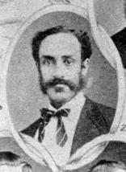
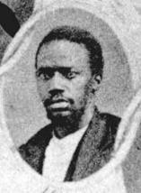
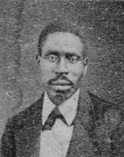
African American Legislators in Texas
Reconstruction marked the first time in American history that many African Americans would be allowed to vote and take seats in office. During this period three African Americans were elected to the Texas Senate and thirty-two others were elected to serve in the Texas House of Representatives.
These legislators worked to advance education, secure voting rights, and to secure full liberties for African Americans.
Three African American legislators elected in 1869.
George Ruby elected Senator (left), Matt Gaines elected Senator (middle), Walter Moses Burton elected Sheriff (right).
https://education.texashistory.unt.edu
Notes:
https://www.tsl.texas.gov/treasures/giants/aalege.html

Slide 5
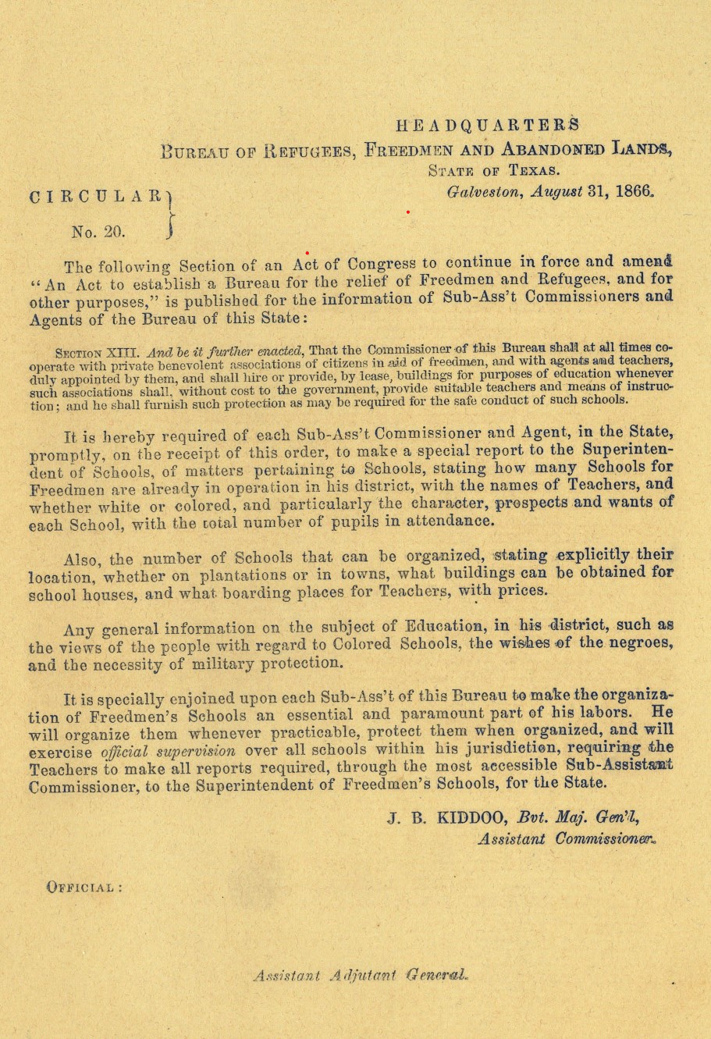

Freedman’s Bureau
Think-Pair-Share
Using the guided questions, analyze the primary source images to answer the document analysis questions.
Support your claims using evidence.
Document Analysis Questions:
Based on Section XIII of the document, what is the Commissioner of the Bureau responsible for?
What information must the Superintendent provide upon request?
Why might the government need to order these kinds of updates on the status of schooling for African Americans in Texas?
https://education.texashistory.unt.edu

Slide 6
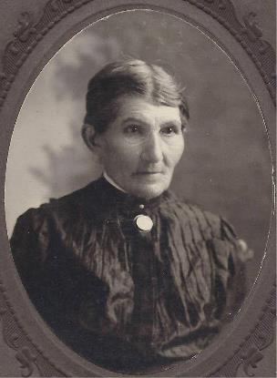
Women’s Rights in Texas
Prior to the Civil War, women across the nation, including Texas, were politically activated around the issue of abolition. Many women abolitionists would later develop ambitions to expand basic liberties to women.
Texas women played a role in the women’s suffrage movement that began during the period of Reconstruction. Women sought to fight back against discrimination and abuse based on sex.
The goal of women’s suffrage was to obtain equal rights and protection under the law for women, including the right to vote.
It was through the work of early Texas suffragists like Mariana Thompson Folsom and Martha Goodwin Tunstall in the 1870s and 1880s, that Texas women would later have a role in the national women’s suffrage movement.
Martha Goodwin Tunstall was a leading woman’s suffrage supporter in Texas during the period of Reconstruction.
https://education.texashistory.unt.edu
Notes:
. Barbara Mulvihill, “Tunstall, Martha Goodwin,” Handbook of Texas Online. https://www.tshaonline.org/handbook/entries/tunstall-martha-goodwin.

Slide 7
Advancing Education in Texas
Following the Civil War, the Freedman’s Bureau established schools and taught both children and adults. These schools were protected by government orders and the military was often used to ensure that the schools operated.
During Reconstruction, the Freedmen’s Bureau succeeded in establishing 66 schools throughout Texas, of which 43 were owned by African Americans.
During Reconstruction, many women, both white and African American, began to teach in schools for African Americans.
By the end of Reconstruction, the Freedmen’s Bureau employed 63 teachers and enrolled 3,248 African American students in Texas.
https://education.texashistory.unt.edu
Notes:
[2] Alton Hornsby, “The Freedmen’s Bureau Schools in Texas, 1865-1870,” The Southwestern Historical Quarterly 76, no. 4 (1973): 416. http://www.jstor.org/stable/30238207

Slide 8
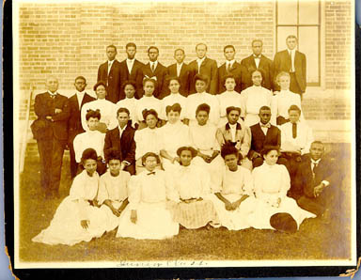
Higher Education in Texas
During the time of Radical Republican leadership, many African-Americans were elected or appointed into political positions. A major focus for many African American officials took steps to increase access to higher education for Africans Americans:
Representative Meshack Roberts - established Wiley College, the first college-level school for African Americans west of the Mississippi.
Senator Matthew Gaines - Supported the Free School Bill that helped finance an agricultural and mechanical college (now Texas A&M University), the first publicly supported state institution of higher education.
Representative William Holland – “Father of Prairie View A&M University” introduced the bill to convert Alta Vista Institute into Alta Vista Agricultural College and a year later into Prairie View Normal College (a school for teachers).
Representative Thomas Beck – fought to protect funding for Prairie View University in 1880 when threatened by the state.
"Junior Class, Texas Normal School for Negroes." Prints and Photographs Collection, Texas State Library and Archives Commission.
https://education.texashistory.unt.edu

Slide 9
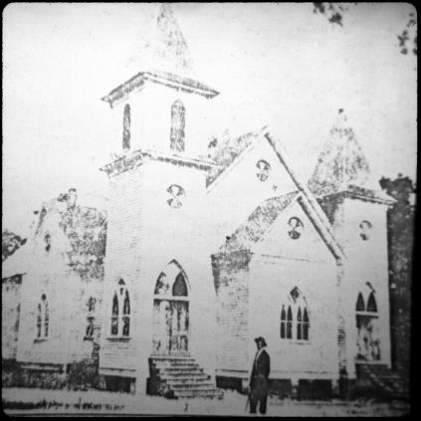
Churches
The church was the center of the community for many African Americans during and after Reconstruction.
The church was a place of worship and often served as a school, meeting house, and place to host social events, and political gatherings.
Men of the church would often organize and sponsor benevolent and fraternal societies. Black ministers played a major role in their communities, often advocated for political rights and the advancement of their communities. In many cases ministers ran for public office and churches hosted political events.
Women were also key in the development of churches in Texas, as they often hosted fundraising events and social gatherings.
[African-American Church, Harrison County], photograph, Date Unknown;
(https://texashistory.unt.edu/ark:/67531/metapth18164/: accessed May 4,
2022), University of North Texas Libraries, The Portal to Texas History,
https://texashistory.unt.edu; crediting Marshall Public Library.
https://education.texashistory.unt.edu
Notes:
African-American Church, Harrison County], photograph, Date Unknown; University of North Texas Libraries, The Portal to Texas History, https://texashistory.unt.edu; crediting Marshall Public Library.

Slide 10
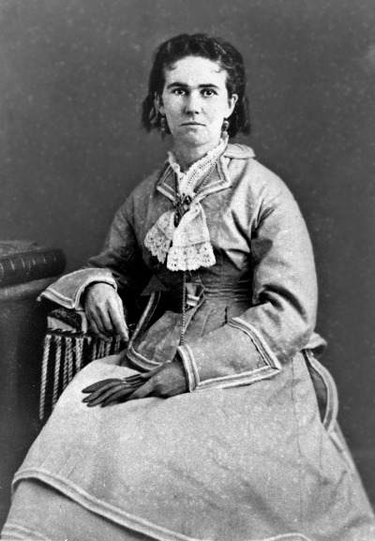
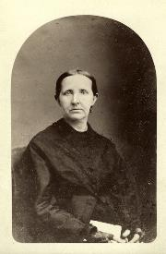
Women in Business
Women played a major role in rebuilding the economy of Texas following the Civil War. With many men off to war, women had the responsibility to take care of things on the “home front” such as tending to farms, maintaining homes, and finding ways to bring income to their families. Some women became prosperous land and business owners during this period.
Lizzie Johnson was one of the most successful cattle dealers and real estate investors in Texas following the Civil War and during Reconstruction.
Sarah Cockrell built the first iron bridge across the Trinity River in Dallas.
https://education.texashistory.unt.edu
Notes:
Portrait of Sarah Horton Cockrell. DeGolyer Library, Southern Methodist University, Dallas, Texas, Cockrell Family Papers, A2002.2335.

Slide 11
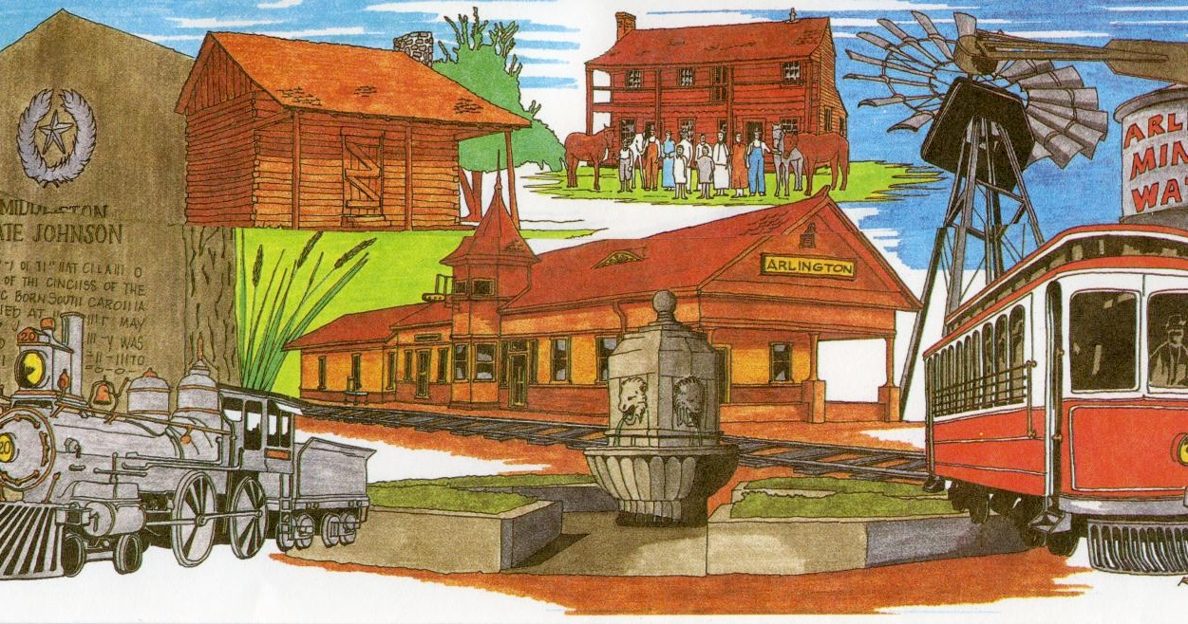
Think - Pair - Share
Using the lesson essential questions discussed at the beginning of the lesson and your newly gained perspective about the key contributors of Reconstruction, answer the following questions using text evidence.
Apply your knowledge:
Use notes and activities from this lesson to support your thinking process.
Essential Questions - Exit Ticket
1. In what ways can individuals or groups impact a society?
2. How did African Americans influence events and issues in Texas during the period of Reconstruction?
3. How did women influence events and issues in Texas during the period of Reconstruction?
https://education.texashistory.unt.edu
Notes:
Revisit the lesson specific essential questions. Allow students to work with a partner or small group for 5-8 minutes to discuss possible answers to the questions. They may need to refer to notes or activities completed during the lesson. Bring all the students together after time is up to facilitate a whole group discussion over the essential questions.

