Slide 1
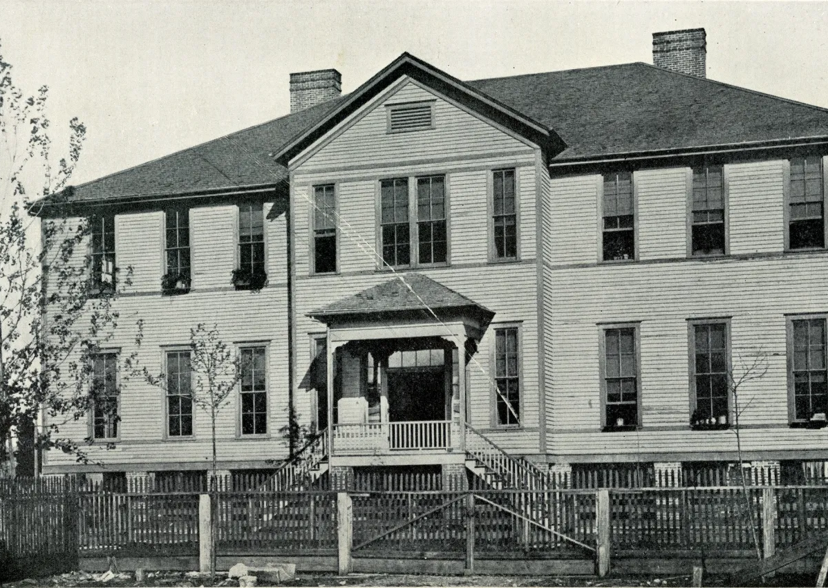
Unit 9: Reconstruction
Lesson 4:
What’s the story?
The Gregory School for African Americans, Houston
The National Archives
Notes:
Gregory School Building, established 1870. Photograph, 1903 (The African American Library at the Gregory School, Houston Public Library) National Archives. Accessed Sept. 9, 2025. https://rediscovering-black-history.blogs.archives.gov/2021/09/01/preserving-a-communitys-legacy-the-history-of-the-gregory-school/

Slide 2
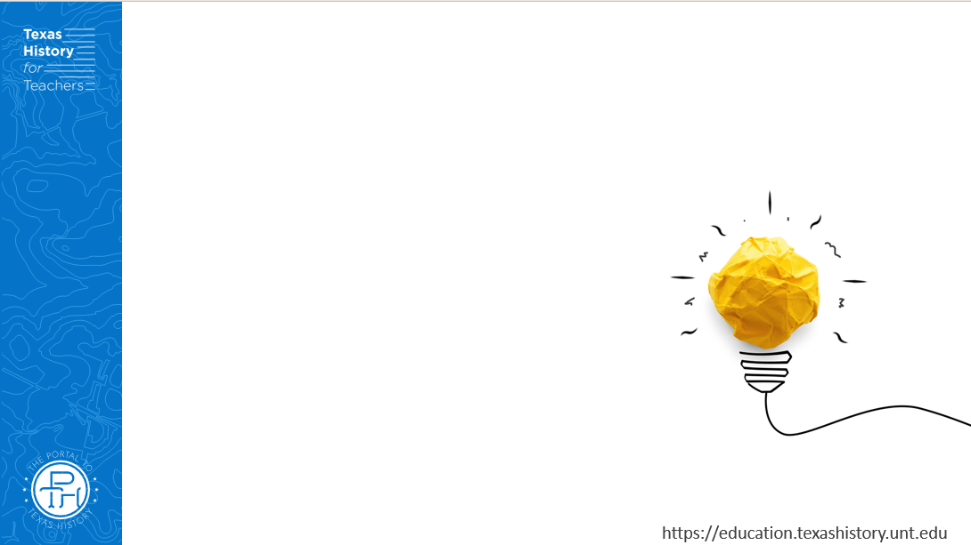



Warm-up: Follow the directions to complete your warm-up
Read the newspaper excerpt about Abraham Lincoln’s assassination.
Answer the question about the excerpt.
Share with a partner.

Slide 3

Share with the class
One conclusion I can draw from this article is that ____________
One inference I can make from this article is that ____________

Slide 4
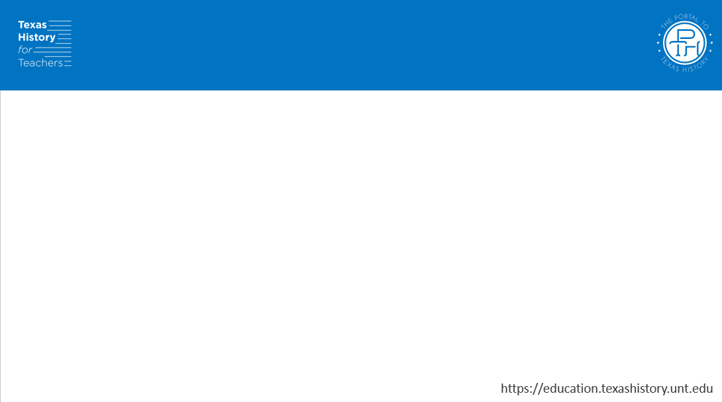
Essential Question
What were the key events and major themes that define and characterize the Reconstruction era?

Slide 5
In today’s lesson…
We will examine six primary topics and themes in Reconstruction to identify the major events that shaped the era in the United States and Texas.
I will read six short passages about key events to determine the primary details and significance of key events that occurred during Reconstruction.

Slide 6
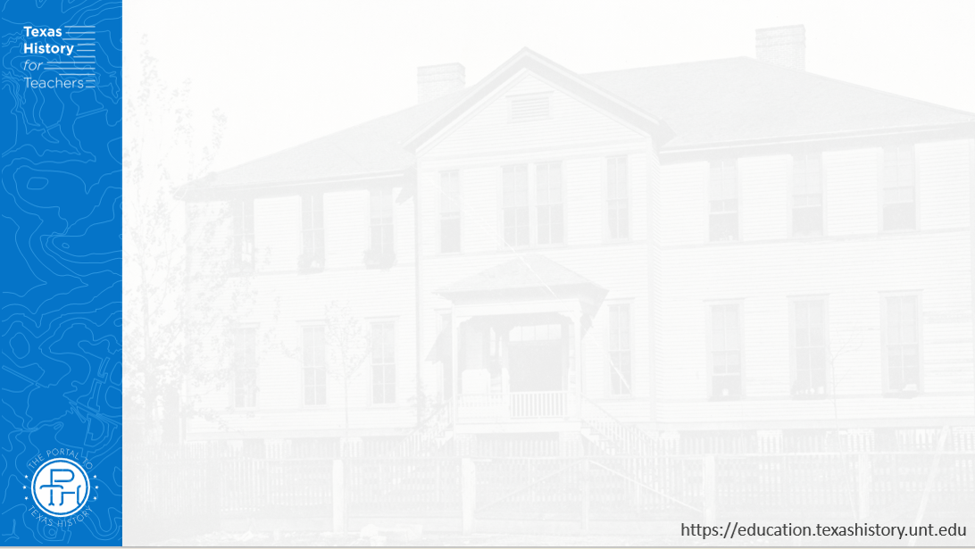
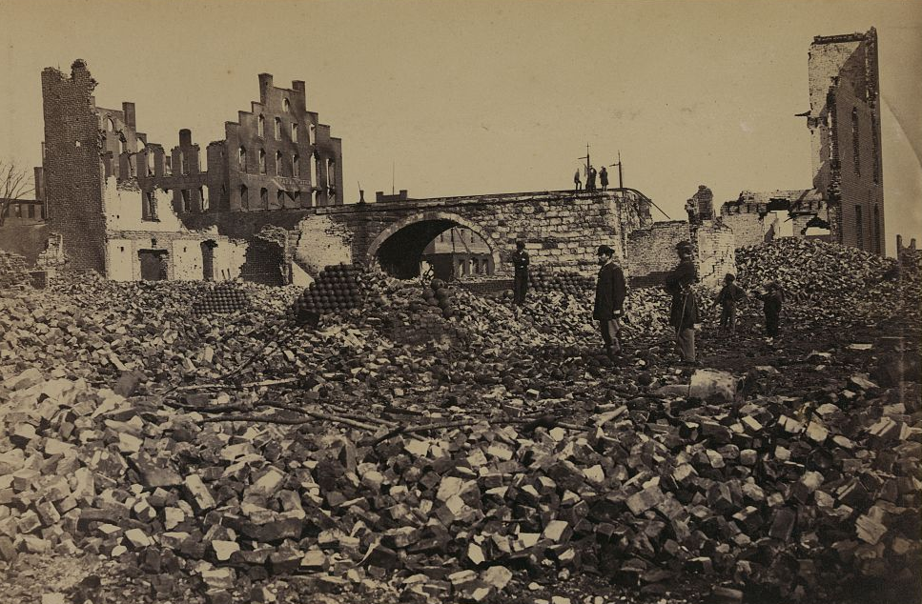
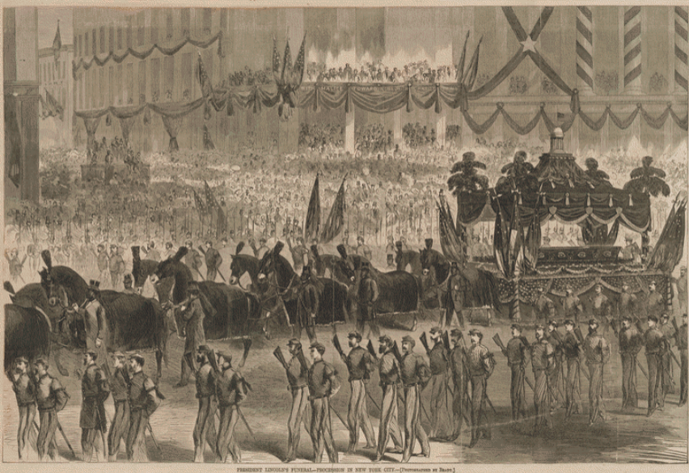
1) The End of the Civil War, 1865
Ruins in Richmond, Virginia, 1865
Library of Congress
Lincoln’s Funeral Procession
New York City, 1865
Library of Congress
Notes:
Russell, Andrew J, photographer. Ruins in Richmond. United States Richmond Virginia, 1865. April. Photograph. https://www.loc.gov/item/91787369/
President Lincoln's funeral. Harper's Weekly illustration. United States New York City New York, 1865. Harper's Weekly, New York. Photograph. https://www.loc.gov/item/scsm000413/

Slide 7
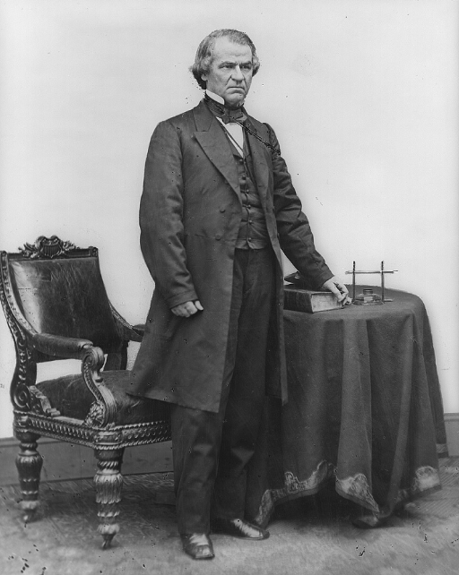
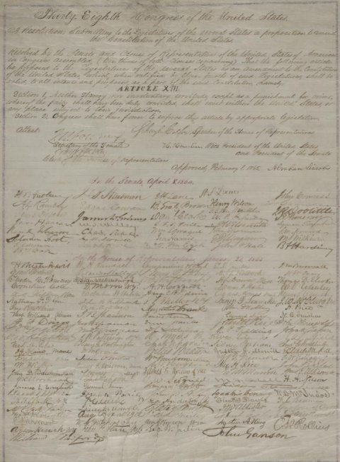
2) Presidential Reconstruction, 1865 - 1867
The Thirteenth Amendment
Library of Congress
President Andrew Johnson
Library of Congress
Notes:
Brady, Mathew B. Andrew Johnson, full-length portrait, standing, facing right, with table and chair. n.d. Photograph. https://www.loc.gov/item/96524285/
Lincoln, Abraham. Abraham Lincoln papers: Series 3. General Correspondence. 1837 to 1897: Congress, Wednesday,Joint Resolution Submitting 13th Amendment to the States; signed by Abraham Lincoln and Congress. February 1, 1865. Manuscript/Mixed Material. https://www.loc.gov/item/mal4361100/

Slide 8
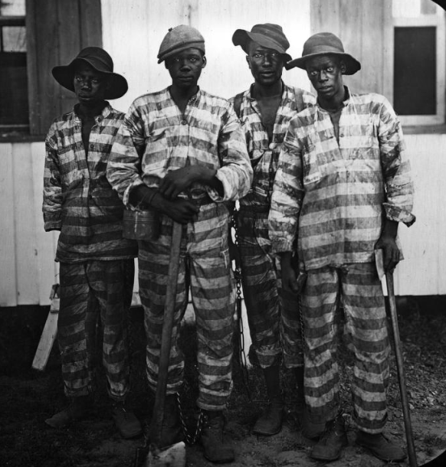
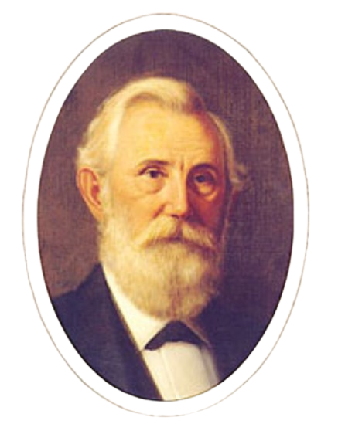
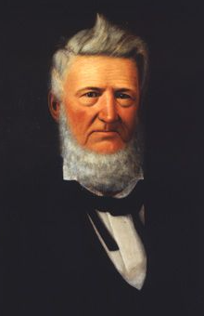
3) Presidential Reconstruction in Texas, 1865 - 1867
Ex-Confederate Senator Oran Roberts
Texas State Library and Archives
Ex-Confederate Senator David G. Burnet
State Preservation Board
Convict Laborers
Library of Congress
Notes:
Convicts Leased to Harvest Timber. Florida United States of America, 1915. [Place of Publication Not Identified: Publisher Not Identified] Photograph. https://www.loc.gov/item/2021669926/
Oran Roberts. Portraits of Texas Governors. Texas State Library and Archives. Accessed Sept. 18, 2025. https://www.tsl.texas.gov/governors/west/index.html
Huddle, William H. David G. Burnet. 1888. Oil on canvas. Capitol Historical Artifact Collection, State Preservation Board. https://tspb.texas.gov/prop/tc/tc-collection/governors/index.html.

Slide 9
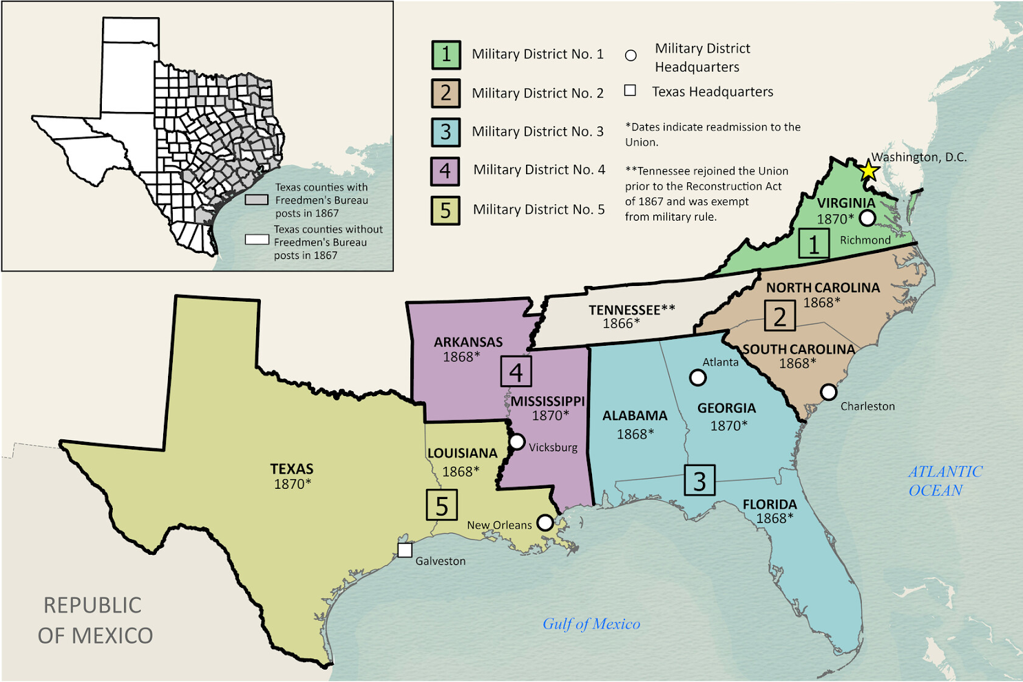
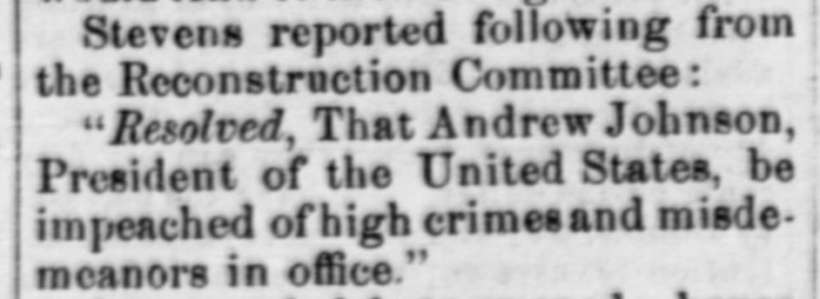
4) Congressional “Radical” Reconstruction 1868 - 1873
The Dallas Herald
Saturday, March 7, 1868
The Portal to Texas History
The Military Districts of the South
The Texas General Land Office
Notes:
Dallas Herald. (Dallas, Tex.), Vol. 15, No. 25, Ed. 1 Saturday, March 7, 1868, newspaper, March 7, 1868; Dallas, Texas. (https://texashistory.unt.edu/ark:/67531/metapth294456/: accessed October 2, 2025), University of North Texas Libraries, The Portal to Texas History, https://texashistory.unt.edu;
Snider, Ben, Lila Rakoczy, and Kelsey Bonnell. Military Reconstruction. 2024. Texas GLO Map Database and Store. https://historictexasmaps.com/object/97345

Slide 10
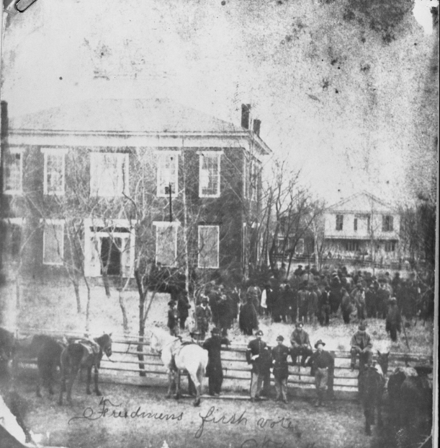
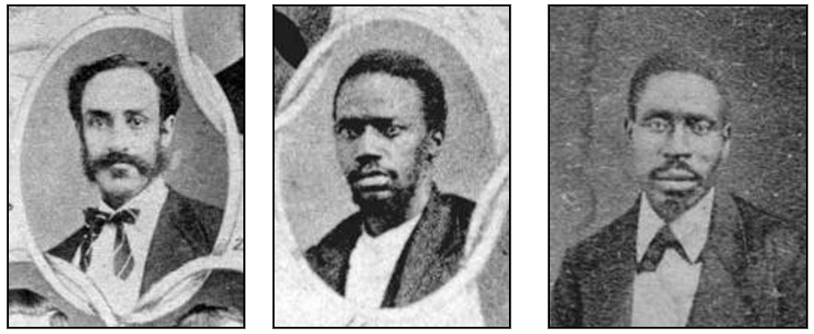
5) Congressional Reconstruction in Texas 1868 - 1873
African Americans elected in Texas, 1869.
George Ruby elected Senator (left), Matt Gaines elected Senator (middle), Walter Moses Burton elected Sheriff (right).
Texas State Library and Archives Commission
The Freedmen’s First Vote
Anderson County, Texas
The Portal to Texas History
Notes:
Freedmens First Vote - Anderson County Courthouse. 1869. The Portal to Texas History. https://texashistory.unt.edu/ark:/67531/metapth26465/
Giants of Texas History: Early African American Senators. Accessed 10/3/25. Texas State Library and Archives Commission. https://www.tsl.texas.gov/treasures/giants/aalege

Slide 11
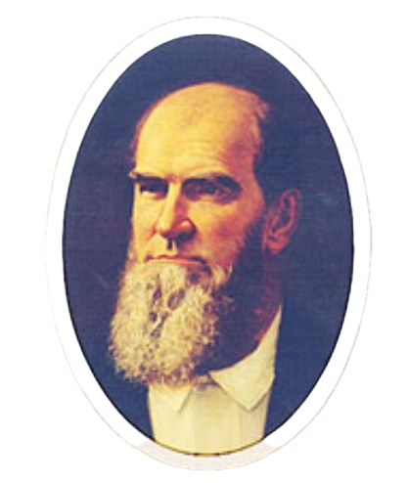
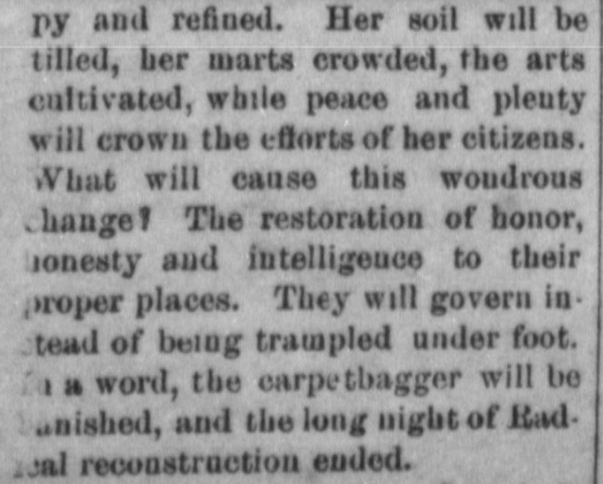
6) The Redeemers & the End of Reconstruction 1873 - 1876
The Schulenburg Argus Newspaper
April 27, 1877
The Portal to Texas History
Redeemer Governor Richard Coke
Texas State Library and Archives Commission
Notes:
Governor Richard Coke. Portraits of Texas Governors. Texas State Library and Archives Commission. Accessed 9/18/2025. https://www.tsl.texas.gov/governors/west/index.html#Coke
Edmonson, P. E. The Schulenburg Argus. (Schulenburg, Tex.), Vol. 1, No. 5, Ed. 1 Friday, April 27, 1877, newspaper, April 27, 1877; (https://texashistory.unt.edu/ark:/67531/metapth1048835/: accessed October 2, 2025), University of North Texas Libraries, The Portal to Texas History, https://texashistory.unt.edu; crediting Fayette Public Library, Museum and Archives.

Slide 12
Exit Ticket: Follow the directions to complete your exit ticket
Read the descriptions of five events from Reconstruction on your exit ticket.
Place each event in the correct chronological order.
Share with a partner.

Slide 13
Share with the class 2
The (first, second, third, etc.) event is letter ______ , (read the event)

