Slide 1
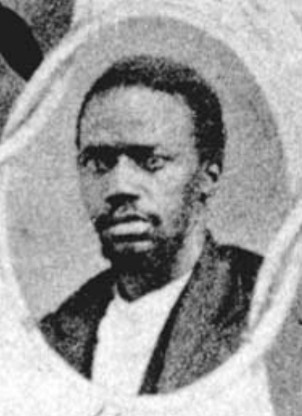
Unit 9:
Reconstruction
Lesson 5:
Who’s Who of Reconstruction
Texas Senator Matt Gaines
Texas State Library and Archives Commission
Notes:
Matt Gaines. Giants of Texas History. Early African American Senators. Accessed 10/7/25. Texas State Library and Archives Commission. https://www.tsl.texas.gov/treasures/giants/aalege

Slide 2
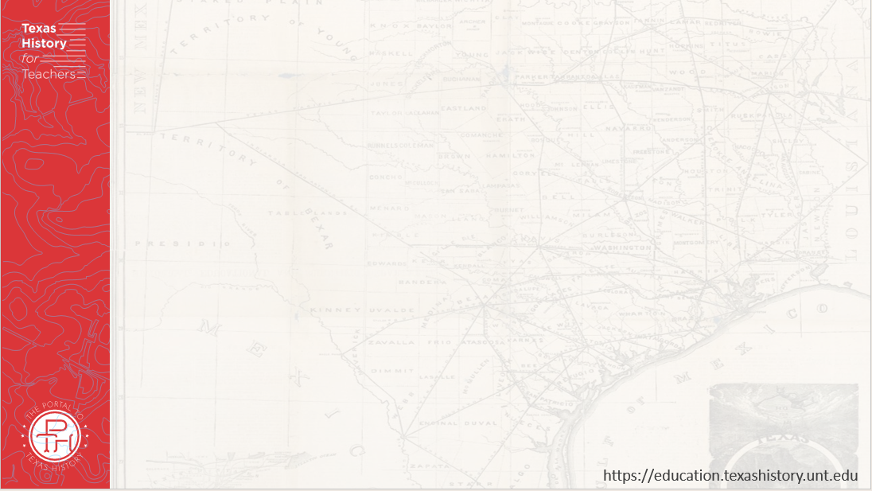




Warm-up
Follow the directions below to complete your warm-up
Read the information about Time Capsules and consider the scenario presented.
Record your response in the space provided.
Share with a partner.

Slide 3

Share with the class:
One thing that I think could be in a time capsule from 1865 is _____
I think this item would be in the time capsule because _______

Slide 4

Essential Question
Who were some of the significant people during Reconstruction, and how were they significant to the era?

Slide 5

In Today’s Lesson
We will learn about some of the significant individuals of the Reconstruction era.
I will research the assigned number of individuals and complete a worksheet recording information about each person’s achievements and significance.

Slide 6
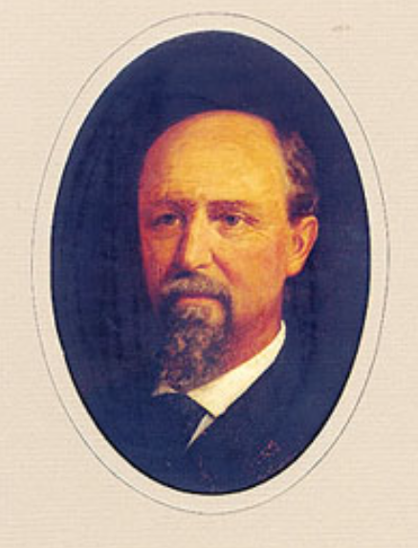
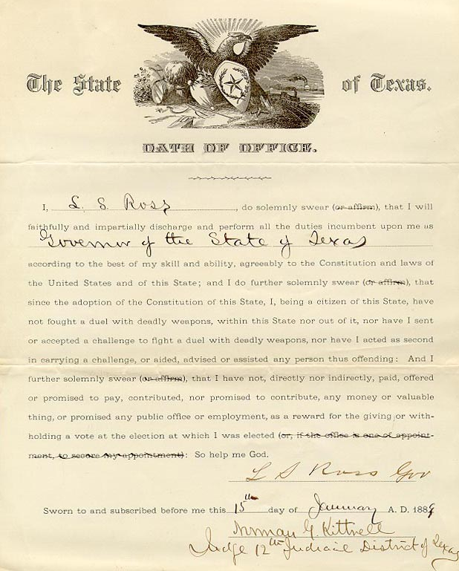
Lawrence Sullivan “Sul” Ross
Sul Ross’s oath of office
Jan. 18, 1889
Texas State Library and Archives
Notes:
Portraits of Texas Governors > Texas Rising, Part 1, 1887-1903 > Texas Rising - Part 2, 1903-1915. Lawrence Sullivan Ross. Accessed Sept. 16, 2025. https://www.tsl.texas.gov/governors/rising/index.html
Ross, Oath of Office, January 15, 1889, Bonds and Oaths, Texas Secretary of State, Archives and Information Services Division, Texas State Library and Archives Commission. Accessed Sept. 16, 2025. https://www.tsl.texas.gov/governors/rising/ross-oath.html

Slide 7
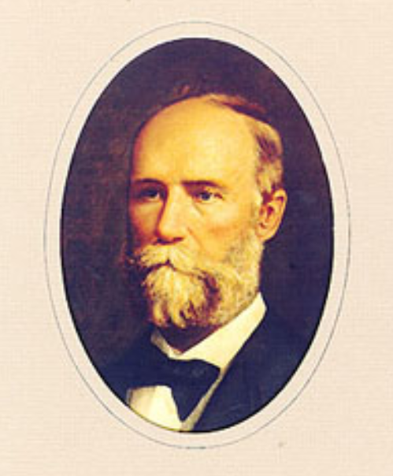
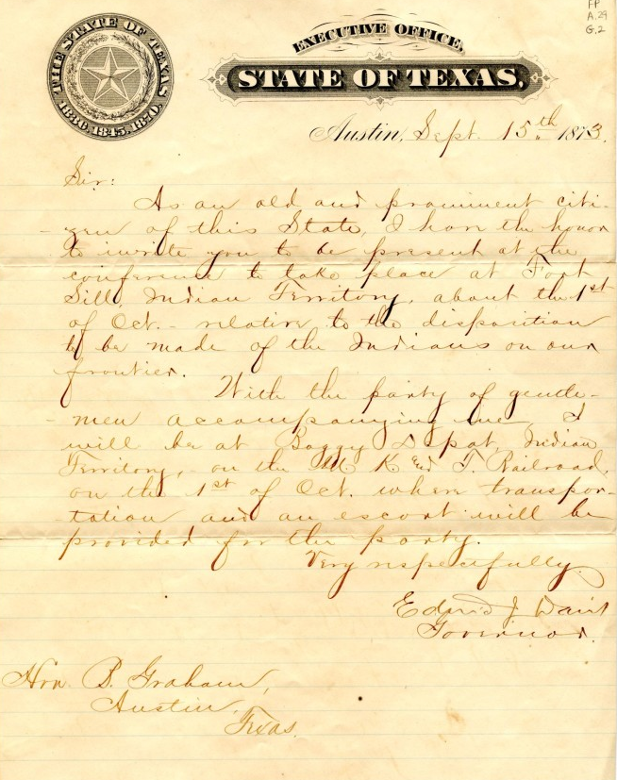
Edmund Jackson Davis
A letter written by Gov. Edmund J. Davis
The Portal to Texas History
Texas State Library and Archives
Notes:
Portraits of Texas Governors > War, Ruin, and Reconstruction - Part 1, 1861-1866 > War, Ruin, and Reconstruction - Part 2, 1866-1876. Accessed 9/16/2025. Texas State Library and Archives Commission. https://www.tsl.texas.gov/governors/war/page2.
Davis, Edmund J. [Correspondence to Beriah Graham from Texas Governor Edmund J. Davis], letter, September 15, 1873; (https://texashistory.unt.edu/ark:/67531/metapth712368/: accessed September 16, 2025), University of North Texas Libraries, The Portal to Texas History, https://texashistory.unt.edu; crediting Austin History Center, Austin Public Library.

Slide 8
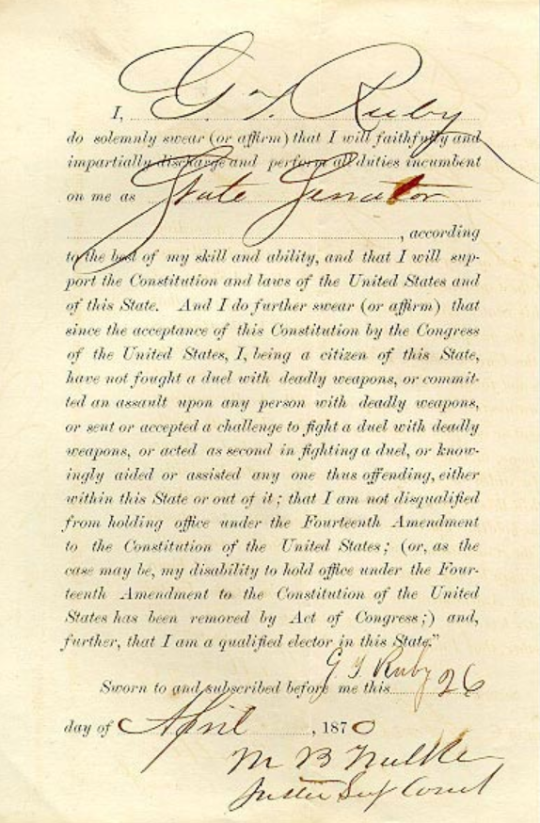
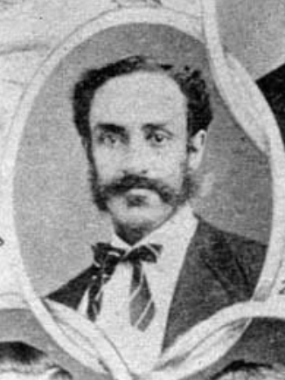
George Thompson Ruby
Ruby’s oath of office
Texas State Library and Archives
Notes:
George T. Ruby. Giants of Texas History. Early African American Senators. Accessed 10/7/25. Texas State Library and Archives Commission. https://www.tsl.texas.gov/treasures/giants/aalege

Slide 9
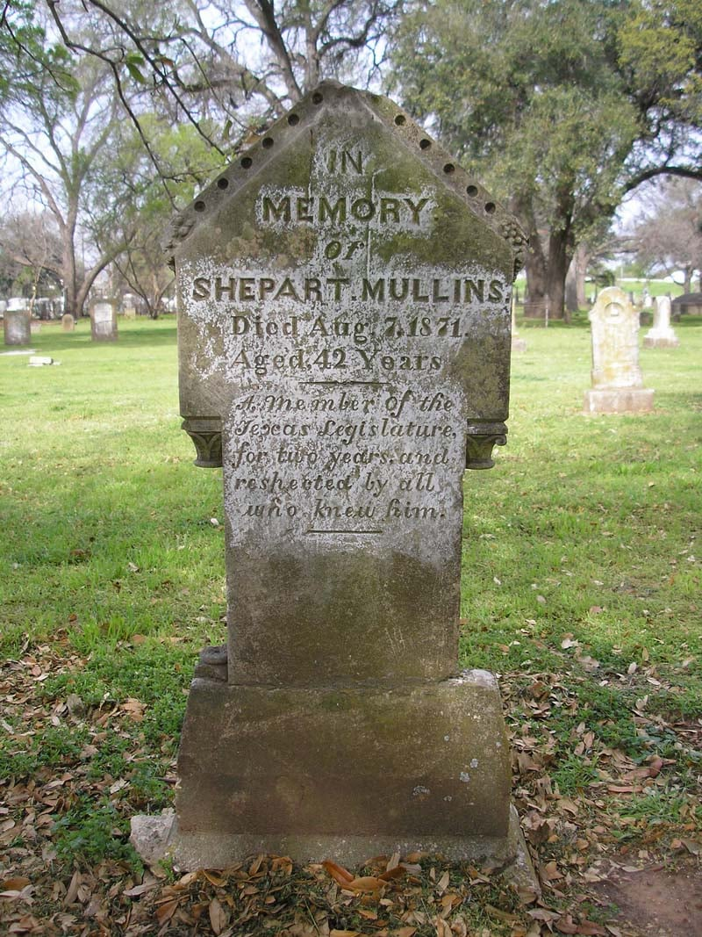
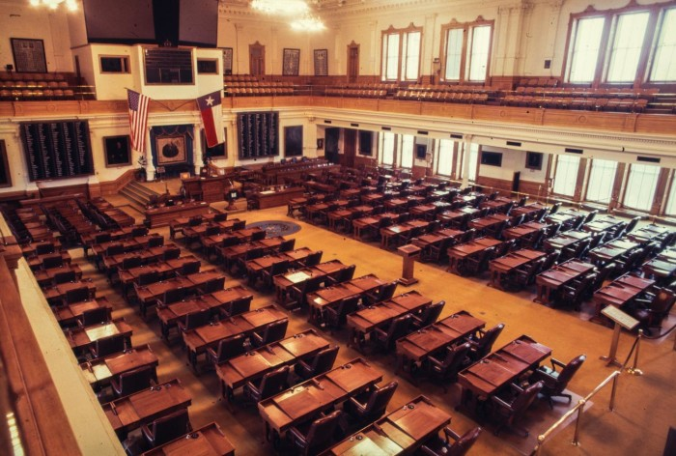
Shepherd Mullens
The Texas State Legislature
The Portal to Texas History
The Texas State Historical Commission
Notes:
Shepherd Mullens: Pioneering Black Political Leader in Texas. Alwyn Barr. Image available through fair use rights as listed here 17 U.S. Code § 107 - Limitations on exclusive rights: Fair use | U.S. Code | US Law | LII / Legal Information Institute
Accessed 10/7/25. https://www.tshaonline.org/handbook/entries/mullens-shepherd
WBAP-TV (Television station : Fort Worth, Tex.). [Texas House of Representatives], photograph, 197X; (https://texashistory.unt.edu/ark:/67531/metadc1611814/: accessed October 7, 2025), University of North Texas Libraries, The Portal to Texas History, https://texashistory.unt.edu; crediting UNT Libraries Special Collections.

Slide 10
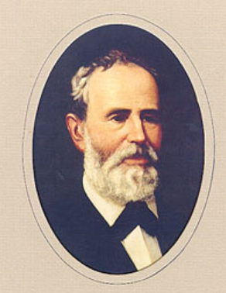
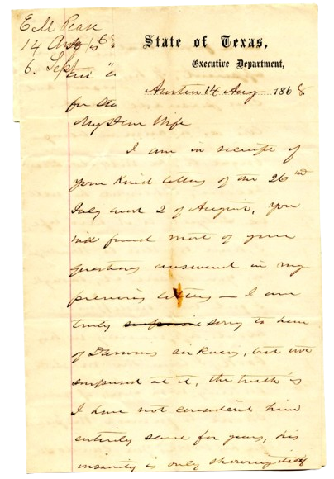
Elisha Pease
A letter from Pease to his wife, Lucadia
The Portal to Texas History
Texas State Library and Archives
Notes:
Elisha Pease. Portraits of Texas Governors. Early Statehood - Part 2, 1853-1861. Texas Library and Archives Commission. Accessed 10/7/25. https://www.tsl.texas.gov/governors/earlystate/page2.html
Pease, Elisha Marshall. [Correspondence from E.M. Pease to Lucadia Pease], letter, August 14, 1868; (https://texashistory.unt.edu/ark:/67531/metapth712955/: accessed October 7, 2025), University of North Texas Libraries, The Portal to Texas History, https://texashistory.unt.edu; crediting Austin History Center, Austin Public Library.

Slide 11
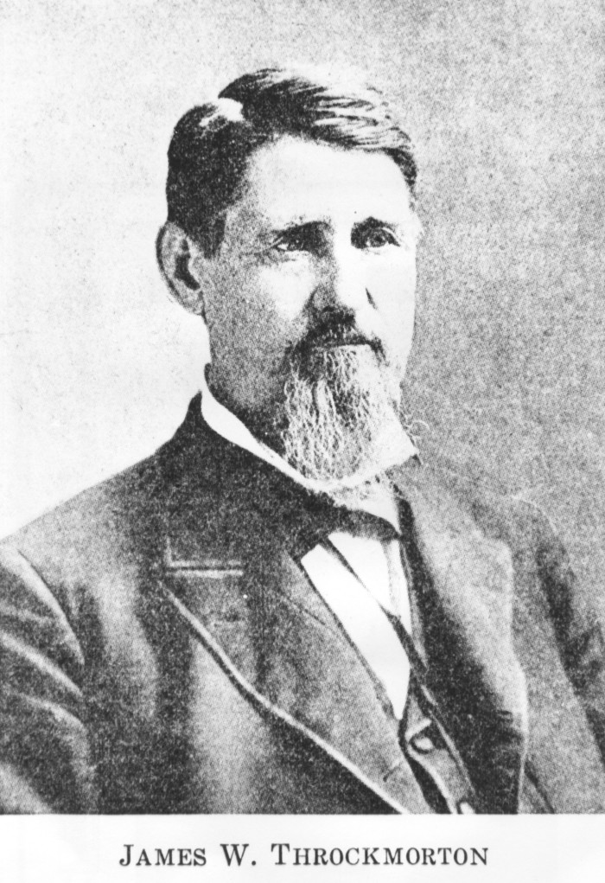
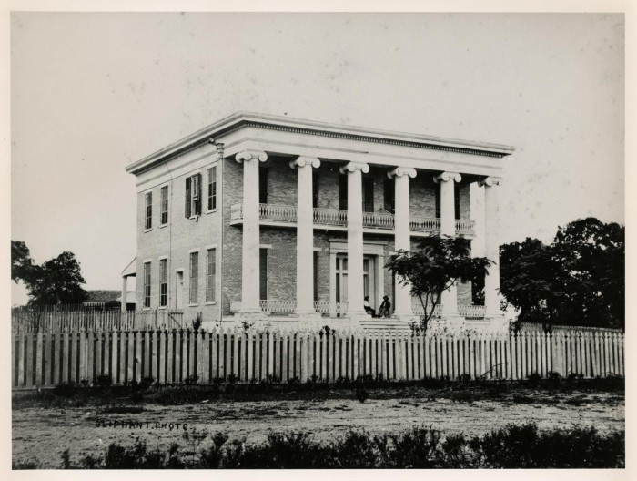
James Webb Throckmorton
A photograph of the Texas Governor’s Mansion in 1866, when Throckmorton served as governor.
The Portal to Texas History
The Portal to Texas History
Notes:
James W. Throckmorton, photograph, Date Unknown; (https://texashistory.unt.edu/ark:/67531/metapth21108/: accessed October 7, 2025), University of North Texas Libraries, The Portal to Texas History, https://texashistory.unt.edu; crediting Tarrant County College NE, Heritage Room.
[Governor's Mansion], photograph, 1866; (https://texashistory.unt.edu/ark:/67531/metapth124244/: accessed October 8, 2025), University of North Texas Libraries, The Portal to Texas History, https://texashistory.unt.edu; crediting Austin History Center, Austin Public Library.

Slide 12
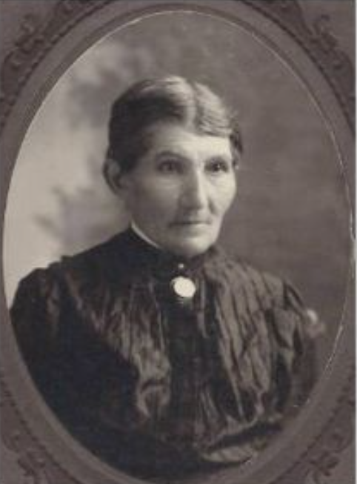
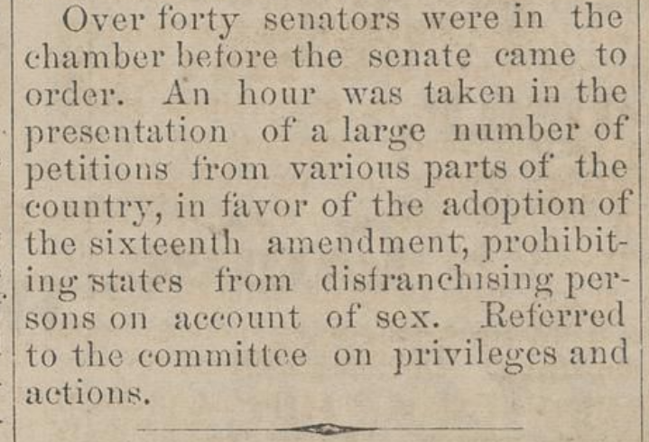
Martha Goodwin Tunstall
Martha was one of many women who took part in a petition of the U.S. government to pass an amendment allowing women to vote. The petition was denied in 1878.
The Portal to Texas History
Texas State Historical Association
Notes:
Martha Goodwin Tunstall: A Pioneer of Women's Rights and Anti-Slavery Activism, by Barbara Mulvihill. Used here under the F17 U.S. Code § 107 - Limitations on exclusive rights: Fair use | U.S. Code | US Law | LII / Legal Information Institute Texas State Historical Association. Accessed on 10/8/25. https://www.tshaonline.org/handbook/entries/tunstall-martha-goodwin
Lacy, Drury. Daily Fort Worth Standard. (Fort Worth, Tex.), Vol. 2, No. 120, Ed. 1 Friday, January 11, 1878, newspaper, January 11, 1878; Fort Worth, Texas. (https://texashistory.unt.edu/ark:/67531/metapth1004927/: accessed October 8, 2025), University of North Texas Libraries, The Portal to Texas History, https://texashistory.unt.edu; crediting Fort Worth History Center.

Slide 13

Exit Ticket
Follow the directions below to complete your exit ticket
Choose one person that we learned about today.
Complete the graphic organizer, responding to questions from this person’s possible point of view.
Share with a partner.

Slide 14
Share with the class: 2
One thing that I think could be in a time capsule from 1865 is _____
I think this item would be in the time capsule because _______

