Slide 1
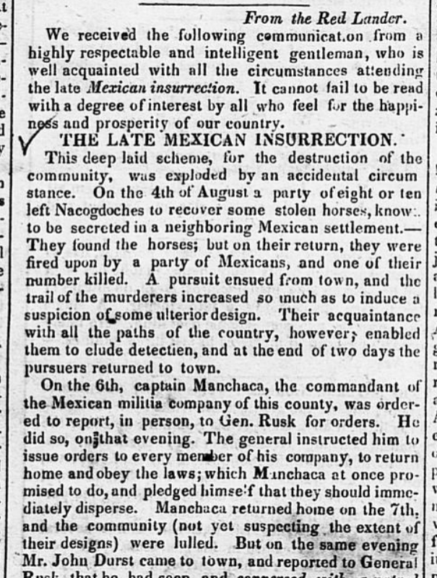
Unit 6:
The Republic of Texas
Extension Lesson:
The Córdova Rebellion
Notes:
Cruger & Moore. Telegraph and Texas Register (Houston, Tex.), Vol. 4, No. 5, Ed. 1, Saturday, September 29, 1838, newspaper, September 29, 1838; Houston, Texas. (https://texashistory.unt.edu/ark:/67531/metapth48012/: accessed May 7, 2025), University of North Texas Libraries, The Portal to Texas History, https://texashistory.unt.edu; crediting The Dolph Briscoe Center for American History.

Slide 2




Warm-up:
Follow the directions to complete your warm-up
Read the information and prompt in the graphic organizer.
Use the sentence stems provided to create a hypothesis about the events of today’s lesson.
Share with a partner.

Slide 3

Share with the class
The group / The groups that might have taken part in this rebellion is/are _______
This group / These groups might have rebelled because __________

Slide 4

Essential Question
What was the Córdova Rebellion, who was involved, why did they rebel, and what was the result?

Slide 5
In today’s lesson…
We will examine three primary source excerpts from newspaper articles giving accounts of various details of the Córdova Rebellion.
I will analyze key details of the Córdova Rebellion including specific events, the causes of the rebellion, and the point of view of the information presented in the articles.

Slide 6
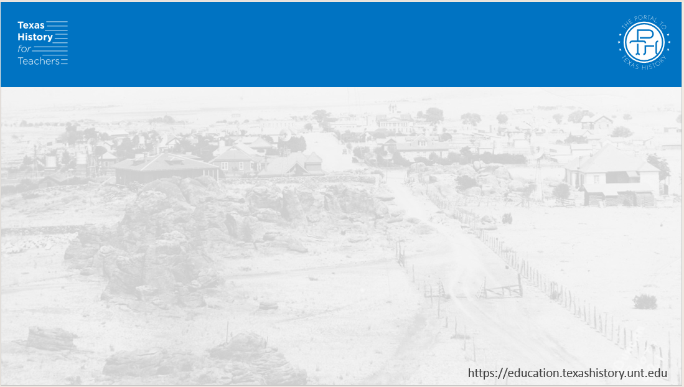
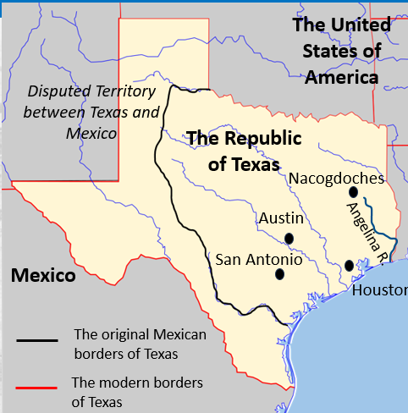
Growing Tension in East Texas
The Córdova Rebellion occurred near the east Texas town of Nacogdoches and along the Angelina river.
Notes:
Blank Map of Texas edited to show historical and contemporary boundaries of Texas, key human geographic features including cities and rivers, and the countries and bodies of water bordering Texas. Permission is granted to copy, distribute and/or modify this document under the terms of the GNU Free Documentation License, Version 1.2 or any later version published by the Free Software Foundation; with no Invariant Sections, no Front-Cover Texts, and no Back-Cover Texts. A copy of the license is included in the section entitled GNU Free Documentation License. This file is licensed under the Creative Commons Attribution-Share Alike 3.0 Unported license. https://commons.wikimedia.org/wiki/File:Texas_blank_map.svg

Slide 7
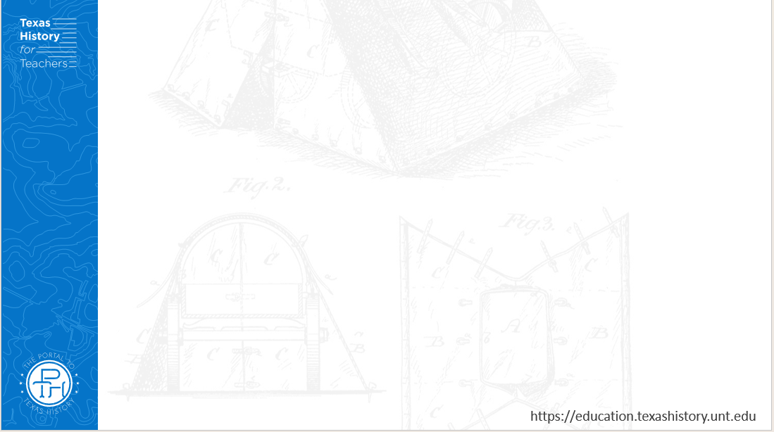
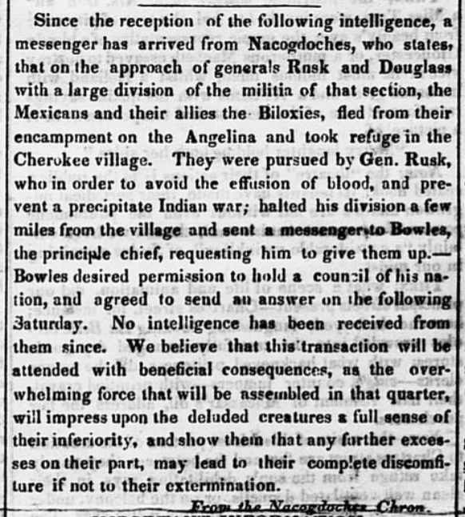
The
Córdova Rebellion
Primary Source #1
The Telegraph and Texas Register Houston, Texas
Saturday, August 25, 1838
The Portal to Texas History
Notes:
Cruger & Moore. Telegraph and Texas Register (Houston, Tex.), Vol. 3, No. 52, Ed. 1, Saturday, August 25, 1838, newspaper, August 25, 1838; Houston, Texas. (https://texashistory.unt.edu/ark:/67531/metapth48007/: accessed May 7, 2025), University of North Texas Libraries, The Portal to Texas History, https://texashistory.unt.edu; crediting The Dolph Briscoe Center for American History.

Slide 8
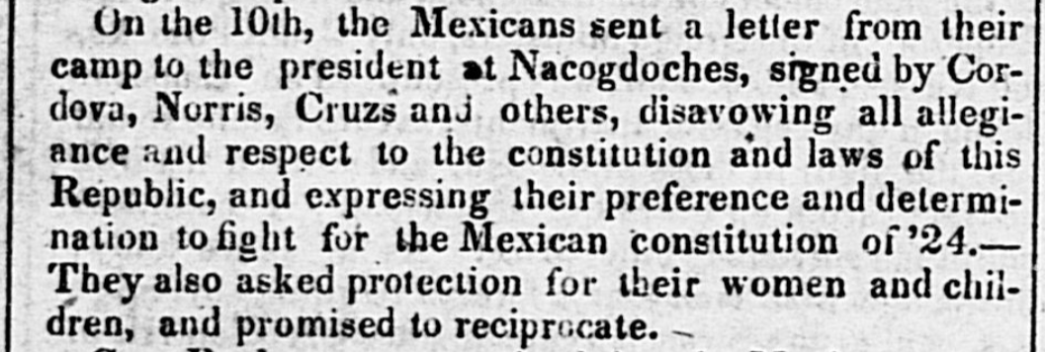
The Córdova Rebellion
Primary Source #2
The Telegraph and Texas Register of Houston, Saturday September 29, 1838
The Portal to Texas History
Notes:
Cruger & Moore. Telegraph and Texas Register (Houston, Tex.), Vol. 4, No. 5, Ed. 1, Saturday, September 29, 1838, newspaper, September 29, 1838; Houston, Texas. (https://texashistory.unt.edu/ark:/67531/metapth48012/: accessed May 7, 2025), University of North Texas Libraries, The Portal to Texas History, https://texashistory.unt.edu; crediting The Dolph Briscoe Center for American History.

Slide 9
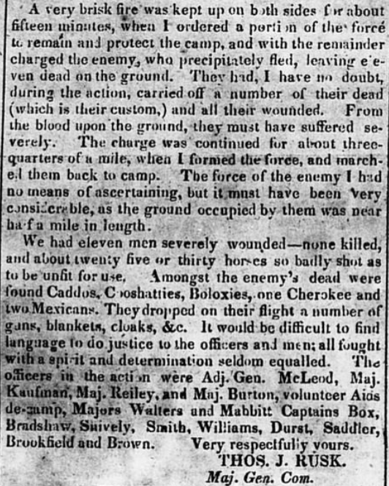
The
Córdova Rebellion
Primary Source #3
The Telegraph and Texas Register Houston, Texas
Saturday November 3, 1838
The Portal to Texas History

Slide 10
Exit Ticket:
Follow the directions to complete your exit ticket.
Consider what we know about the different policies Presidents Houston and Lamar had toward Texas Indians.
Complete the graphic organizer based on this prior knowledge.
Share with a partner.

Slide 11
Share with the class 2
President Houston’s / Mirabeau Lamar’s policy toward the Texas Indians was __________________________
The Córdova Rebellion may have influenced his policy by ______

