Slide 1
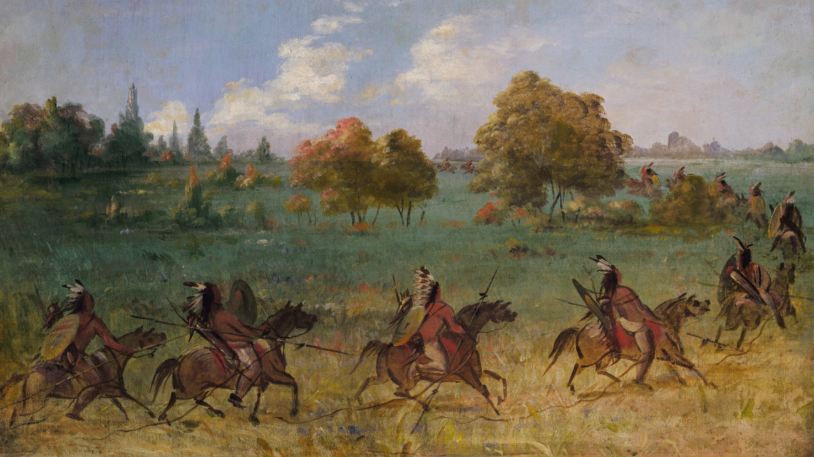
Unit 6: The Republic of Texas
Extension Lesson:
The Council House Fight
Notes:
Catlin, George. Comanche War Party on the March, Fully Equipped. ca. 1846-1848. Oil on canvas, 20 x 27 3/8 in. (50.8 x 69.4 cm). Smithsonian American Art Museum, Gift of Mrs. Joseph Harrison, Jr., 1985.66.596. https://americanart.si.edu/artwork/comanche-war-party-march-fully-equipped-4014

Slide 2
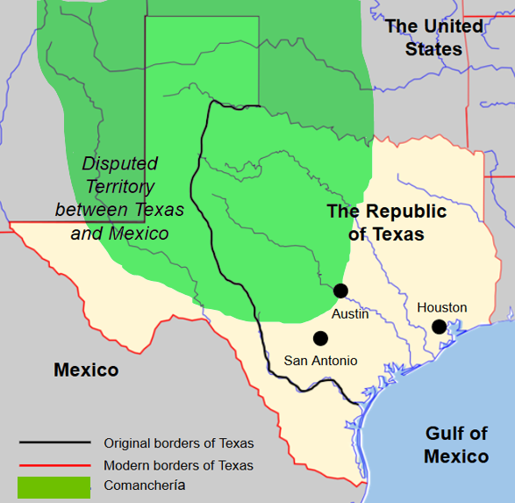
Warm-up Follow the directions to complete your warm-up
Make observations and inferences about the information in the map to answer the questions on your warm-up.
Discuss with a partner
Notes:
Texas Blank Map. Edited to include significant towns, countries, and geographic landmarks from the Republic of Texas era. https://commons.wikimedia.org/wiki/File:Texas_blank_map.svg

Slide 3
Share with the class
I think the shaded area labeled Comanchería means _________
I think the Comanchería territory might have affected towns like San Antonio and Austin by __________

Slide 4
Essential Questions
What was the Council House Fight? What were the causes and events of the Council House Fight, and why was it significant?

Slide 5
In today’s lesson…
We will examine the causes, key events, outcome and significance of the Council House Fight.
I will read a passage explaining key information about the Council House Fight. Then I will use primary source excerpts about the Council House Fight to create a storyboard of fight from a young San Antonio woman’s point of view.

Slide 6
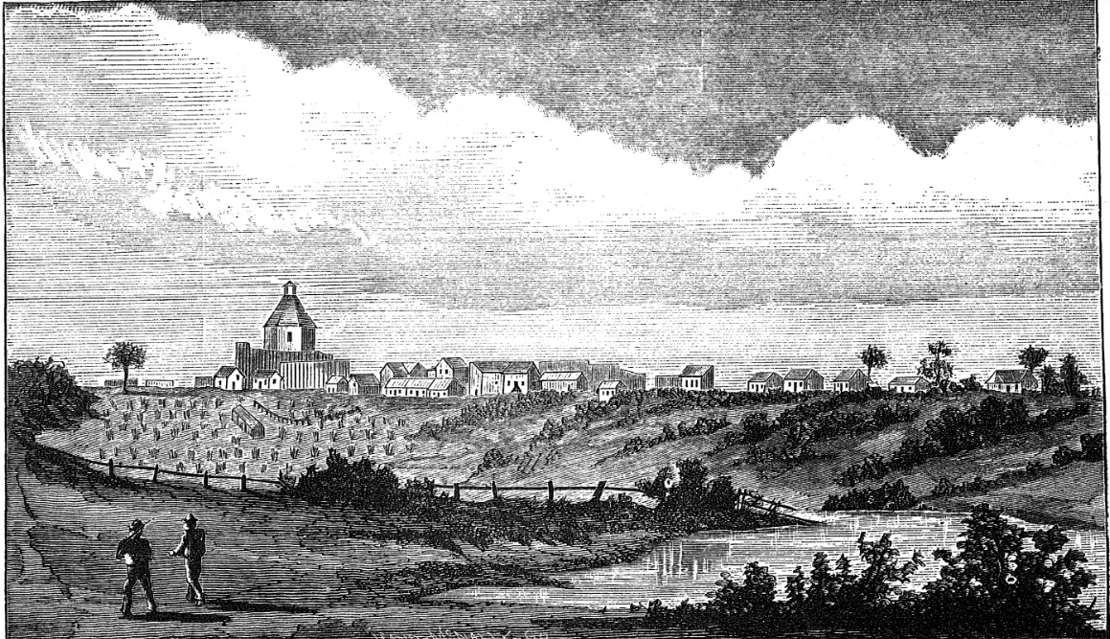
The Council House Fight
An Illustration of San Antonio, 1840
The Portal to Texas History
Notes:
Thrall, Homer S., 1819-1894. A Pictorial History of Texas, From the Earliest Visits of European Adventurers, to A.D. 1879., book, 1879; St. Louis, Missouri. (https://texashistory.unt.edu/ark:/67531/metapth5828/: accessed April 18, 2025), University of North Texas Libraries, The Portal to Texas History, https://texashistory.unt.edu;

Slide 7
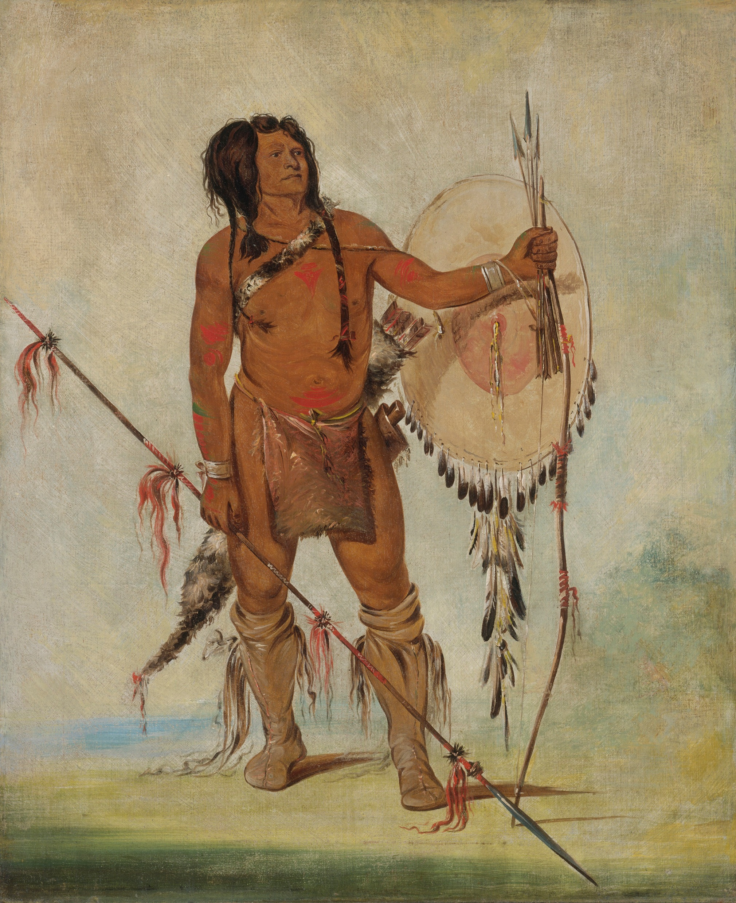
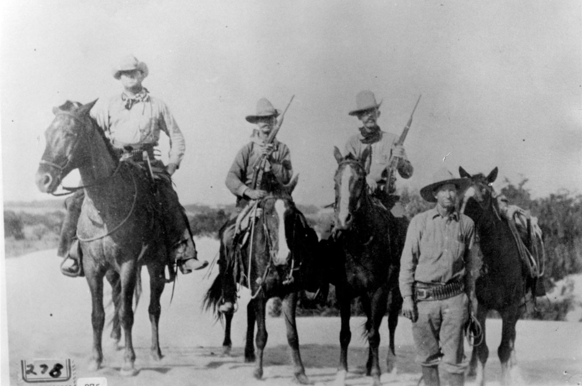
Mary Maverick and the Council House Fight
A group of Texas Rangers
The Portal to Texas History
A Comanche Warrior
The Smithsonian Museum
Notes:
His-oo-sán-chees, Little Spaniard, a Warrior by George Catlin. 1835. Smithsonian American Art Museum, Gift of Mrs. Joseph Harrison, Jr. Smithsonian American Art Museum and its Renwick Gallery His-oo-sán-chees, Little Spaniard, a Warrior | Smithsonian Institution
Texas Rangers, photograph, Date Unknown; (https://texashistory.unt.edu/ark:/67531/metapth43196/: accessed May 22, 2025), University of North Texas Libraries, The Portal to Texas History, https://texashistory.unt.edu; crediting Cattle Raisers Museum.

Slide 8
Exit Ticket Follow the directions to complete your exit ticket
Make observations and inferences about the information in the map to answer the questions on your warm-up.
Discuss with a partner

Slide 9
Share with the class 2
One true statement from the exit ticket about the Council House Fight was that _____________

