Slide 1
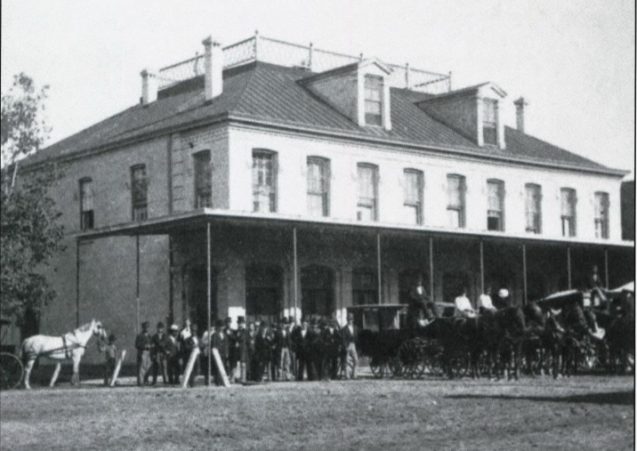
Unit 6: The Republic of Texas
Lesson 6:
Events of the Republic
Republic of Texas Capital in Houston, 1837 – 1839
The Portal to Texas History
Notes:
Texas. Legislature. Legislative Council. The Texas Capitol: A History of the Lone Star Statehouse, book, 2016; Austin, Texas. (https://texashistory.unt.edu/ark:/67531/metapth902948/: accessed April 24, 2025), University of North Texas Libraries, The Portal to Texas History, https://texashistory.unt.edu; crediting UNT Libraries Government Documents Department.

Slide 2
Warm-up Follow the directions to complete your warm-up
Complete the graphic organizer by explaining the cause, effect, and details of one significant event we have learned so far in this unit.
Discuss with a partner

Slide 3
Share with the class
One significant event of the Republic of Texas era is ________.
What happened during this event was ____
This event was significant because ______

Slide 4
Essential Question
What is the most significant information related to the key events of the Republic of Texas era?

Slide 5
In today’s lesson…
We will identify important information about key events of the Republic of Texas era.
I will take notes about the date, location, details, and significance of each event on my worksheet using a graphic organizer.

Slide 6
Sam Houston’s Administration Oct. 22, 1836 – Dec. 10, 1838

Slide 7
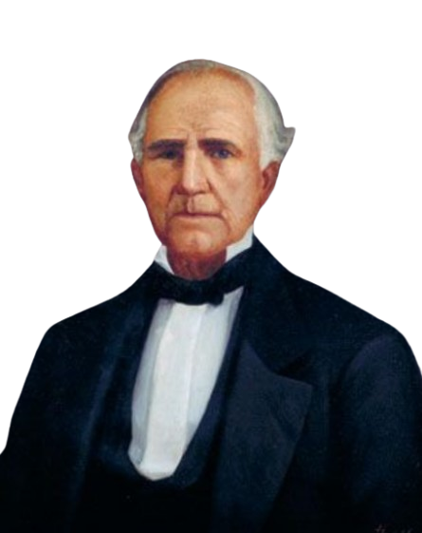
Goals The Houston Administration
Establish peace agreements with Texas Indian tribes
Gain diplomatic recognition from other countries
Establish commercial relationships with other countries
Save money and improve the economy
Sam Houston
The State Preservation Board
Notes:
Huddle, William H. Sam Houston. 1888. Oil on canvas. Capitol Historical Artifact Collection, State Preservation Board. https://tspb.texas.gov/prop/tc/tc-collection/governors/index.html

Slide 8
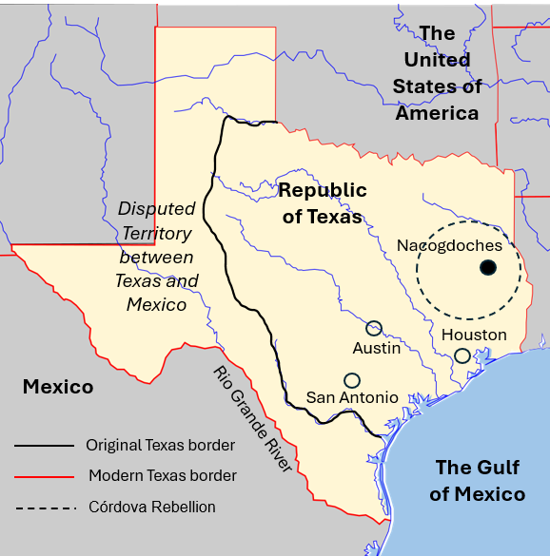
The Córdova Rebellion The Houston Administration
August – October 1838
Nacogdoches
Vicente Córdova led a rebellion of Tejanos and Indians against Texas.
Thomas J. Rusk led a militia to end the rebellion and force the Caddo out of Texas.
Increased distrust between Anglos, Tejanos, and Indians.
Notes:
Blank Map of Texas, edited to show significant locations related to the Republic of Texas and the Cordova Rebellion. https://commons.wikimedia.org/wiki/File:Texas_blank_map.svg

Slide 9
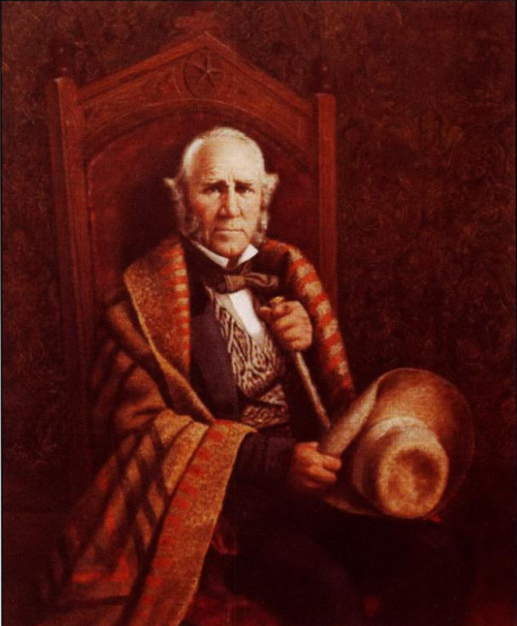
Significance of Houston’s Administration
Established peace agreements with most Indian tribes
Diplomatic recognition only from the U.S.
Debt increased to approximately $3 million
Disbanded army to save money
Relocated capital to Houston
Passed high taxes
Sam Houston
The Portal to Texas History
Notes:
Texas. Legislature. Legislative Council. The Texas Capitol: A History of the Lone Star Statehouse, book, 2016; Austin, Texas. (https://texashistory.unt.edu/ark:/67531/metapth902948/: accessed April 24, 2025), University of North Texas Libraries, The Portal to Texas History, https://texashistory.unt.edu; crediting UNT Libraries Government Documents Department.

Slide 10
Mirabeau Lamar’s Administration Dec. 10, 1838 – Dec. 13, 1841

Slide 11
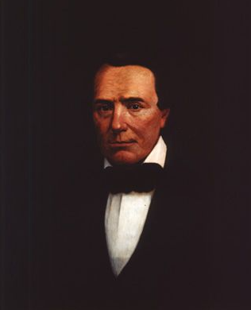
Goals The Lamar Administration
Maintain Texas’ independence
Remove Indians from Texas: “War of Extermination”
Gain diplomatic recognition from other countries
Establish commercial relationships with other countries
Establish new capital city
Mirabeau Lamar
Texas State Preservation Board
Notes:
Huddle, William H. Mirabeau B. Lamar. 1888. Oil on canvas. Capitol Historical Artifact Collection, State Preservation Board. https://tspb.texas.gov/prop/tc/tc-collection/governors/index.html

Slide 12
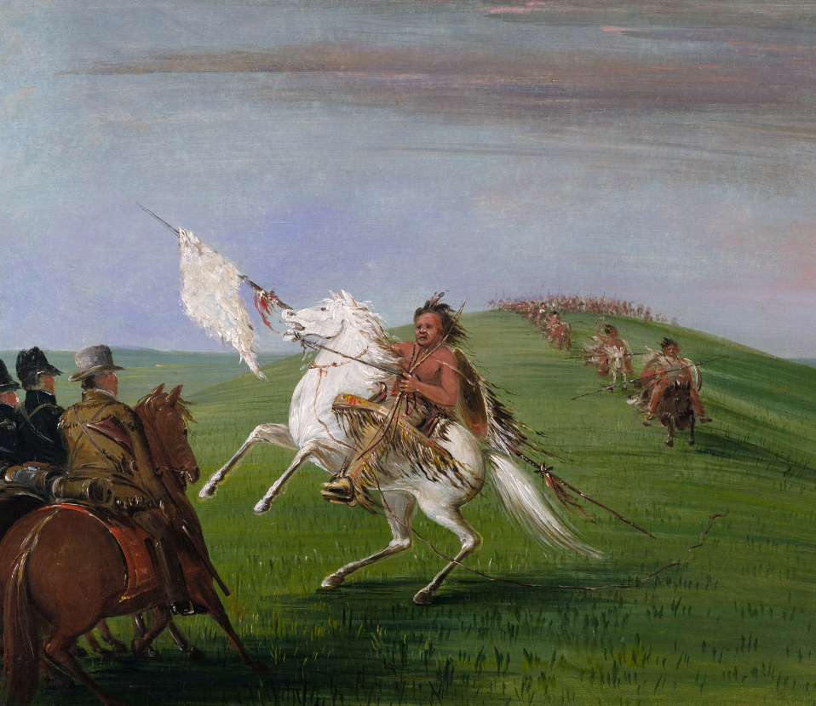
The “War of Extermination” The Lamar Administration
Battle of the Neches: Drove the Cherokee out of Texas
Council House Fight: Killed or captured 60 Comanches in San Antonio, Mar. 19, 1840
Comanches raided Linnville and Victoria in retaliation
Wars against Texas Indians significantly increased debt.
A Comanche Warrior
The Smithsonian Art Museum
Notes:
Catlin, George. Comanche Meeting the Dragoons. ca. 1834-1835. Oil on canvas, 24 x 29 in. (60.9 x 73.7 cm). Smithsonian American Art Museum, Gift of Mrs. Joseph Harrison, Jr., 1985.66.488. https://americanart.si.edu/artwork/comanche-meeting-dragoons-4009

Slide 13
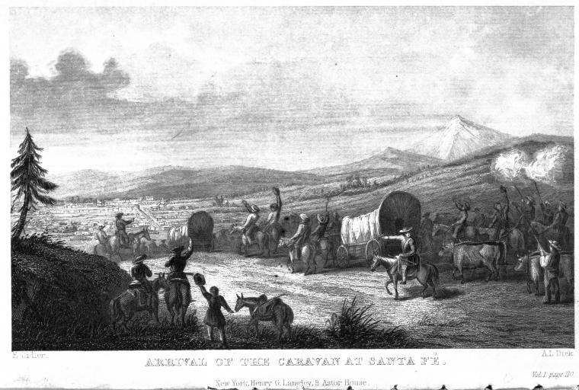
The Santa Fe Expedition The Lamar Administration
June – October 1841
An expedition to establish trade with Santa Fe and ask New Mexico to join the Republic of Texas.
Expedition members arrested and imprisoned on arrival.
National embarrassment for Republic of Texas.
The Arrival of the Caravan at Santa Fe
The New York Public Library
Notes:
Rare Book Division, The New York Public Library. "Arrival of the Caravan at Santa Fe" The New York Public Library Digital Collections. 1844. https://digitalcollections.nypl.org/items/8c6008a5-10ff-4b1f-e040-e00a1806055a

Slide 14
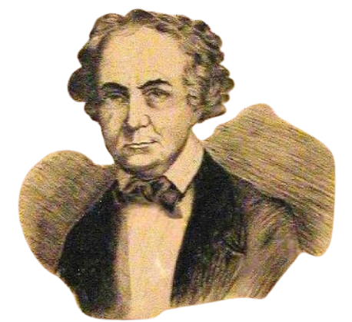
Significance of Lamar’s Administration
Debt increased to $10 million due to:
Wars against Texas Indians
Relocation of the capital to Austin
Purchase of navy ships
Gained French and Dutch diplomatic recognition
Mirabeau Lamar
The Portal to Texas History
Notes:
[Illustration of Mirabeau B. Lamar], physical object, 1936; (https://texashistory.unt.edu/ark:/67531/metapth1152/: accessed April 29, 2025), University of North Texas Libraries, The Portal to Texas History, https://texashistory.unt.edu; crediting Fort Bend Museum.

Slide 15
Houston’s Second Administration Dec. 13, 1841 – Dec. 9, 1844

Slide 16
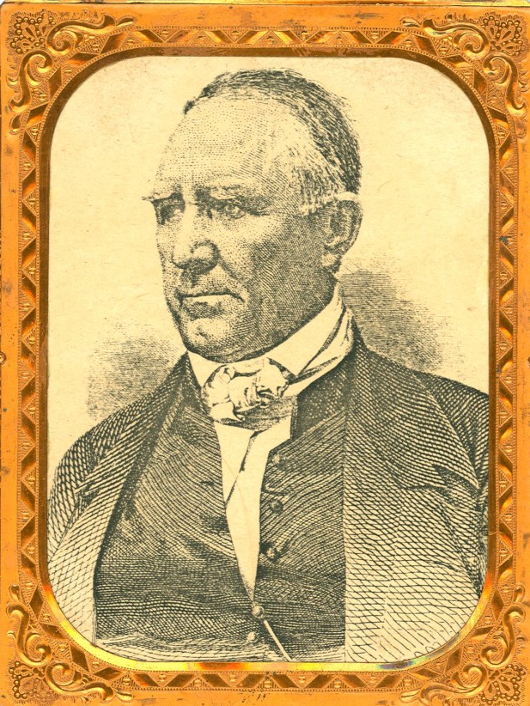
Goals The Second Houston Administration
Reduce spending
Re-establish peace with Texas Indians
Establish commercial and diplomatic relationships
Annexation with the U.S.
Sam Houston
The Portal to Texas History
Notes:
Sam Houston, physical object, Date Unknown; (https://texashistory.unt.edu/ark:/67531/metapth32932/: accessed April 29, 2025), University of North Texas Libraries, The Portal to Texas History, https://texashistory.unt.edu; crediting Star of the Republic Museum.

Slide 17
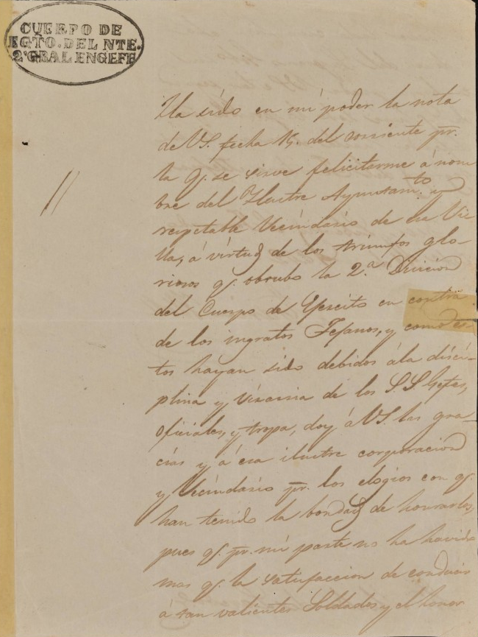
Mexico’s Invasions The Second Houston Administration
March & September 1842
Mexican military invaded and occupied San Antonio.
Battle of Salado Creek: Sept. 1842 - Texas Rangers chased the Mexican army out of Texas.
Mexican General Adrián Woll led the first occupation of San Antonio. This is a letter he wrote about it.
The Portal to Texas History
Notes:
[Letter from General Adrián Woll to the Laredo Ayuntamiento, October 31, 1842], letter, 1842-10~; (https://texashistory.unt.edu/ark:/67531/metapth872377/: accessed April 29, 2025), University of North Texas Libraries, The Portal to Texas History, https://texashistory.unt.edu; crediting St. Mary's University Louis J. Blume Library.

Slide 18
Texas’ Response The Second Houston Administration
Somervell Expedition: Nov. – Dec. 1842, Alexander Somervell led a militia that captured Laredo and Guerrero.
Mier Fight: Dec. 1842, Some Texans under William S. Fisher continued to Mier, Mexico, and fought the Mexican army. They were defeated, captured, and imprisoned in Mexico.

Slide 19
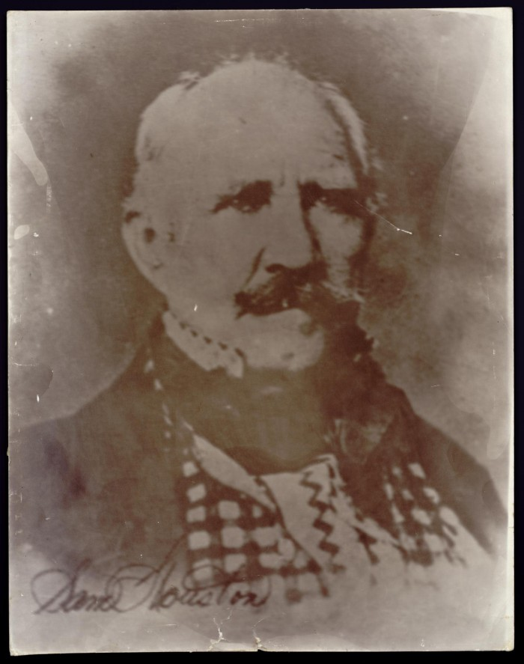
Significance of Houston’s Second Administration
Houston attempted to relocate the capital again = unpopular
Sold the Texas navy
Gained British diplomatic recognition
U.S. denied Texas 2nd annexation application.
Debt grew to $12 million
Sam Houston
The Portal to Texas History
Notes:
Photograph of Sam Houston, photograph, Date Unknown; (https://texashistory.unt.edu/ark:/67531/metapth30051/: accessed April 29, 2025), University of North Texas Libraries, The Portal to Texas History, https://texashistory.unt.edu; crediting Star of the Republic Museum.

Slide 20
Anson Jones’ Administration Dec. 9, 1844 – Dec. 19, 1846

Slide 21
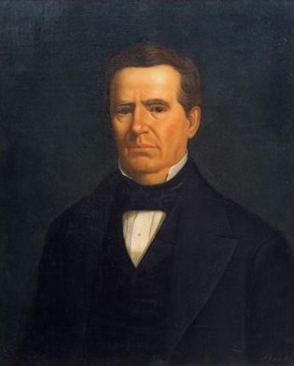
Goals The Jones Administration
Reduce spending
Maintain peace with Texas Indians
Diplomatic relationship with Mexico and Britain OR annexation with the U.S.
Anson Jones
Texas State Preservation Board
Notes:
Huddle, William H. Anson Jones. 1888. Oil on canvas. Capitol Historical Artifact Collection, State Preservation Board. https://tspb.texas.gov/prop/tc/tc-collection/governors/index.html

Slide 22
The Annexation of Texas The Jones Administration
Officially annexed on Dec. 29, 1845
TX became a U.S. state (not a territory)
TX kept ownership of its public lands
TX gave its public buildings and military property to U.S. government
U.S. supported TX boundary disputes with Mexico
TX can divide into 5 total states

Slide 23
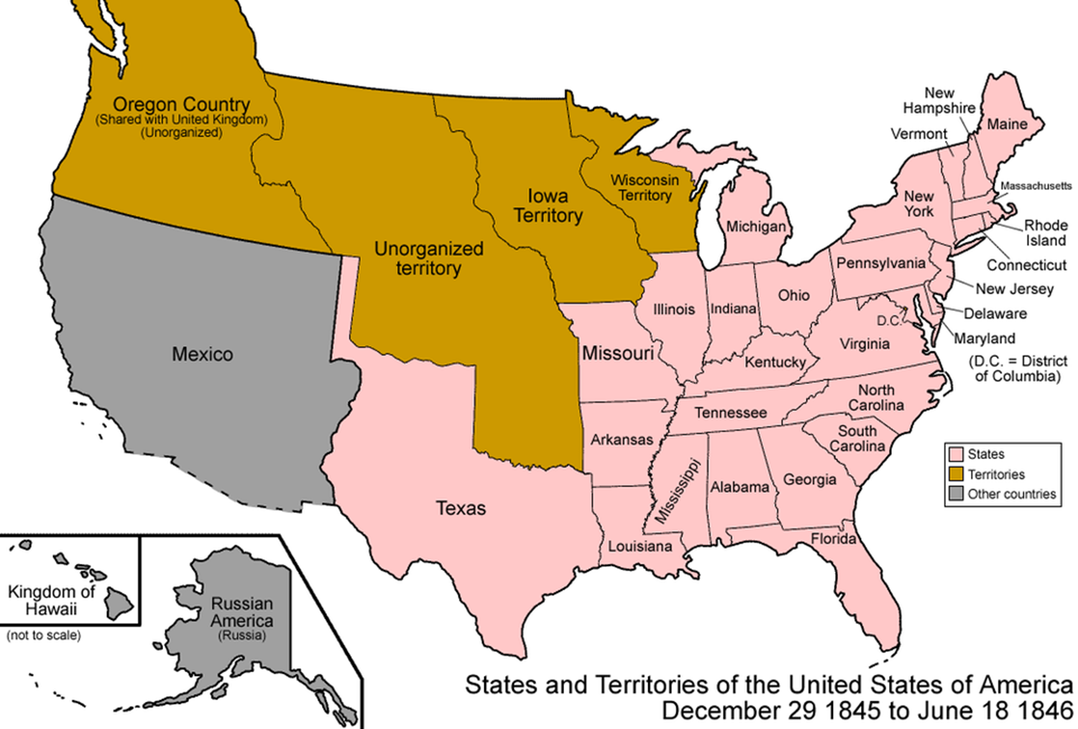
The United States of America, 1846
Notes:
The United States of America 1846. Map of the states and territories of the United States as it was from December 1845 to June 1846. On December 29 1845, the Republic of Texas and all of its claimed lands were admitted as the state of Texas, including Miller County. On June 18 1846, Oregon Country below the 49th parallel, excluding Vancouver Island, was incorporated in to the United States as unorganized territory. Made by User:Golbez Own work, attribution required (Multi-license with GFDL and Creative Commons CC-BY 2.5) This file is licensed under the Creative Commons Attribution-Share Alike 3.0 Unported license. https://commons.wikimedia.org/wiki/File:United_States_1845-12-1846-06.png

Slide 24
Exit Ticket Follow the directions to complete your exit ticket
Complete the graphic organizer by creating a True or False question about one significant piece of information we learned today.
Discuss with a partner

Slide 25
Share with the class 2
(Read your True or False question to the class. Allow the class to answer your question before giving the correct answer.)

