Slide 1
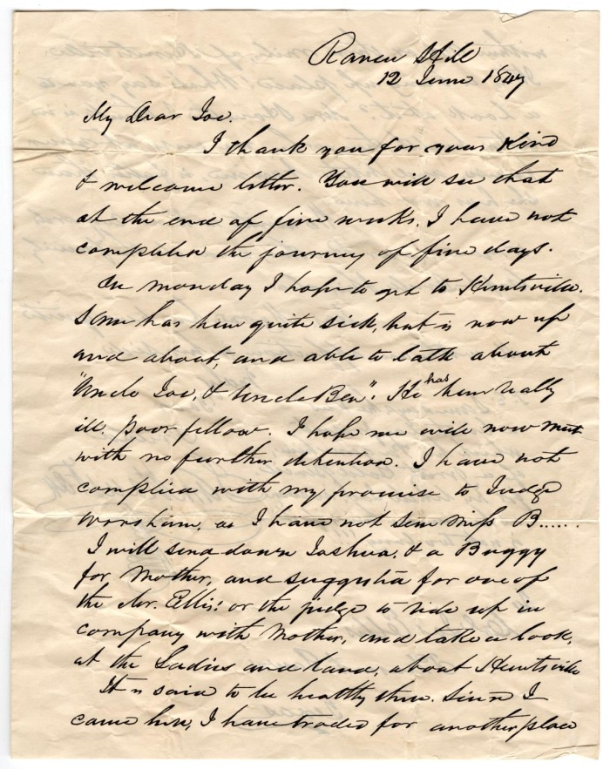
Unit 6: The Republic of Texas
Lesson 2:
How do we know what we know?
Letter from Sam Houston
The Portal to Texas History
Notes:
Houston, Sam. [Copy of letter from Sam Houston to Joseph Ellis, June 12, 1847], letter, June 12, 1847; (https://texashistory.unt.edu/ark:/67531/metapth29462/: accessed April 17, 2025), University of North Texas Libraries, The Portal to Texas History, https://texashistory.unt.edu; crediting Denton Public Library.

Slide 2

How do we know what we know? Warm-up

Slide 3
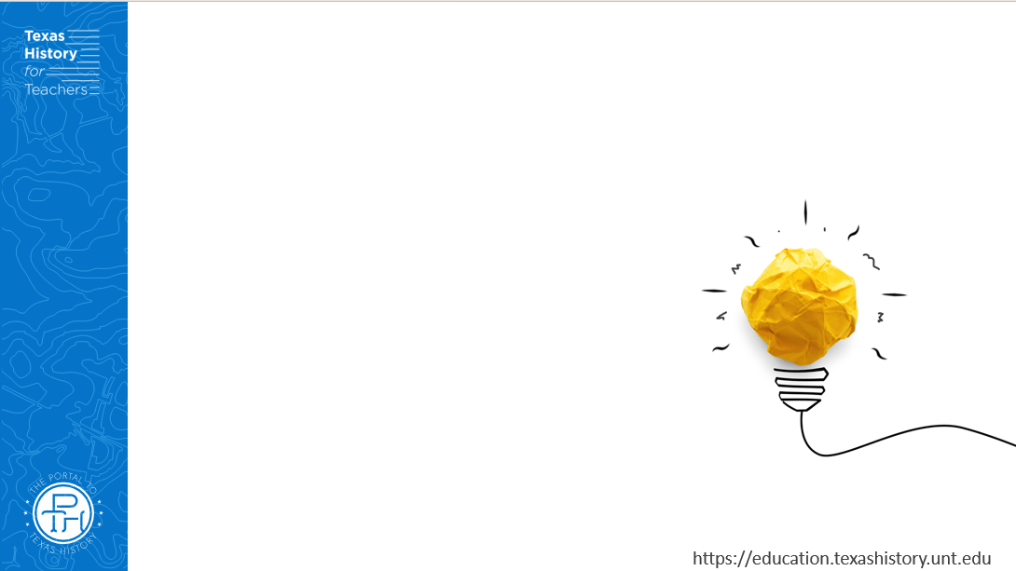




Warm-up: Follow the directions to complete your warm-up
Read the primary source excerpt from a German immigrant woman living with her family in Texas.
What can you infer about life in Texas after the Revolution based on the excerpt?
Share with a partner.

Slide 4
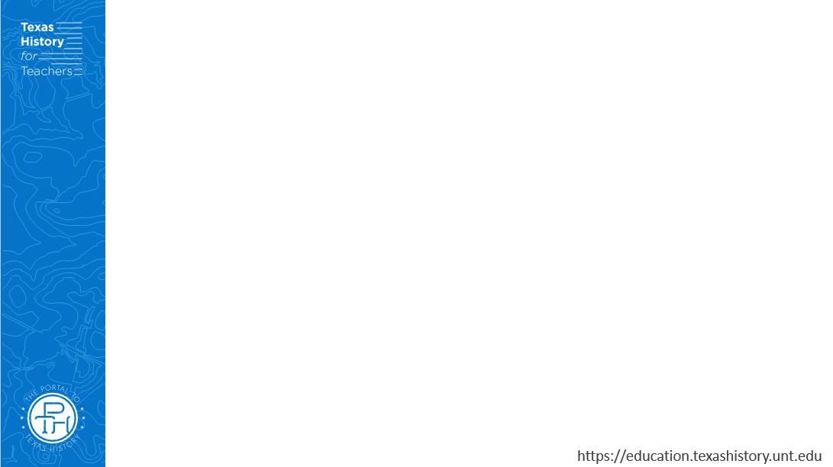
Share with the class
Based on the primary source excerpt, I can infer that life in Texas after the Revolution was ______________

Slide 5

Essential Questions
What primary source materials do historians use to learn about the Republic of Texas era? What can we learn from these materials?

Slide 6
In today’s lesson…
We will examine three different primary source materials to learn about life in Texas after the Texas Revolution.
I will analyze each source to identify challenges the Republic of Texas faced and how the government of the Republic hoped to address these challenges.

Slide 7
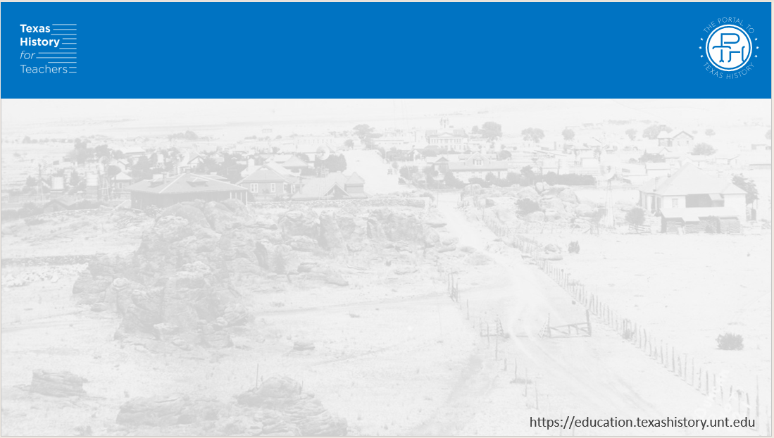
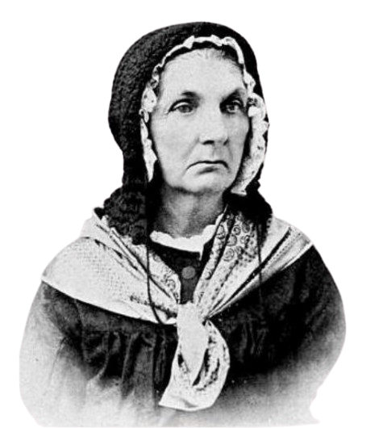
Part I: Life After the Revolution
Rosa Kleberg in her later years
The Texas State Historical Association
The Klebergs later moved to DeWitt County where they lived and raised their seven surviving children. Rosa passed away in 1907 at the age of 94.
Notes:
Photograph, Portrait of Rosalie von Roeder Kleberg. Image available on the Internet and included in accordance with Title 17 U.S.C. Section 107. Located at the Texas State Historical Association webpage: Kleberg, Rosalie Von Roeder Kleberg, Rosalie Von Roeder

Slide 8
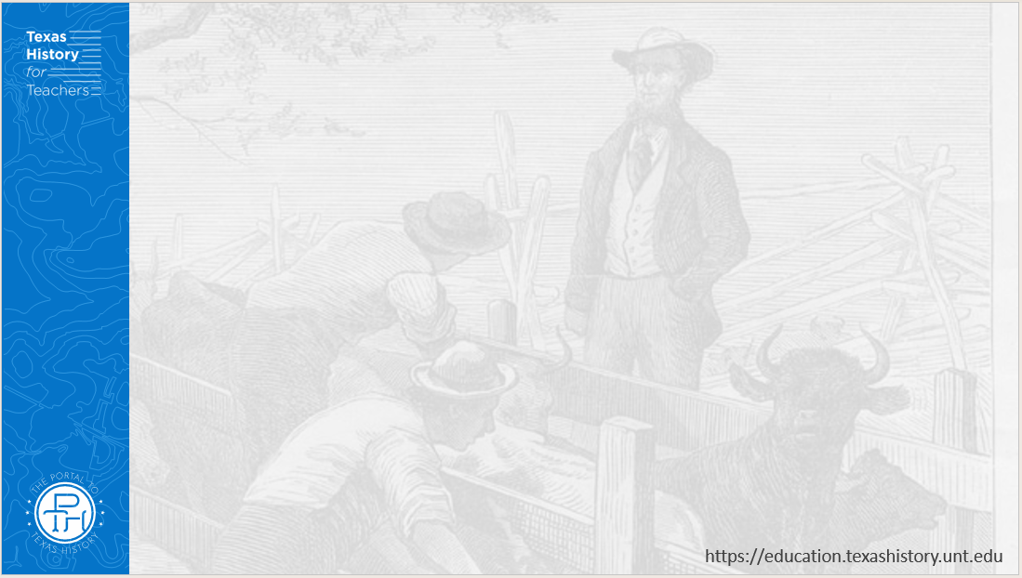
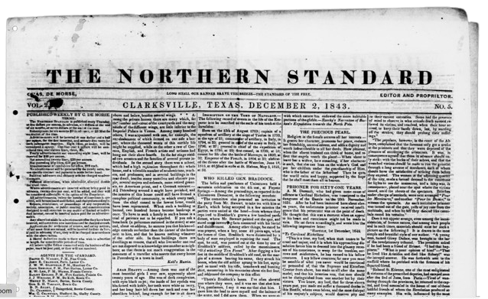
Part II: Hope for the Republic of Texas
The Northern Standard newspaper of Clarksville, Texas, December 2, 1842
The Portal to Texas History
Notes:
De Morse, Charles. The Northern Standard. (Clarksville, Tex.), Vol. 2, No. 5, Ed. 1, Saturday, December 2, 1843, newspaper, December 2, 1843; Clarksville, Texas. (https://texashistory.unt.edu/ark:/67531/metapth80506/: accessed April 16, 2025), University of North Texas Libraries, The Portal to Texas History, https://texashistory.unt.edu; crediting The Dolph Briscoe Center for American History.

Slide 9
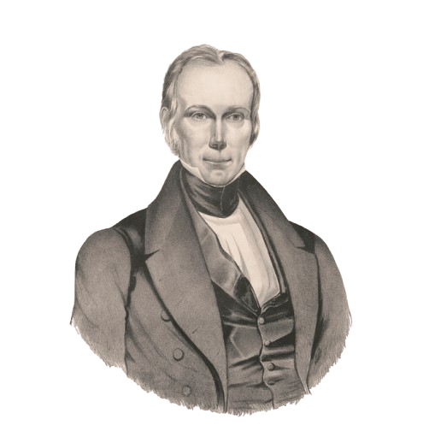
Part III: An American Point of View on Texas Annexation
A portrait of Henry Clay
The Library of Congress
Henry Clay was an American lawyer and politician who represented Kentucky in the United States House of Representatives and the Senate. He unsuccessfully ran for president of the U.S. three times, in 1824, 1832, and 1844.
Notes:
Endicott & Swett, Publisher, Copyright Claimant Endicott & Swett, and William James Hubard. Henry Clay / lithog. & published by Endicott & Swett, N. York ; from the original picture by W.J. Hubard. , ca. 1832. [N. York: Published by Endicott & Swett, 1832? June 27] Photograph. https://www.loc.gov/item/2009633654/

Slide 10
Exit Ticket: Follow the directions to complete your exit ticket
Choose one of the points of view provided in the graphic organizer.
Write a short journal entry of the Republic of Texas from 1836 to 1845 from that point of view.
Share with a partner.

Slide 11
Share with the class 2
(Share your journal entry with the class)

