Slide 1
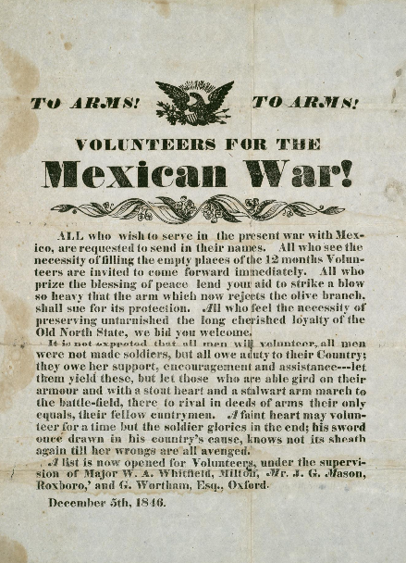
Unit 6:
The Republic of Texas
Lesson 8:
Looking Ahead
Notes:
To Arms! To Arms! Volunteers for the Mexican War!. December 5, 1846. Poster. University of North Texas Libraries, The Portal to Texas History; crediting Star of the Republic Museum. https://texashistory.unt.edu/ark:/67531/metapth31112.

Slide 2




Warm-up:
Follow the directions to complete your warm-up
Consider what we know about Texas annexation and then make a prediction:
Circle or highlight any terms from the chart that you think we will probably see in the next unit.
Discuss with a partner.

Slide 3

Share with the class
One statement that I think will be true in the next unit is that ______
The statement that I believe is 100% certain to happen is that ______

Slide 4

Essential Question
What were some of the significant effects of Texas’ annexation to the United States that we will learn more about in the next unit?

Slide 5
In today’s lesson…
We will examine different points of view regarding Texas’ annexation and identify the significant effects of annexation on Texas, Mexico, and the United States.
I will read short passages and answer comprehension questions about point of view, main ideas, supporting evidence, and the significance of Texas’ annexation.

Slide 6

So, Texas is Part of the United States . . .

Slide 7
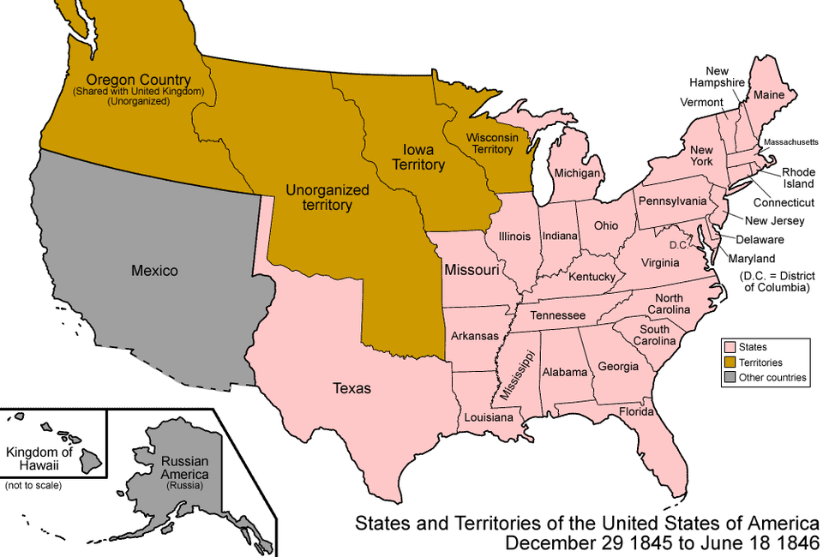
. . . Now What?
Notes:
United States, 1845 – 1846. Map of the states and territories of the United States as it was from December 1845 to June 1846. On December 29 1845, the Republic of Texas and all of its claimed lands were admitted as the state of Texas, including Miller County. On June 18 1846, Oregon Country below the 49th parallel, excluding Vancouver Island, was incorporated in to the United States as unorganized territory. This file is licensed under the Creative Commons Attribution-Share Alike 3.0 Unported license. https://commons.wikimedia.org/wiki/File:United_States_1845-12-1846-06.png

Slide 8
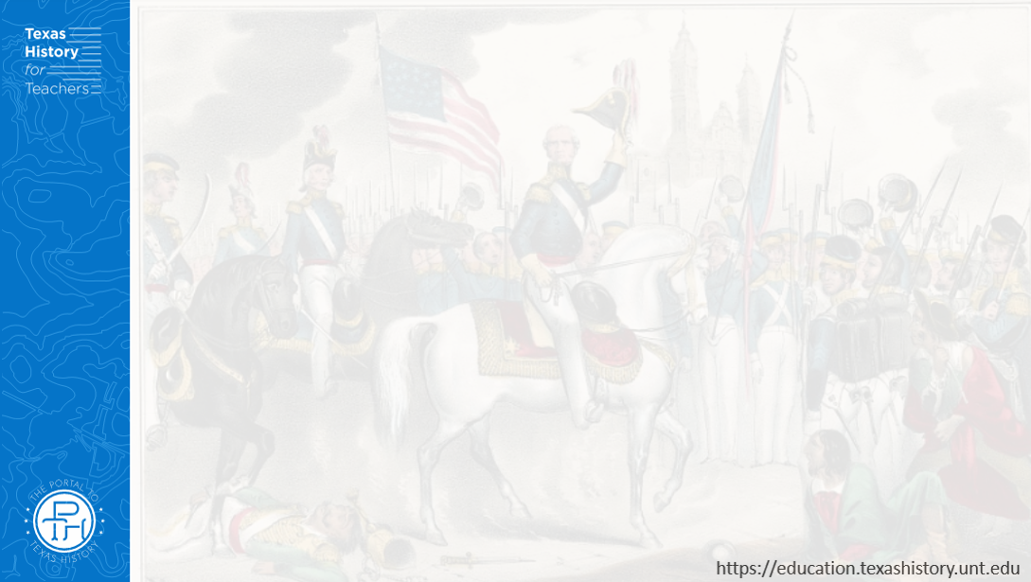
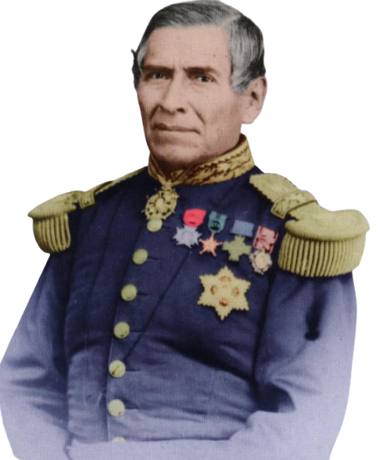
Juan Almonte:
Mexico’s Minister to the United States
“…an act of aggression, the most unjust which can be found recorded in the annals of modern history – namely, that of despoiling a friendly nation, like Mexico, of a considerable portion of her territory.”
The Portal to Texas History
Notes:
Jackson, Jack, 1941-2006 & Almonte, Juan Nepomuceno, 1803-1869. Almonte's Texas: Juan N. Almonte's 1834 Inspection, Secret Report & Role in the 1836 Campaign, book, 2003; Austin, Texas. (https://texashistory.unt.edu/ark:/67531/metapth296837/: accessed June 2, 2025), University of North Texas Libraries, The Portal to Texas History, https://texashistory.unt.edu; crediting Texas State Historical Association.

Slide 9
On the Road to War…

Slide 10
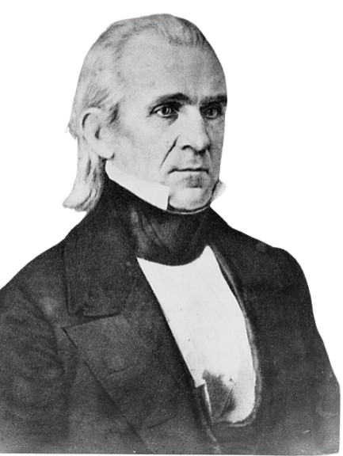
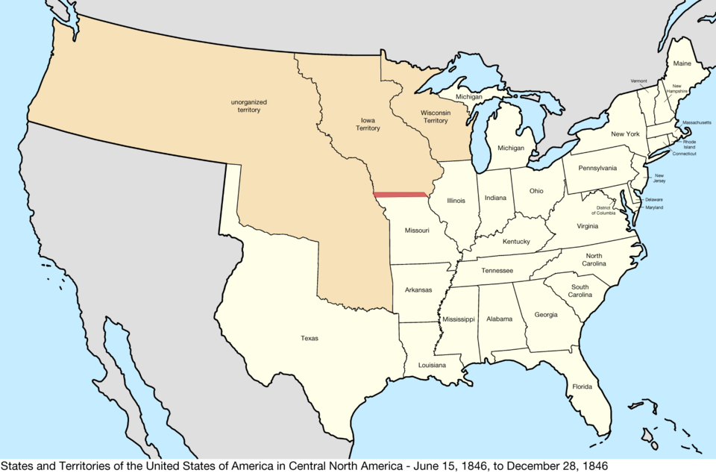
James K. Polk
U.S. President 1845 - 1849
The United States 1846
Library of Congress
Notes:
Portrait of Zachary Taylor. Zachary Taylor Papers: Series 6, Additions, 1820-1863; 2014 Addition; Engraved portrait, 1863. Library of Congress. http://hdl.loc.gov/loc.mss/ms009193.mss42440.009
United States Central map 1846-06-15 to 1846-12-28. This file is licensed under the Creative Commons Attribution-Share Alike 4.0 International license. https://commons.wikimedia.org/wiki/File:United_States_Central_map_1846-06-15_to_1846-12-28.png

Slide 11
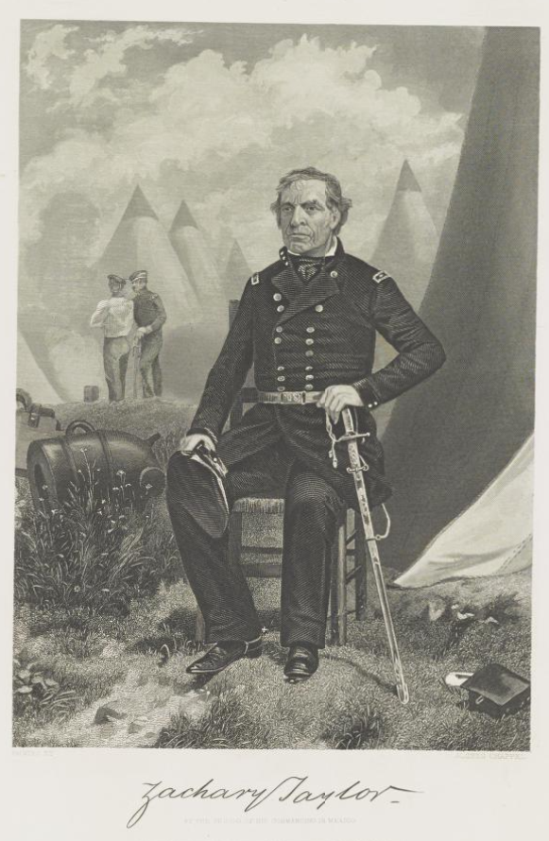
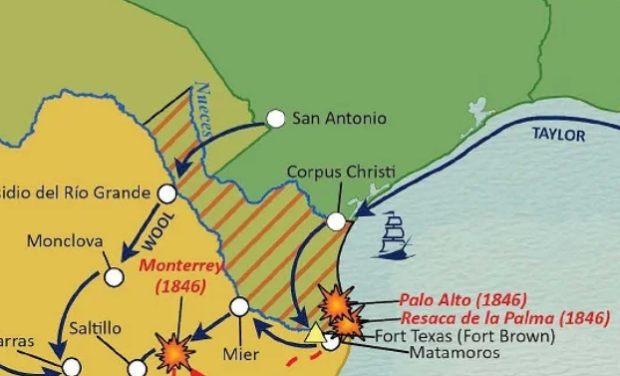
Zachary Taylor
General of the American Army in the U.S. – Mexico War
Texas General Land Office
Library of Congress
Notes:
Taylor, Zachary. Zachary Taylor Papers: Series 6, Additions, -1863; 2014 Addition; Engraved portrait, 1863. 1863. Manuscript/Mixed Material. https://www.loc.gov/item/mss42440009/
Northern Mexico Campaign of the U.S. - Mexico War, 1846 -1847. GIS Educational Maps. Ellyson Wong (Compiler) Lila Rakoczy (Compiler) "Disputed Territory Between Mexico and the United States" (97129) and “Disputed Territory Between Mexico and the United States, 1845 – 1854” (97251) Texas General Land Office. https://historictexasmaps.com/object/97152

Slide 12
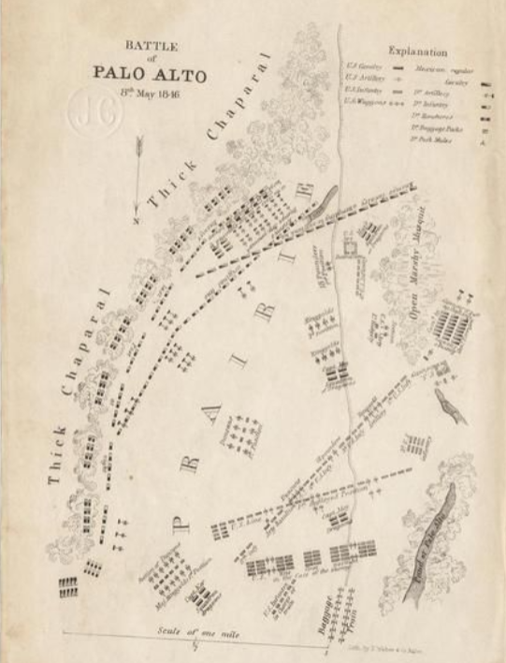
Battle of
Palo Alto
Map of the Battle of Palo Alto, 1846
The Portal to Texas History
Notes:
Edward Weber & Co. Battle of Resaca de la Palma, 9th May 1846 [and the] Battle of Palo Alto, 8th May 1846., map, 1846; Baltimore. (https://texashistory.unt.edu/ark:/67531/metapth192504/: accessed June 5, 2025), University of North Texas Libraries, The Portal to Texas History, https://texashistory.unt.edu; crediting University of Texas at Arlington Library.

Slide 13
Exit Ticket:
Follow the directions to complete your exit ticket
Create a True or False question based on information from today’s lesson.
Be prepared to explain your answer
Discuss with a partner.

Slide 14
Share with the class 2
(Read your true or false question)
Do not provide the answer until after the class has a chance to answer your question.

