Slide 1

Mind Map
Sub-topic
1
Additional information
Main Topic
Sub-topic
2
Sub-topic
3
Additional information
Additional information
Additional information
https://education.texashistory.unt.edu

Slide 2

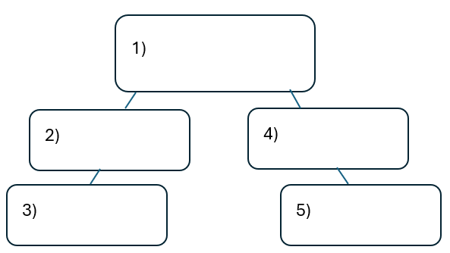


Warm-up:
Follow the directions on your warm-up
Use the word bank provided to fill in the small mind map on your warm-up.
Place each term where you think it fits best in your mind map.
Discuss with a partner.
https://education.texashistory.unt.edu

Slide 3
Share with the class
I think the primary topic in box number one is _______
I think the subtopic in box number two is ____, and box number three is ____
I think the subtopic in box number four is ____, and box number five is ____
https://education.texashistory.unt.edu

Slide 4
Essential Question
How do the key terms and concepts from Unit 6: The Republic of Texas connect to each other?
https://education.texashistory.unt.edu

Slide 5
In today’s lesson…
We will make connections between key terms and concepts within all of Unit 6: The Republic of Texas.
I will create a Mind Map using terms and concepts from the class slides presentation.
https://education.texashistory.unt.edu

Slide 6
Unit Topic & Subtopics
Which of the titles in the boxes below is the main topic of our unit?
Draw a circle in the middle of your Mind Map and write the main topic inside.
Write the remaining topics around the main topic. Connect each sub-topic to the main topic with a line.
Domestic Issues
Republic of Texas
People
Foreign Issues
Economic Issues
https://education.texashistory.unt.edu

Slide 7
Make Connections 1
Connect each item below to the topic on your Mind Map.
Some items will connect directly to the main topic. Some will connect to other items from this slide. Some items can go in more than one place.
TX Presidents
Annexation
Goal: diplomatic recognition
Growing Debt
Sam Houston
Mirabeau Lamar
https://education.texashistory.unt.edu

Slide 8
Make Connections 2
Connect each item below to the topic on your Mind Map.
Some items will connect directly to the main topic. Some will connect to other items from this slide. Some items can go in more than one place.
Peace with Indians
Anson Jones
Wars against Indians
Plantation agriculture
Goal: Commercial partnerships
Córdova Rebellion
https://education.texashistory.unt.edu

Slide 9
Make Connections 3
Connect each item below to the topic on your Mind Map.
Some items will connect directly to the main topic. Some will connect to other items from this slide. Some items can go in more than one place.
Council House Fight
Reduced size of government
Cotton
Cherokees
Great Britain
Comanches
https://education.texashistory.unt.edu

Slide 10
Make Connections 4
Connect each item below to the topic on your Mind Map.
Some items will connect directly to the main topic. Some will connect to other items from this slide. Some items can go in more than one place.
Mexican army invasions
Slave labor
Chief Bowles
Santa Fe Expedition
Texas Rangers
Moved capital to Austin
https://education.texashistory.unt.edu

Slide 11
Make Connections 5
Connect each item below to the topic on your Mind Map.
Some items will connect directly to the main topic. Some will connect to other items from this slide. Some items can go in more than one place.
Disbanded army
José Antonio Navarro
John Coffee Hays
San Antonio
Trade
Tejanos
https://education.texashistory.unt.edu

Slide 12
Make Connections 6
Connect each item below to the topic on your Mind Map.
Some items will connect directly to the main topic. Some will connect to other items from this slide. Some items can go in more than one place.
U.S. denied twice
Representative in TX Congress
Supported annexation
Nacogdoches
Mary Maverick
Occupied San Antonio
https://education.texashistory.unt.edu

Slide 13
Make Connections 7
Connect each item below to the topic on your Mind Map.
Some items will connect directly to the main topic. Some will connect to other items from this slide. Some items can go in more than one place.
Opposed annexation
Raids
Prevent war with Mexico
William
Goyens
Somervell Expedition
Annexation approved 1845
https://education.texashistory.unt.edu

Slide 14
Make Connections 8
Connect each item below to the topic on your Mind Map.
Some items will connect directly to the main topic. Some will connect to other items from this slide. Some items can go in more than one place.
Mier Fight
Goal: Abolish slavery
Conflict between slave and free states
Businessman & landowner
Preserved TX history
Primary peace leader
https://education.texashistory.unt.edu

Slide 15

Create Connections 6
Now take a few minutes to add any information you can think of to your Mind Map.
You can add facts, descriptions, explanations, caused, effects, or anything else you can think of.
https://education.texashistory.unt.edu

Slide 16
Exit Ticket
Complete the sentence summarizing the main idea from our unit.
Discuss with a partner.
https://education.texashistory.unt.edu

Slide 17
Share your response
The (1)____________ is primarily characterized by (2)_______________
https://education.texashistory.unt.edu

