Slide 1
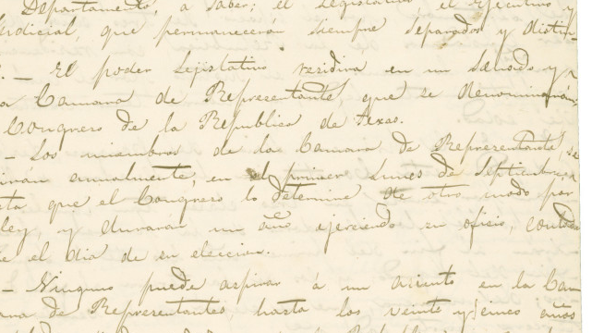
Unit 6: The Republic of Texas
Review Lesson:
Study Guide
Republic of Texas Constitution
The Portal to Texas History
Notes:
Kimble, H. S. [Copy of the Constitution of the Republic of Texas, March 17, 1836], text, March 17, 1836; (https://texashistory.unt.edu/ark:/67531/metapth6708/: accessed May 6, 2025), University of North Texas Libraries, The Portal to Texas History, https://texashistory.unt.edu; crediting The Dolph Briscoe Center for American History.

Slide 2
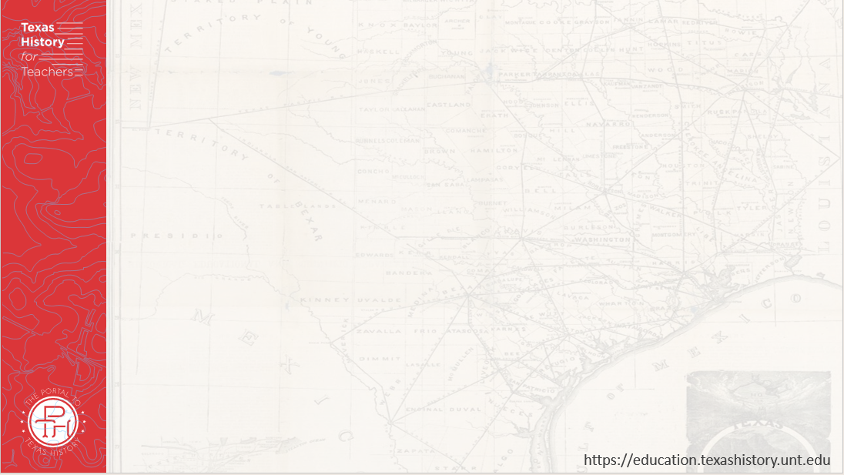





Warm-up Follow the directions below to complete your warm-up
Circle or highlight any and all topics, concepts, or terms that you expect to see on the unit 6 test based on what we have learned and discussed in class.
Share with a partner

Slide 3
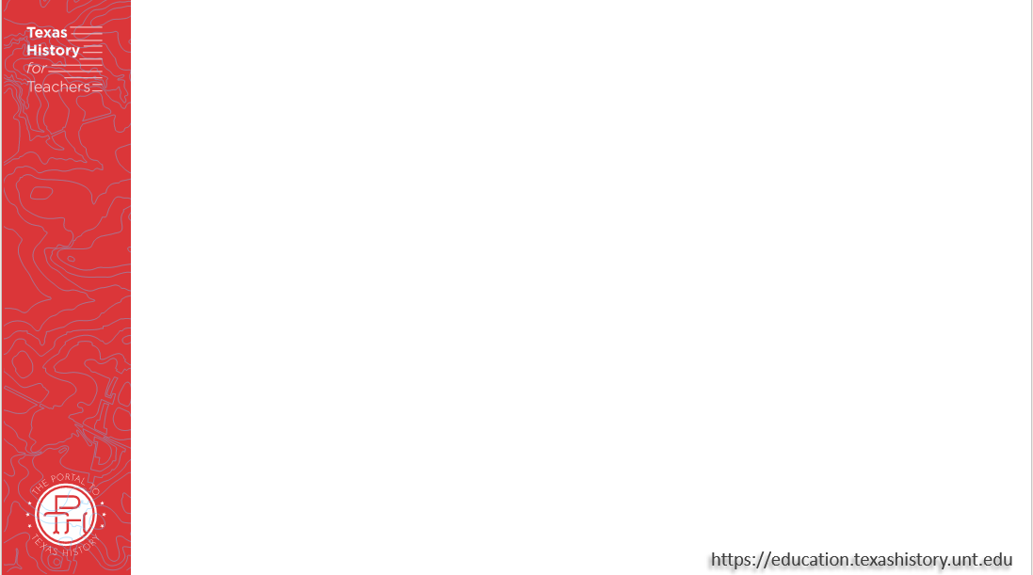
Share with the class:
One topic that we will probably see on the Unit 6 test is _______

Slide 4
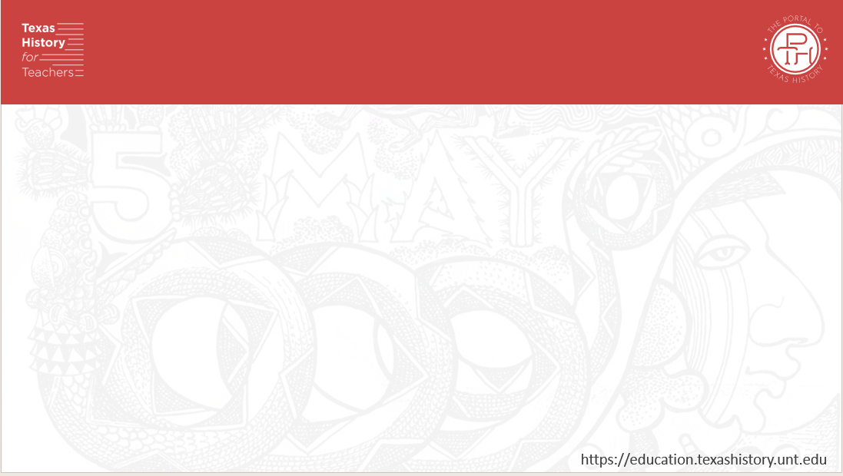
Essential Question
What significant information do we need to know to be successful on the unit 6 test on the Republic of Texas?

Slide 5
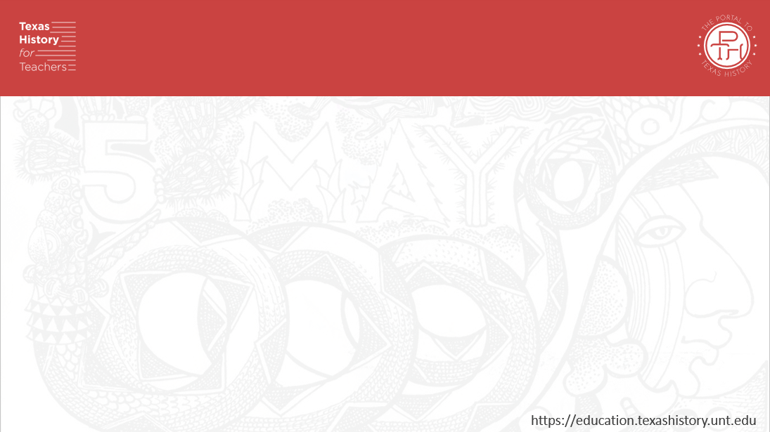
In Today’s Lesson
We will identify and review significant information for our upcoming test.
I will use my previous work and notes to complete my study guide. I will identify and match cause and effect relationships, create short answer responses, and answer practice test questions.

Slide 6

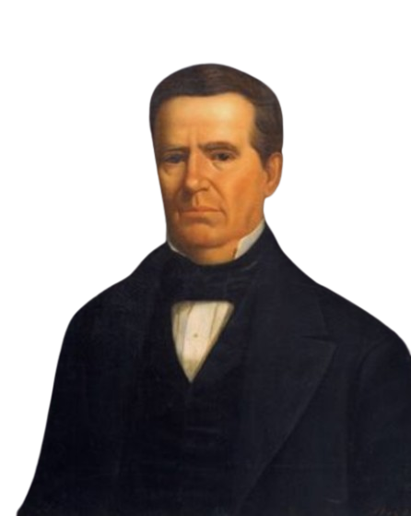
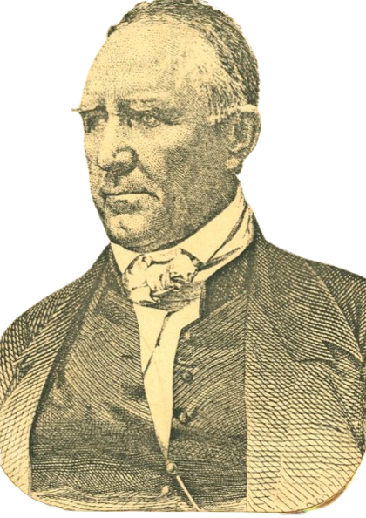
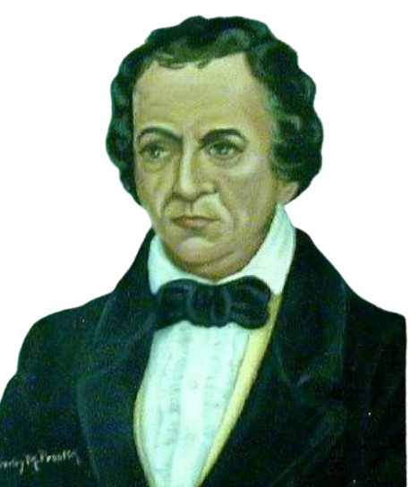
Part I: Significant People
Sam Houston
The Portal to Texas History
Mirabeau Lamar
The Portal to Texas History
Anson Jones
The State Preservation Board
Notes:
Sam Houston, physical object, Date Unknown; (https://texashistory.unt.edu/ark:/67531/metapth32932/: accessed June 6, 2025), University of North Texas Libraries, The Portal to Texas History, https://texashistory.unt.edu; crediting Star of the Republic Museum.
[Mirabeau Lamar, copy by Darby M. Prastik.], artwork, Date Unknown; (https://texashistory.unt.edu/ark:/67531/metapth306/: accessed June 6, 2025), University of North Texas Libraries, The Portal to Texas History, https://texashistory.unt.edu; crediting Fort Bend Museum.
Huddle, William H. Anson Jones. 1888. Oil on canvas. Capitol Historical Artifact Collection, State Preservation Board. https://tspb.texas.gov/prop/tc/tc-collection/governors/index.html.

Slide 7
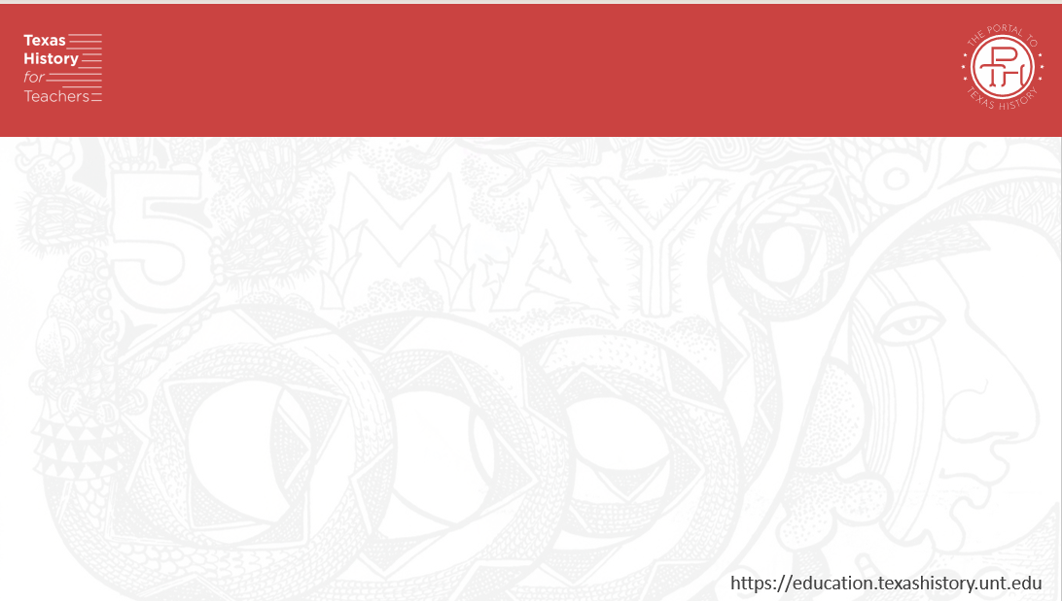
Timeline of the Republic Advanced
Event 2
Title
Description
Date
Event 4
Title
Description
Date
Event 3
Title
Description
Date
Event 1
Title
Description
Date

Slide 8
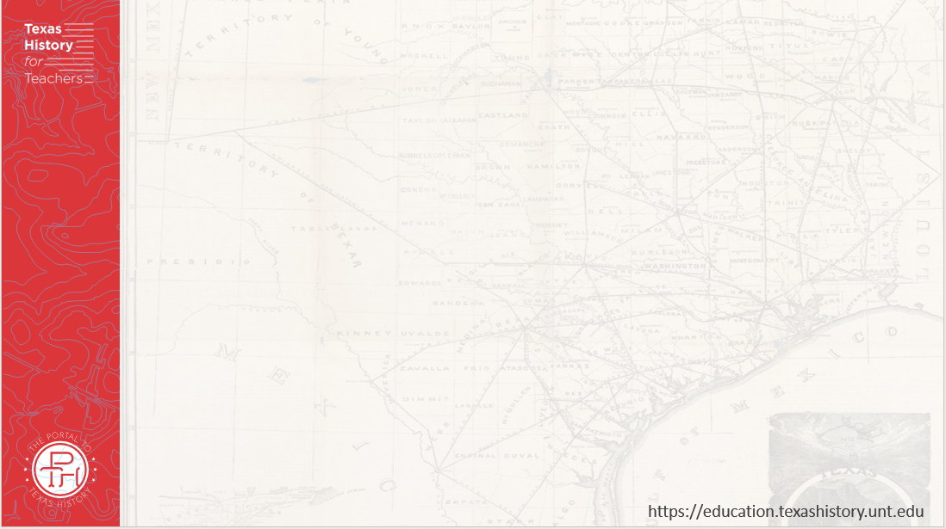
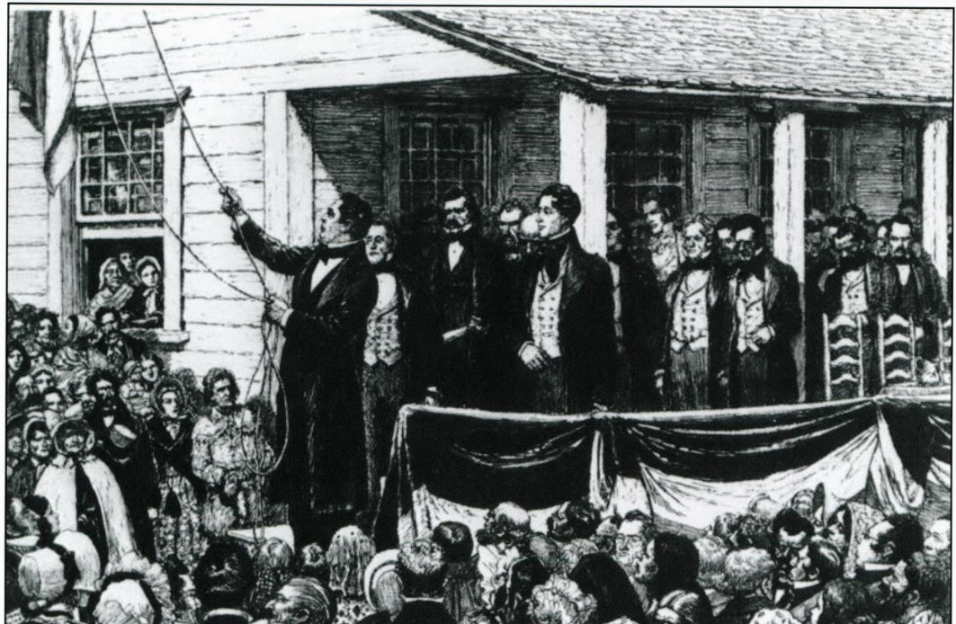
Part II: Matching
“The Republic of Texas is no more.” – Anson Jones
The Portal to Texas History
Notes:
Texas. Legislature. Legislative Council. The Texas Capitol: A History of the Lone Star Statehouse, book, 2016; Austin, Texas. (https://texashistory.unt.edu/ark:/67531/metapth902948/: accessed April 24, 2025), University of North Texas Libraries, The Portal to Texas History, https://texashistory.unt.edu; crediting UNT Libraries Government Documents Department.

Slide 9
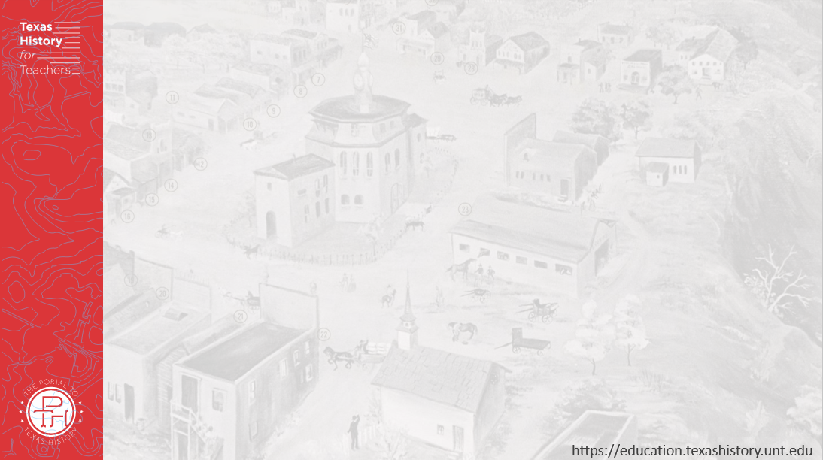
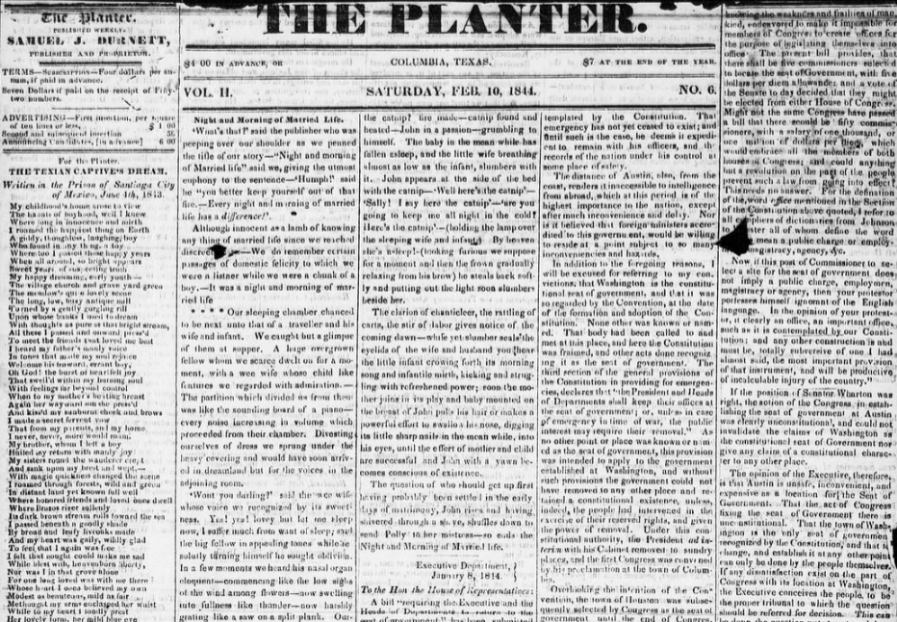
Part III: Practice Test Questions
The Planter newspaper of Brazoria, Texas
Saturday February 10, 1844
The Portal to Texas History
Notes:
The Planter. (Columbia, Tex.), Vol. 2, No. 6, Ed. 1, Saturday, February 10, 1844, newspaper, February 10, 1844; Columbia, Texas. (https://texashistory.unt.edu/ark:/67531/metapth80184/: accessed June 6, 2025), University of North Texas Libraries, The Portal to Texas History, https://texashistory.unt.edu; crediting The Dolph Briscoe Center for American History.

Slide 10

Exit Ticket 2 Follow the directions below to complete your exit ticket
Complete the graphic organizer assessing your knowledge and readiness for our unit 6 test.
Share with a partner

Slide 11
Share with the class: 2
(Choose one thing to share from your exit ticket)

