Slide 1
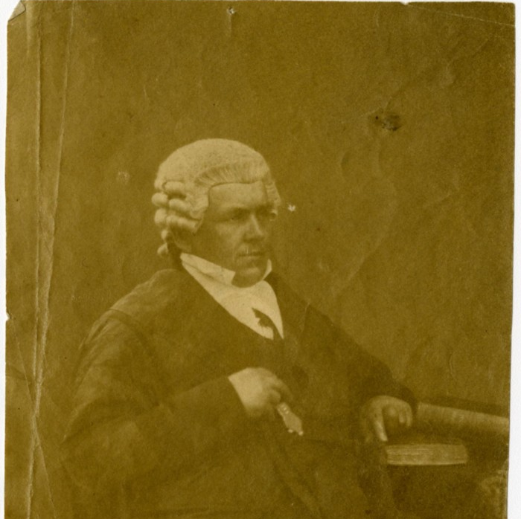
Unit 6: The Republic of Texas
Extension Lesson:
The Santa Fe Expedition
Expedition Member, Thomas Falconer
Notes:
[Portrait of Thomas Falconer], photograph, August 1854; (https://texashistory.unt.edu/ark:/67531/metapth586979/: accessed May 9, 2025), University of North Texas Libraries, The Portal to Texas History, https://texashistory.unt.edu; crediting Southwestern University.

Slide 2
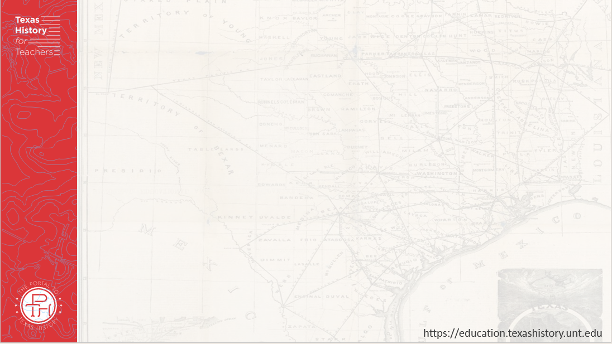

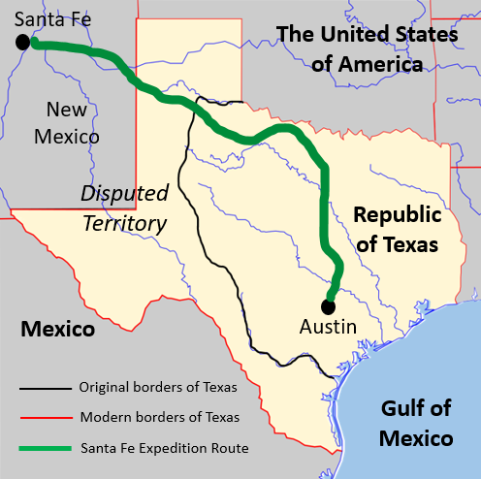


Warm-up Follow the directions below to complete your warm-up
Use the map on your warm-up (shown larger here) to complete your warm-up
Share your response with a partner

Slide 3

Share with the class:
The Santa Fe Expedition traveled through ________
The Santa Fe Expedition probably encountered ________ while traveling through these regions.

Slide 4
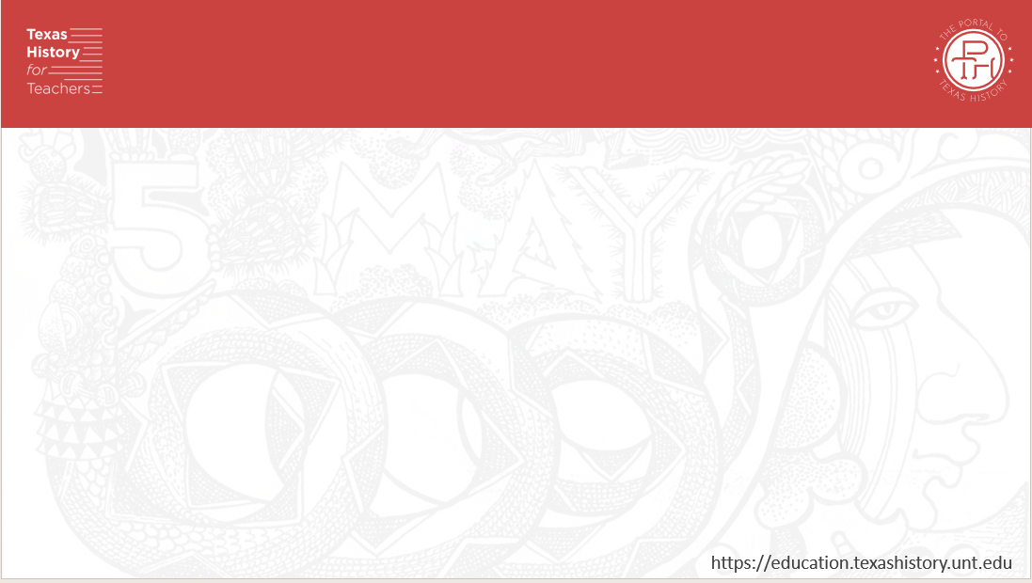
Essential Question
What were the goals, key events, significant challenges, and outcomes of the Santa Fe Expedition?

Slide 5
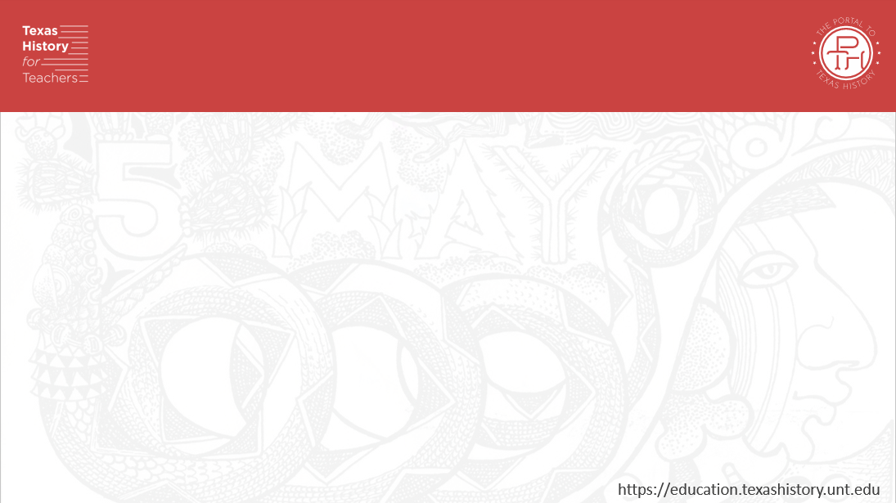
In Today’s Lesson
We will examine the goals, key events, major challenges, and significance of the Santa Fe Expedition during the Republic of Texas era.
I will analyze five primary source excerpts to determine the key information, challenges, and significance of the Santa Fe Expedition.

Slide 6
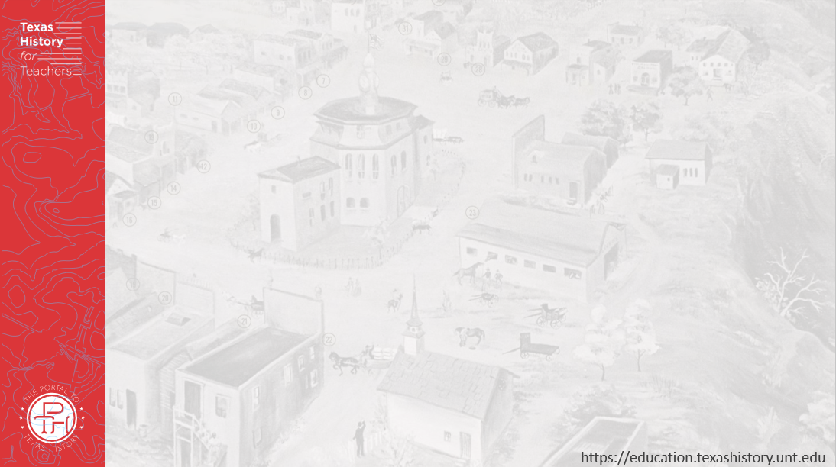
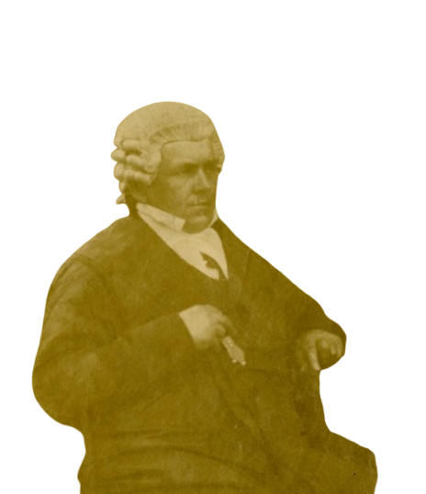
Mirabeau Lamar & the Santa Fe Expedition
Thomas Falconer
The Portal to Texas History
Notes:
[Portrait of Thomas Falconer], photograph, August 1854; (https://texashistory.unt.edu/ark:/67531/metapth586979/: accessed May 9, 2025), University of North Texas Libraries, The Portal to Texas History, https://texashistory.unt.edu; crediting Southwestern University.
Map of the Santa Fe Expedition Route. This image was created using the Wikimedia Commons image: A Blank Map of Texas and edited to include information about the Mexican borders of Texas, and all entities that Texas shared a border with in 1840. This file is licensed under the Creative Commons Attribution-Share Alike 2.5 Generic, 2.0 Generic and 1.0 Generic license. https://commons.wikimedia.org/wiki/File:Texas_blank_map.svg

Slide 7
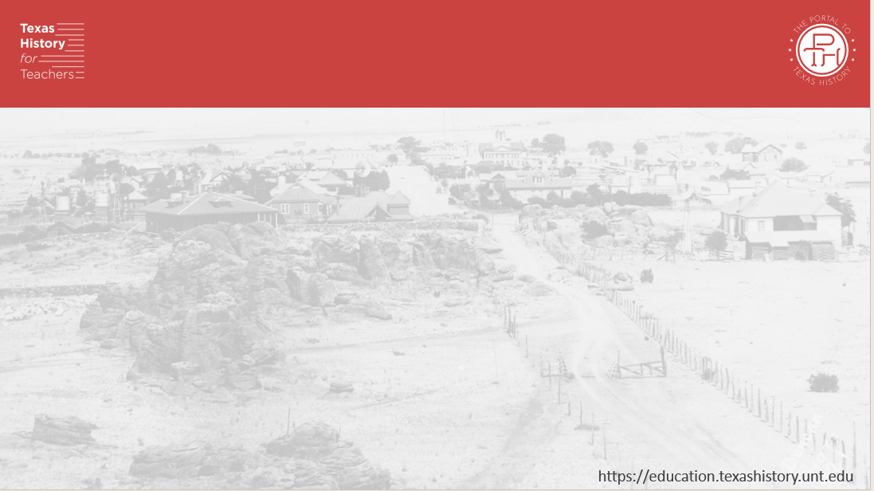
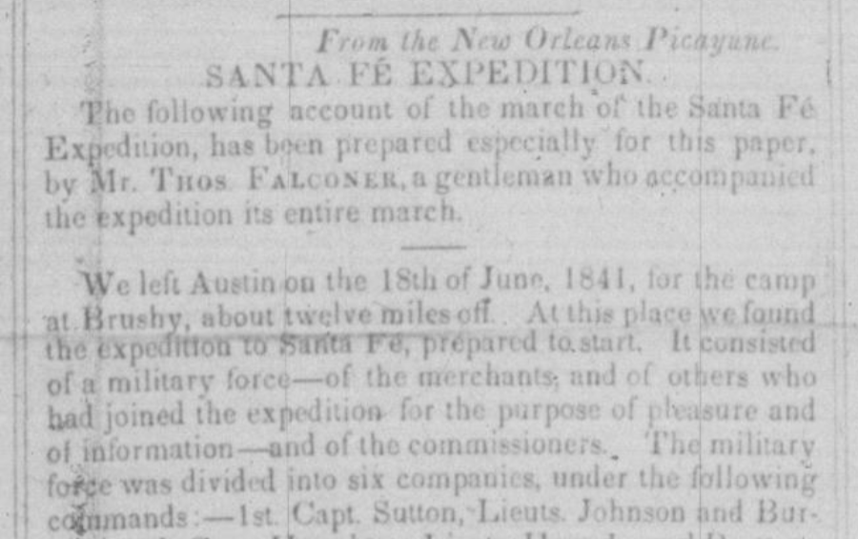
Thomas Falconer’s Account of the Santa Fe Expedition
Thomas Falconer’s account of the Santa Fe Expedition
Printed in
The Morning Star Newspaper
Houston, Texas
Tuesday May 17, 1842
The Portal to Texas History
Notes:
The Morning Star. (Houston, Tex.), Vol. 3, No. 343, Ed. 1 Tuesday, May 17, 1842, newspaper, May 17, 1842; Houston, Texas. (https://texashistory.unt.edu/ark:/67531/metapth1497765/: accessed May 9, 2025), University of North Texas Libraries, The Portal to Texas History, https://texashistory.unt.edu; .

Slide 8
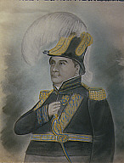
The Capture of the Santa Fe Expedition
Manuel Armijo (Armigo)
New Mexico Governor
Catalog of American Portraits The Smithsonian
Notes:
Portrait of Manuel Armijo by Alfred S. Waugh. Palace of the Governors, New Mexico History Museum. Catalog of American Portraits. The Smithsonian. Manuel Armijo | Smithsonian Institution

Slide 9
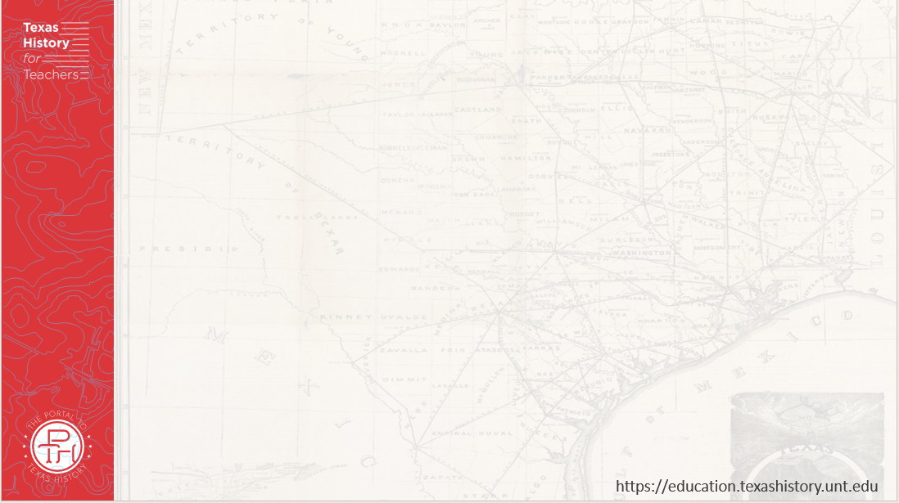
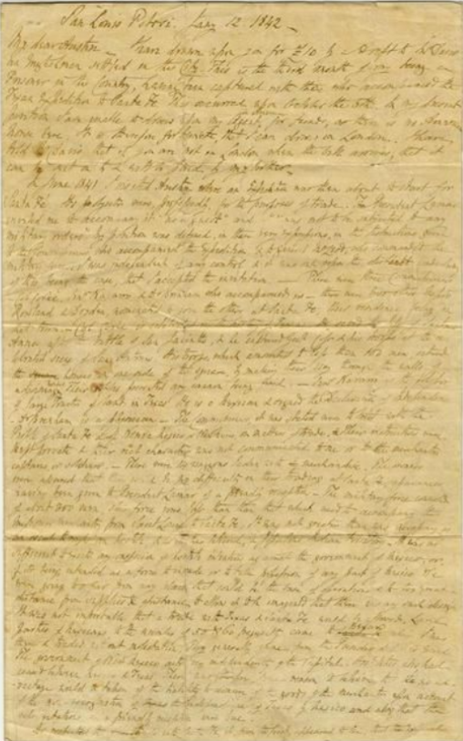
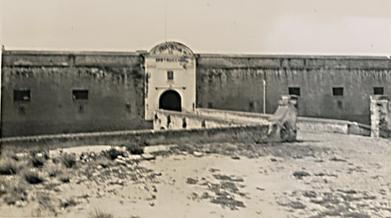
Thomas Falconer’s Thoughts on the Expedition
Perote Prison, Veracruz, Mexico
Texas State Historical Association
Thomas Falconer’s letter to Alfred Austin
The Portal to Texas History
Notes:
Falconer, Thomas. [Letter from Thomas Falconer to Alfred Austin], letter, January 12, 1842; San Luis Potosi, Mexico. (https://texashistory.unt.edu/ark:/67531/metapth586975/: accessed May 9, 2025), University of North Texas Libraries, The Portal to Texas History, https://texashistory.unt.edu; crediting Southwestern University.
Photograph, Perote Prison. Image courtesy of the University of Texas. Image available on the Internet and included in accordance with Title 17 U.S.C. Section 107.
Perote Prison

Slide 10

Exit Ticket Follow the directions below to complete your exit ticket
Think about an experience you might have had as a member of the Santa Fe Expedition.
Write a journal entry in the space provided about your experience.
Share your response with a partner

Slide 11
Share with the class: 2
(Read your journal entry for the class. Begin with the date of your experience.)

