Slide 1
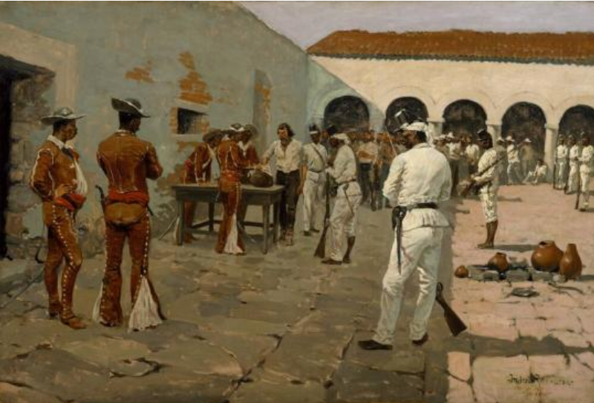

Unit 6:
The Republic of Texas
Extension Lesson:
The Somervell Expedition and the Mier Fight
Notes:
The Mier Expedition: The Drawing of the Black Bean, by Frederic Remington. 1896. The Hogg Brothers Collection, gift of Miss Ima Hogg. The Museum of Fine Arts, Houston. The Mier Expedition: The Drawing of the Black Bean | All Works | The MFAH Collections

Slide 2
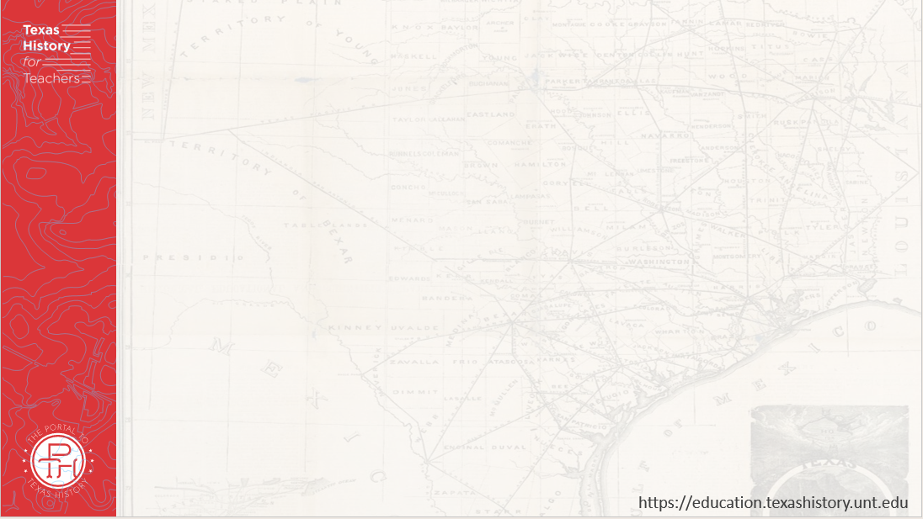





Warm-up
Follow the directions below to complete your warm-up
Read the scenario presented in your warm-up.
Complete your warm-up based on what you believe you would do in that scenario.
Share with a partner.

Slide 3

Share with the class:
As president of Texas, my response to Mexico’s two invasions of my country would be to _____
I think this is a good plan because _______
One possible negative aspect of this plan is __________

Slide 4
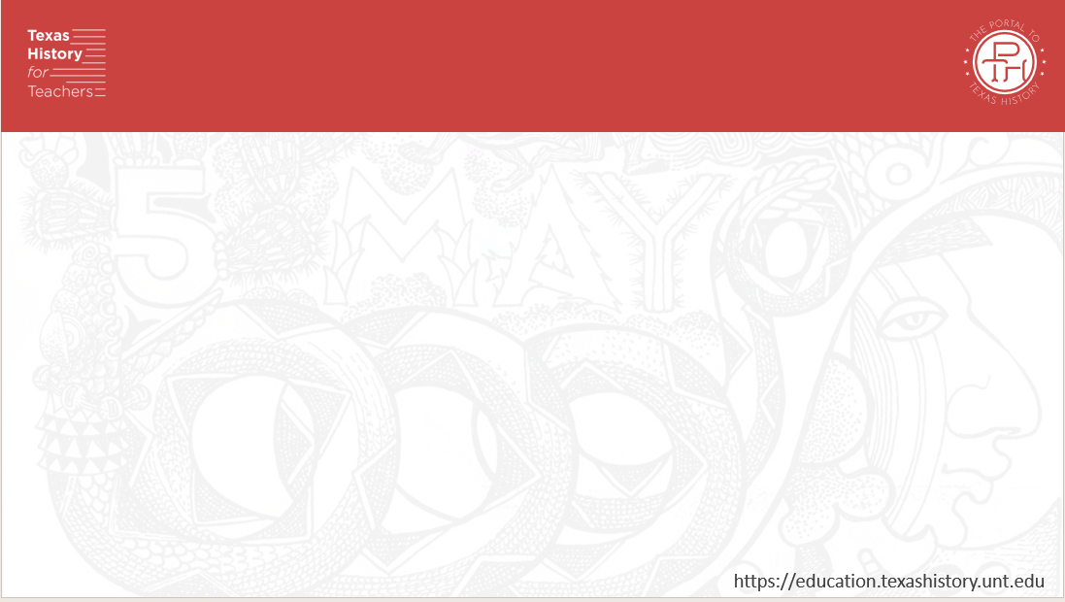
Essential Question
What were the significant events of the Somervell Expedition and Mier Fight in chronological order, and what was the outcome?

Slide 5
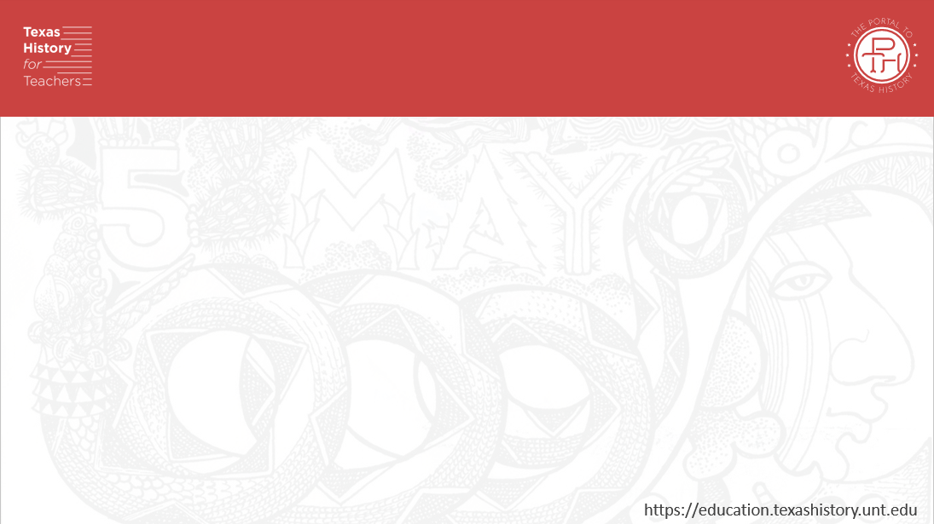
In Today’s Lesson
We will examine the chronological events of the Somervell Expedition and the Mier Fight and create our own representation of the events.
I will choose to create either journal entries, a storyboard, or a newspaper article based on the information provided in the chronological list of events from the reading.

Slide 6

Timeline of Events

Slide 7
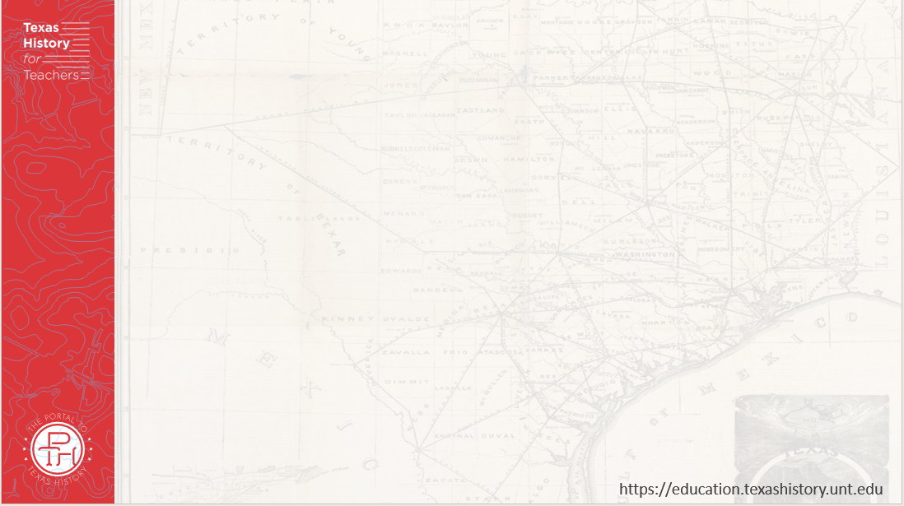
“The Drawing of the Black Bean” by Frederick Remington
Notes:
The Mier Expedition: The Drawing of the Black Bean, by Frederic Remington. 1896. The Hogg Brothers Collection, gift of Miss Ima Hogg. The Museum of Fine Arts, Houston. The Mier Expedition: The Drawing of the Black Bean | All Works | The MFAH Collections

Slide 8
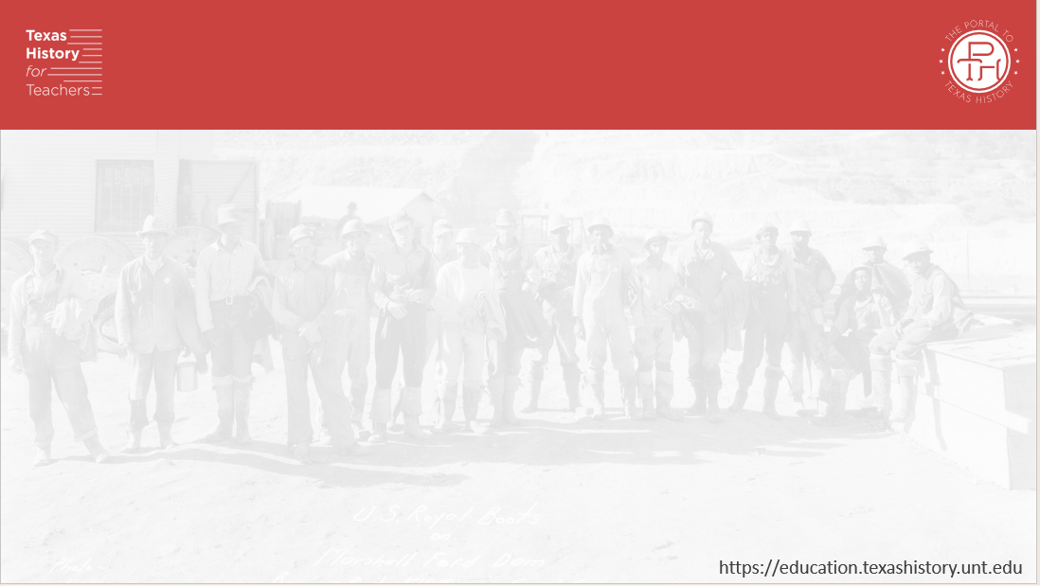
Activity Options
The chart on your paper presents three options for how to complete this assignment. Read each option and choose one of the activities listed. Use the information in the chart to meet all the requirements for your chosen activity.

Slide 9
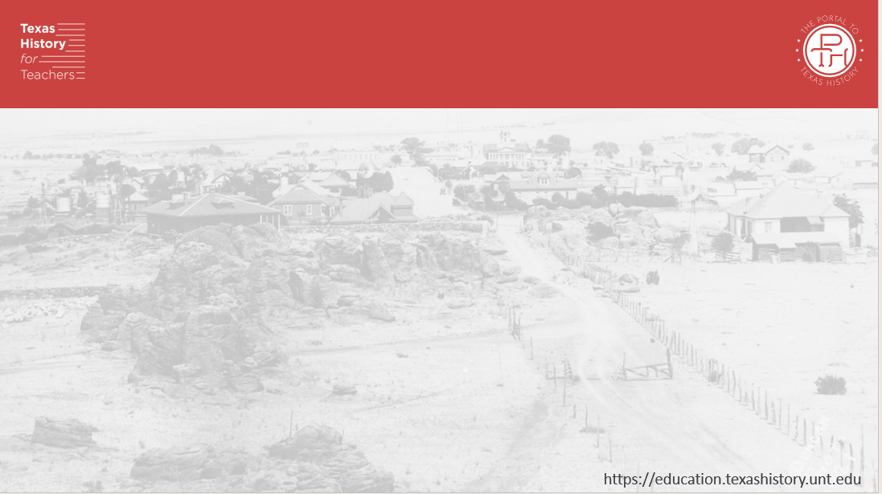
Option 1: Journal Entries
December 19, 1842
Captain Somervell said we have done all we can do. Sure, we raided Laredo and Guerrero, but we have not actually confronted the Mexican army. They must answer for their invasions of our republic! Somervell has ordered us home, but my honor demands that I stay and continue this fight! Hundreds of us have decided to continue on with a man named Fisher. We leave for the town of Mier tomorrow. May the spirits of those brave defenders who gave their lives at the Alamo guide our righteous steps!

Slide 10
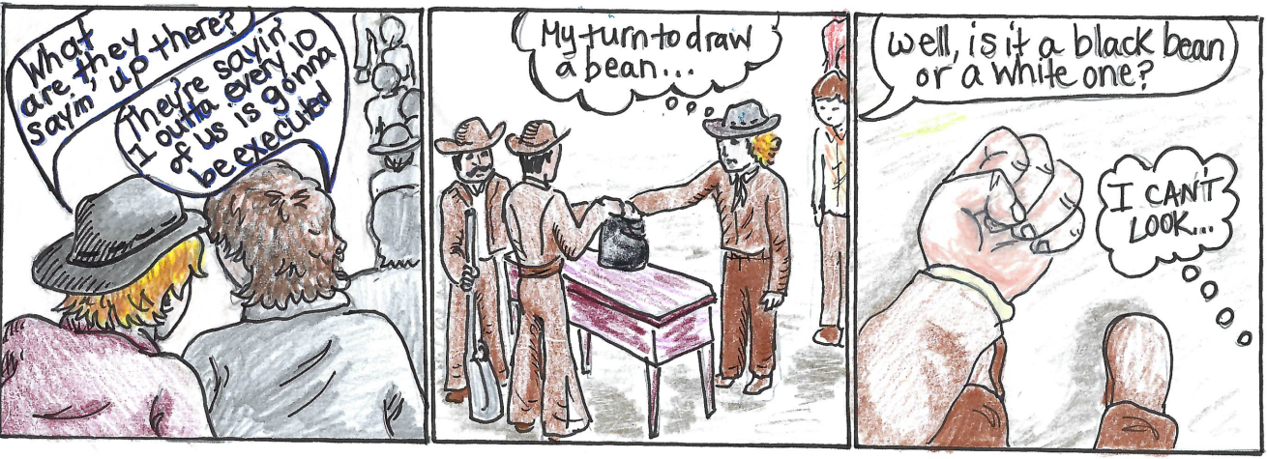
Option 2: Storyboard
Notes:
Storyboard Example of the “Black Bean Episode”. Illustrated by Courtney Abubakar. Texas History for Teachers. The University of North Texas.

Slide 11
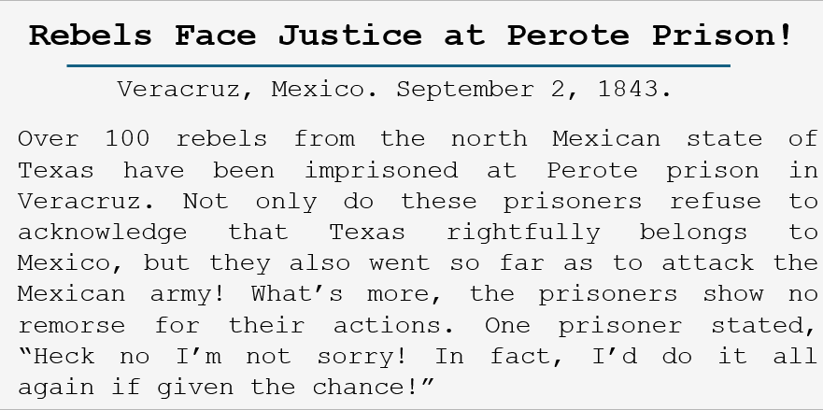
Option 3: Newspaper Article

Slide 12
Exit Ticket
Follow the directions below to complete your exit ticket
Read the scenario presented in your exit ticket.
Complete your exit ticket based on how you believe you would respond to the events from the lesson based on the scenario presented.
Share with a partner.

Slide 13
Share with the class: 2
The events of the Somervell Expedition and Mier Fight would make me more likely to support Texas annexation // more likely to oppose Texas annexation because _____________

