Slide 1
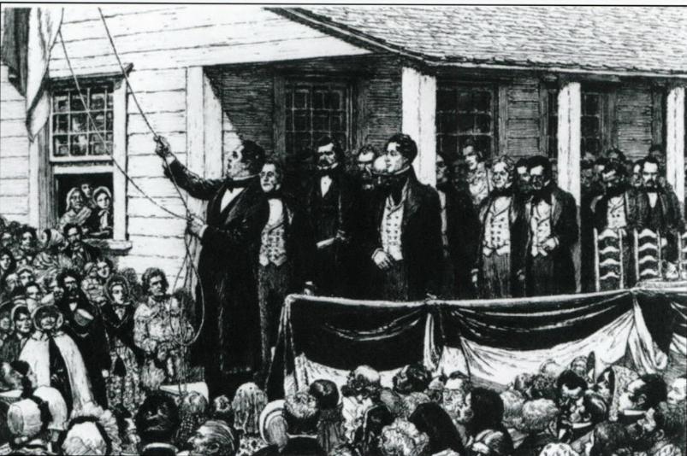
Unit 6:
The Republic of Texas
Lesson 7:
Texas Annexation
Notes:
Texas. Legislature. Legislative Council. The Texas Capitol: A History of the Lone Star Statehouse, book, 2016; Austin, Texas. (https://texashistory.unt.edu/ark:/67531/metapth902948/: accessed April 24, 2025), University of North Texas Libraries, The Portal to Texas History, https://texashistory.unt.edu; crediting UNT Libraries Government Documents Department.

Slide 2

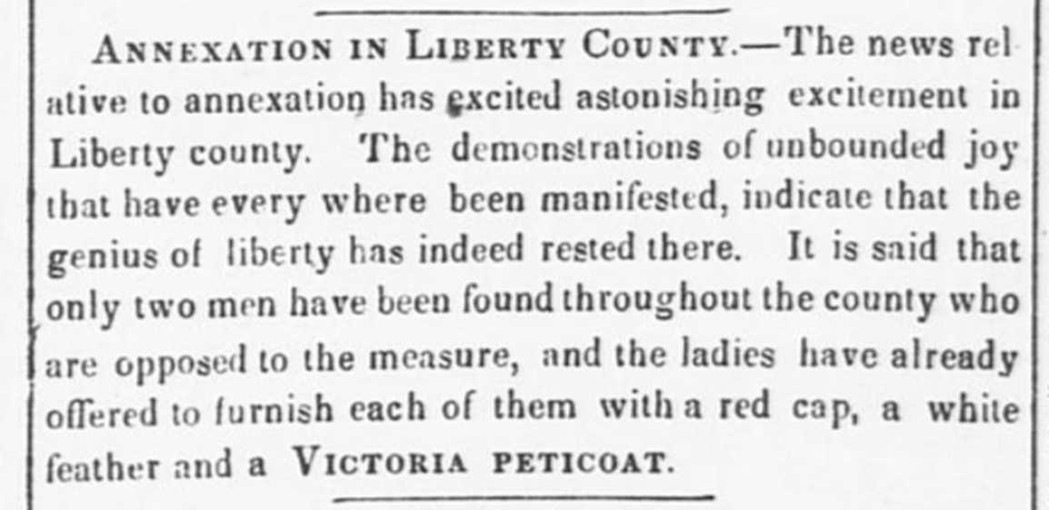
Warm-up:
Use the primary source excerpt to complete your warm-up.
Notes:
Moore, Francis, Jr. Telegraph and Texas Register (Houston, Tex.), Vol. 10, No. 15, Ed. 1, Wednesday, April 9, 1845, newspaper, April 9, 1845; Houston, Texas. (https://texashistory.unt.edu/ark:/67531/metapth78095/: accessed May 30, 2025), University of North Texas Libraries, The Portal to Texas History, https://texashistory.unt.edu; crediting The Dolph Briscoe Center for American History.

Slide 3


Share with the class
According to the article, most people in Liberty County _______.
Evidence from the article that supports my claim is ________

Slide 4

Essential Question
What were the terms the United States government set for Texas annexation, and how did they affect both Texas and the U.S.?

Slide 5
In today’s lesson…
We will examine and analyze the six primary terms of Texas’ annexation to the United States.
I will read each term and analyze its key points, and its potential effects on Texas and the United States.

Slide 6
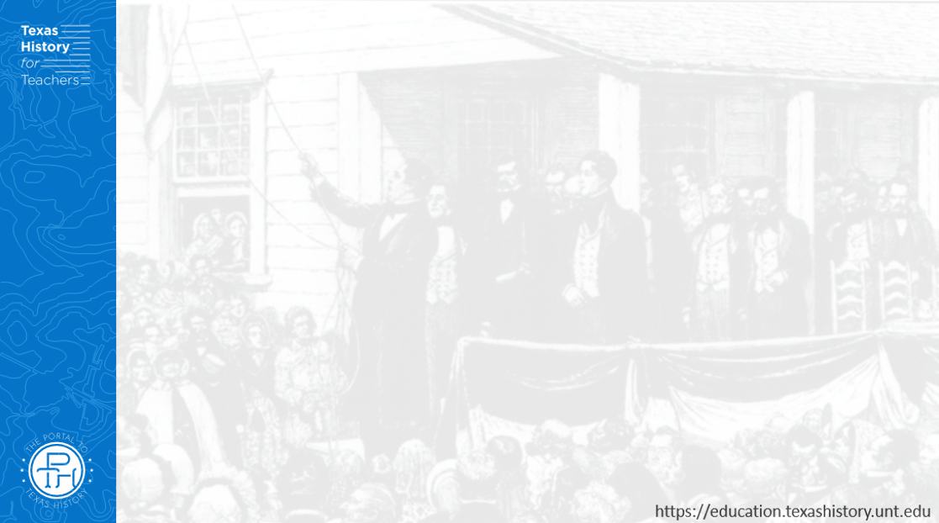
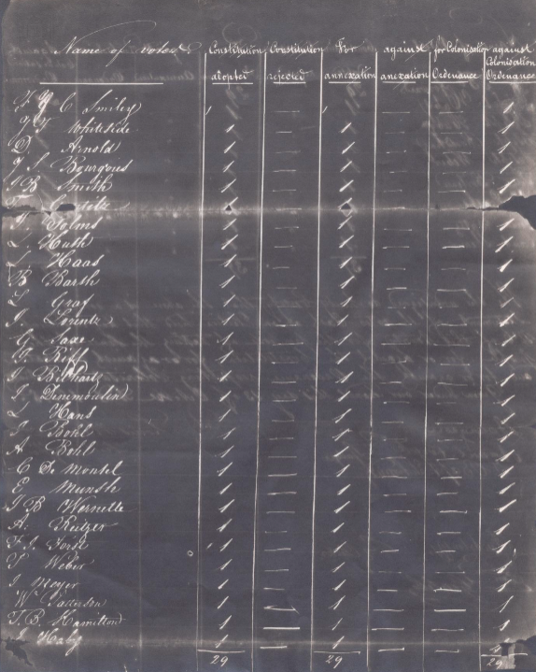
The Long Road to Annexation
This is a negative image of part of the official document tallying the votes among Texan voters on the issue of annexation to the United States. The vote took place in Texas on October 13, 1845. The vote tally was 4,254 to 267 in favor of annexation. The people of Texas overwhelmingly favored annexation to the United States.
The Portal to Texas History
Notes:
Huth, Louis. [Voting results tally sheet, October 13, 1845], legal document, October 13, 1845; (https://texashistory.unt.edu/ark:/67531/metapth188812/: accessed May 30, 2025), University of North Texas Libraries, The Portal to Texas History, https://texashistory.unt.edu; crediting The Dolph Briscoe Center for American History.

Slide 7
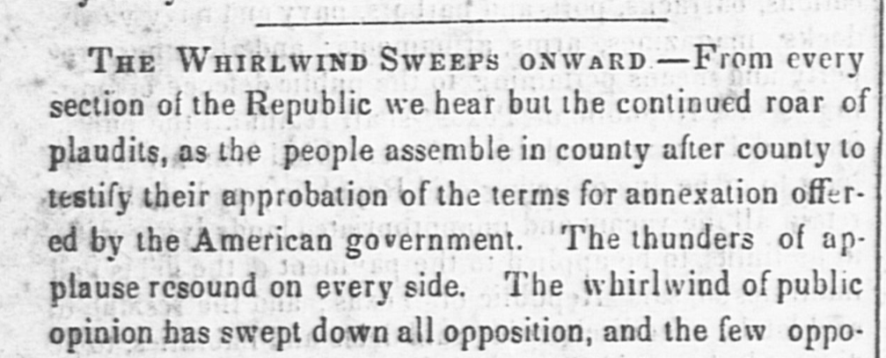
The Terms of Texas Annexation to the United States
The Telegraph and Texas Register, Houston. April 16, 1845
The Portal to Texas History
Plaudit: (n) An Expression of praise or approval
Approbation: (n) Praise or approval
Notes:
Moore, Francis, Jr. Telegraph and Texas Register (Houston, Tex.), Vol. 10, No. 16, Ed. 1, Wednesday, April 16, 1845, newspaper, April 16, 1845; Houston, Texas. (https://texashistory.unt.edu/ark:/67531/metapth78096/: accessed May 30, 2025), University of North Texas Libraries, The Portal to Texas History, https://texashistory.unt.edu; crediting The Dolph Briscoe Center for American History.

Slide 8


Exit Ticket:
Follow the directions to complete your exit ticket.
Choose one term discussed in today’s lesson.
Write your opinion on whether most Texans supported or opposed the term and explain.
Share with a partner.

Slide 9
Share with the class 2
I think the people of Texas probably supported / opposed the term that stated __________ because __________________

