Slide 1
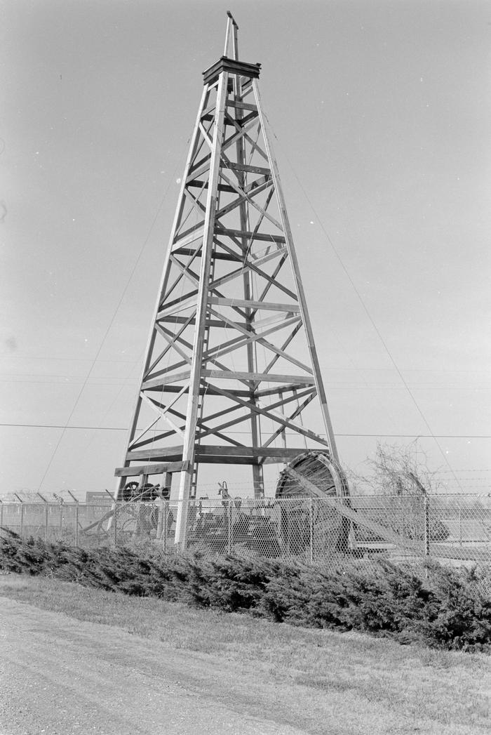

Unit 6:
The Republic of Texas
Lesson 8:
Texas Today
Notes:
Lewis, David P. [Derrick at Spindletop Oil Field], photograph, Date Unknown; (https://texashistory.unt.edu/ark:/67531/metapth1556330/: accessed June 4, 2025), University of North Texas Libraries, The Portal to Texas History, https://texashistory.unt.edu; crediting Lamar University.

Slide 2

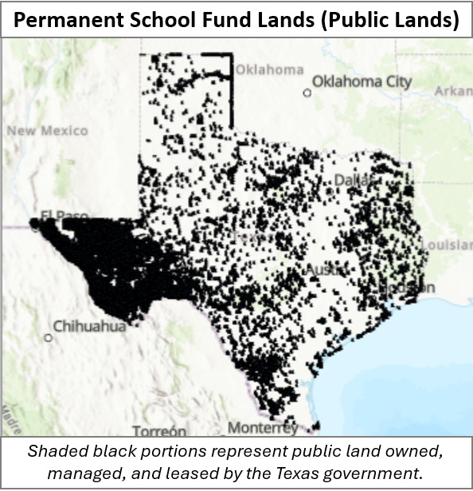



Warm-up
Follow the directions to complete your warm-up
Use the map to respond to the questions on your warm-up.
Write your best educated guess about each question
Discuss with a partner

Slide 3

Share with the class
One thing I observe about this map is _______
I think the purpose of this map is _______
One inference I can make based on this map is _____
One way this map might relate to our unit is ____

Slide 4

Essential Question
How has Texas’ ownership of its public lands benefitted Texas and Texans since annexation to the United States?

Slide 5

In today’s lesson…
We will examine four significant benefits of Texas’s public land ownership as a result of the terms of Texas annexation to the United States.
I will use context to determine the meaning of new terms and use the information provided to write a short essay summarizing the benefits of Texas’ ownership of its public lands.

Slide 6
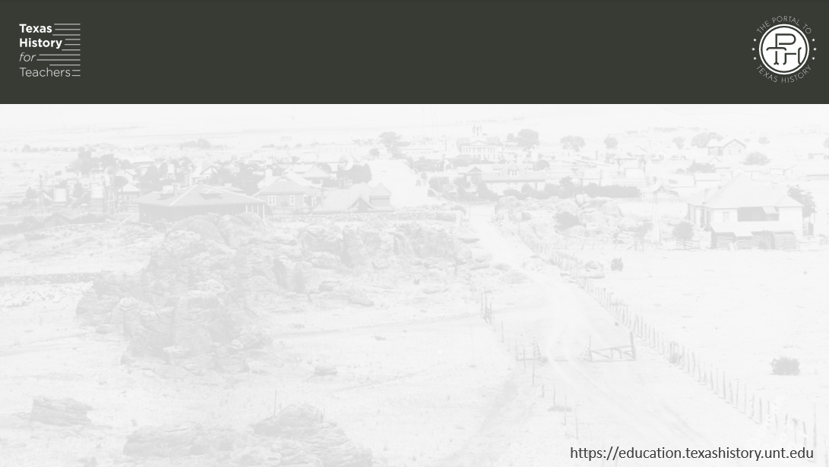
The Importance of Public Land in Texas
“Understanding the importance of land in the history of Texas is essential to understanding Texas. Few Texans, however, are aware of the role that public land has played in our state's development. Land has not only furnished us valuable natural resources, it has been used to finance government operations, reward veterans, provide internal improvements and fund public education.”
“Understanding the Importance of Land in the History of Texas”
Texas General Land Office

Slide 7

Texas Public Lands:
The Gift that Keeps on Giving

Slide 8
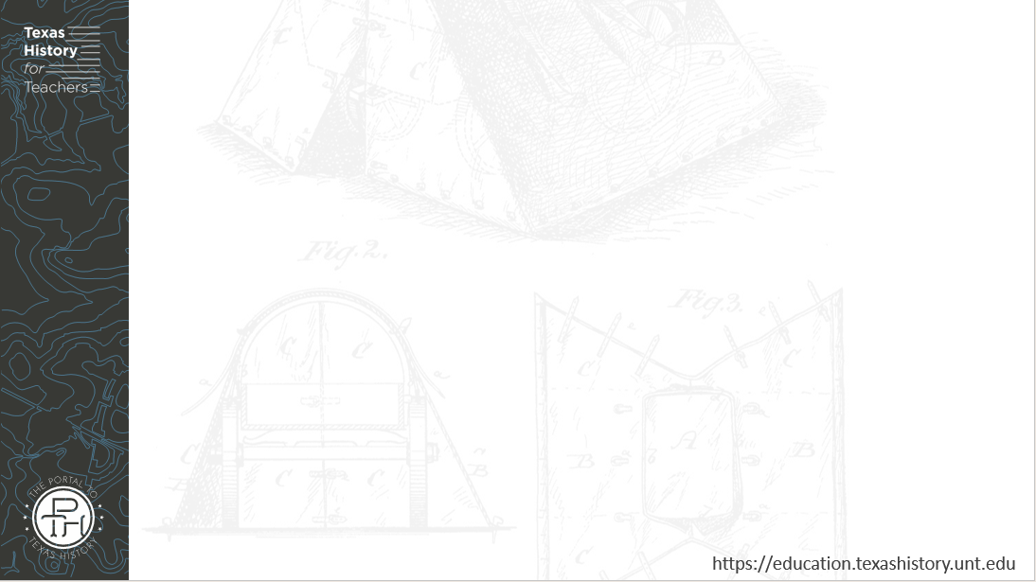
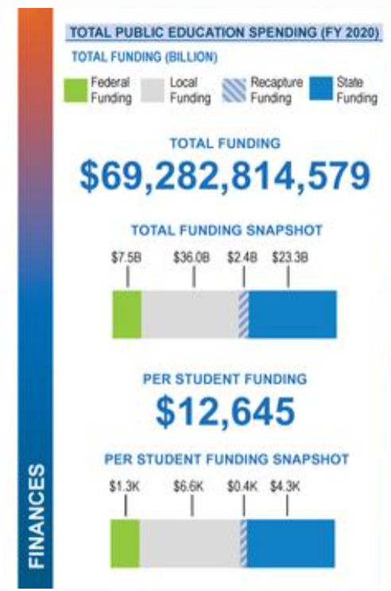
The Permanent School Fund
Texas Public School Statistics
2020 – 2021
Texas Education Agency
The Portal to Texas History
Notes:
Texas Education Agency. Texas Public School Statistics, Pocket Edition: 2020-2021, pamphlet, January 2022; Austin, Texas. (https://texashistory.unt.edu/ark:/67531/metapth1760281/: accessed June 4, 2025), University of North Texas Libraries, The Portal to Texas History, https://texashistory.unt.edu; crediting UNT Libraries Government Documents Department.

Slide 9

Permanent University Fund
Students at a University of North Texas graduation ceremony
The Portal to Texas History
Notes:
[Students at UNT's 2002 graduation ceremony], image, January 23, 2003; (https://texashistory.unt.edu/ark:/67531/metadc1835576/: accessed June 4, 2025), University of North Texas Libraries, The Portal to Texas History, https://texashistory.unt.edu; crediting UNT Libraries Special Collections.

Slide 10

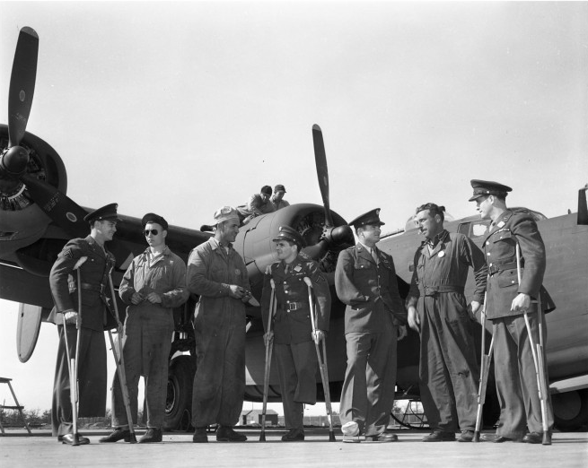
The Veteran Land Board
World War II Veterans at U.S. Army McClosky General Hospital at Temple, Texas, north of Austin.
The Portal to Texas History
Notes:
[World War II Veterans], photograph, Date Unknown; (https://texashistory.unt.edu/ark:/67531/metapth41138/: accessed June 4, 2025), University of North Texas Libraries, The Portal to Texas History, https://texashistory.unt.edu; crediting Lockheed Martin Aeronautics Company, Fort Worth.

Slide 11
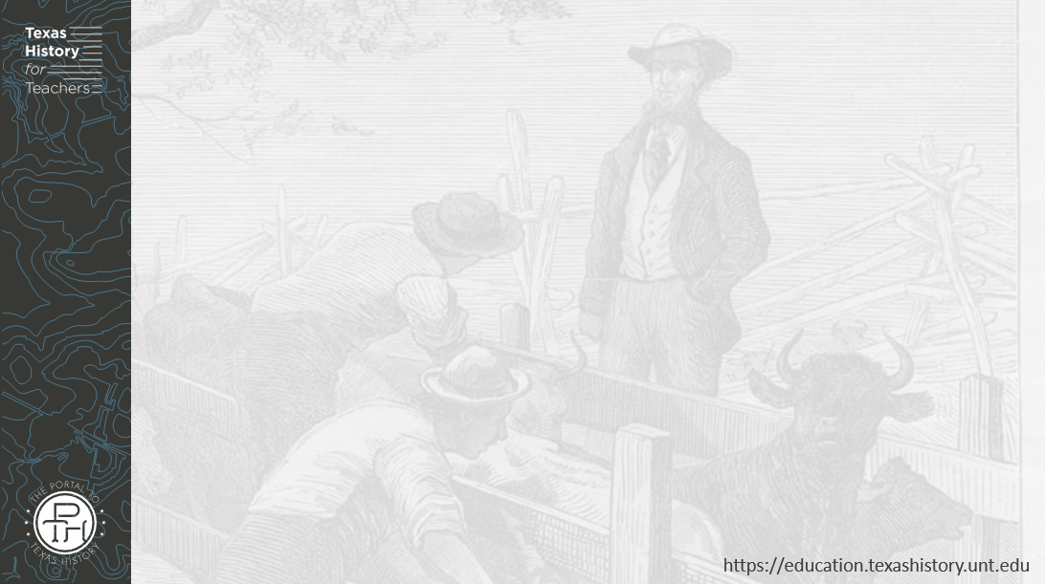
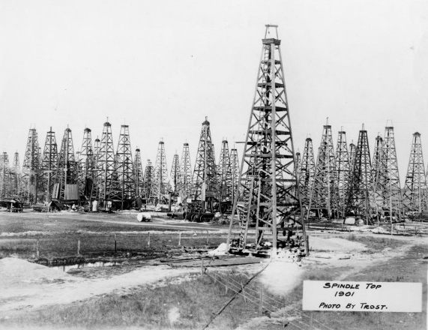
Texas Oil & Natural Gas
The oil field at Spindletop, 1901
The Portal to Texas History
Notes:
[Oil Wells at Spindletop], photograph, Date Unknown; (https://texashistory.unt.edu/ark:/67531/metapth202771/: accessed June 4, 2025), University of North Texas Libraries, The Portal to Texas History, https://texashistory.unt.edu; crediting Museum of the Gulf Coast.

Slide 12

Exit Ticket
Follow the directions to complete your exit ticket
Read the excerpt from the Texas General Land Office.
Based on the information in the excerpt, circle or highlight the option that best completes the statement below the excerpt.
Discuss with a partner

Slide 13
Share with the class 2
According to the excerpt above, the U.S. rejected / accepted Texas’ 1844 application for annexation because the U.S. government wanted / did not want to take responsibility for Texas debt. The U.S. government believed / did not believe that the millions of acres of Texas public land it would get would be worth enough to pay off Texas’ $10 million in debt.

