Slide 1
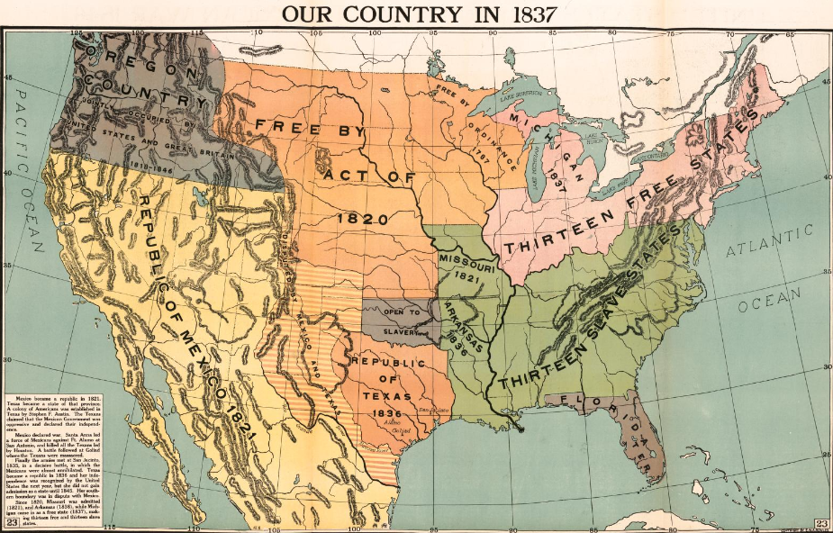
Unit 6:
The Republic of Texas
Lesson 1:
The Big Picture
Notes:
Modern School Supply Company, and E. W. A Rowles. Our Country in 1837. 1919. Library of Congress Geography and Map Division. https://www.loc.gov/item/2009581137/

Slide 2
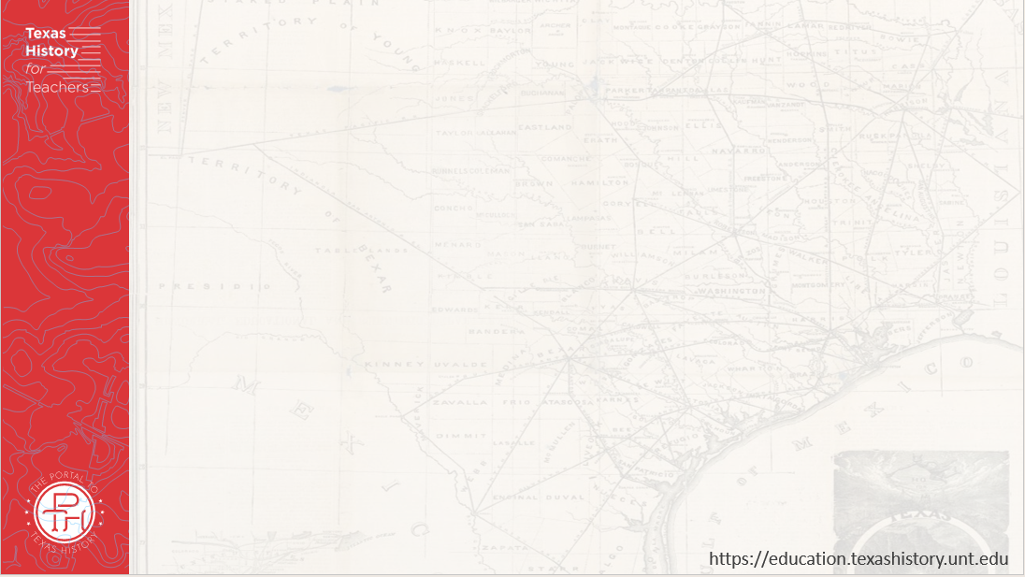






Warm-up
Follow the directions below to complete your warm-up
Consider the events of our last unit: The Texas Revolution.
Circle or highlight each item in the answer bank that you think is true for Texas as we begin this unit.
Share with a partner.

Slide 3

Share with the class:
One thing that I think is true for Texas as we begin this new unit is __________

Slide 4

Essential Question
What are the key events, major themes, and defining characteristics of the Republic of Texas era?

Slide 5

In Today’s Lesson
We will identify the main ideas, themes, key events, and defining characteristics of the Republic of Texas era.
I will analyze a primary source image, identify major themes and significant information related to this era, and answer comprehension questions based on a reading passage.

Slide 6
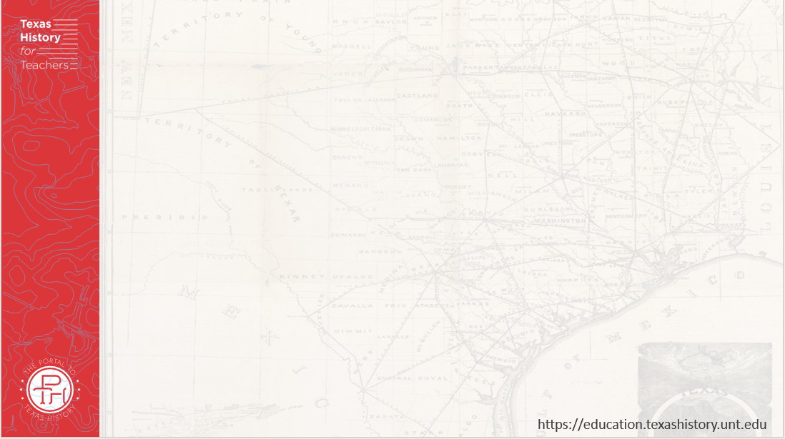
Part I: Analyze an Image
The Library of Congress
Notes:
Modern School Supply Company, and E. W. A Rowles. Our Country in 1837. 1919. Library of Congress Geography and Map Division. https://www.loc.gov/item/2009581137/

Slide 7

Part II: Essential Ideas Reading Passage
Each of the following slides contains an image that accompaniess each paragraph

Slide 8
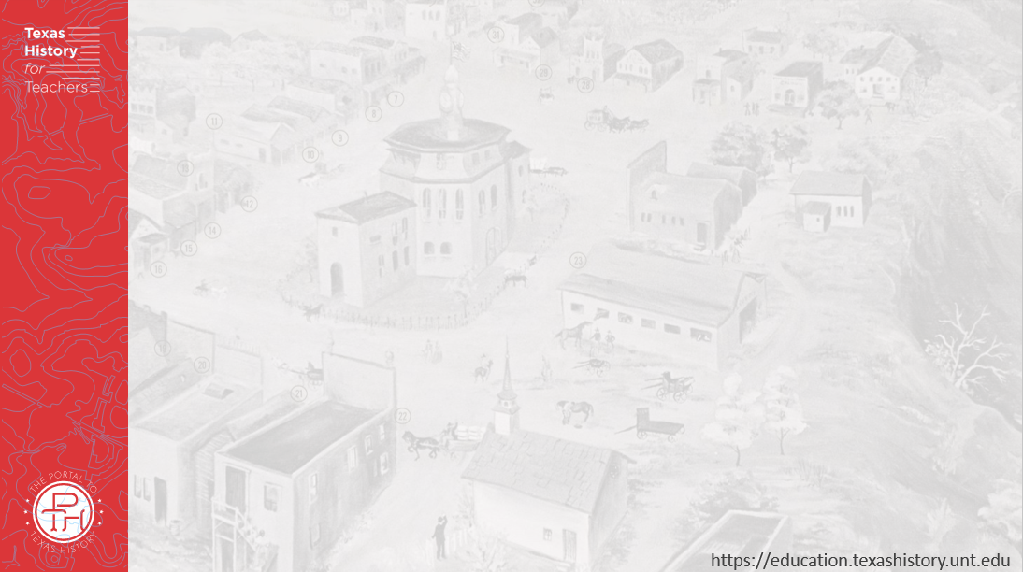
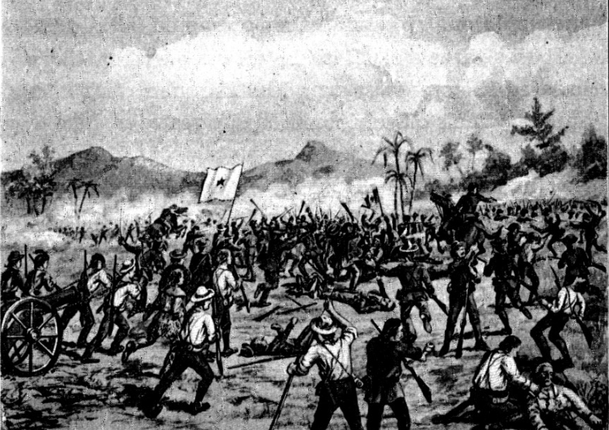
In the previous unit . . .
The Battle of San Jacinto
The Portal to Texas History
Notes:
Battle of San Jacinto. 1901. Texas History Stories: The Alamo, Remember Goliad, Story of San Jacinto by E. G. Little John. 42.Richmond, VA: B. F. Johnson Publishing Company, 1901. University of North Texas Libraries, The Portal to Texas History, https://texashistory.unt.edu/ark:/67531/metapth14381

Slide 9
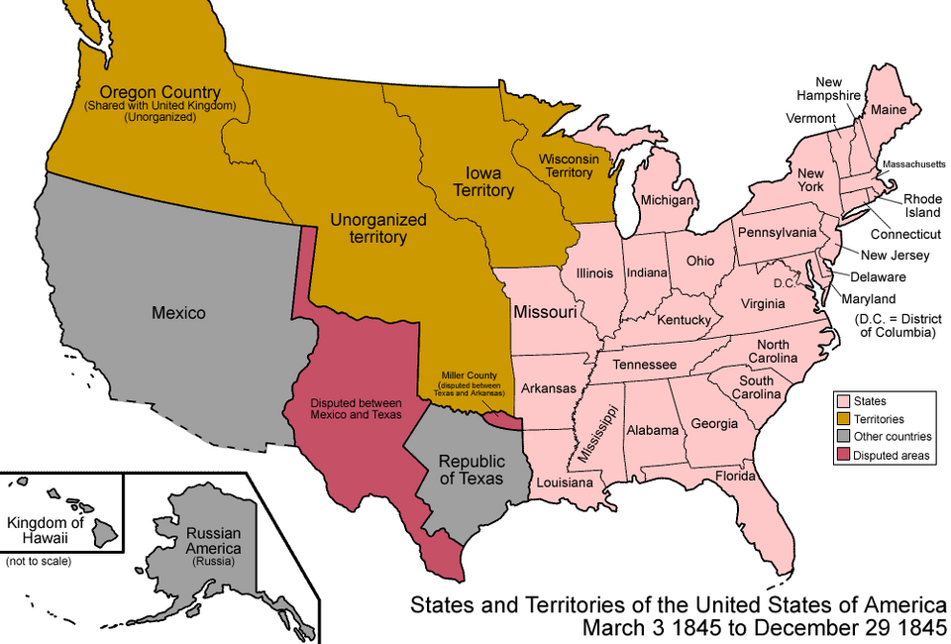
Challenge #1
Notes:
States and Territories of the United States of America March 3, 1845 to December 29, 1845. Own work.See Charles O. Paullin and John K. Wright's Atlas of the Historical Geography of the United States (1932) for PD maps which support these. (Multi-license with GFDL and Creative Commons CC-BY 2.5) This file is licensed under the Creative Commons Attribution-Share Alike 3.0 Unported license. https://commons.wikimedia.org/wiki/File:United_States_1845-03-1845-12.png

Slide 10
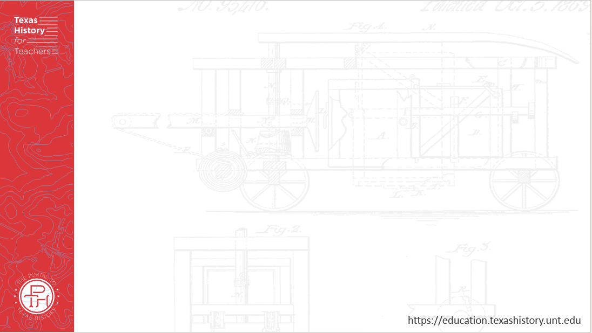
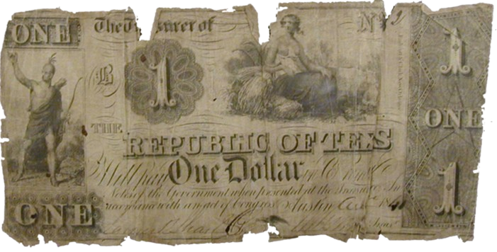
Challenge #2
A Republic of Texas one dollar bill
The Portal to Texas History
Notes:
Texas Treasury Department. Republic of Texas One-Dollar Bill. ca. 1836-46. Paper bill. University of North Texas Libraries, The Portal to Texas History; crediting Fort Bend Museum https://texashistory.unt.edu/ark:/67531/metapth2297

Slide 11

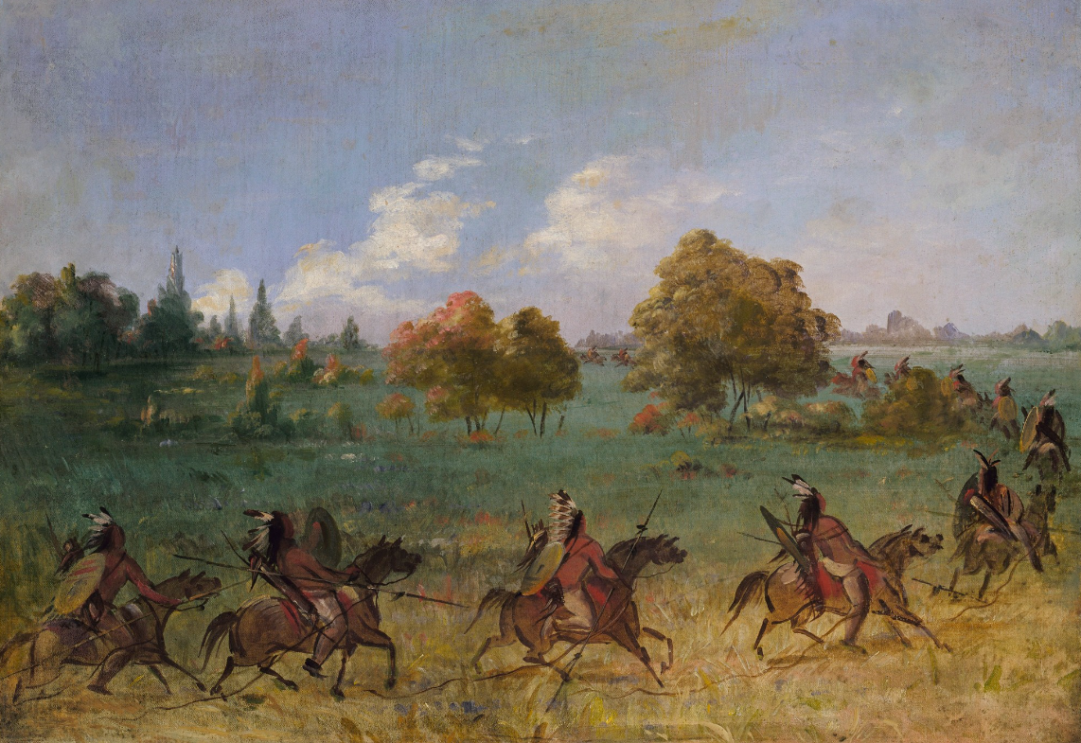
Challenge #3
Comanche War Party on the March by George Catlin
The Smithsonian American Art Museum
Notes:
Catlin, George. Comanche War Party on the March, Fully Equipped. ca. 1846-1848. Oil on canvas, 20 x 27 3/8 in. (50.8 x 69.4 cm). Smithsonian American Art Museum, Gift of Mrs. Joseph Harrison, Jr., 1985.66.596. https://americanart.si.edu/artwork/comanche-war-party-march-fully-equipped-4014

Slide 12
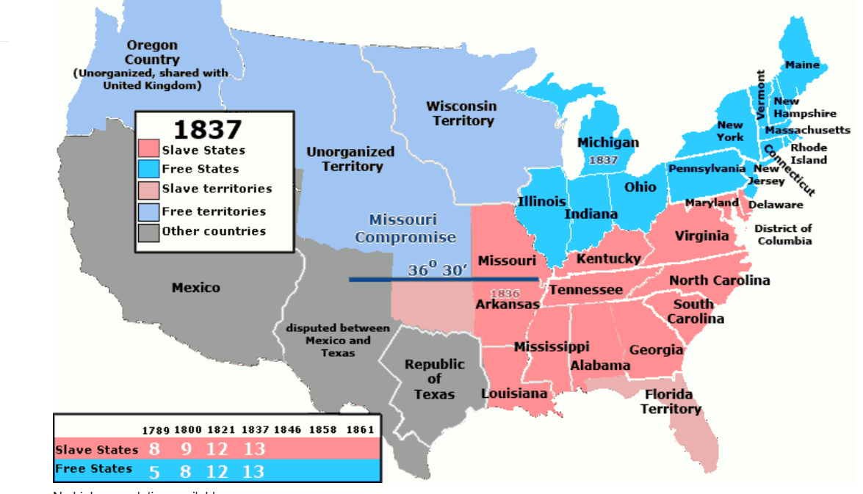
Challenge #4
Notes:
Political map of North America in 1837 demonstrating the balance of slave vs. free states in the United States of America. This file is licensed under the Creative Commons Attribution 3.0 Unported license. https://commons.wikimedia.org/wiki/File:US_Slave_Free_1789-1861.gif

Slide 13
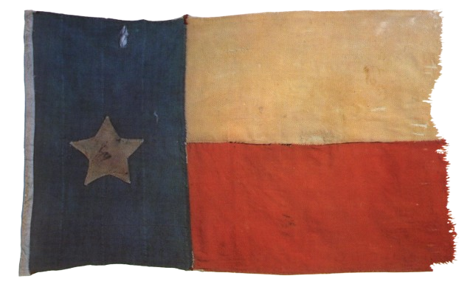
The Republic of Texas Era
The flag of the Republic of Texas
The Portal to Texas History
Notes:
Flag, physical object, Date Unknown; (https://texashistory.unt.edu/ark:/67531/metapth31714/: accessed April 15, 2025), University of North Texas Libraries, The Portal to Texas History, https://texashistory.unt.edu; crediting Star of the Republic Museum.

Slide 14
Exit Ticket
Follow the directions below to complete your exit ticket
Consider the events of our last unit: The Texas Revolution.
Circle or highlight each item in the answer bank that you think is true for Texas as we begin this unit.
Share with a partner.

Slide 15
Share with the class: 2
One challenge that the Republic of Texas faced from 1836 to 1845 was _____
One way the Republic of Texas could address this challenge is ________

Slide 16
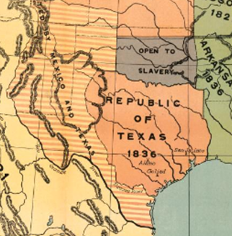
Excerpt of a Map of the United States in 1837
1
4
3
2
Notes:
Excerpt from Modern School Supply Company, and E. W. A Rowles. Our Country in 1837. 1919. Library of Congress Geography and Map Division. https://www.loc.gov/item/2009581137/

