Slide 1
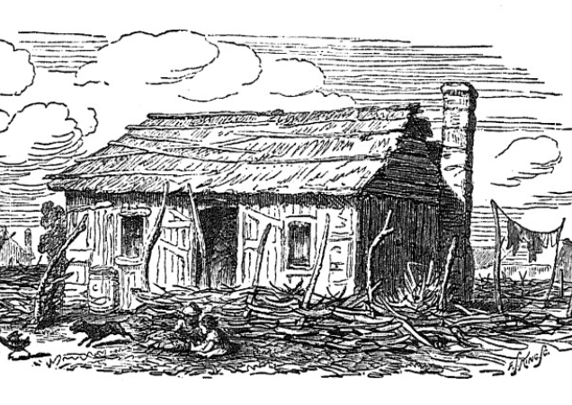




Unit 6:
The Republic of Texas
Lesson 3:
Vocabulary
Notes:
Thrall, Homer S., 1819-1894. A Pictorial History of Texas, From the Earliest Visits of European Adventurers, to A.D. 1879., book, 1879; St. Louis, Missouri. (https://texashistory.unt.edu/ark:/67531/metapth5828/: accessed April 18, 2025), University of North Texas Libraries, The Portal to Texas History, https://texashistory.unt.edu; .

Slide 2

Warm-up
Follow the directions to complete your warm-up
The graphic organizer on your warm-up shows 4 vocabulary terms from this unit.
Complete the graphic organizer based on your knowledge of each word.
Discuss with a partner

Slide 3

Share with the class
I don’t know the word _______ yet
I’ve heard of the word _________.
I think it means _______________.
I know the word _____. It means ____.

Slide 4

Essential Question
What key terms do we need to know to be successful in this unit?

Slide 5

In today’s lesson…
We will identify, define, and exemplify the key terms of Unit 6: The Republic of Texas.
I will use the information and context of several short passages to identify and record the definition of each term and provide examples of the term in the context of our unit.

Slide 6
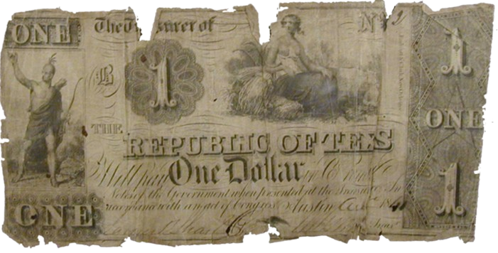
Debt (n)
Wars are very expensive. Providing weapons, ammunition, meals, supplies, medical care, and salaries to the soldiers and officers carrying out a war is very costly.
One way the provisional government of Texas covered the expenses of fighting the Texas Revolution was by borrowing money from American merchants. These loans helped finance the war.
After the war, the Republic of Texas had its independence, but it also had about $1.25 million dollars of debt, or money it owed and needed to pay back. Paying off this debt was a significant challenge for the new country. Running a government, like fighting a war, was also very expensive. From 1836 to 1845, the Republic of Texas’ debt grew to nearly $12 million dollars. The value of that amount today is about $412 million dollars! Throughout this era, the Republic of Texas struggled to address its increasing debt.
A Republic of Texas
one-dollar bill
The Portal to Texas History
Notes:
Texas Treasury Department. Republic of Texas One-Dollar Bill. ca. 1836-46. Paper bill. University of North Texas Libraries, The Portal to Texas History; crediting Fort Bend Museum https://texashistory.unt.edu/ark:/67531/metapth2297

Slide 7
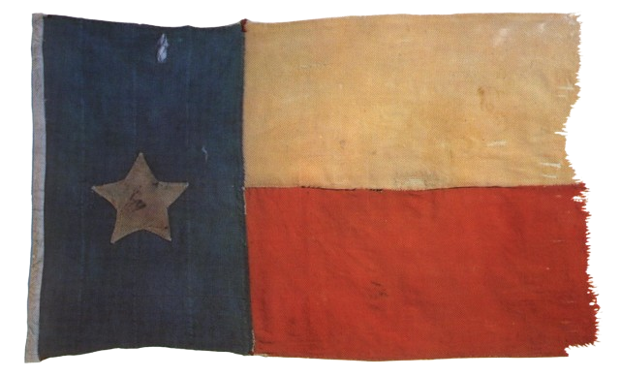

Diplomatic (adj)
After Texas won its independence, the government of the Republic of Texas began to meet with the governments of other countries around the world. The Republic of Texas wanted to establish diplomatic relationships and gain diplomatic recognition of its independence. The term diplomatic describes the work of building and managing international relationships between countries.
There was one major problem, however. Mexico did not recognize Texas’ independence. Mexico’s position was that Texas was still a Mexican state in rebellion against its national government. As a result, Texas struggled to gain diplomatic recognition from many other countries who didn’t want to risk war with Mexico. The United States and Great Britain were two countries who were cautious about forming a diplomatic relationship with Texas because they didn’t want to harm their diplomatic relationships with Mexico.
The Republic of Texas Flag
The Portal to Texas History
The Flag of Mexico, 1835 - 1846
Notes:
Flag, physical object, Date Unknown; (https://texashistory.unt.edu/ark:/67531/metapth31714/: accessed April 15, 2025), University of North Texas Libraries, The Portal to Texas History, https://texashistory.unt.edu; crediting Star of the Republic Museum.
Flag of Mexico 1835 – 1846. This file is made available under the Creative Commons CC0 1.0 Universal Public Domain Dedication. https://commons.wikimedia.org/wiki/File:Bandera_de_M%C3%A9xico_(1835-1846).png

Slide 8

Commerce (n)
In addition to its goal of establishing diplomatic relationships, Texas also set out to establish commerce with other countries. This means that Texas wanted to establish business and trade with other countries. Commercial relationships were very important to Texas as the young nation worked to improve its economy and find markets for its cotton.
Great Britain was the largest market for cotton in the world at the time. Commerce with Great Britain would dramatically improve the Texas economy and help the Republic of Texas pay off its debt. The British government, however, resisted establishing a commercial relationship with Texas because the Republic relied on slavery. This posed a challenge to the Republic of Texas, which believed that it could not successfully produce large quantities of cotton without slave labor. Throughout the era, Texas would continue to work to build international commercial relationships.
A Texas cotton plant, 1996
U.S. Department of Agriculture
Notes:
A cotton plant, Texas, 1996. This image or file is a work of a United States Department of Agriculture employee, taken or made as part of that person's official duties. As a work of the U.S. federal government, the image is in the public domain. File:CottonPlant.JPG - Wikimedia Commons

Slide 9
Tariff (n)
During the Republic of Texas era, the government of Texas worked to establish commercial relationships with other countries. One country that Texas established a commercial relationship with was its neighbor, the United States. Commerce with the U.S. contained some challenges for Texas, however.
The southern states of the U.S. were also major cotton producers. Texas cotton would therefore be competing with American cotton, and the U.S. wanted to protect its own cotton industry while it took part in commerce with Texas.
One way that the U.S. tried to protect its own cotton industry was by implementing tariffs on Texas cotton. A tariff is a tax on items being imported, or brought into your country. If the U.S. placed tariffs on Texas cotton, that would increase the price of Texas cotton in the U.S., making people more likely to buy the cheaper American cotton.
Meanwhile, the Republic of Texas passed its own tariffs on American items imported into Texas. While these tariffs raised the cost of items that Texans bought from the U.S., they also helped provide funds for the Texas government during the nine years that Texas was an independent nation.

Slide 10
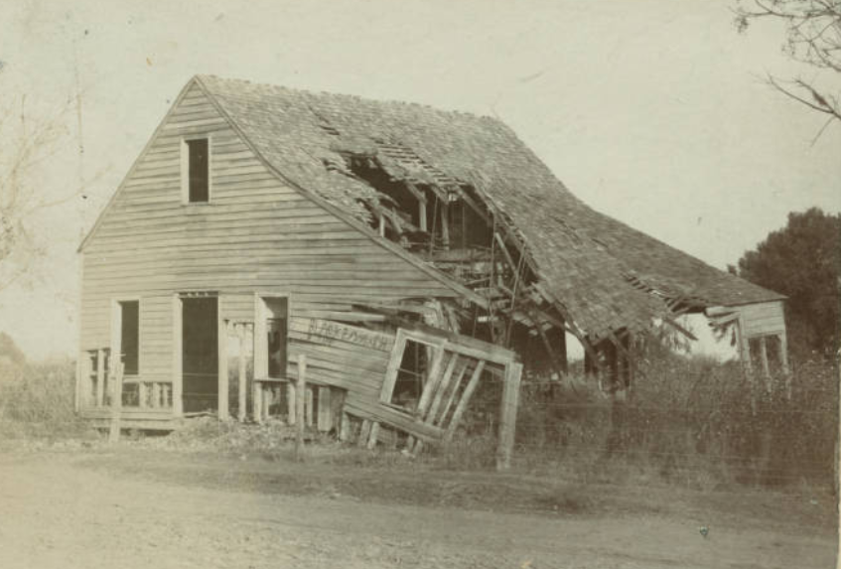
Congress (n)
When the Republic of Texas established its government, it was largely based on the system of representative government in the United States. The people of Texas elected a president and vice president, and they also elected people to serve in congress. Congress is a group of representatives elected to make laws.
One of the responsibilities of congress is raising revenue, or money, and determining how the money will be spent. This was an especially difficult task because of the large amount of debt Texas had gained during the war and the challenges Texas faced trying to establish commercial relationships with other nations.
The Republic of Texas’ congress tried a number of things to raise revenue for the country and pay off its debt, including passing tariffs on American goods, passing taxes on the Texas people, and printing more money, but none of these actions solved the economic challenges that the Republic of Texas faced in this era.
The ruins of the first capitol building of the Republic of Texas in West Columbia. This photograph w as taken in the late 1800s.
The DeGolyer Library
Southern Methodist University
Notes:
Photograph, the first capitol of the Republic of Texas in West Columbia, Brazoria County, Texas. Creator: Beach, F. E
Lawrence T. Jones III Texas photography collection Circa 1885. DeGolyer Library, Southern Methodist University
[First Capitol of the Republic of Texas] - Lawrence T. Jones III Texas Photographs - SMU Digital Collections

Slide 11
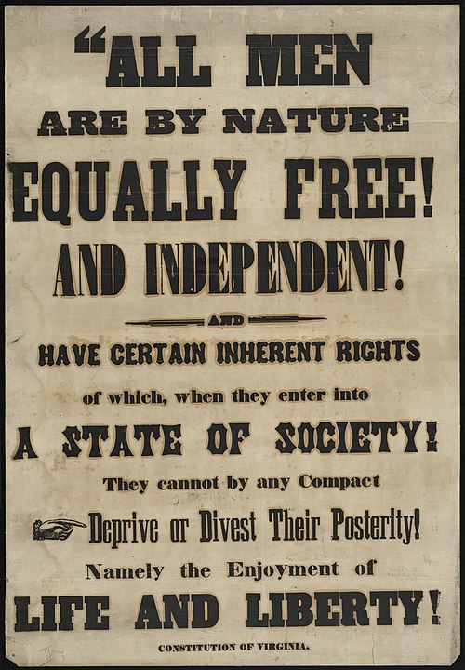
Abolish (v)
A large part of the Texas economy was fueled by the cash crop, cotton. Much of Texas’ cotton crop was grown on plantations using slave labor. The government of the Republic of Texas and many Texas citizens believed that slave labor was necessary to produce large quantities of this valuable and profitable crop.
At the same time, in the United States and around the world, there was a growing movement to abolish, or completely get rid of, slavery. Some believed slavery was morally wrong. Others wanted to abolish slavery for economic reasons arguing that slavery limited economic development and had a negative effect on wage labor – or those who worked for pay.
As the abolition movement grew in the United States and Great Britain, Texas struggled to establish a commercial partnership with Britain and faced opposition to its attempts to join the United States in part because of the significant role that slavery played in its economy.
An abolition poster
The Boston Public Library
Notes:
Poster of the Abolition Movement. This file is licensed under the Creative Commons Attribution 2.0 Generic license. Boston (Mass.)--History Collection: Anti-Slavery Collection Location: Boston Public Library, Rare Books Department
Rights: No known copyright restrictions. https://commons.wikimedia.org/wiki/File:Abolition_(7645378200).jpg

Slide 12
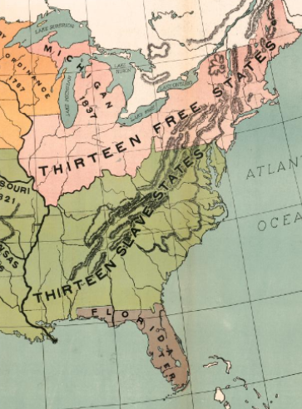
Annexation (n)
Throughout its nine years as an independent nation, the Republic of Texas struggled to address the political and economic challenges it faced. Many Texans believed that the best solution for addressing these challenges was annexation to the United States. They believed that becoming a state in the U.S. would provide the economic and political stability that they were struggling to achieve as an independent nation on their own.
There was a lot of debate over the question of Texas annexation in the United States. Southern states typically supported annexing Texas because it would extend the amount of land that could be used for plantation agriculture and increase the number of slave states in the nation, giving them more political power in the government. Northern states typically opposed annexation because it would mean there were more slave states than free states, making the free states less powerful in the government. Debates over the issue of slavery, combined with the U.S. not wanting to risk war with Mexico, led the U.S. government to deny two of Texas’ three applications for annexation during this era. Texas would finally be annexed into the United States in 1845.
U.S. slave v. free states
The Portal to Texas History
Notes:
Modern School Supply Company, and E. W. A Rowles. Our Country in 1837. 1919. Library of Congress Geography and Map Division. https://www.loc.gov/item/2009581137/

Slide 13
Exit Ticket
Follow the directions to complete your exit ticket
Circle or highlight any terms in the graphic organizer that you think relate to this unit.
Choose one term to complete the sentence stem under the graphic organizer.
Discuss with a partner

Slide 14
Share with the class 2
One term I chose was _________.
I think this term could relate to our unit because _________________

